Slide 1
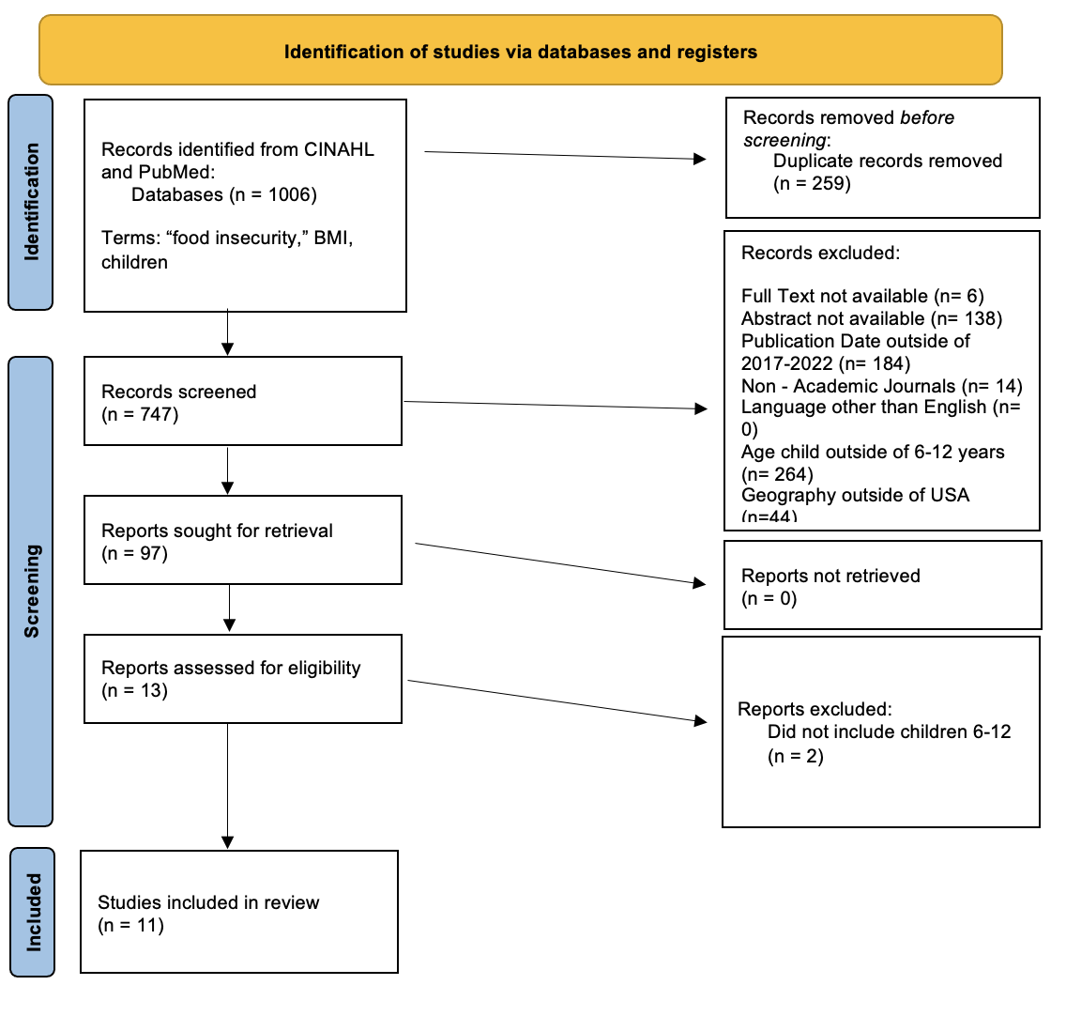
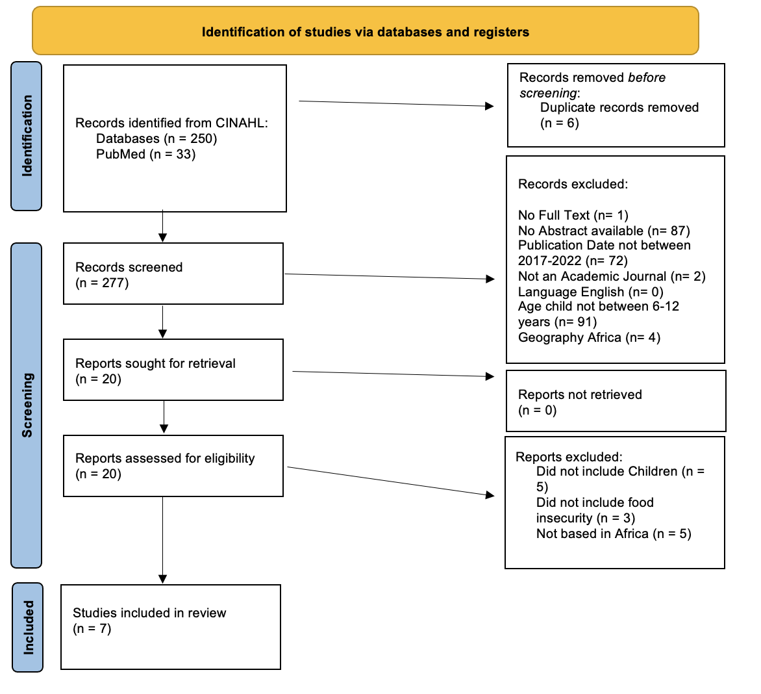
Food Insecurity and BMI Impact on US and African Children:
A Literature Comparison
D. Borregard SN, J. Kleitch SN, S. Strouse PhD, RN
Background
Food insecurity is the lack of access to consistent food to live a healthy, balanced lifestyle.
It is not fully understood how one's childhood habits may impact their likelihood of having obesity.
Through research, we examined food insecurity in the United States and Africa and how it relates to an altered BMI in children.
United States PRISMA Diagram
Methods & Design
Majority of the research contained observational, cross-sectional, quantitative studies.
Many of the studies were longitudinal in nature, allowing for authors to follow children into adulthood and understand how food insecurity in childhood can play a role into their development.
Interviews and surveys were the most common way for researchers to collect data for this research.
PICO Statement
In children ages 6-12 in the United States, what is the effect of food insecurity on an altered BMI compared to children in Africa?
http://www.hungerreport.org/costofhunger/
Results
United States:
There were various findings when it came to BMI of children in food insecure households.
Some studies showed no association whereas others noted that children experiencing food insecurity were more likely to have adverse BMI trajectories and poor eating habits.
Some data showed that race, more than any other demographic, plays a major role in access to food in the United States.
Africa:
Children in food insecure environments under 5 years of age are much more likely to be stunted, underweight, experience wasting, and have a lower BMI than children in food secure environments.
The greatest predictor of food insecurity among children is a low-medium nutritionally diverse diet.
70.2% of nutritionally compromised children were stunted and living with obese or overweight adults (Harper, 2022).
https://edhub.ama-assn.org/steps-forward/module/2702762
https://www.stophiviowaplan.org/social-determinants-of-health-1
Frameworks
Objective: Literature review or understanding of food insecurity as an independent risk factor for obesity in children in the United States and Africa
Conclusions
Studies in both regions showed that children experiencing food insecurity are at a higher risk of developing adverse BMI trajectories and poor eating habits.
More research, such as a meta-analysis, is needed to support that food insecurity is an independent factor in childhood obesity and increased BMI.
Poverty and lack of access to healthy food options contributes the most to the adverse BMI trajectories in children.
Africa PRISMA Diagram
Nursing and Research Implications
Family education on food diversity, food groups, and nutritional needs for children.
Increasing access to food via markets, trucks, and farming.
Assessing and educating patients about food insecurity and resources that are available in the community.

