Slide 1
Advocating for Green with Video Presence
September 23, 2011

Slide 2
Information Literacy Conference
  Linda Masselink, Anne Merkle
  Grand Valley State University

Slide 3
Technology
ooVoo
Slide Share
Jing
Video Chat

Slide 4
Question?
Have you used these technologies before?

Slide 5
Real Life For Students And Librarians
Grand Rapids
Allendale
Holland
28.60 Miles
15.40 Miles
21.21 Miles

Slide 6
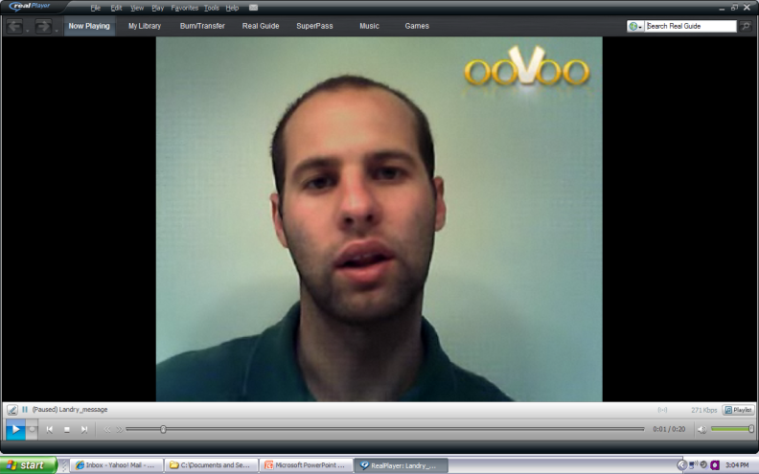
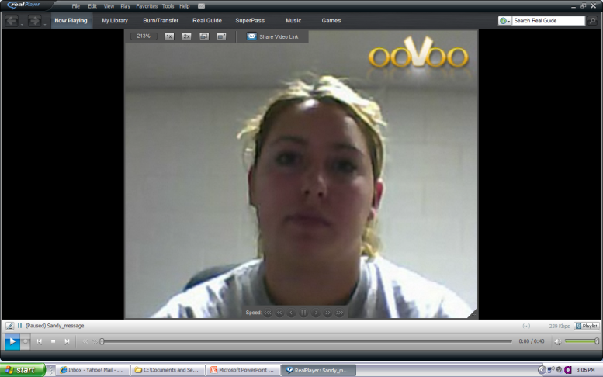
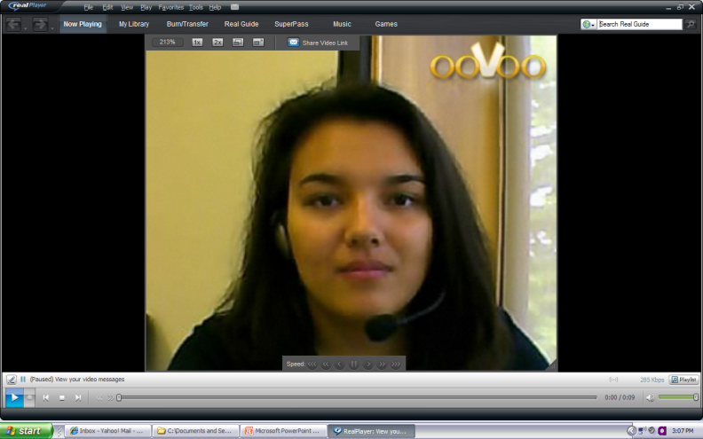
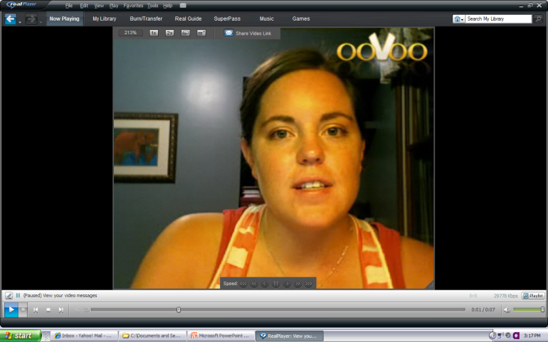
Online Collective Bargaining
GV Holland Campus
Home
Union
vs.
Employer
GV Pew Campus
Home

Slide 7

ooVoo
Prof Swift’s Request for help with class

Slide 8
Response To Request
YouTube Channel Uploads
Secrets of Super Searchers

Slide 9
Tutorials
Spanish Language Children’s Books

Slide 10
Reaching Out To Faculty
New books in the Juvenile Collection

Slide 11
Library Guides
Library Guides using Slide Share and Videos
Honors College Subject Guide

Slide 12
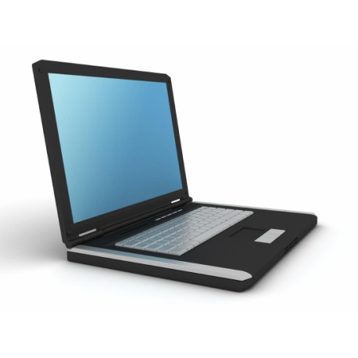
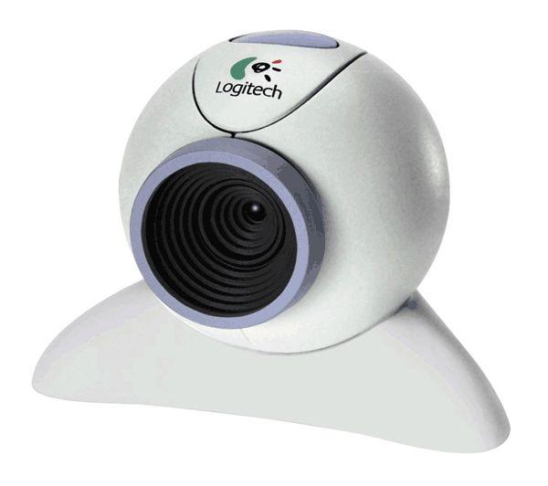

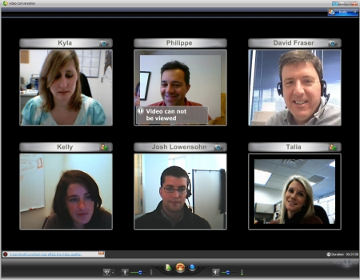
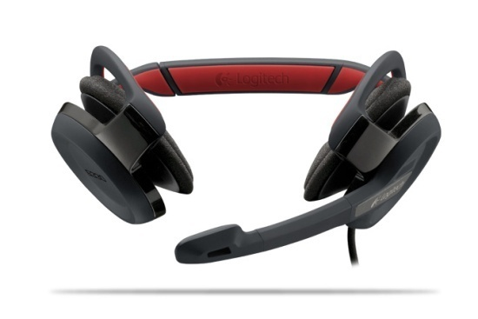
What You Need For Videos
Computer with broadband –plug in!
Video software
Web camera
Headphone

Slide 13
Why Visual Presence In Libraries?
It is green
It saves time
It saves money
It allows a solid personal connection
It is the future

Slide 14
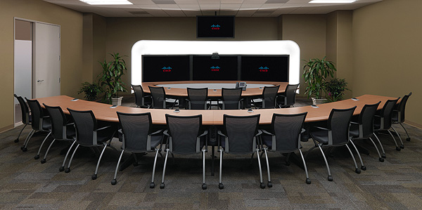
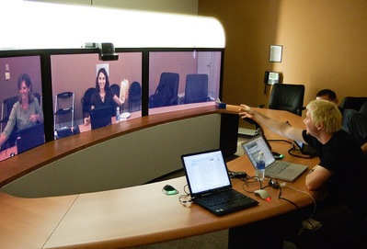
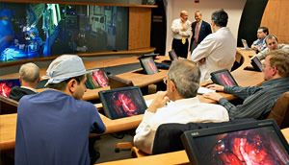
Parallel Uses Of Videos and Video Chat
Businesses/ Hotels
Medicine
Libraries/Education
Sports

Slide 15
Why Is This Technology Important?
Communication with students
Prepare students for the future
Job interviews/Admissions interviews
Build confidence in speaking skills

Slide 16
Students Using ooVoo

Slide 17
Question?
Do you view this as a lasting technology?

Slide 18
Do it Right and Be Prepared!

Slide 19




Tips For Video Use
Appearance – dress appropriately
Be mindful of body language
Test Equipment
Be aware of background
Adjust lighting

Slide 20
More Tips…
Share materials (visuals) slowly due to natural lag time of camera
Keep visuals simple

Slide 21
Creating A Visual
Background
Lighting
Voice
Video Pace and Clarity
Smooth transitions
Keep it short

Slide 22
Questions?

