Slide 1
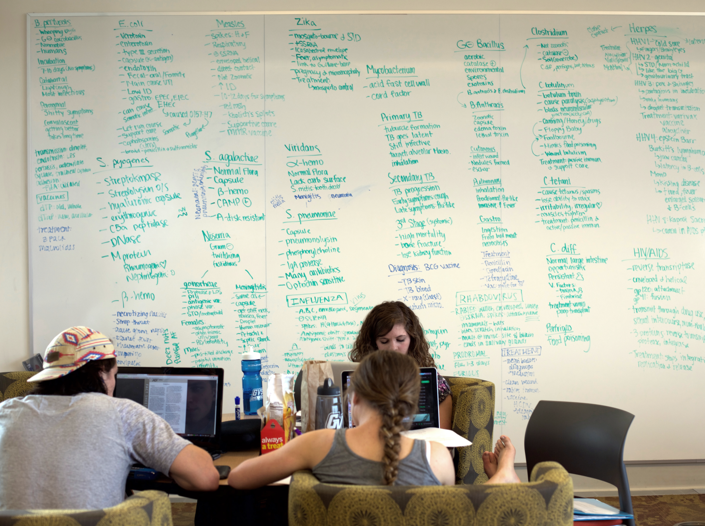
Student Retention Three Ways:
Numbers, People, and stories

Slide 2
Mary O’Kelly, MLIS Head of Instructional Services Grand Valley State University Libraries okellym@gvsu.edu
Data analysis provided by
Rachael Passarelli, MS
Research Analyst
GVSU Office of Institutional Analysis

Slide 3
We found a statistically significant correlation between library instruction and student re-enrollment the following fall.
This was done with a partnership between one librarian and one analyst.
This does not prove causation. It does show that something interesting might be happening.
This also demonstrates that the library is committed to and engaged with measuring its impact on student success.

Slide 4
Q: Is library instruction correlated with retention?
p-value = .0001 for all years
Year | Librarian in class | Number of students | % Retained
2012-2013 | No | 8762 | 70.90
 | Yes | 8763 | 73.70
2013-2014 | No | 9925 | 72.10
 | Yes | 8560 | 74.90
2014-2015 | No | 10040 | 71.00
 | Yes | 8340 | 76.10
2015-2016 | No | 9819 | 71.20
 | Yes | 8799 | 75.20

Slide 5
Q: What about the role of faculty?
Year | Faculty who invited library instruction | Number of students | % Retained | P-value | Odds Ratio
2014-2015 | No | 7555 | 71.30
 | Yes | 10825 | 74.70 | .0001 | 1.19
2015-2016 | No | 6583 | 70.67
 | Yes | 12030 | 74.39 | .0001 | 1.20

Slide 6
GVSU 2016-2021 Strategic Plan
Objective 1.A.3
A strategic plan will be developed for student retention, persistence and completion including goals that are ambitious but attainable and appropriate to GVSU’s mission, student populations, and educational offerings.
http://www.gvsu.edu/strategicplan-view.htm?entityId=0001&entityType=university#objectives

Slide 7
GVSU 2016-2021 Strategic Plan
Objective 1.B.2
Retention rates between freshman and sophomore years and sophomore and junior years for first-generation and other non-traditional undergraduate students meet or exceed the retention rates of traditional undergraduate students.
http://www.gvsu.edu/strategicplan-view.htm?entityId=0001&entityType=university#objectives

Slide 8
What others say
Library use predicted retention (Murray, Ireland, Hackathorn. 2016.)
Connection between logins and loans and retention (Haddow. 2013.)
Correlation between book and audio-visual use and GPA (Wong, Webb. 2011.)
Relationship between checkouts and database use and retention (Allison. 2015.)

Slide 9
What others say
Relationship between first-year students’ library use and retention and GPA (Soria, Fransen, Nackerud. 2013.)
Ratio of FTE library staff to full-time students related to retention (Emmons, Wilkinson. 2011.)
Correlation between library expenditures and retention (Mezick. 2007.)

Slide 10
What others say
“Another research question is whether student use of the library and interactions with librarians are associated with persistence and graduation, net of other factors.” (Kuh, Gonyea. 2003. p372.)

Slide 11
Are you currently analyzing student retention?
Do you have what you need to get started?

Slide 12
1. Data
Make sure you’re collecting clean, complete data.

Slide 13
1. Data

Slide 14
1. Data
Date of instruction
Duration (in minutes)
Librarian name
Course instructor
Location
Course code
Course number
Section number
Delivery method

Slide 15
1. Data
Start with questions. Start small and focused.
Is there a correlation between library instruction and GPA?
Is there a correlation between library instruction and retention?
Is there a stronger effect if the student sees a library more than once?
What is the daily instruction count?

Slide 16
1. Data
Seven question for assessment planning:
Who is responsible and why?
What questions do we have and why?
What info do we need and why?
How will we get it and why?
Who will interpret the results and why?
Who needs to hear about it and why?
What’s our timeline and why?
O’Kelly. Seven Questions for Assessment Planning: A Discussion Starter. 2015, C&RL News.

Slide 17
1. Data
Be clear about the details.
H⁰: There is no correlation between library instruction and student retention.
Definition of retention: re-enrollment the following fall.
Data sources: library instruction data and institutional student enrollment

Slide 18
2. People
Decide who in the library will coordinate this.
At GVSU, Head of Instructional Services coordinates.
Librarians enter instruction data.

Slide 19
2. People
Get help with analysis.
Find the office with access to student-level data.
Ask for help.
Then find the office with analysis expertise.
Ask for help.
Bonus: When you find these in one office.

Slide 20
2. People

Slide 21
3. Stories

Slide 22
3. Stories
We controlled for ACT score, high school GPA, socioeconomic status, and first-generation status using a generalized linear model…why?
We used whole class data…why?
Correlation is not causation but causation is still important…why?

Slide 23
3. Stories
High-impact practices contribute to student success and libraries contribute to high-impact practices…why?
We estimated attendance…why?
We also looked at the faculty role in library use…why?

Slide 24
3. Stories
Retention is a high priority at GVSU.
The library is really interested in how we contribute.
So we partnered with Institutional Analysis.
And we found that there’s a correlation between library instruction and retention.
We’re excited to keep exploring.

Slide 25
3. Stories

Slide 26
Success
Librarian on university assessment committee
Librarian on university retention committee
University retention report includes library
Librarians talking about retention
Faculty interested in library retention study

Slide 27
Success
Solid methods
Pulled student records from course enrollment
Only courses with at least one library session
Chi-squared test of independence using SAS
Fixed p-value of .05 to test significance
Calculated odds ratio to determine magnitude of difference

Slide 28
Success
And a replicable model
Low-barrier data collection
Get help from analysis expert
Refine, share, repeat

Slide 29
Links
Previous presentations on library instruction and student retention:
Correlation between library instruction and student retention. Presented at the Southeastern Library Assessment Conference in Atlanta, Georgia, on November 16, 2015. http://scholarworks.gvsu.edu/library_presentations/55/. [Publication expected 2017.]
Getting started with assessing student retention. Webinar in the Carterette Series for the Georgia Library Association on September 28, 2016. https://vimeo.com/185130648
Academic libraries and student retention: Implications for higher education. Presented at the Library Assessment Conference in Arlington, Virginia, on November 1, 2016. http://scholarworks.gvsu.edu/library_presentations/57/. [Publication in conference proceedings expected 2017.]

Slide 30
Mary o’Kelly, mlis
okellym@gvsu.edu
Texas library association Conference
San Antonio, tx
April 21, 2017

