Slide 1
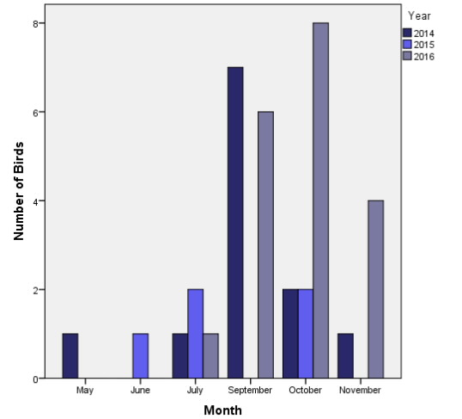
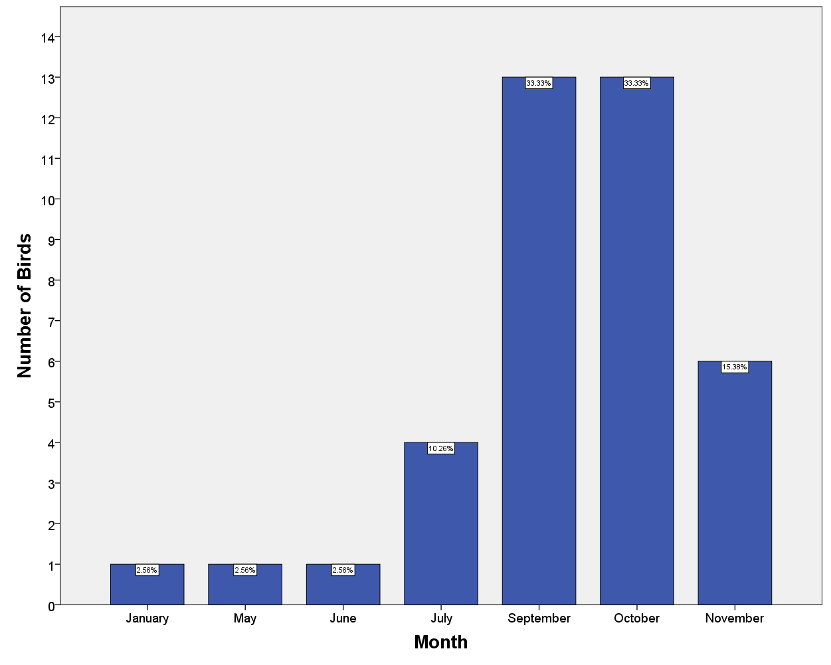
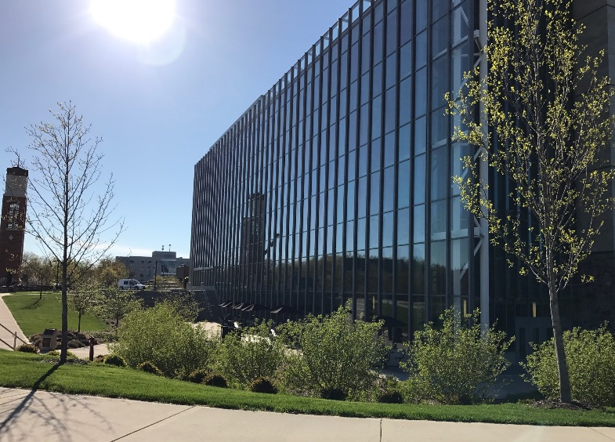
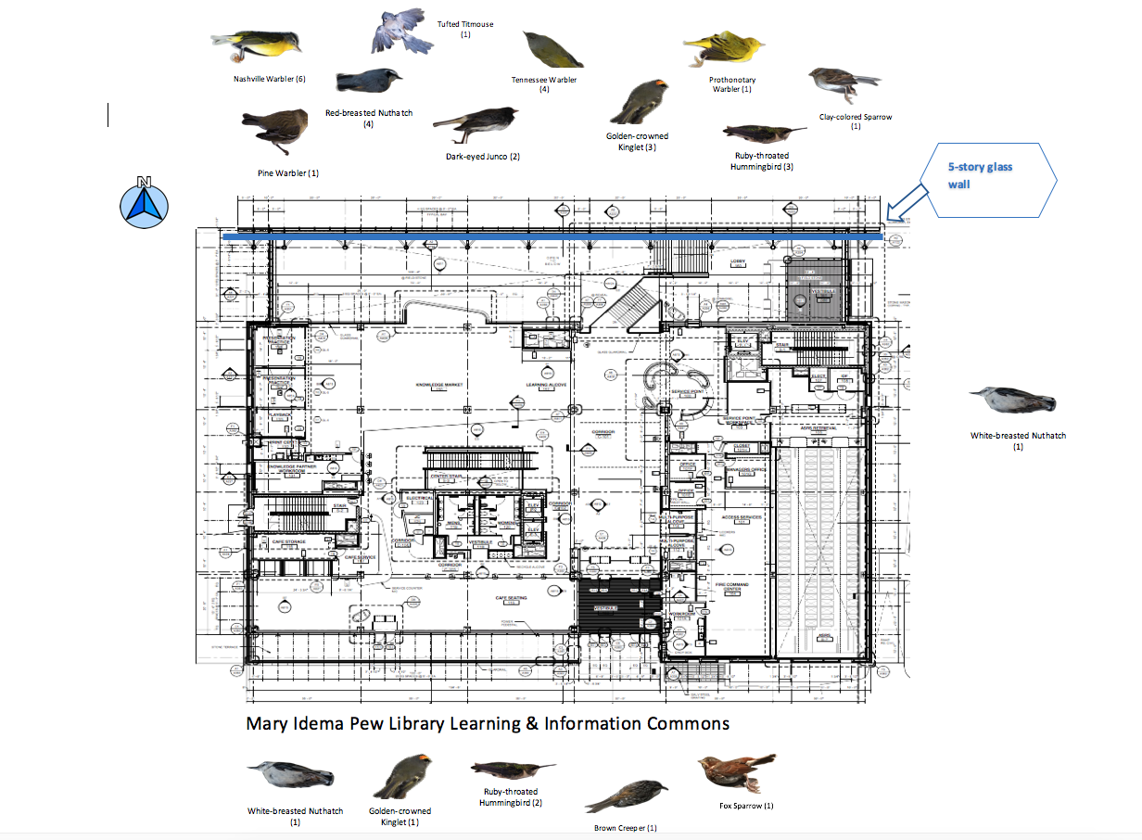
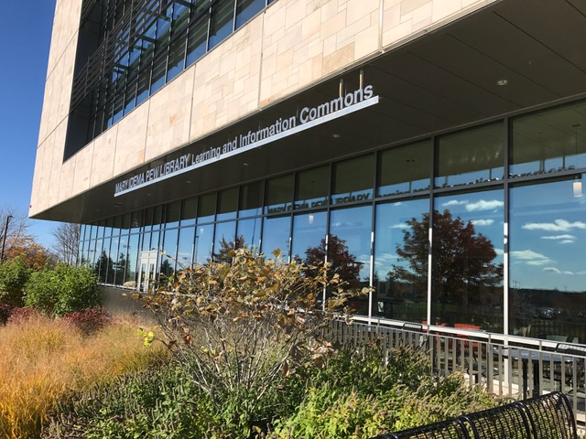
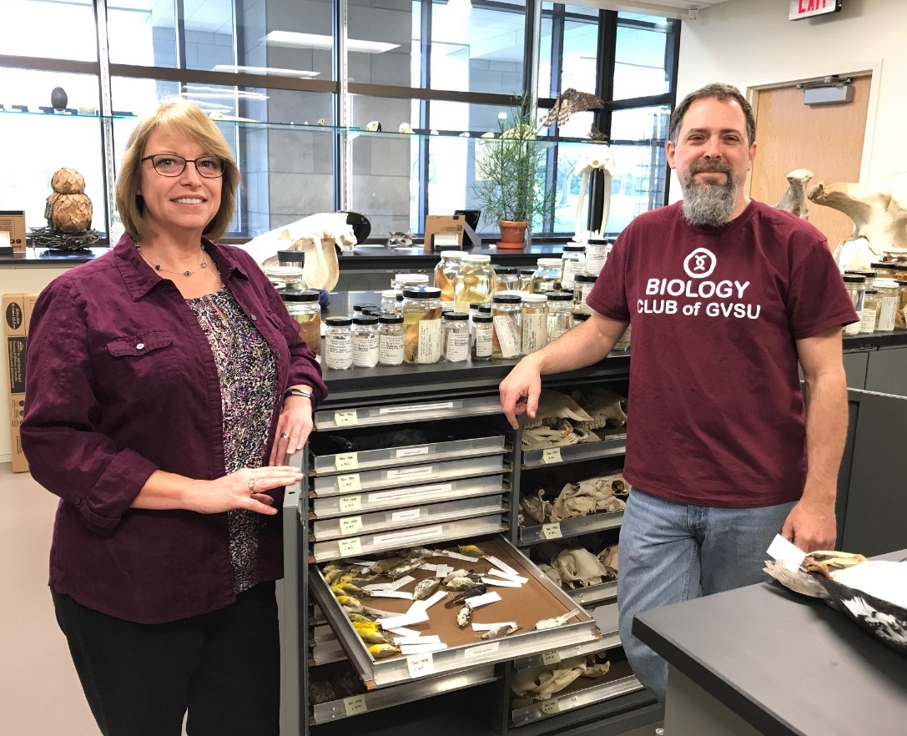
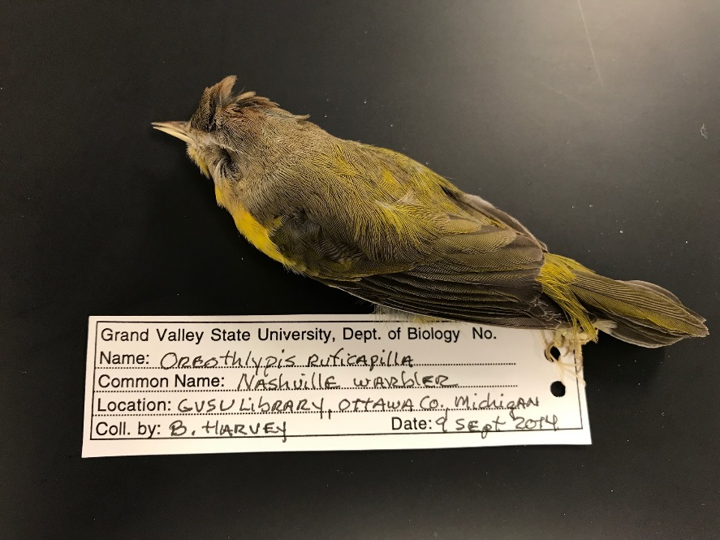
If You Build It, They Will Crash Into It!
A four-year study of bird-building collisions at the LEED Platinum-certified Mary Idema Pew Library
Barbara Harvey• STEM Liaison
harveyb@gvsu.edu
Introduction
Results
The purpose of this study was two-fold:
To determine if there is a discernable pattern in the bird-building collisions which could inform a solution.
To strengthen liaison relationships with the Biology Department by providing museum study skins.
The majority of collisions (63%) occurred during fall migration, in September and October.
75% (30/40) of the documented fatalities occurred on the north side of the building, which is fronted by a four-story glass wall.
Fig. 1. Number of birds killed by year
Fig. 2. Percent of birds killed by month
Background
Conclusions
The species documented in this study are similar to those reported in previous studies²; the majority were migratory song birds.
Remediation could be achieved by the following measures:
Replace all existing glass with fretted glass, which would be very expensive.
Cover the windows with netting or “bird tape” on the outside during September and October.
(Previous studies have shown that window decals are largely ineffective).
Students studying biology, ecology, and art have benefited from the study skins created.
Future Directions:
Students will be recruited to assist with data collection; the study could be expanded to compare with other buildings on campus.
Remediation efforts will be proposed to the Dean of Libraries before fall migration 2017.
The Mary Idema Pew Library Learning and Information Commons in Allendale, Michigan, is the only LEED Platinum certified building on the campus of Grand Valley State University.
Bird-building collisions pose the second highest risk of bird mortality in the United States (after cats), with current estimates of half a billion birds killed per year by colliding with anthropogenic structures, primarily windows ¹.
Figure 3. Species by location and number
Methods
The perimeter of the library was scanned several days a week for dead birds from July, 2013 to present. Data was added to an Excel spreadsheet. Charts were created with R.
The species were verified, and specimens in good shape were collected and delivered to the Biology Department where they were made into study skins for ornithology, ecology, and art courses.
References
1.Loss, S. R., Will, T., Loss, S. S. & Marra, P. P. Bird–building collisions in the United States: Estimates of annual mortality and species vulnerability. The Condor 116, 8–23 (2014).
2. Klem, D. Avian mortality at windows: the second largest human source of bird mortality on Earth. Proceedings of the Fourth International Partners in Flight Conference: Tundra to Tropic 244–251 (2008).

