Slide 1
Towards an Accessible Library
Annie Bélanger
April 2019

Slide 2
Why?
Accessibility permeates every aspect of our public-facing work
It’s everyone’s responsibility
Notes:
Accessibility permeates all aspects of our public-facing work. Yes, we have to do it by the law… However, the ADA is the bare minimum. It may lead to more accessibility, it may not lead to inclusion and equity.
Being accessible is in every aspect of workflow development and application for user services and support. Many more than the manager are involved in the development and application of our guidelines, practices and procedures. Many more are responsible and accountable for this work.
This is EVERYONE’s responsibility.

Slide 3
Overview
What is accessibility?
Accessible Customer Service
Leading Practices
Practical approaches to delivery
Planning with Accessibility in Mind
Process for doing
Ongoing compliance
Resources
Notes:
As I thought of the session today, I imagined all of us wearing 3 hats throughout today’s session:
Customer service provision
Guideline development
Manager/Supervisor

Slide 4
What is Accessibility?
Legislation, definitions, setting the stage

Slide 5
Legislation
Rehabilitation Act (1973)
Prohibits discrimination based on disability
ADA (1990)
Prohibit discrimination in all areas of public life with five areas
Does not mandate inclusion
Section 508 (1998)
Accessibility to electronic information from the government
Morphs into web accessibility
Notes:
In 1973, Nixon passed the Rehabilitation Act that prohibited discrimination on basis of disability.
The Americans with Disabilities Act (ADA) became law in 1990. The ADA is a civil rights law that prohibits discrimination against individuals with disabilities in all areas of public life, including jobs, schools, transportation, and all public and private places that are open to the general public. The purpose of the law is to make sure that people with disabilities have the same rights and opportunities as everyone else. The ADA is divided into five titles (or sections) that relate to different areas of public life.
Employment
Public Services: State and Local Government
Public Accommodations and Services Operated by Private Entities
Telecommunications
Transportation
In 1998, Section 508, which we think of as web accessibility was passed to make access to information to those with disabilities comparable to access for others.

Slide 6
Accessible means
A person with a disability is afforded the opportunity to acquire the same information, engage in the same interactions, and enjoy the same services as a person without a disability in an equally effective and equally integrated manner, with substantially equivalent use of ease.
As fully, equally, and as independently as a person without a disability.
~ Office of Civil Rights, 2013
Notes:
A court case in 2013 set precedent for what accessible meant.

Slide 7
Accessibility
Environment is what disables people
We need to design for universal access
Plan in order to prevent barriers
Accessibility is everyone’s responsibility
Ask yourself:
Is there anything “here” that might present a barrier?
Notes:
There are two major constructs of disability; medical and social. The concept of access is rooted in the social construct and sees the environment as a disability. This means we can design universally and prevent barriers.
Ask yourself: is there anything here that might present a barrier?

Slide 8
Accommodation
Assumption of ‘normal’ activity
Responsibility of ‘disabilities’ office
Modify environment one person at a time
Reactive rectification of barriers
Requires person to disclose
A ‘barrier’ is anything that stops a person with a disability from fully taking part in society because of that disability
Notes:
Normal—everyone walks up stairs; everyone hears, sees, etc.; everyone reads or learns the same way;

Slide 9
Shift in Approach
Accommodation
Accessibility
Disability or problem is with the person
Reactive
Individualized solution
Problem is with the environment
Proactive
Integrate accessibility in planning
Universal design
Note: The duty to accommodate continues!

Slide 10
Four Principles
DIGNITY
Self-respect, respect of others
INDEPENDENCE
Do things without unnecessary help from others
INTEGRATION
Same service, same way
EQUALITY OF OPPORTUNITY
Same options, chances, and benefits
Notes:
We want to ensure that we design and use service delivery methods
that help maintain the person’s dignity and independence,
that ensure their way of receiving service is integrated into the way others receive service, and
That our service delivery methods help us provide persons with disabilities an equal opportunity to benefit from our services.
Dignity
Preserving the person’s self-worth.
Not treating persons with disabilities as an afterthought.
Independence
People are able to do things on their own without unnecessary help or interference. Integration
Person benefits from the same service, in the same place, time, and way as others.
Equal Opportunity
Same chances, options, benefits and results as others.
Equitability…

Slide 11
Print Disabilities
Prevent people from reading standard print.
Can be due to a visual, perceptual or physical disability.
E.g., vision impairment, a learning disability or a disability that prevents the physical holding of a book.
For full access, ensure the provision of:
Publications in multiple formats, such as Braille, audio, large print and electronic text.
Assistive technology
From: Library and Archives Canada: Initiative for Equitable Library Access
Notes:
http://www.collectionscanada.gc.ca/iela/index-e.html The mandate of the Initiative for Equitable Library Access (IELA) is to create the conditions for sustainable and equitable library access for Canadians with print disabilities.
In Libraries, understanding the category of print disabilities is critical as it is an umbrella for many others. It impacts interaction with print materials.

Slide 12
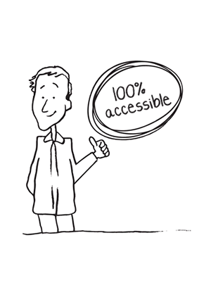
Increasing Accessibility Every Day
Accessible Customer Services

Slide 13
Barriers
Types:
Physical
Architectural
Information or communications
Attitudinal
Technological
Systemic
Key insight:
Think in terms of barriers; don’t focus on the person’s [dis]ability
Can you think examples of each type?
Notes:
Physical – a step at the entrance to a store.
Architectural – no elevators in a building of more than one floor.
Information or communications – a publication that is not available in large print.
Attitudinal – assuming people can’t perform a certain task when in fact they can.
Technological – traffic lights that change too quickly before a person with a disability has time to get through the intersection.
Systemic – Barriers created by policies or practices, for instance not offering different ways to complete a test as part of job hiring.
The following is the same definition as used in the Ontario Human Rights Code. A “disability” is:
Any degree of physical disability, infirmity, malformation or disfigurement caused by bodily injury, birth defect or illness;
A condition of mental impairment or a developmental disability;
A learning disability, or a dysfunction in one or more of the processes involved in understanding or using symbols or spoken language;
A mental disorder; or
An injury or disability for which benefits were claimed or received under the insurance plan established under the Workplace Safety and Insurance Act, 1997.

Slide 14
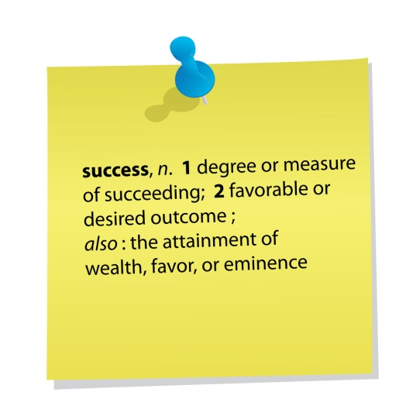
Daily Commitment
Every interaction is an opportunity for accessible service!
Model best practices for interacting and communicating with persons with disabilities
Proactively identify and report barriers
Notes:
Communications
Interact comfortably, taking disabilities into account
Welcome persons using assistive devices and know how to use assistive devices provided by your area. (Speak to expectations – not everyone an expert – reach out to Janet and OPD)
Welcome service animals.
Know how to request verification if in doubt.
Welcome support persons.
Barriers
Provide notice of temporary service disruptions.
Proactively identify and report barriers.

Slide 15
Daily Commitment, cont.
Know what to do when someone encounters a barrier in your department
Inform people about feedback process
Notes:
Barriers
Know what to do when someone encounters a barrier in your department. This can be as simple as knowing whom to talk to.
Feedback
Inform people about feedback process.

Slide 16
Tips for Daily Tips for Daily Interactions
Accessible Customer Services

Slide 17
Communication PACT
Pay calm, individual attention to the other person
Ask “How may I help?” to meet needs
Communicate clearly, patiently
Treat the other person with respect, as a unique individual
What are some communication tips from the modules?
Notes:
Good customer service in general depends on a “Pact” between the person providing service and the person receiving it. It can be summed up in this way:
P -PAY calm, individual attention to the other person.
A- ASK “How may I help you?” in an effort to find suitable ways to understand and meet each person’s learning or service needs; usually, a person is glad to let you know; before ending your interaction, ask, “Does that help with your need?”
C- COMMUNICATE directly, clearly, precisely, and patiently, without interrupting, to ensure shared understanding
T- TREAT the other person with respect, as a unique individual, with attention to his dignity, independence, sense of integration and equality, and

Slide 18
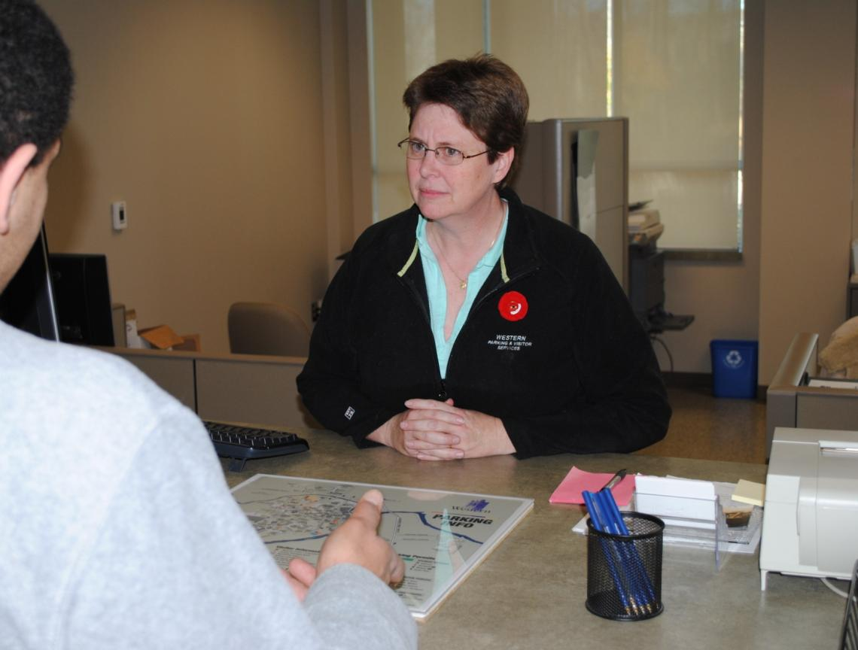
This person can’t figure out what the customer is saying.
Notes:
This service provider can’t figure out what the customer is saying. What can she do to understand his needs?

Slide 19
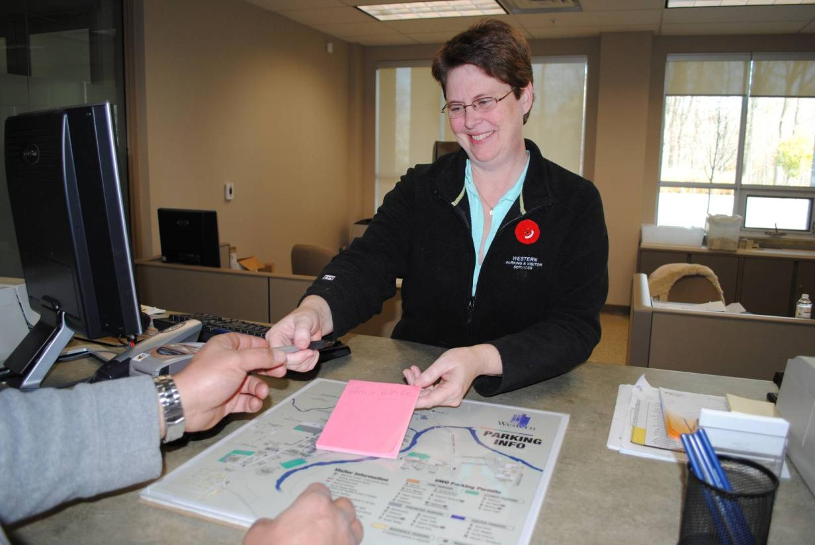
Tip: Keep pen and paper handy and offer it to the person.
Notes:
. Keep pen and paper handy and offer it to the person.
TIPS
Keep area well lit; keep face clearly visible for lip-reading
Offer to read information if it is clear the person is having difficulty
If you are using a computer, offer to increase the font size. increase font size.
Keep pen and paper handy and offer it to the person.

Slide 20
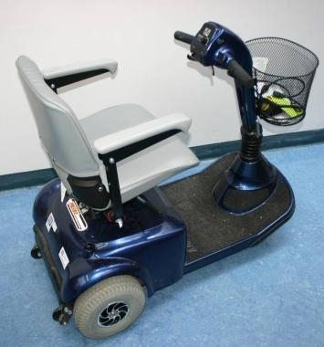
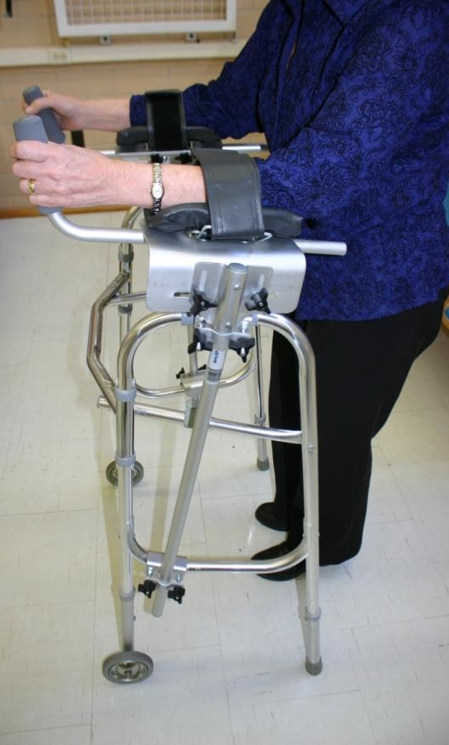
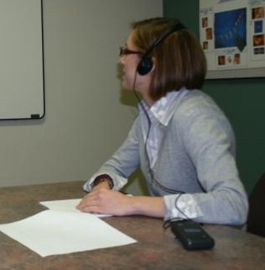
Increasing Independence: Assistive Devices
An extension of a person’s capabilities
Increase independence
Notes:
To ensure maximum accessibility, persons with disabilities need to be able to use their assistive devices on our premises. Such devices are an extension of the person’s capabilities.
They increase the person’s independence and provide freedom to participate as the person chooses without unnecessary help or interference from others.
Here are some examples of Assistive Devices that someone might bring with them campus.
The Office for Persons with Disability provides assistive devices to help persons with disabilities access services across campus (upon request). We also offer assistive devices in the Adaptive Technology Centre, such as ZoomText, JAWS, etc.
In the bottom right photo, an FM system is being used to amplify sound.

Slide 21
Tip: “Please don’t lean over, touch, or move my Assistive Device; it’s an extension of me.”
Notes:
The assistive device is an extension of the person’s capabilities; don’t lean over, touch, or move a device.

Slide 22
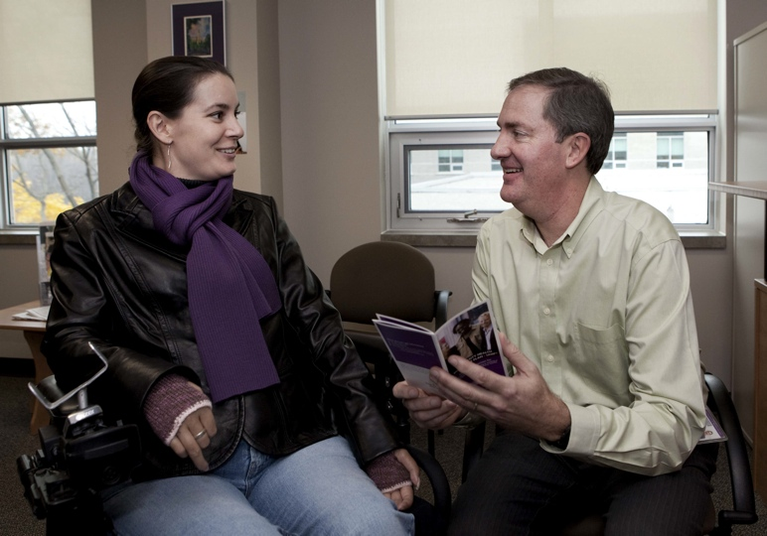
Tip: Get eye to eye; avoid neck strain.
Notes:
22
Get eye to eye; avoid neck strain.
This is best because you are making the users most comfortable, you would be making eye contact, and you would be able to show the documentation easily to the user.

Slide 23
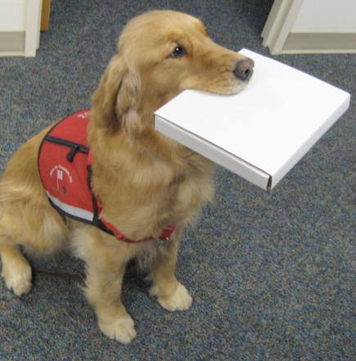
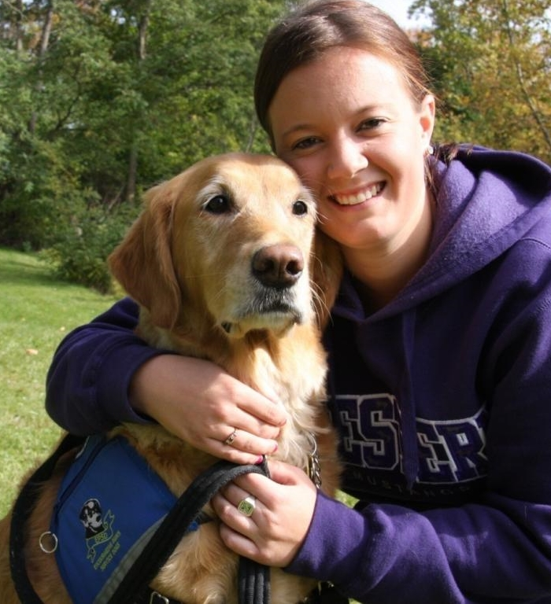
Maintaining Dignity
Allow service animals
Types of service animals:
Guide dog
Hearing or signal
Mobility assistance
Seizure response
Therapeutic assistance
Notes:
Can increase overall accessibility by allowing service animals in our site libraries.
Service animals provide assistance in the many ways listed in your handout
Dogs are often the most common service animal. However, a variety of animals have been used for a variety of assistive purpose. If unsure, don’t ask. It is common to wear a vest. It is always the responsibility of owner to be in control of animal.
A Mobility Assistance Animal picks up items, opens doors…And we certainly don’t want to interfere with a mobility assistance animal, as she fetches and picks up a pizza for her owner.
Here a Western student gives a hug to her therapeutic, or mental health assistance animal, Spirit.

Slide 24
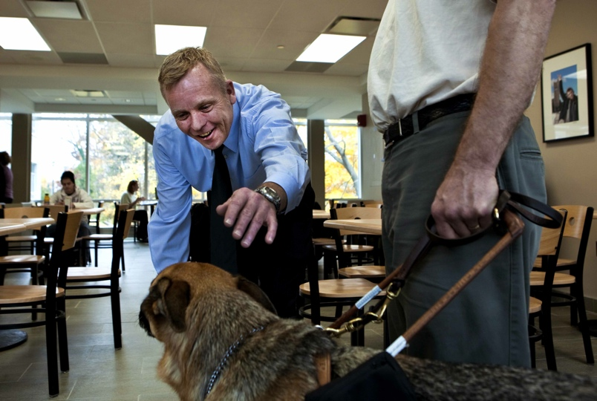
Tip: Working Dog - do not pet or distract.
Notes:
24
To maintain a person’s dignity, pay no attention to the animal. It is at work and must not be distracted. The dog serves as an extension of the owner’s capabilities. Focus your attention on communicating with the person. (NEXT SLIDE SHOWS THIS TIP)
How do can you know if it is a working dog?
You should always permission to pet a dog… it could be relaxing but still on duty i.e.. Out of its harness.

Slide 25
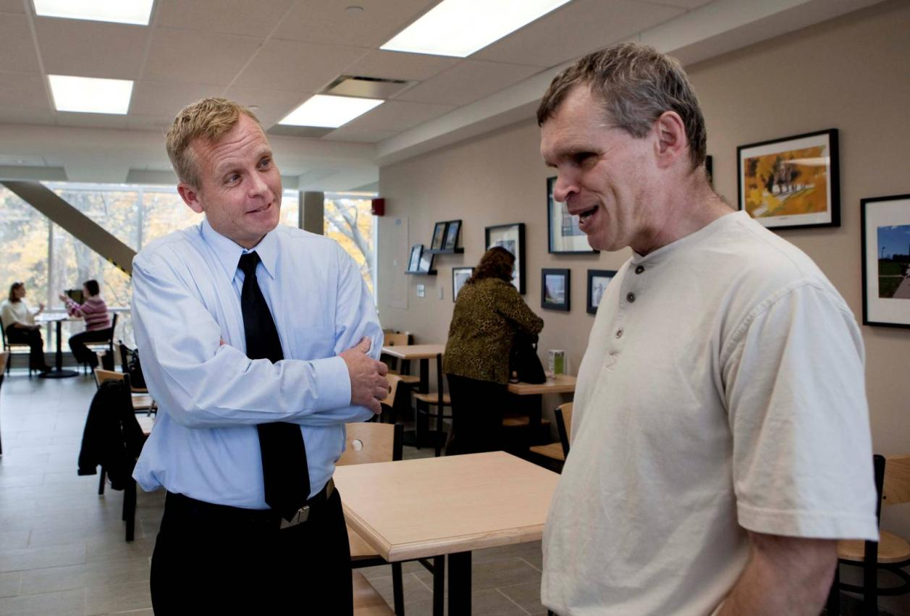
Tip: Pay attention to the owner.
Notes:
25
To maintain a person’s dignity, pay no attention to the animal. It is at work and must not be distracted. The dog serves as an extension of the owner’s capabilities. Focus your attention on communicating with the person. (NEXT SLIDE SHOWS THIS TIP)
How do can you know if it is a working dog?
You should always permission to pet a dog… it could be relaxing but still on duty i.e.. Out of its harness.

Slide 26
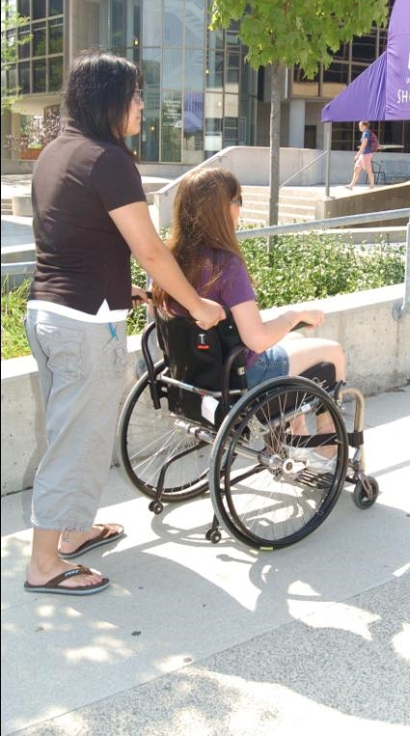
Maintaining Dignity: Support Persons
Welcome support persons.
Support persons:
Guides
Interpreters
Note-takers, scribes, readers
Personal care
Notes:
We can increase a person’s access to services and support his or her dignity by welcoming his or her Support Person
Support persons help with mobility, note-taking, reading, sign-language, interpretation, personal care. Family, friends, volunteers and professionals serve as support persons.
Support person may be mandatory for health or safety reasons.

Slide 27
Tip: “Talk to me, not to my support person.”
Interpreter
Notes:
27
When interacting with a person accompanied by a support person, speak directly to the customer, not to his or her support person to maintain the accessibility principle of dignity. If you’re not sure who is the customer, ask.

Slide 28
Service and Invisible Disabilities
Universal and inclusive service approach to all users is key.
Scenario:
A student has left their school paper to the last minute.
She approaches the service desk appearing somewhat overwhelmed and makes several attempts to explain her needs.
At your suggestion to write the information down, she tells you that she didn’t bring paper and otherwise appears unprepared.
She may seem impatient and quick to become frustrated.
Notes:
Note that these behaviours may indicate a neurological disorder.
-It may not be a reflection of a personality style or of your efficiency.

Slide 29
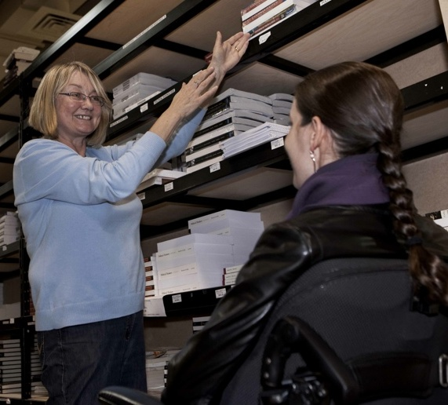
Great Service: How may I help?
Notes:
Overall, great service starts with a simple question, “How may I help?”
Person with vision loss needs help? Offer your elbow to guide him.
Guided Questioning
“Is this the information you were looking for?”
“Do you require any other type of assistance?”
“Is there any information you didn’t follow/write down that I can review with you again?”

Slide 30
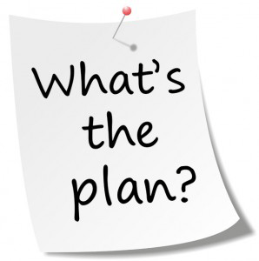
Moving beyond Compliance
Planning with Accessibility in Mind
Notes:
ADA require ongoing commitments for compliance. Let’s look at what that means.

Slide 31
Areas of Focus
Communication Expectations
Feedback Process
Reporting of Barriers
Service Disruption Notices
Service Philosophy
Staff Training
Notes:
Communication Expectations and General Principles of Accessible Service
Q. What are the points of contact where a person receives service?
Q. At these contact points, what barriers to service might persons with disabilities encounter?
Q. What changes would improve accessibility?
***These questions are key for all of us to consider.
Service Disruptions
Organizations should provide public notice when there is a temporary disruption in services usually used by persons with disabilities goods or services. Indicate
the reason for the disruption
the expected duration, and
a description of alternate facilities or services, if available.
Examples of facilities used to access services are: elevators, lifts, power door openers, accessible washrooms, etc.
This leading practice supports independence.

Slide 32
Some Definitions…
Policies/Guidelines
what you intend to do, including any rules for staff
Procedures
reflect your policies
describe how you will go about providing service OR the steps staff are expected to take in certain situations
Practices
what you do on a day-to-day basis, including how your staff actually offer or deliver services
may be informal or written
Notes:
Example - Policy: The Library seeks to provide equitable quality services to the campus community.
Example – Procedures: All persons registered with the Special Needs Services can register with the Adaptive Technology Centre. This additional registration ensure that they receive tailored library services, which can include provision of alternate formats, quiet workspace with assistive technologies, book retrieval, term loans, etc.
Example - Practices: Fines assessed due to a situation related to the person’s disability can be forgiven. This is done by Circulation Services in consultation with the Coordinator for Special Needs Services. This is not a formally documented policy.
Universal Practice: Anyone who ask for support in locating a book in the stacks in helped.

Slide 33
Make accessibility part of planning
What can accessibility mean in the context?
Consider how to support the 4 principles
Dignity – self-respect and the respect of others
Independence – do things without unnecessary help from others
Integration – same service, same way
Equal Opportunity – same options, chances and benefits
Notes:
Integrating accessibility into your initial planning saves money and time (it’s far more expensive to retrofit). The resources on this page are designed to help you plan with accessibility and inclusivity in mind.

Slide 34
Make accessibility part of planning
Include a statement of how accessibility will be considered
Define end users
Define stakeholders and involve those with knowledge/experience
Will the project outcomes create barriers?

Slide 35
1 - Getting Started
3 questions to get started:
What is the scope of the project?
Who should be involved?
When will it begin and end?
Notes:
3 questions before getting started on this:
What is the scope of the audit?
How widely will you collect the documentation? It’s easiest to eat an elephant one bite at a time, so piecing it out is often best.
Who should be involved?
A mixture of big picture people and very detailed oriented people is optimal. They can balance out how each document
fits with the rest of the Library and the “what about x” questions. You’ll want to pick a project lead who can dedicate
time and is organized.
When will it begin and end?
Be realistic, but do set a deadline.
For the requirements of compliance, the “what to collect” will be largely focused on public services guidelines, procedures and workflows. It will be divided along departmental lines. Examples include: ILL policies, desk service philosophy, notification of service changes and disruptions, etc.
LINC Example:
Wanting to review the delivery of Library instruction we could look at sessions offered. For the purpose of the project, I set the scope to only look at LINC sessions. I will be looking at the process from development of materials, registration through offering the session and feedback.
Members of instruction group and a department head.
A member should be lead.
Over the summer term, with delivery of a staff session at the end of August.

Slide 36
2 - Do an Audit
You have your scope, team and timelines set. Now:
Communicate the scope of guidelines, procedures and practices being reviewed
Collect all existing statements, procedures, guidelines within the scope
Ask staff to share their knowledge of documented and undocumented guidelines, procedures and practices (within the scope).
Organize the collected materials before beginning the next steps (gaps identification and assessment)
Notes:
You have your scope, team and timelines set. Now:
Collect all existing statements, procedures, guidelines in identified categories within the scope.
Some of this may include chatting with people to see what they have and what they haven’t even documented. There is a prevalence of practices that are “common knowledge”. Those are key to gather as they reflect on the daily realities.
Organize the collected materials before beginning the next steps (gaps identification and assessment).
Sort and organize. You need to do this to see gaps and overlaps.
In the case of the AODA, the scope is the range of guidelines, practices, procedures and workflows that can impact users and how they access our library services.
Continuing with our example:
Sample communication:
Instruction group will be reviewing its practices. Our scope is the delivery of library instruction sessions. It will include registration system, preparation of materials, accommodations during session, and the feedback process. Please send us, or talk with us, about your knowledge of our practices.
Collect
Instruction group will speak to all liaison librarians as well as library associates who support them to gather minutes, guidelines, and existing “common knowledge”.
Organize
The collected information will be organized thematically. Duplicates will be removed.

Slide 37
3 - Assess What You Have & Need
Create clearly defined evaluation criteria that will be used to assess the guidelines, procedures and practices
Think of the desired outcomes
Evaluate existing documents
Identify gaps (new documents needed)
Determine needed revisions and documentation to be created
Dignity
Independence
Equal Opportunity
Integration
Notes:
Create clearly defined evaluation criteria that will be used to assess the guidelines, procedures and practices.
Think of the desired outcomes. What do you hope to accomplish? This will help you come up with your assessment criteria.
Evaluate existing documents.
Establish next steps, that is needed revisions and documentation to be created.
The “next steps” can include that no work is needed or that a practices can be done away with.
The standard requires you to use reasonable efforts to ensure that guidelines, practices and procedures are consistent with the principles of:
Dignity
Independence
Integration
Equal opportunity
Continuing with our instruction example:
Outcomes-Based Criteria:
Instruction decided that their outcome would be accessible sessions for library instruction. Their evaluation criteria for practices and procedures will include:
Is it simple?
Is it clear what expectations for instructors are?
Is our commitment and its applications clear?
Is there a clear communication path and identification of who needs to be contacted when there are concerns?
Evaluate:
They have no formal documentation. They have committee minutes as well “common knowledge”. They will evaluate their existing procedures using those.
Identify Gaps:
There are no alternate ways to register for sessions.
There are no clear ways to alert Instruction of needed accommodations.
There is no documented commitment to creating accessible presentation materials.
No process if someone has a service animal and another participant is not comfortable.
The feedback process is a printed form.
Impacts?
May be preventing users from full participation.
Needed Revisions:
The next step will be to document procedures for:
Registration
Material prep
Delivery of session
Feedback mechanism

Slide 38
3.3 - Identify Gaps
Identify gaps in your guidelines, procedures and practices
Review feedback from users; focus on barriers
No feedback doesn’t mean no work to do!
Consult with public-facing staff about issues and potential service solutions
Think about how those gaps impact your ability to provide services to your users
Anticipate users’ needs
Notes:
Think about what people with different types of disabilities will need in order to be able to access your services and what, if anything, you could do differently so that they can access these.
Continuing with our Instruction group example:
There are no alternate ways to register for sessions.
There are no clear ways to alert LINC of needed accommodations.
There is no documented commitment to creating accessible presentation materials.
No process if someone has a service animal and another participant is not comfortable.
The feedback process is a printed form.
Impacts?
May be preventing users from full participation.
A barrier prevents a person with a disability from participating fully in society because of his or her disability. A barrier may not be apparent, and therefore, the best method to remove the barrier may not be obvious.
See Appendix A of the compliance manual for more information on barriers and solutions that may be developed through policies, practices and procedures.
It is difficult to anticipate the needs of all users. However, learning about the experiences of users with various disabilities and the barriers they face may improve your ability to anticipate their needs and to offer accessible services.
See Chapter 4 of the Compliance Manual for more information on communicating with users with disabilities.

Slide 39
4 - Determine Your Approach
How will you address accessibility?
Things to Consider:
Stand-alone statements
Integrated into existing customer service policies/guidelines, procedures and practices
Combination of both
Accessibility should be planned for from the beginning.
What will work for:
Your department?
The policy being discussed?
Universal Design gives preference to integration!
Flexibility goes
a long way!
Notes:
How will you address accessibility?
Stand-alone statements
Integrated into existing customer service policies/guidelines, practices and procedures
Combination of both
Things to Consider:
Accessibility should be planned for from the beginning.
What will work for:
Your department?
The policy being discussed
Depends policy being discussed.
Universal design would give preference to integration of accessibility components into guidelines, practices, and procedures.
Flexibility in your approach goes a long way!
Continuing with our LINC example:
An overarching statement to their commitment to accessibility would be useful, but may not give clear ideas on the procedures instructors should be using.
Since they have not documented their procedures and practices, it may be easiest to create a instruction accessibility procedure that would touch on those categories highlighted in the gaps analysis ( alternate means of communication, alternate formats, accommodations, service animals, feedback process that is accessible and clear intent).
They could also create documents to address how they provide services in different areas and include accessibility within those practices.

Slide 40
5 - Develop Required Documents
Plan:
Assign a priority level to each document that needs to be revised/created
Identify individuals to be involved
Determine a development schedule
Identify current practices in the Library and best practices elsewhere
Write/revise the documents
Decide on a review and approval process
Notes:
Earlier in the process, you would have identified who was involved in the audit. Now, you need to identify who will be involved in the revision: think about who should do the edits, who should review, and who will need to be consulted.
Again, be realistic about timelines. You should allot time for the consultation, review and approval process.
Current practices could be in your department only. Best practices can be more outwardly focused.
Get down to business: write the new documents and revise existing ones. Keep in mind your criteria based on desired outcomes.
Who needs to be involved in the final review? Who has the authority to approve the documentation? Who will be key in assisting in the implementation of changes?
PRACTICES THAT RELATE TO USERS WITH DISABILITIES ALSO NEED TO BE DOCUMENTED MOVING FORWARD
Continuing with our instruction example:
Plan
Set priorities. Number 1 is adapting the registration system.
Instruction group, Systems, IST
Fall term – to be discussed
Review current/best practices:
Other registration systems in the Library are similar.
Review and approval
Consult librarians
Finalize documents with admin sponsor and appropriate managers

Slide 41
6 - Implement and Communicate
Provide training for staff about:
New/revised documents.
New/revised workflows.
Communicate with impacted users:
On web, by email, etc.
Have documents available in an easily accessible format
Notes:
Continuing with instruction Example:
Train:
Train librarians and library associates on the new expectations and guidelines.
Communicate:
Place their statement on their web pages and the Library Services for persons with disabilities webpage.
Accessible documents:
Create documents as “accessibly” as possible.

Slide 42
We’re all in this together! Session Registration Process
To register, users:
Visit the Library site, navigating to the Help & Instruction section
Click on the session of interest
Login using user id
Review full list and select appropriate session.
Click on the register button
View confirmation screen
Notes:
Let’s take a look at the practice surrounding instruction registration.
Keep in mind: How can it be improved to take into account the 4 principles?
Dignity
Independence
Integration
Equal Opportunity
Alternate modes of communications are not available.
Process does not allow users to identify any accommodations they need.
Confirmation screen does not reiterate full information.
Doesn’t give contact information for a real person
Doesn’t specify service animals are welcome or any other accommodations (they are allowed in the Library, but if
another user is allergic to dogs, they’re could be issues).
Assistive Device
Class cancellation and room change
Support person
Does work with JAWS. Meet basic technical web accessibility. Does have an alias contact link.

Slide 43
We’re all in this together! Session Registration Process 2.0
To register, users can:
Complete the accessible online form
Email the provider
Call, or visit, the Information Desk
After registering, users can alert us to accommodations they will need for full participation by contacting Accessibility Coordinator
Accommodations will be provided.
May need to be provided in collaboration with others. (e.g. FM System)
Materials are made available in an accessible format upon request
Notes:
For example, we can bring large print handouts. And if handouts will be given, it’s great to have a few large print on hand. However, we can’t predict what font size any particular large print user will need. If large print is needed, the assistant can go print an appropriate version.
Alternate modes of communications are available.
The form has a section for users to identify any accommodations they need.
Communication methods and materials take the users’ needs into consideration.
It allows for equal participation and independence.
If the file is sent to the student ahead of time, we can help with dignity by preserving confidentiality.
Integration is met when the student can participate as a member of the group.

Slide 44
Sample Statement Confirmation Screen
The Library is committed to providing equitable access to its services.
If you require specific accommodations as related to a disability, please let us know so we can make arrangements in advance.
Please also identify any assistance you may require in the event of an emergency evacuation.
For more detailed information, contact [Name], by phone at xxx-xxxx or by email at [email link].
Notes:
http://www.hrsdc.gc.ca/eng/disability_issues/doc/gpim/page08.shtml#p1
Based on above link
Statement would also be on the webpage for Library Services for Persons with Disabilities as well as the Tours & Workshops page.

Slide 45
Breakout Time
In small groups, think of and examine an existing guideline or practice at your library
How can it be improved for accessibility?
Determine your approach
Assess what you have
Revise it
Dignity
Independence
Equal Opportunity
Integration

Slide 46
Plan, Ready, Set = Accessible
Practise inclusive, universal design
Plan for accessibility from the start
Remember the 4 principles: dignity, independence, integration and equal opportunity
Be flexible
Ask yourself:
Are there any implications for accessibility in this decision?
Notes:
Some steps to consider when developing new initiatives, service changes, etc.

Slide 47
Resources & References

Slide 48
Tipsheets at the Rescue
Accessible self-service kiosks
Making information accessible
Principles of accessible web design
Accessible Meeting and Event Checklist

Slide 49
Resources
Guide to planning accessible meetings
http://www.hrsdc.gc.ca/eng/disability_issues/doc/gpim/page08.shtml
Disability Awareness Kit – State Library of Victoria, Australia
http://www.openroad.net.au/access/dakit/welcome.htm
ARCH Disability Law Center—“Interacting with Persons who Have a Disability”
http://www.archdisabilitylaw.ca/sites/all/files/Interacting_FactSheet_Dec07.pdf
Notes:
ADD TIPSHEETS
ACCESSIBLE PDF… CNIB?

Slide 50
Resources to Learn More
American Library Association: Library Services for People with Disabilities Policy
http://www.ala.org/ala/mgrps/divs/ascla/asclaissues/libraryservices.cfm
The universal design file: designing for people of all ages and abilities (PDF) (from North Carolina State University)

Slide 51
Training for Library Staff
Project ENABLE (Expanding Non-discriminatory Access By Librarians Everywhere) offers free, self-paced, online training specifically for librarians. Users who successfully complete all of the training modules and quizzes can obtain a Certificate of Achievement.
A handy booklet of Tips On Interacting With People With Disabilities provides guidance for a wide range of situations. This one is worth printing and sharing with all your staff.

Slide 52
Training for Library Staff
Learn how to speak about people with disabilities using language from this People First chart.
The Computer/Electronic Accommodations Program (CAP) has created a series of online training modules, including some on disability etiquette and how to interact with an individual who has a disability.

Slide 53
Training for Library Staff
"At Your Service: Welcoming Customers with Disabilities" is a self-paced webcourse for people interested in discovering best practices for working with patrons and customers who have disabilities.
"Reaching out to Customers with Disabilities" is another self-paced webcourse explaining how the ADA applies to nonprofits and businesses.

Slide 54
Training for Library Staff
Serving Library Users on the Autism Spectrum is an online course designed by experts in both the library and autism fields. It consists of a series of four independent, self-paced instructional modules that are intended for librarians and library staff to learn how to better serve their users with autism spectrum disorder (ASD).
For training on interacting with patrons with autism, try Autism Services and Resources of Connecticut or the FOCUS Center for Autism.
For training on interacting with patrons who have intellectual or developmental disabilities, try BnB Global Services.

Slide 55
Developing Services for Patrons with Disabilities
Connecticut librarian Barbara Klipper published a book through ALA called "Programming for Children and Teens with Autism Spectrum Disorder." for library staff to help them serve individuals with autism and their families more effectively.
The Saint Paul (MN) Public Library has a guide for Resources and Outreach for the Diffabled (Differently Abled) focusing primarily on children and young adults.
LearningWorks for Kids has developed gaming recommendations for alternative learners with autism, ADHD, dyslexia and other diffabilities.

Slide 56
Developing Services for Patrons with Disabilities
Connecticut librarian Barbara Klipper published a book through ALA called "Programming for Children and Teens with Autism Spectrum Disorder." for library staff to help them serve individuals with autism and their families more effectively.
The Saint Paul (MN) Public Library has a guide for Resources and Outreach for the Diffabled (Differently Abled) focusing primarily on children and young adults.
LearningWorks for Kids has developed gaming recommendations for alternative learners with autism, ADHD, dyslexia and other diffabilities.

Slide 57
References
Connecticut State Library: Division of Library Development, Libraries and Accessibility Toolkit https://libguides.ctstatelibrary.org/dld/accessibility
University of Waterloo Library, AODA Toolkit https://uwaterloo.ca/library/aoda-toolkit/
Office of Civil Rights, South Carolina

Slide 58
Situations & Responses

Slide 59
Situation
Some disabilities may affect social skills.
Medication may slow an individual’s speech or reactions; a lack of response does not mean the person is being rude.
Symptoms of various disabilities may become more apparent or aggravated with fatigue or stress.

Slide 60
Response
Focus on the overall goal of the conversation, rather than on the person’s behaviour.
Accept the fact that some tasks may take longer—such as finding a book, using the computer or reading instructions.

Slide 61
Situation/Response
People with learning disabilities sometimes rely on visual aids, so be concrete and give examples.
Use different cues to explain a process.
E.g. Point to a link on a web page and describe its position: ‘top-right corner’.
When giving directions, ask ‘do you like maps?’

Slide 62
Situation/Response
If a person tells you about his or her disability, politely ask them for guidance on how they best learn/understand information.
Don’t assume that a person has understood (or failed to understand) you.
Ask whether you have provided sufficient information.
Clarify by summarizing the information.

Slide 63
Situation/Response
If someone seems upset, ask calmly if there is anything you can do to help.
If they say no, respect their wishes if they are not being disruptive.
If you are in a public area with many distractions, ask the person if they would prefer moving to a quieter location.

