Slide 1
Sharing our Value through Critical Librarianship
Mary Kickham-Samy, Marygrove College Joshua Neds-Fox, Wayne State University Susan Ponischil, Grand Valley State University Virginia C. Thomas, Wayne State University Zoë McLaughlin, Moderator Michigan Academic Library Association Annual Conference Saginaw Valley State University May 2019
Notes:
Entrance slide

Slide 2
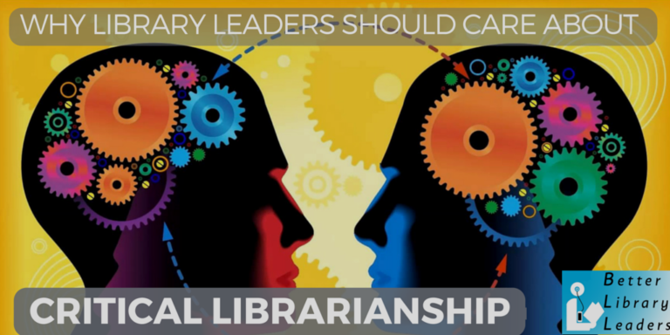
Welcome
Image credit: http://betterlibraryleaders.com/2016/05/19/why-library-leaders-should-care-about-critical-librarianship/
Notes:
ZOE
Welcome to Sharing our value through critical librarianship.
I’m Zoe McLaughlin, Area Studies Librarian at Michigan State University.
I will be facilitating this panel discussion.
Each panelist will talk about critical librarianship from a unique perspective and through a unique lens.
Mary Kickham-Samy will talk about critical information literacy
Joshua Neds-Fox will talk about a critical issues in publishing
Susan Ponischil will talk about critical cataloging
and
Virginia C. Thomas will talk about critical library administration and collection management

Slide 3
Critical Librarianship
“Critlib is short for “critical librarianship”, a movement of library workers dedicated to bringing social justice principles into our work in libraries. We aim to engage in discussion about critical perspectives on library practice. Recognizing that we all work under regimes of white supremacy, capitalism, and a range of structural inequalities, how can our work as librarians intervene in and disrupt those systems?”
critlib. (n.d.) about/join the discussion. Retrieved from http://critlib.org/about
“Critical theory is a framework for understanding social structures and social phenomena by examining struggles between domination and liberation. It is a critical way of looking at the world through the lens of power: who has the power, who doesn’t have power, and what are the consequences of this dynamic.”
Branum, C., & Masland, T. (2017). Critical library management: Administrating for equity. Critical Librarianship, 23(2), 28-36. Retrieved from https://commons.pacificu.edu/cgi/viewcontent.cgi?article=1898&context=olaq
“According to Elaine Harger, librarians that practice critical librarianship strive to communicate the ways in which libraries and librarians consciously and unconsciously support systems of oppression. Critical librarianship seeks to be transformative, empowering, and a direct challenge to power and privilege.”
Garcia, K. (2015, June 19). Keeping up with… Critical librarianship. Retrieved from http://www.ala.org/acrl/publications/keeping_up_with/critlib
Notes:
ZOE
To begin the discussion we’d like to provide you with a definition.
Critlib is short for “critical librarianship”, a conscious effort to approach librarianship through the lens of Critical Theory. This framework examines social systems for their impact on oppression vs. liberation, whether they bind or free people. Critical librarianship seeks transformation and empowerment, to be a direct challenge to power and privilege: disrupting systems of oppression and enacting systems of liberation.
These slides will be available after the conference.
We ask that you save any questions you may have until the end.
Let’s begin the discussion with Mary
[Zoe will manage slide transitions - panelists will use the word ‘next’ as a prompt if needed]

Slide 4
Critical Information Literacy
Mary Kickham-Samy Marygrove College, Detroit
Notes:
Mary
Critical information literacy is an approach to library instruction that generates student awareness of the powers that control information, and prompts students to question assumptions about how information is produced, distributed and consumed.

Slide 5
Critical Information Literacy and Empowering Our Students: My Perspective
Elmborg, J. (2006). Critical information literacy: Implications for instructional practice. The Journal of Academic Librarianship, 32(2), 192-199.
Gee, J. P. (2008). Social linguistics and literacies: Ideology in discourses (3rd ed.). New York: Routledge.
Vygotsky, L.S. (1962). Mind in society: The development of higher psychological processes. Cambridge, MA: Harvard University Press.
Notes:
MARY
Among the Scholars who influenced my understanding and perspective on Critical Information Literacy are: Lev Vygotsky, known for Social Constructivist Learning Theory and for the expression “Zone of Proximal Development,” and James Paul Gee, who developed the concept of critical discourse theory. Among the librarian scholars that influenced my thinking is James Elmborg. These scholars and theorists share the notion that learning takes place when knowledge is co-constructed.

Slide 6
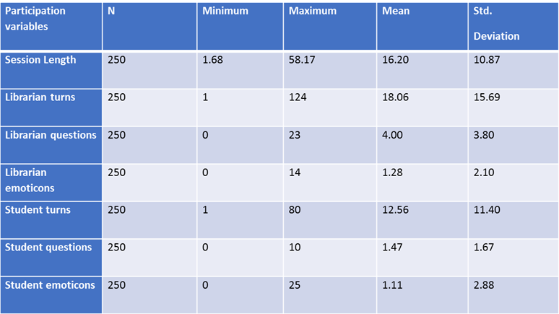
Critical Information Literacy and Empowering Our Students: My Experience
Kickham-Samy, M (2010). Balance of power and negotiation of meaning in virtual veference learning environments. In M. L. Radford & R. D. Lankes (Eds.), Reference renaissance: Current & future trends. (pp. 55-70). New York : Neal-Schuman.
Notes:
MARY
In 2008-9, I conducted a quantitative study, based on 250 virtual reference transcripts in order to look at how the librarian and the student interacted and who controlled the learning environment. I counted the number of turns the librarian and the student each took, the number of questions each asked, and the number of emoticons each used. On average, the librarian, with a mean of 23 actions per session, had a much stronger presence during the interaction than the student, with a mean of 15 actions per session.

Slide 7
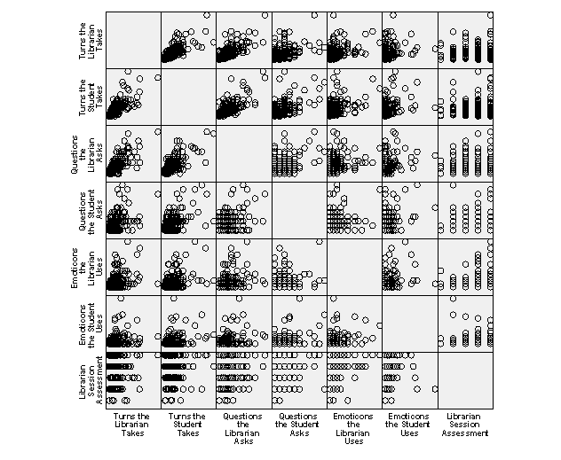
Critical Information Literacy and Empowering Our Students: My Experience
Notes:
MARY
This scatter plot shows that, although the librarian had a stronger presence, both the student and the librarian took turns asking and answering questions in an effort to solve a problem.
However, when I looked at how the librarian assessed the success of the session, I observed that the librarian did not appear to evaluate the success of the session based on how engaged the student was or what knowledge the student gained during the interaction. I hypothesized that the librarian focused on one factor -whether or not she was able to answer the student’s question.

Slide 8
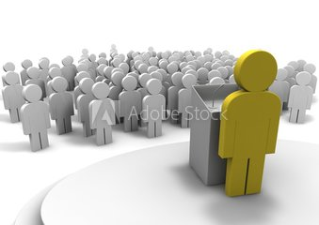
Critical Information Literacy and Empowering Our Students: My Experience
Lecture
vs.
Tutoring
Graesser, A.C., Person, N.K., & Magliano, J.P. (1995). Collaborative dialogue patterns in naturalistic one-to-one tutoring. Applied Cognitive Psychology, 9, 495-522.
Notes:
MARY
In 2010-11, I continued my interest in VR as a learning environment by turning to the literature on tutoring for insight. Graesser, Person, and Magliano (1995) observed that “normal” tutors who lacked experience, formal training, and expertise in the subject matter made greater academic gains with students than classroom teachers, who were subject-matter experts, experienced and professionally trained. From this, these researchers hypothesized that tutoring was successful not because of superior teaching strategies, but rather because of the natural “conversational dialogue patterns” embedded in the interaction.

Slide 9
Critical Information Literacy and Empowering Our Students: My Experience
Two discourses:
•our native discourse, and
•our acquired discourses
Gee, J. P. (2005). An introduction to discourse analysis: Theory and method (2nd ed.). London: Routledge.
Notes:
MARY
Gee says that we conduct our daily lives using two discourses. The first is the one that we learn in our homes and the second is the one we acquire from the surrounding community. Whether or not a student succeeds in school largely depends on how well these discourses align with the academic discourse of the school environment.

Slide 10
Critical Information Literacy and Empowering Our Students: My Experience
Student: ty
Student: Thank you
(Student aligning her discourse with with what she perceives as the librarian’s more formal, academic expectations.)
Kickham-Samy, M. (2012). The tutorial dialogue and problem solving in virtual reference interactions. In M. L. Radford (Ed.). Leading the reference renaissance: Today’s ideas for tomorrow’s cutting edge services (pp. 47-61). New York: Neal-Schuman.
Notes:
Mary
In face-to-face or online reference sessions or during information literacy instruction sessions, there are two participants, the librarian, who is a member of the academic community and the students, who are joining this community. In these learning environments, librarians have the opportunity, through mentorship and by example, to move the student along to becoming a participating member of the academic community.

Slide 11
Critical Information Literacy and Empowering Our Students: Application
Information Literacy Instruction: A New Landscape
The reference interview => tutorial dialogue.
The “one-shot” => self-instructional, self-paced, web-based modules
Three-credit courses in critical information literacy
Notes:
MARY
From my understanding of the literature and from other influences, I make the following three observations:
1. The practice of meaningful tutorial dialogue will replace the prescriptive, agenda-driven format of the reference interview.
2. Self-instructional, self-paced, web-based learning modules will replace the classroom “One-shot.”
3. The value of critical Information literacy instruction will become more recognized by the academy as crucial to the education of an individual. Three-credit courses in critical information literacy will start to appear in course catalogs as either an elective within a major field or as part of the core curriculum.
In conclusion, instruction librarians have been slow to adopt constructivist learning theory. The ACRL standards for information literacy were grounded in narrow behavioral learning theory, which has generated some useful applications, but in far too many instances, has generated learning environments that oppress the learner and suppress creativity. The ACRL standards have been replaced by the Framework, which is a set of principles that position librarians, academics, and students to ask difficult questions that expose social injustice.
Possessing fluency in critical information literacy theory
and practice is key to standing up to and speaking out against the oppressive power structures that favor some citizens, marginalize others, and control all of us.

Slide 12
Critical Librarianship and Library Publishing
Joshua Neds-Fox Wayne State University, Detroit
Lippincott, S. K. (2016). The Library Publishing Coalition: Organizing Libraries to Enhance Scholarly Publishing. Insights 29(2): 186–91. DOI: http://doi.org/10.1629/uksg.296
Roh, C. (2016). Library publishing and diversity values: Changing scholarly publishing through policy and scholarly communication education. College & Research Libraries News, 77(2). Available at https://crln.acrl.org/index.php/crlnews/article/view/9446/10680
Brown, J., Ferretti, J. A., Leung, S. & Menéndez-Brady, M. (2018). We here: Speaking our truth. Library Trends, 67(1). Available at https://escholarship.org/uc/item/5cb040z6
Notes:
JOSHUA Some table-setting before you listen to a white male present on a micro-contribution to critlib practice. My chief contributions to enacting my professional work through a critical lens involve interrogating my own whiteness, and interrupting racist, sexist, or ableist actions against target identities in white spaces where I have influence. This is an all-white panel presenting on a few nodes in a work that has a deep and ongoing history of practice by people with target identities, and I’m recognizing that history first, and publicly, before I say one word about my involvement in the project I’m presenting today. I will be crediting my colleagues and mentors in my presentation who are doing more and risking more in this space, and I encourage you to read their work (cited in my presentation) and follow their examples.
I work in Library Publishing, and am deeply involved with my area’s professional organization, the Library Publishing Coalition.
LPC defines LP as “the set of activities led by college and university libraries to support the creation, dissemination, and curation of scholarly, creative, and/or educational works. Based on core library values, and building on the traditional skills of librarians, it is distinguished from other publishing fields by a preference for Open Access dissemination as well as a willingness to embrace informal and experimental forms of scholarly communication and to challenge the status quo.”
Little to no credentials support my involvement in critlib, but I do have a story to tell about how I stumbled into other, better librarians’ critlib practice. The library literature is well established regarding the the undiversified state of publishing and the need to interrogate our practice through a critical theory lens in order to decolonize our space. Fellow library publisher and scholarly communication librarian Charlotte Roh in C&RL News (2016) reports that when it comes to ALA members OR publishing professionals, 9 out of 10 are white, resulting in “a feedback loop in scholarship that privileges and publishes the majority voice, which is often white and male.”

Slide 13
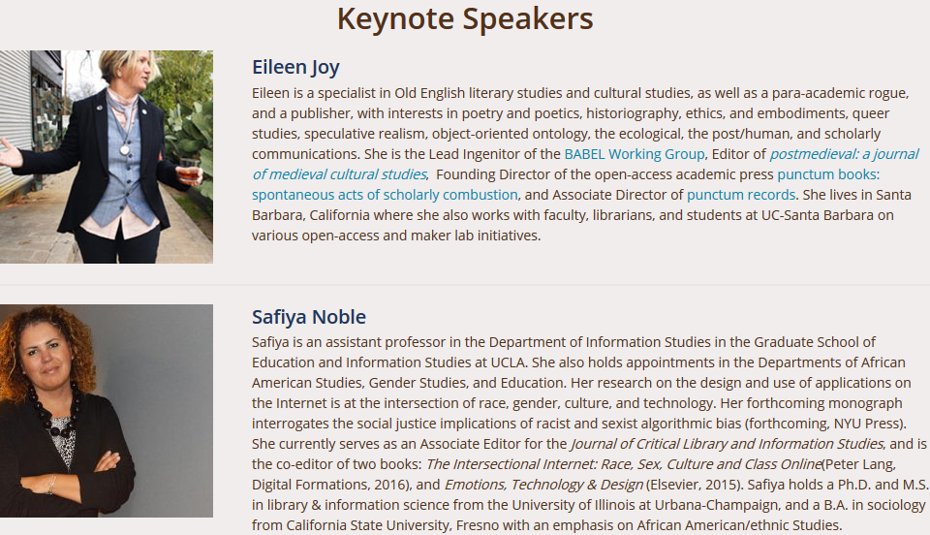
Noble, S. (2017, March 21). Social justice and library publishing. Keynote presented at the 2017 Library Publishing Forum, Baltimore, MD. Available at https://www.periscope.tv/w/1yNGaPXEjXbKj?t=1
Roh, C., Drabinski, E., & Inefuku, H. (2016, May 18). Librarian engagement and social justice in publishing. Plenary session presented at the 2016 Library Publishing Forum, Denton, TX. Available at https://librarypublishing.org/wp-content/uploads/2016/05/lpc_lpforum16_slides_roh-inefuku-drabinski.pdf
Notes:
JOSHUA Organizers of our 2017 conference, which directly followed Roh’s article and the 2016 Presidential election, positioned us to consider social justice in librarianship and library publishing, in large part a response to a 2016 plenary session on Librarian Engagement and Social Justice in Publishing from Roh, Inefuku and Drabinski. The 2 keynote speakers:
Eileen Joy, founder of Punctum Press, an explicitly justice-oriented open access monograph publisher, and
Safiya Noble, professor in UCLA’s Graduate School of Education and Information Studies, author of Algorithms of Oppression detailing the biases inherent in our search infrastructure, and editor of the Journal of Critical Library and Information Studies,
spoke at length about the harms inherent in an uncritical approach to our work.
Noble advocated for "engaged academics and practitioners, particularly in the realm of controlling knowledge dissemination, who can articulate and enact visible commitments to social justice on campus, in the academy writ large, and in the broader culture." She noted that “publishing functions in this space, as those who aren't published do not get to contribute.” She encouraged the room: "Library publishing can operate within a different paradigm than commercial publishers, who will compromise any type of ethical commitment to make money."

Slide 14
An Ethical Framework for Library Publishing 1.0
https://librarypublishing.org/resources/ethical-framework/
This document supports libraries and other mission-driven publishers by providing resources and guidance in a number of ethical areas. The framework provides high-level topic overviews, highlights existing resources, and identifies areas where further research or support is needed.
Notes:
JOSHUA The membership meeting that followed these (and other) presentations was in a reflective mood, and this call to “enact visible commitments,” possibly in combination with Noble’s disparaging of commercial compromise of ethical commitments, gave rise to the formation, on-the spot, of an ad hoc task force to develop an Ethical Framework for Library Publishing. This working group included Roh, Inefuku, and a raft of others willing to work on defining areas for exploration, evaluating resources, drafting the framework, and shepherding the document through peer review, workshops, and editing, to publication.
I did not know enough about representation or positionality to remove (or reduce) myself from this effort, so it’s a matter of cosmic grace that the authorship of this document ended up being only 1/7th white male. The whiteness of librarianship generally almost certainly affected the perspectives encoded in the resulting document, but the participation of key librarian/publishers of color helped provide accountability during development.

Slide 15
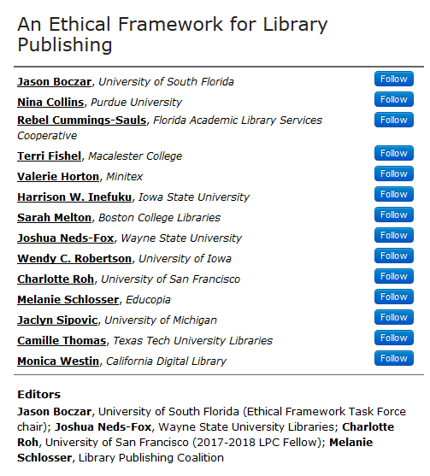
Coalition on Publication Ethics. (2017). Core practices. Retrieved from https://publicationethics.org/core-practices
Notes:
JOSHUA The Framework is intended to embody an ongoing outline of the ethics underpinning and unique to library publishing. The authors worked collaboratively to identify topics for inclusion, and to group the resulting topics into five key areas of ethical consideration: Publishing Practice, Accessibility, Diversity Equity & Inclusion, Privacy and Analytics, and Academic and Intellectual Freedom.
The critlib lens was explicitly important in the writing of the Framework. For instance, sections under each topic identified areas where our practice has not yet risen to the demands of a critical framework: an investigation into intersectional accessibility practice, best practices for inclusive metadata, and the impact of documents like the Library Bill of Rights on the radical access responsibilities of library publishers. This is just one example; truly, the social justice concerns that sparked the project are self-evident in the resources and areas the authors’ chose to focus on throughout the Framework.
If there’s time: [The document received multiple peer reviews, and underwent a series of revisions in response to feedback. My own section, Publishing Practice, was extensively rewritten, and is better for the numerous reviews we received. Charlotte Roh and I workshopped the Framework prior to publication with the attendees of the 2018 Library Publishing Forum, and those comments both served as another round of review and as a set of future directions for the Framework. The LPC is in the process of identifying the infrastructure-- an editor or task force -- to update the Framework as new library publishing practice emerges. ]
The Framework will be introduced at the American Association of University Publishers this June, and is already informing the work of the Humane Metrics Initiative, among other projects.
The hope of the LPC is that the Framework makes it easier for library publishers to ground their practice in an ethic that incorporates both traditional scholarly publishing ethics (as embodied in the Coalition on Publication Ethics’ Core Practices, among other documents) and a critical librarianship framework, so that future publishing practice is less oppressive, less protective of a white male hegemonic scholarship, more conducive to a future that empowers the voices we desperately need to hear and historically have not heard in the scholarly record.

Slide 16
Critical Librarianship and Critical Cataloging
Susan Ponischil Grand Valley State University, Grand Rapids
Notes:
SUSAN
Introduction:
Hello, My name is Susan Ponischil.
I work at Grand Valley State University and I’m here to talk a bit about critical cataloging which seems to be the only aspect of critical librarianship with a category of it’s own.
Critical cataloging happens when catalogers address biases, misrepresentations and omissions in records representing the collection.
During my portion of the presentation I’m going to talk about Library of Congress Subject Headings, two critical catalogers, and authority control.

Slide 17
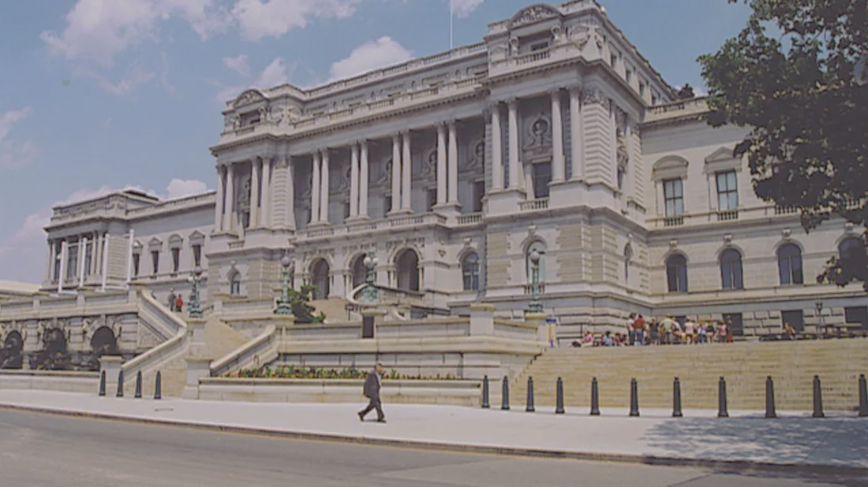
Policy and Standards Division [PSD]
Process for Adding and Revising
Library of Congress Subject Headings
Notes:
SUSAN
Perspective:
Here is a picture of the Library of Congress.
Within the Library of Congress is The Policy and Standards Division. OR PSD
The PSD is the department that makes decisions about subject headings.
Catalogers advocate for social justice by making suggestions for subject heading changes that reflect current culture.
And catalogers advocate for social justice by persisting to see that changes ARE made.
And catalogers advocate for social justice by advocating for authority control to update the headings in their local collections.
As you’ll see in my future slides, conversations about subject headings are often conversations addressing issues of power.

Slide 18
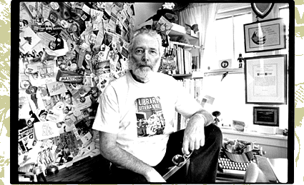
http://www.sanfordberman.org/cityp/ber1t.htm
Cover Story · Vol 20 · Issue 971 · 7/14/99
“For 26 years Hennepin County’s head cataloger led the charge for libraries of, by, and for the people. When he took aim at a new target this spring, his boss fired back.”
Notes:
SUSAN Perspective:
Here is a picture of Sanford Berman. At the time he was 65. That was 20 years ago. He’s still well known in cataloging circles as a critical cataloger and a rebel who got in big trouble at the Hennepin County Library in Minneapolis in 1999 by accusing his boss of not being available.
In a memo sent to several people including his boss he says, "Supervisors should be accessible and not occupy some sort of mystified space or be up on some metaphoric pedestal!" (With 2 exclamation points.!!).
He was, and still is, committed to advocating for Libraries of, by, and for the people.

Slide 19
Sandy Berman Subject Heading Suggestions
WHITE PRIVILEGE
SEX WORKERS
INDUSTRIAL POLLUTION
DRONE WARFARE
REVENGE PORN
ANARCHA-FEMINISM
WAR PROFITEERING
MASS INCARCERATION
DEMOCRATIC SOCIALISM
CLIMATE CHANGE DENIALISM
ANTIVACCINE MOVEMENT
NATIVE AMERICAN HOLOCAUST (1492-1900)
CLASSISM IN LENDING
CRITICAL LIBRARIANSHIP
Gross, T., & Berman, S. (2017). Expand, humanize, simplify: an interview with Sandy Berman. St. Cloud State University Repository. Retrieved from https://repository.stcloudstate.edu/cgi/viewcontent.cgi?article=1061&context=lrs_facpubs
Notes:
SUSAN
Perspective:
In this next slide you can see some of the changes Berman suggested in 2016.
Not seeing changes implemented he wrote a letter to Carla Hayden, then the Librarian of Congress,
In it he says “I feel an urgency about the fact that these critical topics related to public policy and much-discussed issues have not been recognized by Library of Congress subject headings, although all have been formally recommended.” In response Berman was told to make suggestions using appropriate procedures [which had already been done].
These suggestions were made in 2016. As of last week, only the two in bold type have been approved.
That said, according to LoC website, “A majority of the proposals submitted each year are accepted.” And reasons proposals are not accepted is made publicly available on LC's Summaries of Decisions web page.

Slide 20
Authority Control
NAME AUTHORITY
100 $a Diddy, $d 1969-
400 $a Puff Daddy, $d 1969-
400 $a P. Diddy, $d 1969-
400 $a Combs, Sean, $d 1969-
400 $a Combs, Puffy, $d 1969-
400 $a Puffy, $d 1969-
400 $a Diddy, P., $d 1969-
400 $a Combs, $d 1969-
400 $a Combs, Diddy, $d 1969-
SUBJECT AUTHORITY
Gender-nonconforming people
Sex change (revision)
Female impersonators (revision)
Cultural appropriation
Afrofuturism
Ableism (cross reference)
Mass incarceration
Why is authority control important? (2010, May 20). MARS authority control: Automated services for libraries, authority control, machine matching, and marcadia. Retrieved from https://ac.bslw.com/community/blog/2010/05/why-is-authority-control-importan
Topics: subjects. (n.d.). The Cataloging Lab. Retrieved from http://cataloginglab.org/kbtopic/subjects/
Notes:
SUSAN
Application
Subject headings can change, but it’s authority control that makes those changes local.
Two things are accomplished with authority control
One. names are standardized
Two. subject headings are updated.
On the left side of the screen is the authority record for Diddy, 1969- and all the approved variations of his name.
When authority control is done it makes sure all the representations listed above are linked. If you search for ‘puffy’, all items association with ‘diddy’ will appear.
The column on the right represents subject heading suggestions that are still in the evaluation process.
New subject headings are approved monthly. Authority control is a way to import those changes into local catalogs.

Slide 21
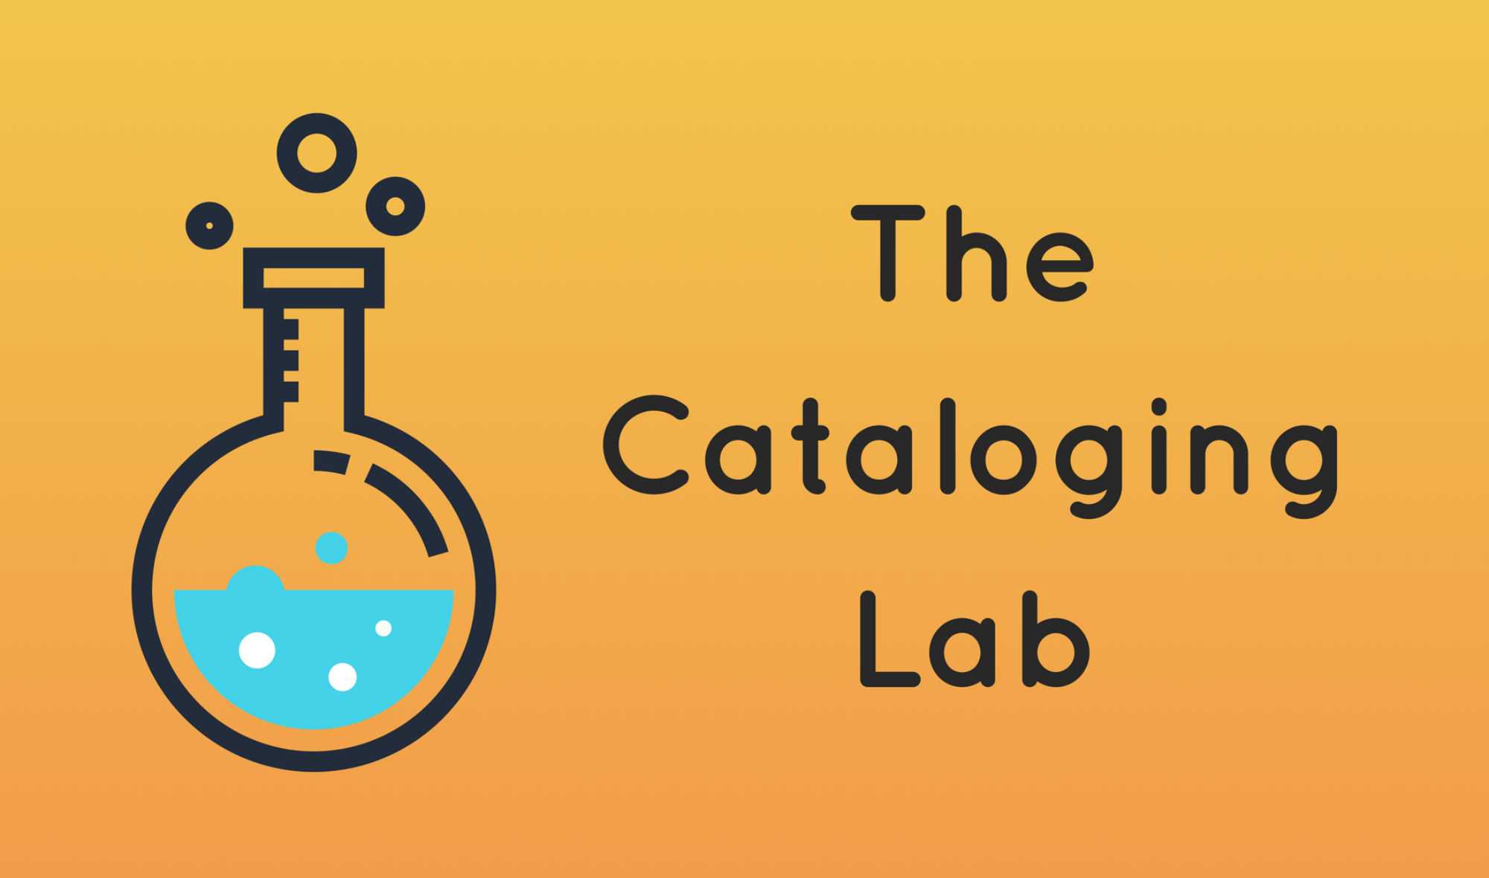
http://Cataloginglab.org
Notes:
SUSAN
Experience:
Like Sandy Berman, Violet Fox is an active and public critical cataloger. She created and maintains The Cataloging Lab; a Wordpress space that makes the business of subject headings more transparent. And It’s a tool anyone can use.
I used The Cataloging Lab when asked by a Women and Gender Studies faculty member to come up with a project for her 400 level independent research class. Ideally she wanted a project that would accommodate multiple students and require approximately 60 hours per student.
To me, the ‘proof of need’ step in the subject heading proposal process provided a great research opportunity - AND it met the project requirements.
I also used this idea to write a proposal for a roundtable discussion for the Creative Ideas in Technical Services Interest Group at ALA Midwinter 2019 even though I couldn’t attend.
Submissions were allowed in absentia and IG chairs said they would help find a facilitator if proposals were accepted. My proposal was called ‘Critical Cataloging and Faculty Engagement’

Slide 22
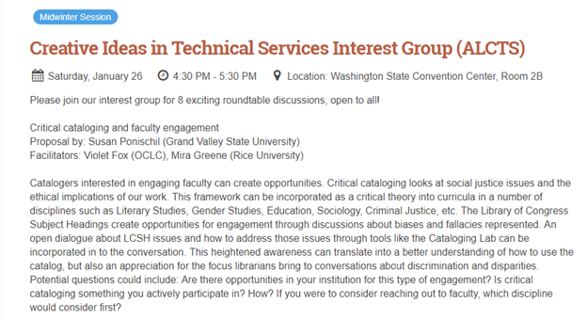
ALA Midwinter
Violet Fox 🦊
@violetbfox
https://www.eventscribe.com/2019/ALA-Midwinter/fsPopup.asp?Mode=presInfo&PresentationID=470124
Notes:
SUSAN
Application [example[s] of practical application]
Well, my proposal was accepted. Here is the session description.
And guess who facilitated the discussion
Violet Fox! I’d struck a chord :)

Slide 23
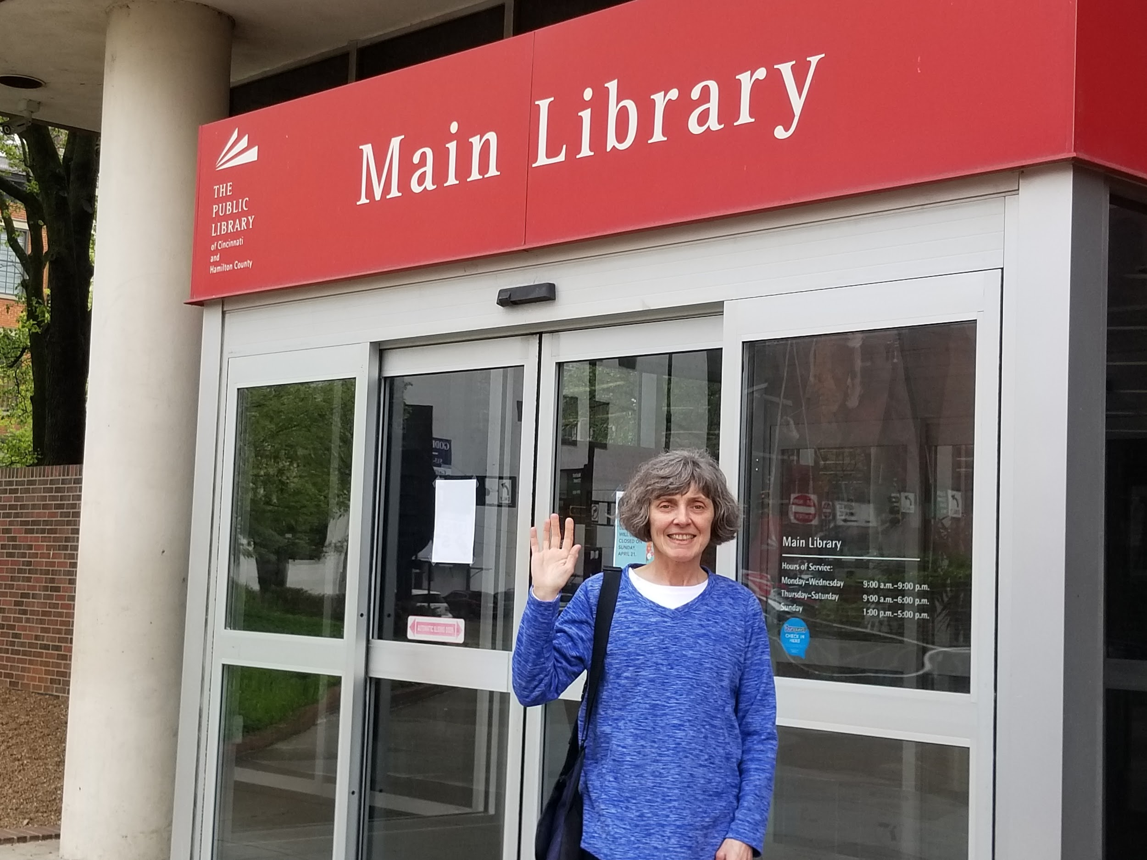
Library Administration and Collection Management
Virginia C. Thomas Wayne State University Arthur Neef Law Library, Detroit

Slide 24
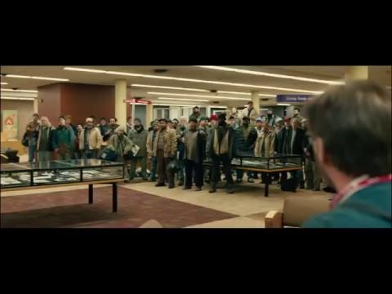
The Public

Slide 25
Who is “us”?

Slide 26
“How do you know what I need?”

Slide 27
Closing Thought ...
“You don’t need a weatherman to know which way the wind blows”
Dylan, B. (1965). Subterranean Homesick Blues. In New Left Notes, 4(22) (June 19, 1969, pp. 3-8 at p.3). Retrieved from
https://archive.org/stream/NewLeftNotesJune181969#page/n1/mode/2up.

Slide 28
Questions?
Mary | Information Literacy and Reference
Joshua | Library Publishing
Susan | Cataloging
Virginia | Administration and Collection Development
Notes:
ZOE [10 minutes]
Ask audience if they have questions.
Take microphone around for questions

Slide 29
Bibliography: General
Branum, C., & Masland, T. (2017). Critical library management: Administrating for equity. Critical Librarianship, 23(2), 28-36. Retrieved from https://commons.pacificu.edu/cgi/viewcontent.cgi?article=1898&context=olaq
Clark, S. (2016, May 19). Why library leaders should care about critical librarianship. Better Library Leaders. Retrieved from http://betterlibraryleaders.com/2016/05/19/why-library-leaders-should-care-about-critical-librarianship/
critlib. (n.d.) about/join the discussion. Retrieved from http://critlib.org/about
Notes:
ZOE
I’d like to thank our presenters, Mary Kickham-Samy, Joshua Neds-Fox, Susan Ponischil, and Virginia C. Thomas.
Slides will be made available after the Conference.
I’m Zoe McLaughlin, thank you for coming.

Slide 30
Bibliography: M. Kickham-Samy (1/2)
Elmborg, J. (2006). Critical information literacy: Implications for instructional practice. The Journal of Academic Librarianship, 32(2), 192-199.
Gee, J. P. (2005). An introduction to discourse analysis: Theory and method (2nd ed.). London: Routledge.
Gee, J. P. (2008). Social linguistics and literacies: Ideology in discourses (3rd ed.). New York: Routledge.
Graesser, A. C., Person, N. K., & Magliano, J. P. (1995). Collaborative dialogue patterns in naturalistic one-to-one tutoring. Applied Cognitive Psychology, 9, 495-522.
Notes:
ZOE
I’d like to thank our presenters, Mary Kickham-Samy, Joshua Neds-Fox, Susan Ponischil, and Virginia C. Thomas.
Slides will be made available after the Conference.
I’m Zoe McLaughlin, thank you for coming.

Slide 31
Bibliography: M. Kickham-Samy (2/2)
Kickham-Samy, M. (2010). Balance of power and negotiation of meaning in virtual reference learning environments. In M. L. Radford & R. D. Lankes (Eds.), Reference renaissance: Current & future trends. (pp. 55-70). New York : Neal-Schuman.
Kickham-Samy, M. (2012). The tutorial dialogue and problem solving in virtual reference interactions. In M. L. Radford (Ed.). Leading the reference renaissance: Today’s ideas for tomorrow’s cutting edge services (pp. 47-61). New York: Neal-Schuman.
Vygotsky, L. S. (1962). Mind in society: The development of higher psychological processes. Cambridge, MA: Harvard University Press.
Notes:
ZOE
I’d like to thank our presenters, Mary Kickham-Samy, Joshua Neds-Fox, Susan Ponischil, and Virginia C. Thomas.
Slides will be made available after the Conference.
I’m Zoe McLaughlin, thank you for coming.

Slide 32
Bibliography: J. Neds-Fox (1/2)
Brown, J., Ferretti, J. A., Leung, S. & Menendez-Brady, M. (2018). We here: Speaking our truth. Library Trends, 67(1). Available at https://escholarship.org/uc/item/5cb040z6
Coalition on Publication Ethics. (2017). Core practices. Retrieved from https://publicationethics.org/core-practices
Library Publishing Coalition Ethical Framework Task Force. (2018) An Ethical Framework for Library Publishing, Version 1.0. Atlanta, GA: Educopia. http://dx.doi.org/10.5703/1288284316777.
Lippincott, S. K. (2016). The Library Publishing Coalition: Organizing Libraries to Enhance Scholarly Publishing. Insights 29(2): 186-91. DOI: http://doi.org/10.1629/uksg.296
Notes:
ZOE
I’d like to thank our presenters, Mary Kickham-Samy, Joshua Neds-Fox, Susan Ponischil, and Virginia C. Thomas.
Slides will be made available after the Conference.
I’m Zoe McLaughlin, thank you for coming.

Slide 33
Bibliography: J. Neds-Fox (2/2)
Noble, S. (2017, March 21). Social justice and library publishing. Keynote presented at the 2017 Library Publishing Forum, Baltimore, MD. Available at https://www.periscope.tv/w/1yNGaPXEjXbKj?t=1
Roh, C. (2016). Library publishing and diversity values: Changing scholarly publishing through policy and scholarly communication education. College & Research Libraries News, 77(2). Available at https://crln.acrl.org/index.php/crlnews/article/view/9446/10680
Roh, C., Drabinski, E., & Inefuku, H. (2016, May 18). Librarian engagement and social justice in publishing. Plenary session presented at the 2016 Library Publishing Forum, Denton, TX. Available at https://librarypublishing.org/wp-content/uploads/2016/05/lpc_lpforum16_slides_roh-inefuku-drabinski.pdf
Notes:
ZOE
I’d like to thank our presenters, Mary Kickham-Samy, Joshua Neds-Fox, Susan Ponischil, and Virginia C. Thomas.
Slides will be made available after the Conference.
I’m Zoe McLaughlin, thank you for coming.

Slide 34
Bibliography: S. Ponischil (1/2)
Gilyard, B. (1999, Jul 14). Sandy Berman's Last Stand. City Pages Minneapolis / St. Paul, 20(971). Retrieved from http://www.sanfordberman.org/cityp/ber1t.htm
Gross, T., & Berman, S. (2017). Expand, humanize, simplify: an interview with Sandy Berman. St. Cloud State University Repository. Retrieved from https://repository.stcloudstate.edu/cgi/viewcontent.cgi?article=1061&context=lrs_facpubs
Process for adding and revising Library of Congress subject headings. (n.d.). Retrieved from https://www.loc.gov/aba/cataloging/subject/lcsh-process.html
Topics: subjects. (n.d.). The Cataloging Lab. Retrieved from cataloginglab.org
Notes:
ZOE
I’d like to thank our presenters, Mary Kickham-Samy, Joshua Neds-Fox, Susan Ponischil, and Virginia C. Thomas.
Slides will be made available after the Conference.
I’m Zoe McLaughlin, thank you for coming.

Slide 35
Bibliography: S. Ponischil (2/2)
Wamsley, L. (2017, Dec 26). Library of Congress Will No Longer Archive Every Tweet. NPR: The Two Way. Retrieved from https://www.npr.org/sections/thetwo-way/2017/12/26/573609499/library-of-congress-will-no-longer-archive-every-tweet
Why is authority control important? (2010, May 20). MARS authority control: Automated services for libraries, authority control, machine matching, and marcadia. Retrieved from https://ac.bslw.com/community/blog/2010/05/why-is-authority-control-important/
Notes:
ZOE
I’d like to thank our presenters, Mary Kickham-Samy, Joshua Neds-Fox, Susan Ponischil, and Virginia C. Thomas.
Slides will be made available after the Conference.
I’m Zoe McLaughlin, thank you for coming.

Slide 36
Bibliography: V. C. Thomas
Doherty, John J. (1998). The academic librarian and the hegemony of the canon. Journal of Academic Librarianship 24(5), 403-406.
Dylan, B. (1965). Subterranean Homesick Blues. In New Left Notes, 4(22) (June 19, 1969, pp. 3-8 at p.3). Retrieved from https://archive.org/stream/NewLeftNotesJune181969#page/n1/mode/2up
Niedenthal, L., Estevez, E., Lebovici, A., & Ponce, S. (Producers), & Estevez, E. (Director). (2018). The Public [Motion Picture] United States: Universal Pictures.
Wadas, Linda R. (2017). Mission statements in academic libraries: a discourse analysis. Library Management 38(2/3), 108-116.
Notes:
ZOE
I’d like to thank our presenters, Mary Kickham-Samy, Joshua Neds-Fox, Susan Ponischil, and Virginia C. Thomas.
Slides will be made available after the Conference.
I’m Zoe McLaughlin, thank you for coming.

