Slide 1
I am Oz the great and powerful:
Elevator pitches to pull back the curtain on the Value of Technical Services
Susan Ponischil | Beth Johns | Francene Lewis
Michigan Academic Library Association
Annual Conference
Saginaw Valley State University
May 2019
Notes:
Opening slide
Somewhere over the rainbow w/ukelele guy
and Follow the yellow brick road playing on a loop quietly in the background as people come in?
Two cellos

Slide 2
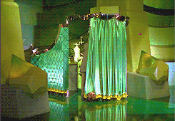
Welcome
https://media.giphy.com/media/o59mueTI2hnQQ/giphy.gif
Notes:
Welcome:
Purpose of this presentation is to give us all an opportunity to talk about the work we do in technical services and think about how we can communicate the value of our work to others.
Please feel free to use the note cards on the table to capture words that resonate.
Beth, Francene and I will be your facilitators in this process

Slide 3
PRESENTATION and FACILITATION
the Pitch ~ Susan
the Data ~ Beth
the Value ~ Francene
we brainstorm
we draft a pitch
we wrap-up
Notes:
FRANCENE:
This presentation is a facilitated discussion.
You will hear about elevator pitches from Susan, Beth will tell you about data she collected, and I will talk about the value of technical services.
Then we’ll brainstorm
Then you’ll have an opportunity to begin creating your own elevator pitch

Slide 4
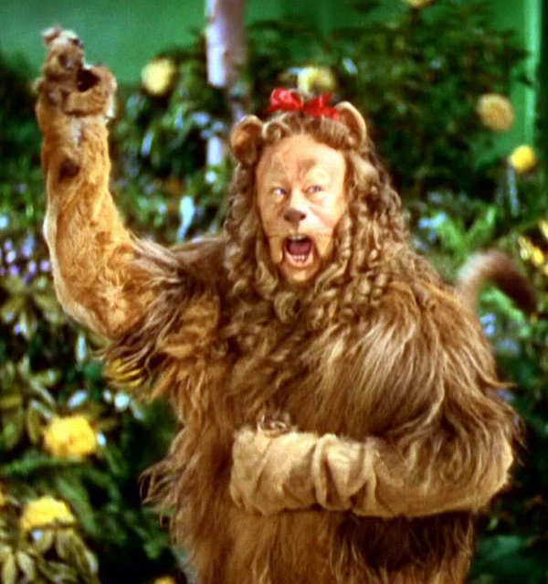
the Pitch
https://hollywoodlife.com/2014/11/24/cowardly-lion-original-costume-from-wizard-of-oz-up-for-auction/
Notes:
I’m Susan Ponischil. I work at Grand Valley State University as the Metadata and Resource Discovery Librarian.
I’m here to talk about elevator pitches. What they are and how to start thinking about creating one.
I chose this picture because I find the cowardly lion relatable. I think the lion is misunderstood. I don’t think he lacks courage……..….I think he lacks confidence. He roars but his roar doesn’t communicate a sense of power or influence.
If he only had an elevator pitch! That might give him some confidence!

Slide 5
“This speech is not a pitch or a commercial but an invitation to start a conversation.”
“It’s important to always be prepared.”
Toastmaster Magazine
https://issuu.com/losangelestoastmasters/docs/august_2012_toastmasters_-district5
Entrepreneur Magazine
https://www.entrepreneur.com/article/249750
Notes:
So what’s an elevator pitch.
According to the literature, and by literature I mean magazines like Forbes, Business Insider & Toastmaster magazine, the purpose of a pitch varies.
In a Toastmaster article titled Reel ‘em in: the anti-elevator pitch, the author writes “This speech is not a pitch or a commercial but an invitation to start a conversation”
Another example comes from Entrepreneur magazine and states simply, “it’s important to always be prepared”.
The girl scout motto.
Q: Who can relate?

Slide 6
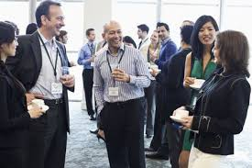
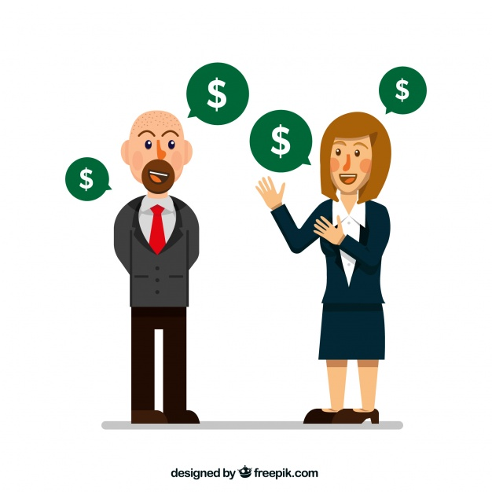
https://www.thespruce.com/etiquette-tips-for-business-conference-attendees-1216801
https://www.themuse.com/advice/lets-do-lunch-how-to-prepare-for-a-job-interview-over-a-meal
https://www.everypixel.com/image-8468825718372161222
Notes:
Now let’s talk for a minute about why would you want to create an elevator pitch.
let’s say you’re at a conference and you’re mingling with other attendees and they ask what you do.
-Or you’re at lunch during a job interview.
-Or you want to ask your boss for money to do projects like authority control…….
Wouldn’t it be great if you had an elevator pitch in your back pocket!.
Planning a pitch takes time.
But it’s time well spent as the process reveals the value of your work. That’s empowering.
To get started, here are some things to consider.

Slide 7
Time
Attention Span: 8 seconds
First Impression:
7 seconds
Length: “20 words” to “2 minutes”
CONSIDERATIONS
https://www.shiftcomm.com/blog/10-to-20-to-30-an-elevator-pitch-framework/
Notes:
There are 3 things to consider about pitches and i’ll address them individually: time, length and audience
Time:
What is the average attention span? According to a highly cited 2015 Microsoft report its 8 seconds, though an article written that same year in The Journal of College Student Retention states it’s 22 seconds. https://journals.sagepub.com/doi/full/10.1177/1521025115611404
And what about first impressions? According to Forbes and many other sources it’s 7 seconds
So how long should the pitch be? Sources vary on this topic. It really depends on the purpose. Determining audience will help to determine length.

Slide 8
Length
Length: 20 words to 120 words
Example of 20 words
You can't predict when interactions, whether in a grocery store or at a networking function, will present a new opportunity.
https://www.entrepreneur.com/article/249750
CONSIDERATIONS
Notes:
Length.
In the previous slide you saw data about the average length of an elevator pitch - anywhere from 20 words to 2 minutes.
Translation = the average length of an elevator pitch is 20 to 120 words.
Here is an example of 20 words. …….pause...

Slide 9
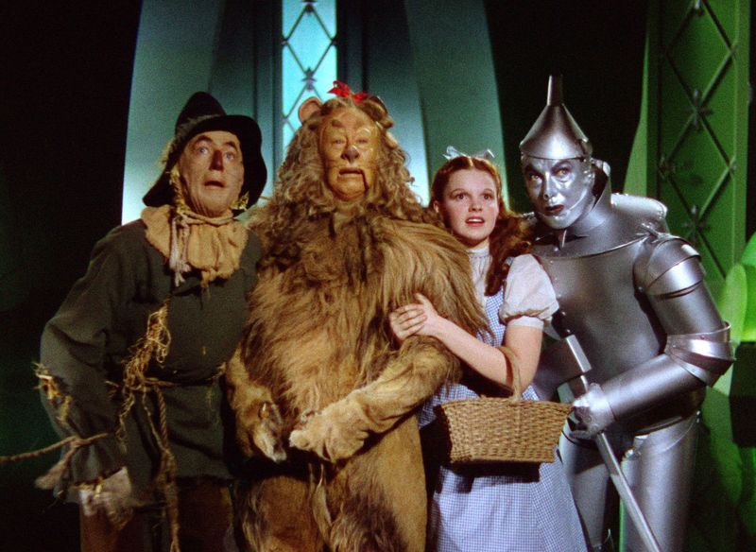
Audience
Focus
Impact
Terminology
Tone
CONSIDERATIONS
https://jeezjon.typepad.com/jeez_jon_an_almost_workin/2015/05/if-the-wizard-of-oz-got-a-round-of-reality-tv-network-notes.html
Notes:
When thinking about creating a pitch, the first thing you’ll want to do is consider your audience.
Focus on audience. Who do you want your audience to be? colleagues, administrators, potential employers, prospective in-law, who?
Impact of your work on your audience. Why would they care about what you do, what do you do that has [or can have] a direct impact on them?
Terminology - What terminology will your audience understand, will they know the difference between ILS and ILL?
Tone - How formal or informal will your pitch be; is your tone appropriate considering the intended audience………
Determining audience is really key.
Next up is Beth to talk about the landscape of Technical Services in Michigan.

Slide 10
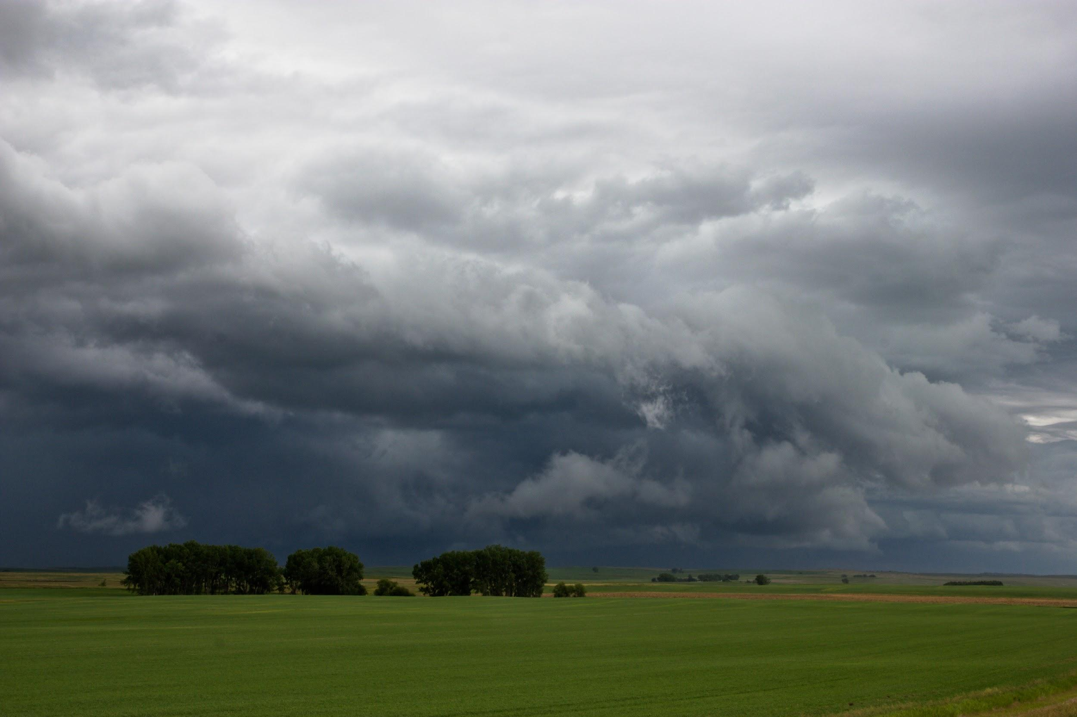
The Data -- what the Michigan landscape looks like
Survey sent to 75 academic library deans and directors in Michigan.
Public and private universities
45% response rate
Notes:
I am Beth Johns, electronic resources librarian at Saginaw Valley State University. I’ve been in this position for about 3 years, but before that I was in a 50/50 position of Reference/E-Resources.
We sent out a short survey to 75 academic libraries in MI

Slide 11
Type and Size of Responding Libraries
Less than 5,000
5,000 - 15,000
More than 15,000
Public
Private
Notes:
We found there is a pretty good split between public and private university respondents.
Most are from small universities.

Slide 12
Respondents said . . .
Average number of library full time staff = 12
Average number of full time technical services staff = 3
Notes:
Range from 1 to 75.
Average number of full time staff -- 12
Range of FT TS staff is 0 to 18
Average number of TS - 3

Slide 13
How have staff positions changed?
Increased electronic maintenance
Additional responsibilities added
Positions cut
Notes:
how staff positions have changed over the last five years.
Most responded that roles and job descriptions have changed.
Much of this due to the growth of electronic resources now bypassing print
Some had additional responsibilities added to their original role - some without salary increase
Departments re-envisioned to accommodate new roles and priorities
Some moved from TS to Systems

Slide 14
How has the Technical Services budget changed?
Staff budget decreased = 35%
Operational budget decreased = 18%
https://media.giphy.com/media/9M4WoqUpulPO/giphy.gif
Notes:
Though we did not define the types of budgets, we were considering staff budget = amount for recruitment, hiring, training of staff, salaries
Operational budget = amount for doing the work of technical services (equipment, resources)
No change in the budget = 38%
Some comments re: budgets.
Some tech services staff moved to systems
“Staff budget has really gone down since losing a Tech Services position.”
“No specific budget for Technical Services.”

Slide 15
Specific areas of Technical Services with FT staff:
Cataloging = 26% of libraries have no FT cataloging staff.
MOST RESPONDENTS DO NOT HAVE FULL TIME STAFF IN:
E-Resources Serials/Periodicals
Acquisitions Systems
Collection Management Department Manager
Notes:
Responses could indicate that the size of the library doesn’t justify a full time staff member in the positions.
Cataloging is still regarded as vital -- most libraries have that if nothing else in Technical Services
Collection Management = most do not have FT collection managers; 4 have 1
Serials/Periodicals = Most do not have FT serials staff; 6 have 1
E-Resources = most do not have FT e-resources staff; 5 have 1 or more
Acquisitions = most do not have FT acquisitions staff; 7 have 1 or more
Systems = most do not have FT acquisitions staff; 5 have 1
Department manager = most do not have FT department managers; 4 have 1 or more
Other = 7

Slide 16
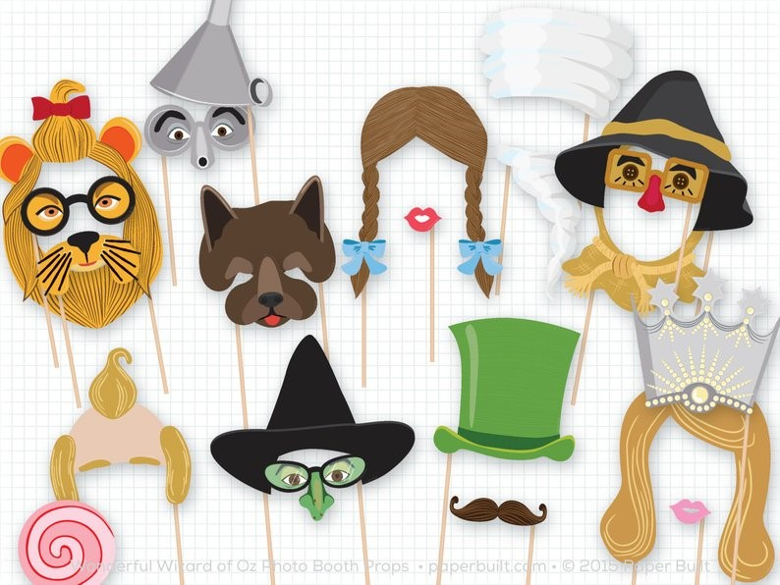
We wear multiple hats!
Notes:
8. If you answered Other to Question 7, please indicate other areas of full-time Technical Services employment.
One respondent said there are 3 full time librarians and each does multiple jobs. We only have 3 librarians, One Head Librarian who does Collection, Management,reference, e-resources, One Reference who does Collection, Serials, Special Cataloging and one Technical Services who does Collection, Acquisitions, Serials, Cataloging
There really aren’t “other” FT Technical Services staff descriptions.

Slide 17
“. . . [University] Administrators do not understand the details and skills involved and I’m finding there may be a radical change in our support staff with a likely decrease in positions. This will cause a lot of stress in our library as we are already short staffed due to a loss of a position last year.” -- Community college library director
Notes:
this is a key statement; actually no one other than librarians really understands this. This is particularly true of technical services -- we aren’t seen, our work isn’t in their faces
Introduce Francene

Slide 18
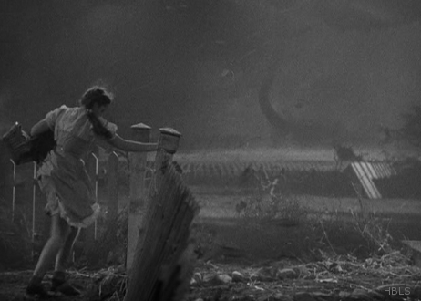
Value
“ … much of the higher education community views libraries as a support organization alone, rather than an instructional organization.”
“The unfortunate truth … is that librarians have failed to explain to those outside the field what contributions they … make.”
What is true for our field as a whole rings true for technical services.
https://media.giphy.com/media/zybncsOjg5ATC/giphy.gif
Notes:
I’m Francene Lewis, Head of Collection Management at the Hekman Library, Calvin College and Calvin Theological Seminary. I’ve worked there as the Cataloging librarian and Head of the Department for the past 32 years. Now more than ever, we need to be able to communicate the value of the work we do, to a wide variety of audiences.
From the ACRL report, “The value of academic libraries. P. 29.
Libraries are often seen across higher education as support organizations rather than as instructional partners. Within the library, technical services departments are often viewed in this same way. We are the support structures and not partners. If people do not know what you do, and how it adds value and worth to the things they care about, support structures are easily ignored and overlooked.
We are like the air you breathe, the water you drink, or the invisible power of electricity, easily ignored until something drastic happens. Our work provides the foundation and building blocks of ILSs and discovery systems, the access to resources both physical and virtual. Until researcher’s results become unreliable and URLs lead nowhere, our work is not much considered. Users don’t know or think about our work, until the collection materials are all over 10 years old, professors are calling the department because their name is incorrect in the catalog, and the discovery layer has some weird results no one can explain. The use of a library and its resources is based upon the fact that you can find and access what a user needs in a relatively fast and efficient manner.

Slide 19
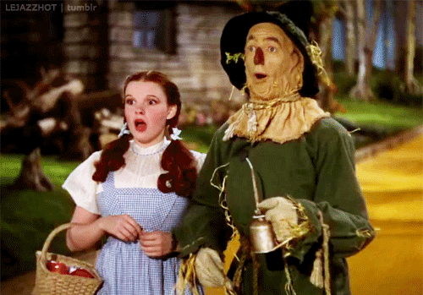
Values change
In Technical Services, we focus on:
Numbers of items purchased, cataloged, or edited
Productivity and efficiency studies and analyses
https://media.giphy.com/media/cjDoRld4xH83K/giphy.gif
Notes:
In the past, Technical services were told that we needed to focus on how many items were purchased, how many were cataloged and added to the collection, how long did it take to get materials ordered, received, and out on the shelves. We assess our value through productivity and efficiency studies, workflow analysis, and Return on investment studies if we are really on the ball. We still need to do these things. IPEDS, NCES, and ACRL still collect statistics on collection size, number of FTE, amount spent per student, and so on.

Slide 20
Our audience has a different set of values
based on outcomes or centered on user needs.
Notes:
BUT our academic organizations have moved on and now judge our value and worth by a different set of rules. Most academic departments and institutions of higher education now look for outcomes, not quantitative measurements. They center value on things like faculty research productivity, institutional prestige and ranking, student learning experiences, etc.
Key performance indicators such as student recruitment, retention, or graduation rates.
Outcomes based around faculty recruitment, research productivity or grant applications and grants obtained.
Values around positive alumni relationships, institutional rankings and prestige, student and faculty success.
It is difficult enough to connect outcomes like these to library services such as information literacy and research assistance due to one-off literacy sessions and ideals of research privacy. It is even harder to connect these values to the background work of technical services.

Slide 21
Impact
Make connections between your work
and the mission of
the organization.
CONSIDERATIONS
Notes:
Begin by looking at your work and position. Attempt to draw connections between it and the things your organization values. What is its mission and vision? What are the strategic plan goals that your work supports and builds up?
Read through the report to your Board of Trustees, the strategic plan of your university. Be part of the library assessment work.
What is your impact on the organization?
Can you say we are aligning our journal collection to the research and study curriculum of the college by focusing on the core periodicals of each department.
Or
Students’ learning experience and achievements are directly and indirectly impacted by the work the technical services department does to enhance discovery and access to library resources.
Or
The research reputation of the university is enhanced by the special collections housed in the library and made available by technical services staff.
Question for the audience: How many of you in Technical Services have had a conversation or discussed Student Learning Outcomes, or student retention, or other value outcomes like this in connection to your work in technical services? Quick show of hands?

Slide 22
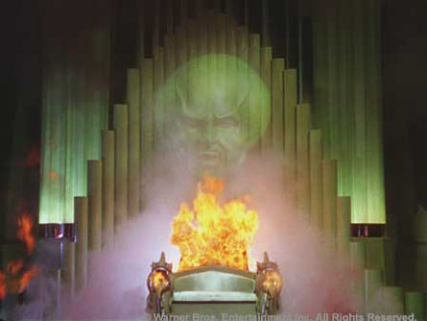
Advocate for yourself.
Metadata
Is
everywhere.
https://media.giphy.com/media/vpL0uc6yniAuc/giphy.gif
Notes:
As Beth mentioned in her section on data, the overall trend in technical services is to cut staffing, cut the materials budget and cut operations. It’s easier to cut services when you don’t know or see the impact immediately. When your value isn’t acknowledged or even known.
Make sure your library administration and others in the organization know the value of your work. You have to advocate for yourself. Susan told us that we need to have a pitch ready for those important moments when you have the ear of a student, college administrator, or faculty member.
Be able to articulate your work and worth in ways that resonate with the values important to your institution.

Slide 23
Describe your Value
Curate the collection to fulfill the needs of the institution
Provide serendipitous research opportunities by placing like items together
Preserve the institution’s past for use in the present and in the future
Troubleshoot electronic resource access problems so that researchers can complete their work
Notes:
So as we look at writing our own elevator pitches and try to succinctly describe our value and impact to our institutions, here are some phrases or ideas you might use to talk about various technical services work.
Use action verbs to describe what you do to your audience. Get excited about your job. Connect it with the library’s work or the university or the faculty or student’s research need depending on your audience.

Slide 24
POLL
How does your work impact students?
Notes:
Let’s start putting pen to paper.
Consider this question.
Then take a minute to write down individual words or maybe a short phrase in response, “How does your work impact students?”
……...Give them a minute or two…….
Let’s regroup.
Would anyone like to share a word you wrote identifying how your work impacts students?
……...select maybe 3…….depends how short they keep it

Slide 25
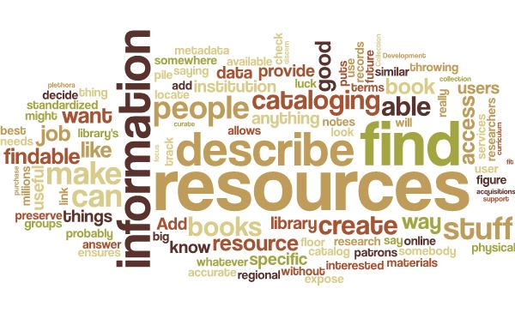
Notes:
Here’s a word cloud for inspiration……...
Show of hands.
Any words here you could use? Jot those down.
Now that you have a few building blocks…..next slide

Slide 26
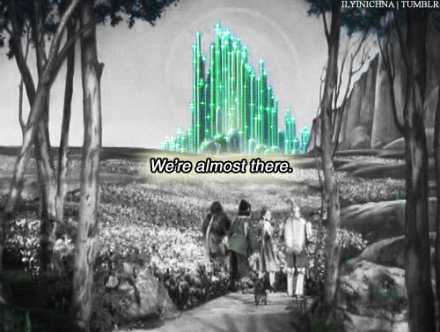
Now it’s time to work on our Pitches!
https://media.giphy.com/media/E06y8YMEGwU24/giphy.gif
Notes:
It’s time to work on our pitches!

Slide 27
PITCHES
Beth [audience: University administrators] I’m Beth Johns, E-Resources Librarian. I make sure access to our vast number of electronic resources is healthy and working. If there is a problem with a resource, I fix it -- or find someone to fix it. Because of my education in library science, I deeply understand the need to access information quickly and painlessly so that you can complete your work.
Francene [audience: a student researcher]
Hi, I’m Francene Lewis, Head of the Collection Management department. Like the electric grid, our work powers everything else in the library. We purchase the many books, journals, and resources you need for your research. We work hard to make them findable, and help you locate them in a fast and efficient way.
Susan [audience: anyone who does not work in a library] I work in a library. You probably won’t see me. But know this, if you’re looking for books on just about any topic, I’m the person working behind the scenes making sure you can find what you’re looking for.
Notes:
Beth will identify her audience and read her pitch as tribute :) .

Slide 28
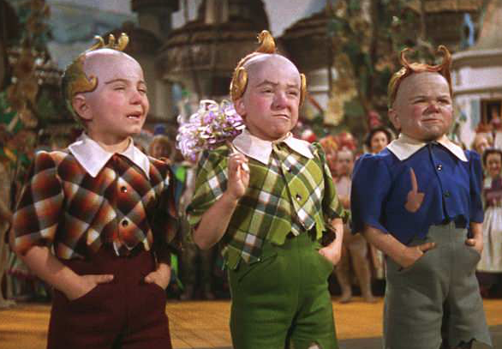
PRACTICE
GROUPWORK
Who will the audience be for your elevator pitch?
How does your work add value to the organization?
https://gr8erdays.com/2018/06/06/jerry-maren-last-adult-wizard-of-oz-munchkin-dies-98/
Notes:
Beth and Susan are passing out handouts. There’s a template with tips on one side, and value statements for technical services categories on the other.
At this time we’d like you to pair up at your tables and take turns talking about how you would answer questions raised on the template. Be sure to take time to consider the following questions,
Who will the audience be for your elevator pitch?
How does your work add value to the organization?
We’ll give you about 5 minutes, then we’ll have you work individually.
…….we will meander to make ourselves available for questions……...

Slide 29
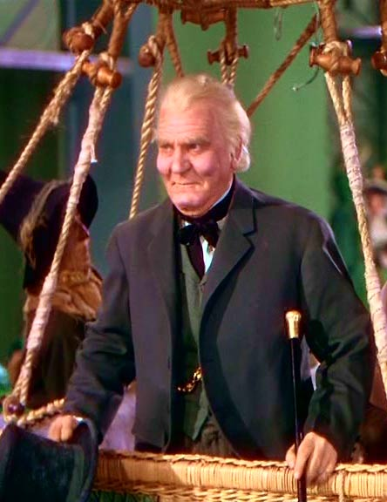
PRACTICE
INDIVIDUAL WORK
Identify your audience
Document what your audience values
Connect what your audience values to your work
Notes:
Practice: [10 minutes]
Individual Work
@ table [individual work]
Francene:
Now that you have some tools in your toolbox we’d like you to take some time to work individually. Creating an elevator pitch takes time. But you have to start somewhere so you will have an opportunity to take about 10 minutes to start your process.
At the very least
1. Identify your audience
2. Document what your audience values
3. Connect what your audience values to your work,
Answers to these questions will provide a good foundation for any elevator pitch
We’ll give you about 10 minutes.

Slide 30
Wrap-up
How was that experience?
Was it challenging?
Did it make you think about your work differently?
Do you feel empowered?
Questions?
Volunteers?
Notes:
Let’s regroup [10 minutes]
how was that experience?
Was it challenging?
Did it make you think about your work
differently?
Do you feel empowered?
Q&A
Call for volunteers to read their pitch
Francene reads her pitch
Susan reads her pitch.
Thank participants
Point to handouts / takeaways - 50 paper handouts / link to MiALA
Presentation slides w/Bibliography and Outline of things to consider for elevator pitch and Template

Slide 31
PITCHES
Beth [audience: University administrators] I’m Beth Johns, E-Resources Librarian. I make sure access to our vast number of electronic resources is healthy and working. If there is a problem with a resource, I fix it -- or find someone to fix it. Because of my education in library science, I deeply understand the need to access information quickly and painlessly so that you can complete your work.
Francene [audience: a student researcher]
Hi, I’m Francene Lewis, Head of the Collection Management department. Like the electric grid, our work powers everything else in the library. We purchase the many books, journals, and resources you need for your research. We work hard to make them findable, and help you locate them in a fast and efficient way.
Susan [audience: anyone who does not work in a library] I work in a library. You probably won’t see me. But know this, if you’re looking for books on just about any topic, I’m the person working behind the scenes making sure you can find what you’re looking for.
Notes:
Francene and Susan share their audience and pitches

Slide 32
BIBLIOGRAPHY
Baxmeyer, Jennifer W. Describing technical services work to non-librarians. Facebook, 12 April, 2019, 9:53am, https://www.facebook.com/groups/161813927168408/permalink/2638297586186684/ Accessed 28 April, 2019.
Borie, Juliya, et al. "Asserting Catalogers' Place in the "Value of Libraries" conversation." Cataloging & Classification Quarterly, vol. 53, no. 3-4, Apr. 2015, pp. 352-67. Library Literature & Information Science Index, doi:10.1080/01639374.2015.1007543. Accessed 10 Apr. 2019.
Chang-FitzGibbon, Kerry, and Jianrong Wang. "Technical Services Professionals in Library-Wide Assessment." Technical Services Quarterly, vol. 32, no. 2, 19 Mar. 2017, pp. 157-73. Library Literature & Information Science Index, doi:10.1080/07317131.2017.1286845. Accessed 10 Apr. 2019.
Cole, Samantha. “The Proven Ideal Length of Every Tweet, Facebook Post, and Headline Online.” Fast Company, 5 Apr. 2014, https://www.fastcompany.com/3028656/the-proven-ideal-length-of-every-tweet-facebook-post-and-headline-online
Gremmels, Gillian S. "Staffing trends in college and university libraries", Reference Services Review, vol. 41, issue. 2, 2013, pp.233-252, https://doi.org/10.1108/00907321311326165 Accessed 10 Jan. 2019.
Johns, Beth. “Survey re: Michigan academic library Technical Services departments (Responses).” March 2019. https://docs.google.com/spreadsheets/d/1guvgzwtSHJE3ymiR23013F_9cWoeMCmQFKmDG9wF8AU/edit?usp=sharing Accessed 12 May 2019.

Slide 33
BIBLIOGRAPHY
Mitchell, Erik. “Assessing the Value of Metadata in Information Services.” Technical Services Quarterly, vol. 30, no. 2, Apr. 2013, pp. 187–200. Library Literature & Information Science Index, doi:10.1080/07317131.2013.759828. Access 10 Apr. 2019.
Oakleaf, Megan J. The Value of Academic Libraries: A Comprehensive Research Review and Report. Chicago, IL, Association of College and Research Libraries, 2010, p. 29, www.ala.org/acrl/sites/ala.org.acrl/files/content/issues/value/val_report.pdf.
Suttle, Cliff. “Reel ‘Em In: the anti-elevator pitch.” Toastmaster, August 2012: 22-24, https://issuu.com/losangelestoastmasters/docs/august_2012_toastmasters_-district5. Accessed 03 May 2019.

Slide 34
PRESENTERS
Beth Johns, Electronic Resources Librarian Saginaw Valley State University
Francene Lewis, Head of Collection Management Calvin College
Susan Ponischil, Metadata and Resource Discovery Librarian Grand Valley State University

Slide 35
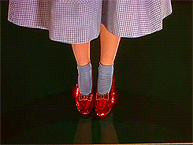
Notes:
… There’s no place like home to queue the end of the presentation.

