Slide 1
Towards an Accessible Library
Annie Bélanger
November 2019

Slide 2
Why?
Accessibility permeates every aspect of our public-facing work
It’s everyone’s responsibility
Notes:
Accessibility permeates all aspects of our public-facing work. Yes, we have to do it by the law… However, the ADA is the bare minimum. It may lead to more accessibility, it may not lead to inclusion and equity.
Being accessible is in every aspect of workflow development and application for user services and support. Many more than the manager are involved in the development and application of our guidelines, practices and procedures. Many more are responsible and accountable for this work.
This is EVERYONE’s responsibility.

Slide 3
Overview
What is accessibility?
Accessible Customer Service
Leading Practices
Practical approaches to delivery
Resources
Notes:
As I thought of the session today, I imagined all of us wearing 3 hats throughout today’s session:
Customer service provision
Guideline development
Manager/Supervisor

Slide 4
What is Accessibility?
Legislation, definitions, setting the stage

Slide 5
Legislation
Rehabilitation Act (1973)
Prohibits discrimination based on disability
ADA (1990)
Prohibit discrimination in all areas of public life with five areas
Does not mandate inclusion
Section 508 (1998)
Accessibility to electronic information from the government
Morphs into web accessibility
Notes:
In 1973, Nixon passed the Rehabilitation Act that prohibited discrimination on basis of disability.
The Americans with Disabilities Act (ADA) became law in 1990. The ADA is a civil rights law that prohibits discrimination against individuals with disabilities in all areas of public life, including jobs, schools, transportation, and all public and private places that are open to the general public. The purpose of the law is to make sure that people with disabilities have the same rights and opportunities as everyone else. The ADA is divided into five titles (or sections) that relate to different areas of public life.
Employment
Public Services: State and Local Government
Public Accommodations and Services Operated by Private Entities
Telecommunications
Transportation
In 1998, Section 508, which we think of as web accessibility was passed to make access to information to those with disabilities comparable to access for others.

Slide 6
Accessible means
A person with a disability is afforded the opportunity to acquire the same information, engage in the same interactions, and enjoy the same services as a person without a disability in an equally effective and equally integrated manner, with substantially equivalent use of ease.
As fully, equally, and as independently as a person without a disability.
~ Office of Civil Rights, 2013
Notes:
A court case in 2013 set precedent for what accessible meant.

Slide 7
Accessibility
Environment is what disables people
We need to design for universal access
Plan in order to prevent barriers
Accessibility is everyone’s responsibility
Ask yourself:
Is there anything “here” that might present a barrier?
Notes:
There are two major constructs of disability; medical and social. The concept of access is rooted in the social construct and sees the environment as a disability. This means we can design universally and prevent barriers.
Ask yourself: is there anything here that might present a barrier?

Slide 8
Accommodation
Assumption of ‘normal’ activity
Responsibility of ‘disabilities’ office
Modify environment one person at a time
Reactive rectification of barriers
Requires person to disclose
A ‘barrier’ is anything that stops a person with a disability from fully taking part in society because of that disability
Notes:
Normal—everyone walks up stairs; everyone hears, sees, etc.; everyone reads or learns the same way;

Slide 9
Shift in Approach
Accommodation
Accessibility
Disability or problem is with the person
Reactive
Individualized solution
Problem is with the environment
Proactive
Integrate accessibility in planning
Universal design
Note: The duty to accommodate continues!

Slide 10
Four Principles
DIGNITY
Self-respect, respect of others
INDEPENDENCE
Do things without unnecessary help from others
INTEGRATION
Same service, same way
EQUALITY OF OPPORTUNITY
Same options, chances, and benefits
Notes:
We want to ensure that we design and use service delivery methods
that help maintain the person’s dignity and independence,
that ensure their way of receiving service is integrated into the way others receive service, and
That our service delivery methods help us provide persons with disabilities an equal opportunity to benefit from our services.
Dignity
Preserving the person’s self-worth.
Not treating persons with disabilities as an afterthought.
Independence
People are able to do things on their own without unnecessary help or interference. Integration
Person benefits from the same service, in the same place, time, and way as others.
Equal Opportunity
Same chances, options, benefits and results as others.
Equitability…

Slide 11
Print Disabilities
Prevent people from reading standard print.
Can be due to a visual, perceptual or physical disability.
E.g., vision impairment, a learning disability or a disability that prevents the physical holding of a book.
Think/Pair/Share: How does your library support those with print disabilities?
For full access, ensure the provision of:
Publications in multiple formats, such as Braille, audio, large print and electronic text.
Assistive technology
From: Library and Archives Canada: Initiative for Equitable Library Access
Notes:
What constitutes a print disability?
http://www.collectionscanada.gc.ca/iela/index-e.html The mandate of the Initiative for Equitable Library Access (IELA) is to create the conditions for sustainable and equitable library access for Canadians with print disabilities.
In Libraries, understanding the category of print disabilities is critical as it is an umbrella for many others. It impacts interaction with print materials.

Slide 12
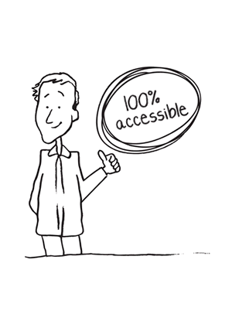
Increasing Accessibility Every Day
Accessible Customer Services

Slide 13
Barriers
Types:
Physical
Architectural
Information or communications
Attitudinal
Technological
Systemic
Key insight:
Think in terms of barriers; don’t focus on the person’s [dis]ability
Can you think examples of each type?
Notes:
Think, Pair, Share: Examples of these barriers in the average daily interaction of a library
Physical – a step at the entrance to a store.
Architectural – no elevators in a building of more than one floor.
Information or communications – a publication that is not available in large print.
Attitudinal – assuming people can’t perform a certain task when in fact they can.
Technological – traffic lights that change too quickly before a person with a disability has time to get through the intersection.
Systemic – Barriers created by policies or practices, for instance not offering different ways to complete a test as part of job hiring.
The following is the same definition as used in the Ontario Human Rights Code. A “disability” is:
Any degree of physical disability, infirmity, malformation or disfigurement caused by bodily injury, birth defect or illness;
A condition of mental impairment or a developmental disability;
A learning disability, or a dysfunction in one or more of the processes involved in understanding or using symbols or spoken language;
A mental disorder; or
An injury or disability for which benefits were claimed or received under the insurance plan established under the Workplace Safety and Insurance Act, 1997.

Slide 14
Think, Pair, Share
Examples of these barriers in the average interaction of a library

Slide 15
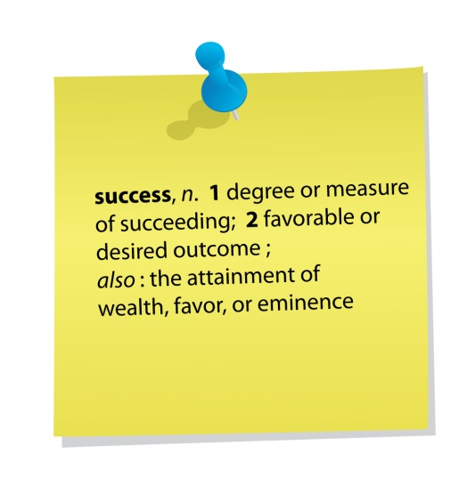
Daily Commitment
Every interaction is an opportunity for accessible service!
Model best practices for interacting and communicating with persons with disabilities
Proactively identify and report barriers
Notes:
Communications
Interact comfortably, taking disabilities into account
Welcome persons using assistive devices and know how to use assistive devices provided by your area. (Speak to expectations – not everyone an expert – reach out to Janet and OPD)
Welcome service animals.
Know how to request verification if in doubt.
Welcome support persons.
Barriers
Provide notice of temporary service disruptions.
Proactively identify and report barriers.

Slide 16
Daily Commitment, cont.
Know what to do when someone encounters a barrier in your department
Inform people about feedback process
Notes:
Barriers
Know what to do when someone encounters a barrier in your department. This can be as simple as knowing whom to talk to.
Feedback
Inform people about feedback process.

Slide 17
Tips for Daily Tips for Daily Interactions
Accessible Customer Services

Slide 18
Communication PACT
Pay calm, individual attention to the other person
Ask “How may I help?” to meet needs
Communicate clearly, patiently
Treat the other person with respect, as a unique individual
What are some communication tips from the modules?
Notes:
Good customer service in general depends on a “Pact” between the person providing service and the person receiving it. It can be summed up in this way:
P -PAY calm, individual attention to the other person.
A- ASK “How may I help you?” in an effort to find suitable ways to understand and meet each person’s learning or service needs; usually, a person is glad to let you know; before ending your interaction, ask, “Does that help with your need?”
C- COMMUNICATE directly, clearly, precisely, and patiently, without interrupting, to ensure shared understanding
T- TREAT the other person with respect, as a unique individual, with attention to his dignity, independence, sense of integration and equality, and

Slide 19
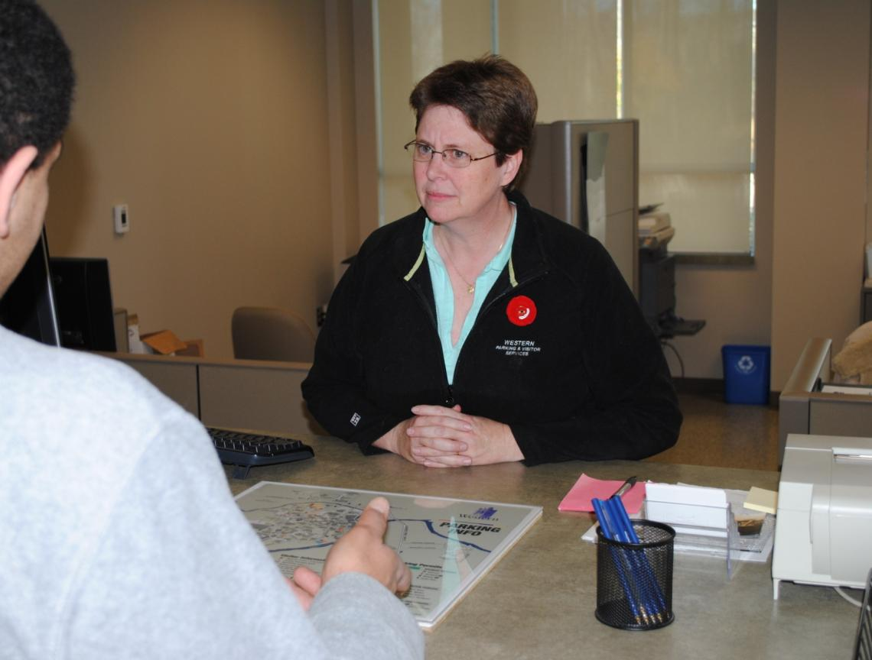
This person can’t figure out what the customer is saying.
Notes:
This service provider can’t figure out what the customer is saying. What can she do to understand his needs?

Slide 20
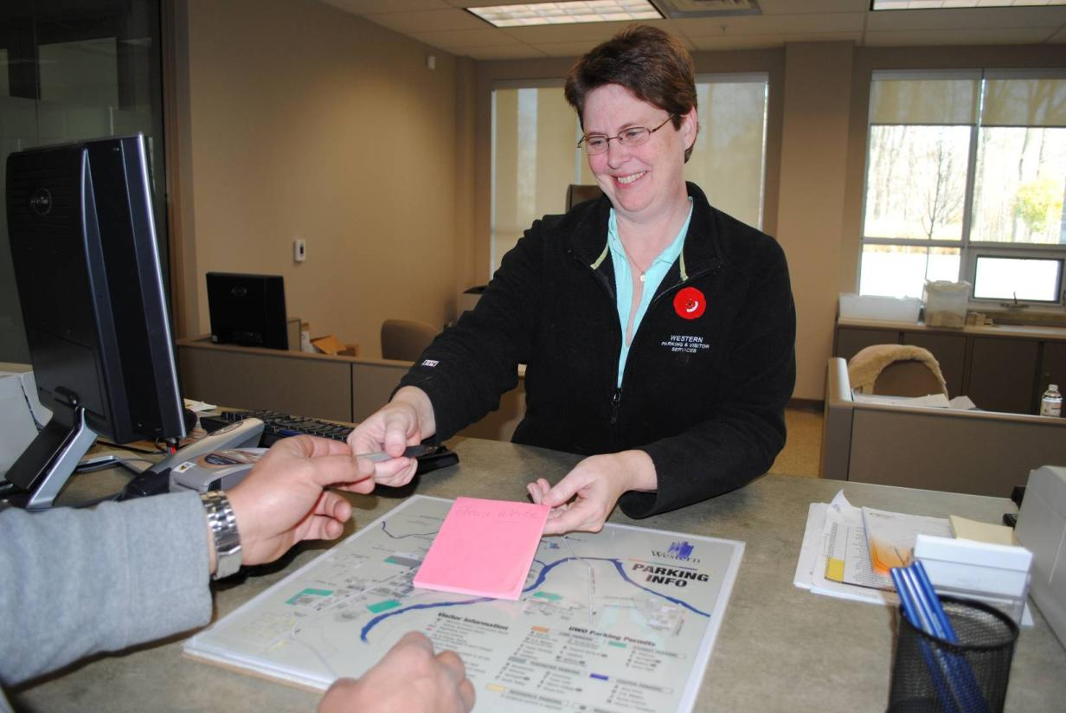
Tip: Keep pen and paper handy and offer it to the person.
Notes:
. Keep pen and paper handy and offer it to the person.
TIPS
Keep area well lit; keep face clearly visible for lip-reading
Offer to read information if it is clear the person is having difficulty
If you are using a computer, offer to increase the font size. increase font size.
Keep pen and paper handy and offer it to the person.

Slide 21
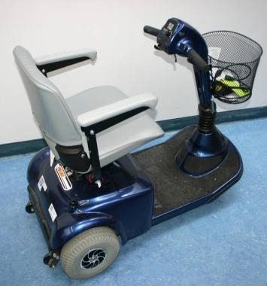
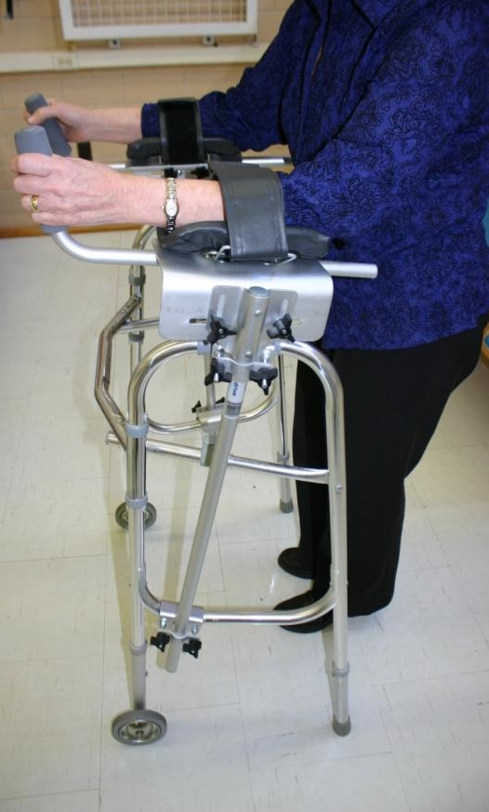
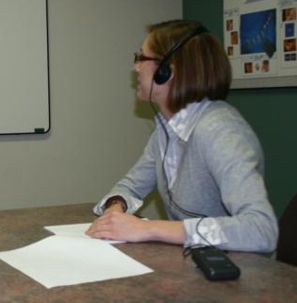
Increasing Independence: Assistive Devices
An extension of a person’s capabilities
Increase independence
Notes:
To ensure maximum accessibility, persons with disabilities need to be able to use their assistive devices on our premises. Such devices are an extension of the person’s capabilities.
They increase the person’s independence and provide freedom to participate as the person chooses without unnecessary help or interference from others.
Here are some examples of Assistive Devices that someone might bring with them campus.
The Office for Persons with Disability provides assistive devices to help persons with disabilities access services across campus (upon request). We also offer assistive devices in the Adaptive Technology Centre, such as ZoomText, JAWS, etc.
In the bottom right photo, an FM system is being used to amplify sound.

Slide 22
Tip: “Please don’t lean over, touch, or move my Assistive Device; it’s an extension of me.”
Notes:
The assistive device is an extension of the person’s capabilities; don’t lean over, touch, or move a device.

Slide 23
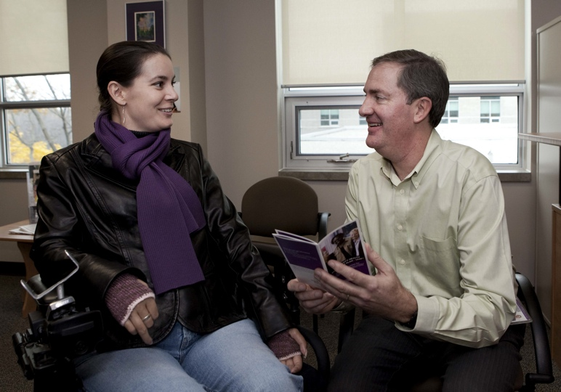
Tip: Get eye to eye; avoid neck strain.
Notes:
23
Get eye to eye; avoid neck strain.
This is best because you are making the users most comfortable, you would be making eye contact, and you would be able to show the documentation easily to the user.

Slide 24
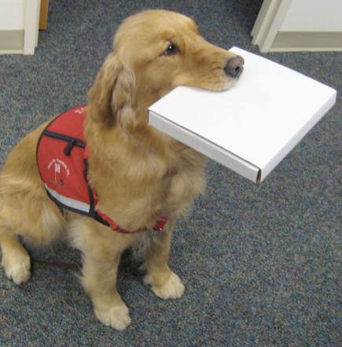
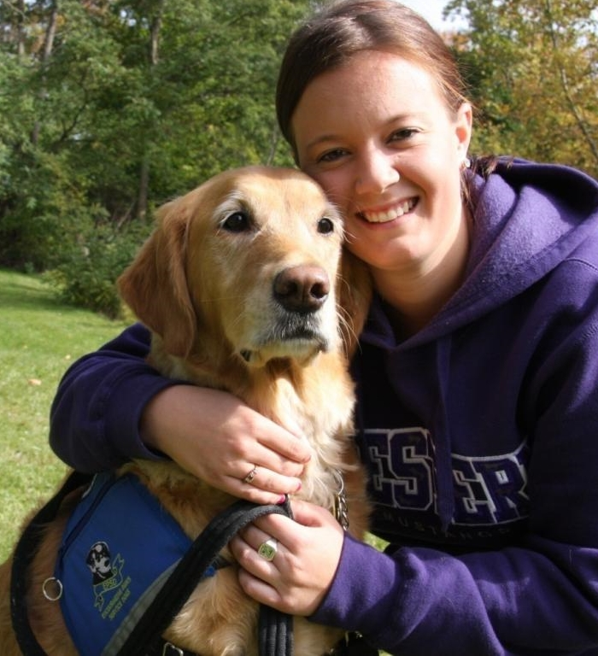
Maintaining Dignity
Allow service animals
Types of service animals:
Guide dog
Hearing or signal
Mobility assistance
Seizure response
Therapeutic assistance
Notes:
Can increase overall accessibility by allowing service animals in our site libraries.
Service animals provide assistance in the many ways listed in your handout
Dogs are often the most common service animal. However, a variety of animals have been used for a variety of assistive purpose. If unsure, don’t ask. It is common to wear a vest. It is always the responsibility of owner to be in control of animal.
A Mobility Assistance Animal picks up items, opens doors…And we certainly don’t want to interfere with a mobility assistance animal, as she fetches and picks up a pizza for her owner.
Here a Western student gives a hug to her therapeutic, or mental health assistance animal, Spirit.

Slide 25
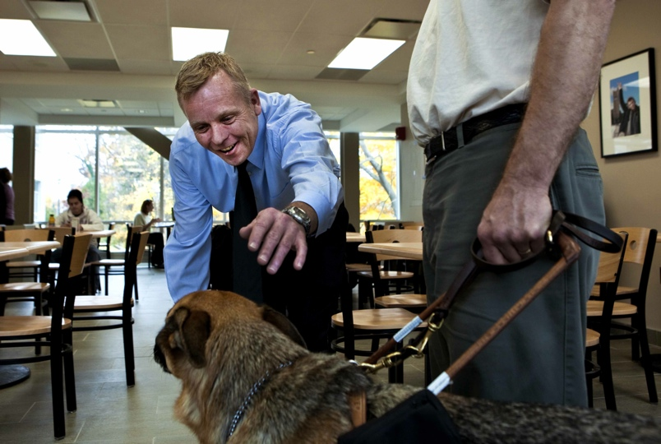
Tip: Working Dog - do not pet or distract.
Notes:
25
To maintain a person’s dignity, pay no attention to the animal. It is at work and must not be distracted. The dog serves as an extension of the owner’s capabilities. Focus your attention on communicating with the person. (NEXT SLIDE SHOWS THIS TIP)
How do can you know if it is a working dog?
You should always permission to pet a dog… it could be relaxing but still on duty i.e.. Out of its harness.

Slide 26
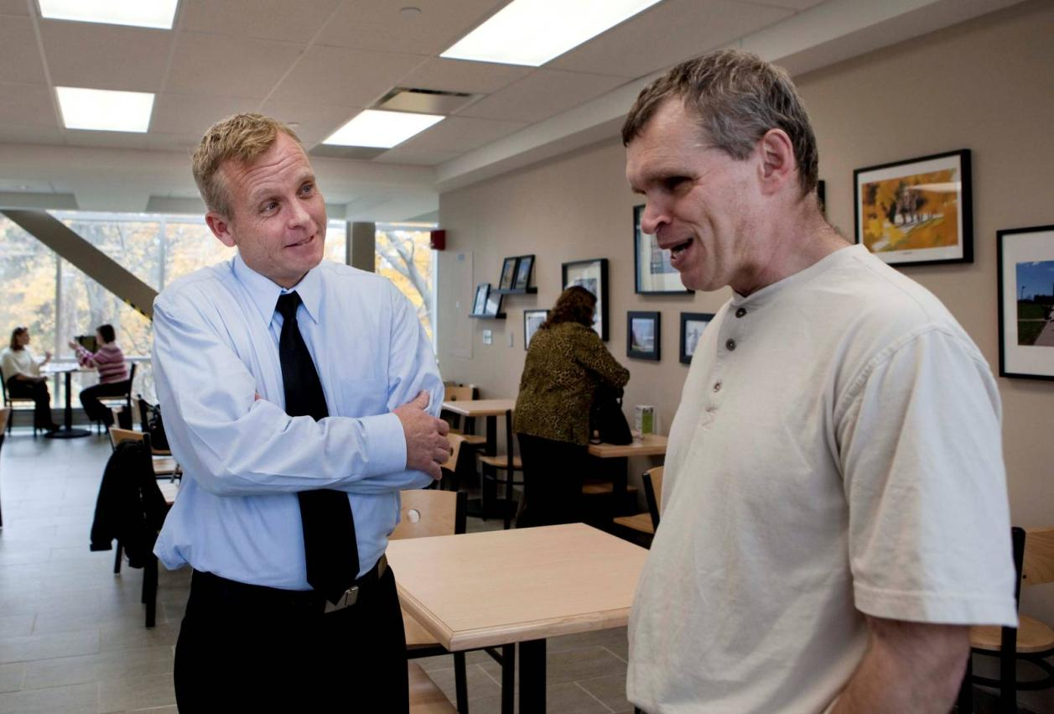
Tip: Pay attention to the owner.
Notes:
26
To maintain a person’s dignity, pay no attention to the animal. It is at work and must not be distracted. The dog serves as an extension of the owner’s capabilities. Focus your attention on communicating with the person. (NEXT SLIDE SHOWS THIS TIP)
How do can you know if it is a working dog?
You should always permission to pet a dog… it could be relaxing but still on duty i.e.. Out of its harness.

Slide 27
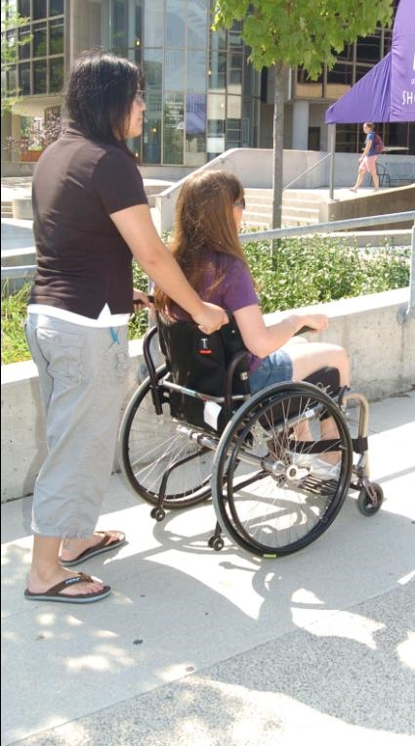
Maintaining Dignity: Support Persons
Welcome support persons.
Support persons:
Guides
Interpreters
Note-takers, scribes, readers
Personal care
Notes:
We can increase a person’s access to services and support his or her dignity by welcoming his or her Support Person
Support persons help with mobility, note-taking, reading, sign-language, interpretation, personal care. Family, friends, volunteers and professionals serve as support persons.
Support person may be mandatory for health or safety reasons.

Slide 28
Tip: “Talk to me, not to my support person.”
Interpreter
Notes:
28
When interacting with a person accompanied by a support person, speak directly to the customer, not to his or her support person to maintain the accessibility principle of dignity. If you’re not sure who is the customer, ask.

Slide 29
Service and Invisible Disabilities
Universal and inclusive service approach to all users is key.
Scenario:
A student has left their school paper to the last minute.
She approaches the service desk appearing somewhat overwhelmed and makes several attempts to explain her needs.
At your suggestion to write the information down, she tells you that she didn’t bring paper and otherwise appears unprepared.
She may seem impatient and quick to become frustrated.
Notes:
Note that these behaviours may indicate a neurological disorder.
-It may not be a reflection of a personality style or of your efficiency.

Slide 30
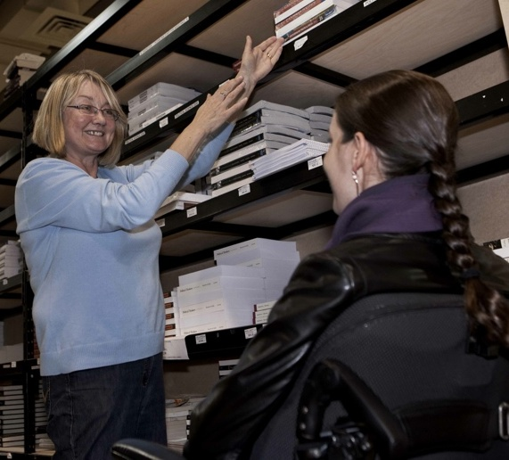
Great Service: How may I help?
Notes:
Overall, great service starts with a simple question, “How may I help?”
Person with vision loss needs help? Offer your elbow to guide him.
Guided Questioning
“Is this the information you were looking for?”
“Do you require any other type of assistance?”
“Is there any information you didn’t follow/write down that I can review with you again?”

Slide 31
All Together to Prevent New Barriers
Planning with Accessibility in Mind
Notes:
ADA require ongoing commitments for compliance. Let’s look at what that means.
All together to Prevent New Barriers
(Int.) Think/Share Reflection:
What is one thing you can commit to doing that would support greater accessibility?
What is one thing your colleagues can support each other in reaching for?

Slide 32
Think, Pair, Share
One thing you can commit to doing that would support greater accessibility?
One thing your team can support each other in reaching for?
Notes:
All together to Prevent New Barriers
(Int.) Think/Share Reflection:
What is one thing you can commit to doing that would support greater accessibility?
What is one thing your colleagues can support each other in reaching for?

Slide 33
Plan, Ready, Set = Accessible
Practise inclusive, universal design
Plan for accessibility from the start
Remember the 4 principles: dignity, independence, integration and equal opportunity
Be flexible
Ask yourself:
Are there any implications for accessibility in this decision?
Notes:
Some steps to consider when developing new initiatives, service changes, etc.

Slide 34
This Photo by Unknown Author is licensed under CC BY-NC

Slide 35
Situations & Responses

Slide 36
Situation
Some disabilities may affect social skills.
Medication may slow an individual’s speech or reactions; a lack of response does not mean the person is being rude.
Symptoms of various disabilities may become more apparent or aggravated with fatigue or stress.

Slide 37
Response
Focus on the overall goal of the conversation, rather than on the person’s behaviour.
Accept the fact that some tasks may take longer—such as finding a book, using the computer or reading instructions.

Slide 38
Situation/Response
People with learning disabilities sometimes rely on visual aids, so be concrete and give examples.
Use different cues to explain a process.
E.g. Point to a link on a web page and describe its position: ‘top-right corner’.
When giving directions, ask ‘do you like maps?’

Slide 39
Situation/Response
If a person tells you about his or her disability, politely ask them for guidance on how they best learn/understand information.
Don’t assume that a person has understood (or failed to understand) you.
Ask whether you have provided sufficient information.
Clarify by summarizing the information.

Slide 40
Situation/Response
If someone seems upset, ask calmly if there is anything you can do to help.
If they say no, respect their wishes if they are not being disruptive.
If you are in a public area with many distractions, ask the person if they would prefer moving to a quieter location.

Slide 41
Resources & References

Slide 42
Tipsheets at the Rescue
Accessible self-service kiosks
Making information accessible
Principles of accessible web design
Accessible Meeting and Event Checklist

Slide 43
Resources
Guide to planning accessible meetings
http://www.hrsdc.gc.ca/eng/disability_issues/doc/gpim/page08.shtml
Disability Awareness Kit – State Library of Victoria, Australia
http://www.openroad.net.au/access/dakit/welcome.htm
ARCH Disability Law Center—“Interacting with Persons who Have a Disability”
http://www.archdisabilitylaw.ca/sites/all/files/Interacting_FactSheet_Dec07.pdf
Notes:
ADD TIPSHEETS
ACCESSIBLE PDF… CNIB?

Slide 44
Resources to Learn More
American Library Association: Library Services for People with Disabilities Policy
http://www.ala.org/ala/mgrps/divs/ascla/asclaissues/libraryservices.cfm
The universal design file: designing for people of all ages and abilities (PDF) (from North Carolina State University)

Slide 45
Training for Library Staff
Project ENABLE (Expanding Non-discriminatory Access By Librarians Everywhere) offers free, self-paced, online training specifically for librarians. Users who successfully complete all of the training modules and quizzes can obtain a Certificate of Achievement.
A handy booklet of Tips On Interacting With People With Disabilities provides guidance for a wide range of situations. This one is worth printing and sharing with all your staff.

Slide 46
Training for Library Staff
Learn how to speak about people with disabilities using language from this People First chart.
The Computer/Electronic Accommodations Program (CAP) has created a series of online training modules, including some on disability etiquette and how to interact with an individual who has a disability.

Slide 47
Training for Library Staff
"At Your Service: Welcoming Customers with Disabilities" is a self-paced webcourse for people interested in discovering best practices for working with patrons and customers who have disabilities.
"Reaching out to Customers with Disabilities" is another self-paced webcourse explaining how the ADA applies to nonprofits and businesses.

Slide 48
Training for Library Staff
Serving Library Users on the Autism Spectrum is an online course designed by experts in both the library and autism fields. It consists of a series of four independent, self-paced instructional modules that are intended for librarians and library staff to learn how to better serve their users with autism spectrum disorder (ASD).
For training on interacting with patrons with autism, try Autism Services and Resources of Connecticut or the FOCUS Center for Autism.
For training on interacting with patrons who have intellectual or developmental disabilities, try BnB Global Services.

Slide 49
Developing Services for Patrons with Disabilities
Connecticut librarian Barbara Klipper published a book through ALA called "Programming for Children and Teens with Autism Spectrum Disorder." for library staff to help them serve individuals with autism and their families more effectively.
The Saint Paul (MN) Public Library has a guide for Resources and Outreach for the Diffabled (Differently Abled) focusing primarily on children and young adults.
LearningWorks for Kids has developed gaming recommendations for alternative learners with autism, ADHD, dyslexia and other diffabilities.

Slide 50
Developing Services for Patrons with Disabilities
Connecticut librarian Barbara Klipper published a book through ALA called "Programming for Children and Teens with Autism Spectrum Disorder." for library staff to help them serve individuals with autism and their families more effectively.
The Saint Paul (MN) Public Library has a guide for Resources and Outreach for the Diffabled (Differently Abled) focusing primarily on children and young adults.
LearningWorks for Kids has developed gaming recommendations for alternative learners with autism, ADHD, dyslexia and other diffabilities.

Slide 51
References
Connecticut State Library: Division of Library Development, Libraries and Accessibility Toolkit https://libguides.ctstatelibrary.org/dld/accessibility
University of Waterloo Library, AODA Toolkit https://uwaterloo.ca/library/aoda-toolkit/
Office of Civil Rights, South Carolina

