Slide 1
Holding Space for Voice
Using Powerful Questions and Appreciative Inquiry Conversations to Understand Values and Needs
Annie Bélanger @annie_belanger
Preethi Gorecki
@helloitspree
OLA 2022
Notes:
Change management is often process-centered instead of people-centered. People are centered when we focus on what is good. Appreciative Inquiry’s strengths-based, positive approach to organizational change allows leaders and facilitators to re-center individuals’ voices.
This session will focus on articulating questions that are aspirational and shift to thinking about what could be in order to co-create pathways for forward movement as well as highlighting some facilitation best practices for inclusive dialogues.

Slide 2
Learning Objectives
Understand the importance of asking powerful questions
Learn to craft generative questions
Understand and select facilitative practices to support group processes
Notes:
Today we are going to focus on three learning objectives!
Understanding the importance of asking powerful questions in order to foster inclusive conversations
Learning to craft generative questions that seek to uncover what is good in order to hold space for all to hear and be heard while avoiding blame and shame
AND
Understanding and selecting facilitative practices to support group processes to create new shared understanding while empathetically listening to all voices through generous accountability

Slide 3
Appreciative Inquiry
“A focus on the positive is useful for appreciative inquiry but it’s not the purpose. The purpose is to generate a new and better future.”
~ Gervase R. Bushe, Ph.D.
Notes:
Let’s start with a brief overview of what appreciative inquiry is and how it can be used. Appreciative inquiry seeks to identify what is good, what is best, and what could be. Before we dig deeper, we also want to acknowledge that the shadow side of appreciation and generative approaches must be addressed when there is dysfunction. Annie will discuss this in further detail a bit later in the presentation. We just wanted to address this upfront before diving in. We selected this apt quote from Gervase Bushe to kick off our discussion about appreciative inquiry: “A focus on the positive is useful for appreciative inquiry but not the purpose. The purpose is to generate a new and better future.”

Slide 4
Appreciative Inquiry ...
Engages stakeholders in self-determined change
Is a strengths-based, positive approach to leadership development and organizational change
Seeks what is best in their organization
Appreciation
Inquiry
Wholeness
Notes:
Appreciative Inquiry (AI) is "about the co-evolutionary search for the best in people, their organizations, and the relevant world around them. In its broadest focus, it involves systematic discovery of what gives “life” to a living system when it is most alive, most effective, and most constructively capable in economic, ecological, and human terms. AI involves, in a central way, the art and practice of asking questions that strengthen a system’s capacity to apprehend, anticipate, and heighten positive potential.” The first phase of AI is discovery. It asks the questions in a positive frame, seeking the strength as opposed to the problem. That is not to say it seeks to ignore problems, but it seeks to find the solution by focusing on what is the positive outcome we would seek to have. There are three main tenets to appreciative inquiry: appreciation, inquiry, and wholeness.
To appreciate is to recognize the best in people, or the world around us. These strengths become the foundation on which the future can be built.
To inquire is to ask questions. It invites participants to ask questions so they can learn from one another, and together identify a shared vision of the future. Participating in an AI process requires an attitude of curiosity and a hunger for discovery.
AND the final AI tenet of wholeness encourages participation from all levels of an organization, knowing that the best ideas often emerge from unexpected places. Additionally, AI encourages seeking outside perspectives. It is a whole-system process.

Slide 5
Appreciative Inquiry vs Problem-Solving
What to grow
True, good, better, possible
Defines ideal first, coherent response
Expands vision of future
Assumes infinite capacity for imagination
What to fix
Problem, symptom, causes, solutions, plan
Breaks things into pieces, fragmenting response(s)
Responds to past
Assumes constellation of problems to overcome
Notes:
When we think about appreciative inquiry, we want to step away from the problem-solving mindset. Another way of thinking about appreciative inquiry is generative inquiry. You are appreciating in order to see what is good and what is best. These qualities help you remain centered in a positive intent of betterment, of improvement, of growth, of sustainability. In other words, it helps you stay out of the vortex of despair. You are inquiring in order to generate a better future, a better iteration.
In problem-solving mode, we are often focused on problems or symptoms- we are focused on pieces of the puzzle rather than the full picture. Problem-solving roots us in the past- it asks us to look back and identify what went wrong, what needs to be fixed, where we went wrong; whereas appreciative inquiry pushes us into the future. It demands that we focus on what’s ahead of us instead of getting lost in the rearview mirror. It allows us to move forward with intention.

Slide 6
Crafting Powerful Questions
“We live in the world our questions create.”
~ David Cooperrider
Notes:
Now that we’ve covered some of the basics of appreciative inquiry, let’s dive into the aspect of appreciative inquiry that we are most interested in for the purposes of this presentation: Powerful questions, referred to as generative questions in the realm of appreciative inquiry. In this section, I’m going to explain what a powerful question is (and isn’t) and offer a few methods for how to to craft your own powerful questions. To start us off in the right mindset, I offer this quote from one of the founders of appreciative inquiry, David Cooperrider: “We live in the world our questions create..”

Slide 7
Powerful Questions are valuable because they…
Set the tone for the conversation and set the change in motion
Allow exploration beyond the immediate
Move us beyond what is to what could be
Are framed within the concept of positive intent, challenging each other as partners not adversaries
Notes:
So what are powerful questions and what do they do? Powerful questions set the tone for conversation and set change in motion, they allow exploration beyond the immediate, they move us beyond what is to what could be, and they are framed within the concept of positive intent, allowing us to challenge each other as partners intent on growing ideas and fostering growth in one another.

Slide 8
Powerful Questions generate reflection and creativity by:
Asking open-ended questions to which you do not know the answer, and expect to learn something interesting and important
Including a clear scope and intent of the inquiry to move us forward
Anchoring in constructive intent
Notes:
Powerful questions invite thinking—they stretch the imagination and inspire new thoughts without evoking defensiveness or hostility.
Open ended questions allows the speaker to imagine what could be, and explore what is. Close ended question invite efficiency and yes/no answers. They do not generate conversation. Keep in mind that not all open-ended questions are powerful questions, but in order to be a powerful question, a question must be open-ended.
The linguistic construction of questions impacts its effectiveness and importance. It was found out that questions starting with “Why,” “How,” and “What” are more powerful as compared to queries that start with simple “Who,’ “When,” “Where,” and “Which” which may fall under the less powerful category. This is because powerful questions motivate more reflective thinking and a more profound level of conversation.
One caveat: “Why” can be a trigger for some. It can imply judgment.. It can imply blame. Rephrasing Why questions to “How might we?” or “Help me understand” can help you move past accidental icebergs.
The second dimension is the scope of the question which simply means knowing how to tailor the kind of question to our needs. The extent of asking the question must only be within the needs of the situation and realistic goals.
Lastly, the assumptions embedded into most of the questions must be appropriately applied. To demonstrate it, you might as well ask “What can be done to prevent it from happening again?” instead of “Why did you fail to do it?” The first question stimulates reflective thinking in contrast to the second question.
http://www.exforsys.com/career-center/questioning-skills/how-to-ask-powerful-questions.html
Another resource is: Vogt, E., Brown, J., and Issacs, D. (2003). The Art of Powerful Questions: Catalyzing Insight, Innovation, and Action.

Slide 9
When building Powerful Questions…
Present questions as an invitation using expansive, positive, feeling, experiential words
What has inspired you to get engaged? What do you most hope to contribute?
What challenges might come our way and how might we meet them?
What has inspired you to get engaged? What do you most hope to contribute?
Help see old things in new ways
How might we succeed? How do we have a respectful, inclusive workplace?
Notes:
When building powerful questions, present questions as an invitation using expansive, positive, feeling, experiential words and consider questions that will help you see old things in new ways. This will help to envision the future you want without getting stuck in the past.

Slide 10
When building Powerful Questions…
Ask about ultimate concerns;
What do you value most?
What would someone who had a very different set of beliefs than we do say about our decision?
Use positive questions that build on positive assumptions;
What about this library makes you especially glad you work here?
What are all the possibilities for collaboration between our departments?
Enhance the possibilities of storytelling by asking questions about trusted personal experience;
Thinking back on your year, please share a high point when…
Notes:
When building powerful questions, consider asking about ultimate concerns; using positive questions that build on positive assumptions, and enhancing the possibilities of storytelling by asking questions about trusted personal experience. On this slide, there are several examples of powerful questions that you can use or adapt for your own purposes. I want to draw your attention to one in particular- it is the second question under “ask about ultimate concerns”: what would someone who had a very different set of beliefs than we do say about our decision? As we know, libraries tend to be very homogenous, which means that when we make decisions we often do not have all of the perspectives and viewpoints of our affected stakeholders represented across our decision-makers. By asking this powerful question, we are pushing ourselves outside of the limitations of our own lived experiences in order to imagine how someone with a very different set of experiences may feel about our decisions.

Slide 11
Flip the Narrative
Name It
Flip It
Frame It
Name the problem or concern - often a negative statement
Flip it to its opposite - often a positive statement
Frame it in reality: powerful question(s) that help(s) actualize the “flipped” statement
Notes:
Now that you have a base understanding of powerful questions, let’s discuss some tools for crafting them. Cognitive reframing is a psychological technique that consists of identifying and then changing the way situations, experiences, events, ideas, and/or emotions are viewed.The main goal of reframing is to refashion negative thoughts and to turn them into positive ones. It is important to highlight the opportunities, the good, and also be transparent about the difficulties and challenges. Framing what is good cannot be done by invalidating the realities of others involved in the change.

Slide 12
Flip the Narrative Example
Name It
Flip It
Frame It
“We have failed.”
“We are unhappy with our work environment.”
“We want to succeed.”
“We want to feel good coming to work everyday.”
“What could success look like?
“How might we create a work environment that makes all of us feel safe, happy, and productive?”
Notes:
The name it, flip it, frame it tool can help you create powerful questions. Here, we have included two examples of situations where this tool could be useful. In the first instance, we state the complaint/negative statement: we have failed. We flip the statement to a positive one: we want to succeed. And finally, we frame our positive statement in the form of a powerful question that can help us actualize the reality we want: what could success look like?
The second example takes a common complaint: we are unhappy with our work environment, flips it to a positive statement: we want to feel good coming to work everyday, and frames it as a powerful question: how might we create a work environment that makes all of us feel safe, happy, and productive?

Slide 13
Evolving Questions: Closed → Open → Powerful
Closed
Open
Powerful
Questions that spark creativity and invite conversation and storytelling
Questions with many possible answers
Yes/No Questions
Notes:
Evolving questions is the other tool for crafting powerful questions that we wanted to share with you today. This tool gets you to convert a closed yes/no question into an open question with many possible answers and then finally into a powerful question that sparks creativity and invites conversation and storytelling.

Slide 14
Evolving Questions: Closed → Open → Powerful Examples
Closed
Open
Powerful
How might your experience impact the initiative’s success?
Do you have experience?
What experience do you have?
→
→
Notes:
In this example, we start with the closed question “do you have experience” convert the question into an open one “what experience do you have?” and then finally we convert that one into a powerful question: how might your experience impact the initiative’s success?
You’ll notice that in this example, one of the key differences between the open question and the powerful question is that the open question encourages an answer that is very focused on the past: what experience do you have? As in what have you already done? Tell us about your past experience. This isn’t necessarily a bad question, but it does not invite the same creativity and future-focused thinking we would want to see from a powerful question. The powerful question on the other hand asks you to look toward the future and envision what is possible in the future rather than what has been possible in the past.
Now that we have covered key aspects of appreciative inquiry and powerful questions, I’m going to pass it over to my co-presenter Annie to cover everything you need to know about preparing to facilitate and facilitating conversations using appreciative inquiry and powerful questions.

Slide 15
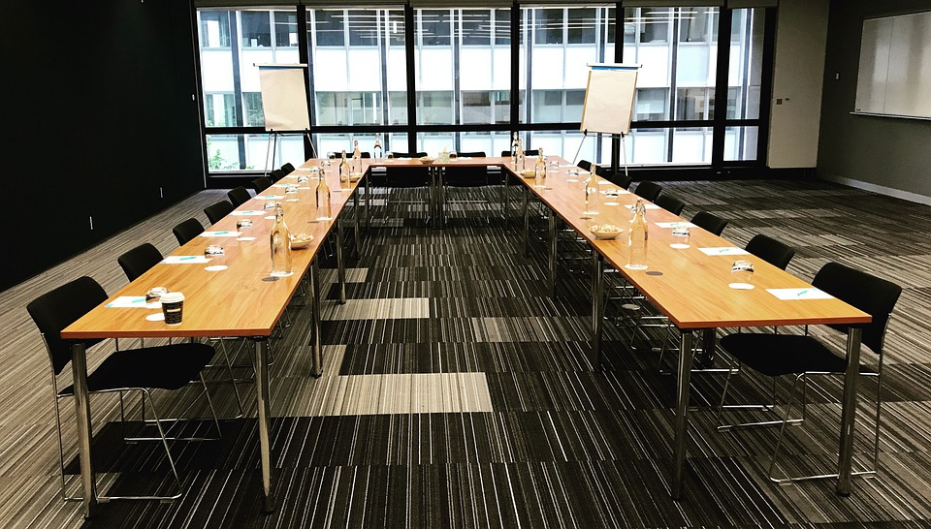
Preparing to Facilitate

Slide 16
“The power of conversation cannot be underestimated.”
Lewis, Passmore

Slide 17
Appreciative Inquiry Conversations…
Focusing on what matters most to people
Making real and tangible the highest potentials of an organization and its people
Transforming communication into open, whole-system dialog
Expanding the realm of positive possibilities
Aiming to take the authentic person into account
Notes:
Having a sense of being listened to and of listening to others/affirmation of our self-value and value of others. It helps to build an atmosphere of trust and openness.

Slide 18
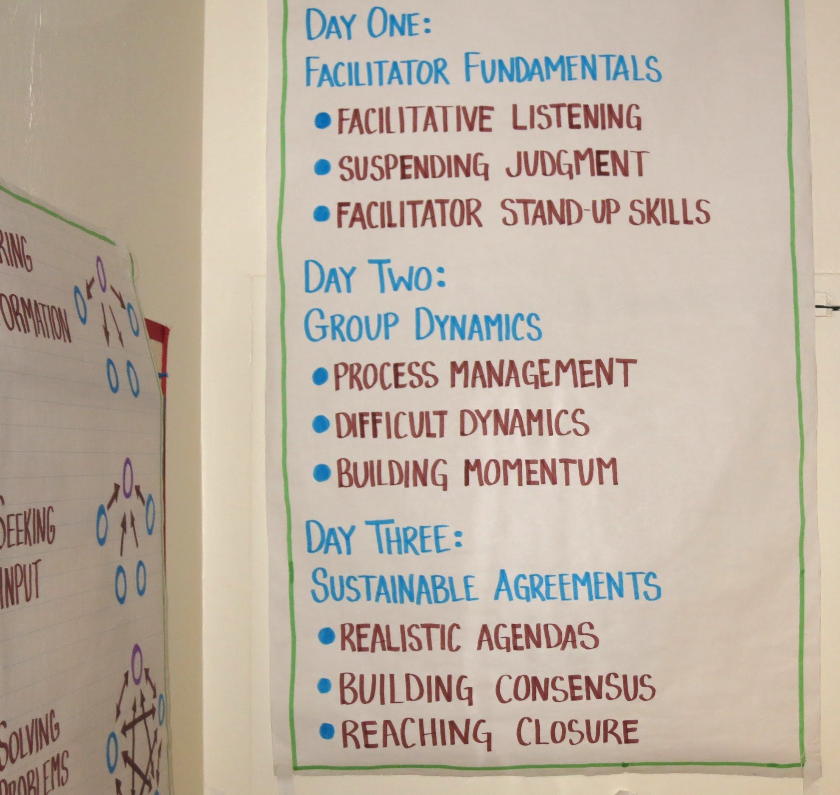
Create Structure for Conversations
Select a focus topic
State a clear purpose
Give structure to engagement activities
Articulate questions and prompts
Identify who, when, how, where
Prepare to mitigate harm
Notes:
Select a focus topic.
State a clear purpose in your invitation - why are you seeking to have this conversation? What will be gained?
Give structure to engagement activities - create activities that focus on the relationships while advancing the conversation. First identify your purpose
Articulate questions and prompts that move the conversation forward
Identify who, when, how for the conversation as well as ways to consider who will be able to have voice
Prepare to mitigate harm by calling in and if needed calling out participants

Slide 19
Sample Topic & Associated Activities: Thriving through change: even in the midst of uncertainty
Primer: Working in a pandemic has been stressful, trying, difficult, exhausting, and traumatizing at times. For the compassion we have brought each other, we have had many successes ranging from individual, to teams, and to the whole libraries. I want us to take some time to celebrate what is good about our work. We can then learn what we want more of.
Activity 1 in Small Group: Considering the last full year, share a story of a time when have you experienced thriving through uncertain change? What made that possible?
Activity 2 in Small Group: As you listened to other stories, what themes were present in these positive experiences? Identify the five most common success factors across your stories and insights.
Activity 3 in Small Group: As a group decide how to finish this sentence: “We are able to thrive through change even when it’s uncomfortable, disruptive, uncertain, or chaotic when we…”
Report out
Notes:
The topic should be a 3-7 word headline. It needs to paint a picture that is meaningful, evocative, and inviting. It should 1) matter, 2) be emotional and poetic (create excitement or urgency), 3) create meaning (what is in it for me?). Make it surprising to spark curiosity. Topics should avoid the how. For example, a topic could be thriving through change: even in the midst of uncertainty.

Slide 20
Cont’d Sample Topic & Associated Activities: Thriving through change: even in the midst of uncertainty
Activity 4 in small groups:
Considering where we are right now, what is your greatest hope when it comes to thriving through uncertain change more consistently?
What behaviors might we see more of when it comes to thriving through uncertain change more consistently?
What are the three changes we could make to thrive through uncertain change more consistently?
What are the first three steps we could take towards thriving through uncertain change?
Activity 5 individually: Write a story about your vision for thriving in uncertain change with this story tree: Once upon a time, Every day, One day, Because of that, Because of that, Until finally,
Closeout: If there is one you can take to help you thrive through uncertain change in the next 2 weeks, what would it be? What tiny habit would you love to create now and over the next month to help you thrive through uncertain change
Notes:
The topic should be a 3-7 word headline. It needs to paint a picture that is meaningful, evocative, and inviting. It should 1) matter, 2) be emotional and poetic (create excitement or urgency), 3) create meaning (what is in it for me?). Make it surprising to spark curiosity. Topics should avoid the how. For example, a topic could be thriving through change: even in the midst of uncertainty.

Slide 21
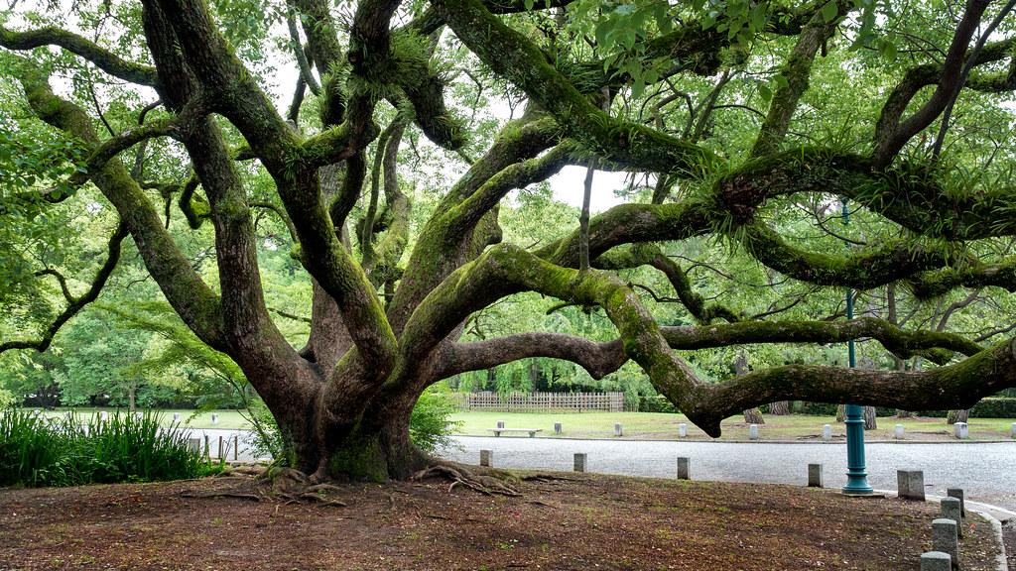
“We grow in the direction of the questions we ask”
~ Cooperrider
Notes:
Carefully frame the initial question
It provides the foundation
It sets the tone
It signals the direction

Slide 22
Define how we want to be with each other
Co-create rules of engagement & collective agreements to:
Establish communication norms, what is in and out of bounds
Create shared understanding
Center the group
Notes:
Let’s talk about how to begin to support a group’s process through powerful conversations
In order for us to do anything with each other, we first have to understand how we want to be with each other. Having stated and understood rules of engagement, shared agreements for participation, helps create a brave space for individual participation. Defining norms for a conversation, community, or organization helps people understand "this is who we are and how we will do things here." As Margaret Wheatley has said, “To create learning organizations, we must understand the underlying agreements we have made about how we will be together.”
Rules of engagement operate best when a group itself generates them, as well as identifying how they are to be applied and when and how the group's alignment with them should be evaluated. Because some individuals will see no need for the exercise, I generally begin with a very brief discussion of the following question: When you've been part of a group that really produced some amazing results, what helped make that possible? Inevitably, individuals will suggest a clarity of roles and responsibilities, shared goals or direction, and an understanding of how to work with each other.
Guide to developing them: http://www.ideaarchitects.org/2012/03/facilitation-friday-10-establish-rules.html
These responses then make it easier to answer the next question: Given the work that we are to do with each other, what are some of the agreements or ground rules we should make to guide our efforts?

Slide 23
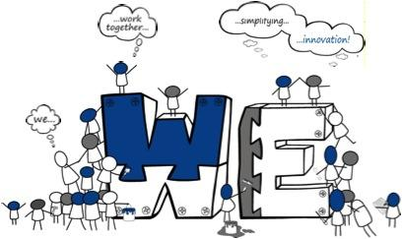
Collective Engagement Agreement Example
Participating today:
Everyone has wisdom,
Everyone’s wisdom for the wisest result,
There are no wrong answers,
The whole is greater than the sum of its parts,
Each will use voice and allow others to use voice,
Each will avoid assumptions, ask questions,
Each will react minimally, act maximally, and
Each person will hear others and be heard.

Slide 24
“Courage is the most important of all the virtues, because without courage you can't practice any other virtue consistently. You can practice any virtue erratically, but nothing consistently without courage.”
~ Maya Angelou

Slide 25
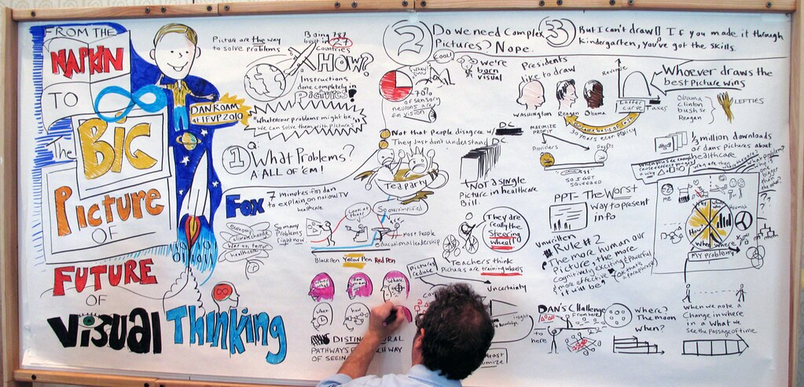
Facilitating & Holding Space

Slide 26
Facilitators…
Ensure all voices are heard
Support the group in taking and making space
Draw out the questions that may not yet be voiced
Know it’s ok to interrupt when it’s needed
Hear the whole person
Synthesize shared understanding
Notes:
Ensure you are actively listening and making meaning. Listening is the key to all good conversations. We’re often thinking of our response while others are talking. Good conversations require us to stay present and pay attention when others, and ourselves, are speaking. This means that we don’t entertain other thoughts while we’re listening. Whenever our mind wanders, we bring our attention back to the speaker.
Stay on track but be willing to leave it. Some of the best conversations I’ve had moved all over the place. Not in a disjointed fashion, but like a dance, forming a mosaic of meandering patterns that fit together into a coherent whole.
Be flexible and willing to move from one subject to the next, but beware of leaving incomplete ideas hanging.
Get everyone involved. One problem with group conversations is that they often turn into monologues for the most vocal people in the group. People often politely allow others to monopolize a conversation when they’re obviously uncomfortable. We’ve all felt the awkwardness and read the obvious body language of those tolerating a tirade.
In this situation, validate the speaker, and then ask for input from someone else.
Know it’s OK to interrupt when appropriate. One thing to consider when redirecting a conversation is that you may have to interrupt people. This is hard for many of us who’ve been trained to listen when others are speaking.

Slide 27
Listen For ALL Voices
Carefully and actively because we are genuinely curious and care about the speaker and what they are saying
Provide multiple means of engaging in the conversation
Call in participants that are not adhering to the collective engagement agreements
Notes:
Carefully and actively because we are genuinely curious and care about the speaker and what they are saying by:
Shifting from being focused on ourselves to concentrate fully on others
Being present, attentive, curious, and caring
Listen to yourself and use your internal voice to stimulate curiosity
Listen for shared meaning by developing an ear that is attuned to interrelationships, perceptions, insights occurring in the room
Call in participants if harm is occuring
“Our advice is not as good as we think. How do we listen better?” Michael Bungay Stanier

Slide 28
Listening Empathetically
Goes beyond active listening by seeking connection to:
Build trust and respect
Develop stronger understanding
Hear the words and the emotion
Validate feelings, without needing agreement
Encourage the surfacing of information
Create an environment that is conducive to collaborative problem solving
Notes:
Psychologist Carl Rogers wrote, "Real communication occurs when we listen with
understanding - to see the idea and attitude from the other person's point of view, to sense
how it feels to them, to achieve their frame of reference in regard to the thing they are
talking about." Listening with empathy allows us to create connection and new understanding.
“Empathetic listening asks you to go beyond the surface of what is being said to unpack why and how it’s being said and get to know someone’s emotional experience—and empathize with it.”
Not only is empathetic listening a mindset and philosophy. It is active listening on a new level:

Slide 29
Avoid Toxic Positivity
Notes:
Toxic positivity is the faulty belief that people should only feel "good" emotion and that a positive attitude will solve one's problems. Toxic positivity happens we focus on the positive no matter what, switch off acknowledging the negative, and always encourage others to see the bright side, without a willingness to open up about the bad. While you will want to focus on the positives, find the opportunities, it is important to acknowledge these in a way that does not invalidate anxieties, the stress and the loss that others may be experiencing. When we stray too far into positivity, we can inadvertently dip into the well of toxic positivity.
Psychology today article: https://www.psychologytoday.com/us/blog/the-high-functioning-hotspot/202107/what-is-toxic-positivity

Slide 30
Questions?
Annie Bélanger
annie.belanger@gvsu.edu
@annie_belanger
Preethi Gorecki
preethi.gorecki@gmail.com
@helloitspree
Slides will be available at
scholarworks@gvsu.edu

Slide 31
References
Much of the information in this presentation is based on Chapter 6: The Power of Conversation from Appreciative Inquiry for change management: Using AI to facilitate organizational development (2008) by Sarah Lewis, Jonathan Passmore, and Stefan Cantore. Philadelphia: Kogan Page
Appreciative Inquiry: A Positive Revolution in Change (2005) by David L. Cooperrider and Diana Whitney. San Francisco: Berrett-Koehler Publishers
Appreciative Inquiry Handbook for Leaders of Change (2nd edition 2008) by David L. Cooperrider, Jacqueline M. Stavros, and Diana K. Whitney. San Francisco: Berrett-Koehler Publishers

Slide 32
References
The Art of Powerful Questions: Catalyzing Insight, Innovation, and Action (2003) by Juanita Brown, and David Isaacs Eric E. Vogt. Mill Valley: Whole Systems Associates
The Power of Appreciative Inquiry: A Practical Guide to Positive Change (2nd edition 2010) by Diana Whitney and Amanda Trosten-Bloom. San Francisco: Berrett-Koehler Publishers
Thin Book of Appreciative Inquiry (3rd edition 2013) by Sue Annis Hammond. Bend: Thin Book Publishing Co.
Appreciative Inquiry Is Not (Just) About The Positive. OD Practitioner, Vol. 39, No. 4, pp.30-35, 2007. Gervase R. Bushe, Ph.D

Slide 33
References
Conversations worth having: Using appreciative inquiry to fuel productive and meaningful engagement (2018) by Jackie Stavros and Cheri Torres: Berrett-Koehler Publishers
Appreciative Inquiry for Change Management: Using AI to Facilitate Organizational Development (2011) by Sarah Lewis, Jonathan Passmore, and Stefan Cantore: Kogan Page.

Slide 34
References
What is Appreciative Inquiry? A Short Guide to the Appreciative Inquiry Model & Process, Center for Values-Driven Leadership Blog, 2017, Online at: https://cvdl.ben.edu/blog/what-is-appreciative-inquiry/
Why Empathetic Listening Is Crucial for Your Career—and How to Do It Well, themuse, Ximena Vengoechea. 2021, online at https://www.themuse.com/advice/what-is-empathetic-listening-definition-examples

Slide 35
Resources
The Book of Beautiful Questions Question Index: https://amorebeautifulquestion.com/wp-content/uploads/2019/01/Question-Index-BBQ.pdf
Anti-Oppression Resource & Training Alliance: https://aorta.coop/resources/
Liberating Structures: https://www.liberatingstructures.com/
Appreciative Inquiry Commons: https://appreciativeinquiry.champlain.edu/
HyperIsland [facilitation] Toolbox: https://toolbox.hyperisland.com/
Guide to developing Rules of Engagement: http://www.ideaarchitects.org/2012/03/facilitation-friday-10-establish-rules.html

