Slide 1
Thriving through Human-Centered Approaches to Change
Annie Bélanger & Meghan Musolff
ALAO 2021
Notes:
Hello. I’m Annie. I’m the Dean of University Libraries at Grand Valley State University.
Hello. I’m Meghan Musolff. My role is Lead Project Manager at the University of Michigan Library.

Slide 2
Learning outcomes
Session participants will:
Understand the basic components of human-centered change
Gain awareness of tools to facilitate engaged change leadership
Deepen your understanding of how to communicate effectively and compassionately during change efforts
Notes:
Here are the learning outcomes for our time together. Session participants:
Understand the basic components of human-centered change
Gain awareness of tools to facilitate engaged change leadership
Deepen your understanding of how to communicate effectively and compassionately during change efforts

Slide 3
What is change?
What does it mean to you?
Notes:
We are going to start with basics and work together to define change. Pause this video and take a few minutes to reflect on what is change? What does change mean to you?

Slide 4
What is Change?
Notes:
Welcome back. Thank you for participating in that short activity. We’ll do a couple of these reflection activities throughout the presentation.
Change is most simply defined as the act or instance of making or becoming different. In this definition, it is process and object/deliverable focused. Yet, we know that change is about the humans experiencing the change and that emotions play a large role in change. Change is about hearts and minds, about the past, present, and future, about building trust within our community.
How does this definition compare to yours? What would you add? We look forward to continuing this conversation during the Q&A.

Slide 5
Human-Centered Change
Empower others to advance change:
Provide clarity
Ask how might we
Leverage compassion and empathy
Participation increases empowerment, which reduces helplessness and leads to action
Most change management mitigates risk. What if it could promote good?
Centering the human-experience
Engaging colleagues as partners
Providing opportunities to plan and take action
Articulating why, what, and how
Seeking to co-create as an ideal
Notes:
Traditional change mgt is about mitigating risks. What if it could promote good? Human-centered layers in order to promote good by:
Centers the human-experience
Engages colleagues as partners
Provides opportunities to plan and take action
Articulates why, what, and how
Seeks to co-create as an ideal
Whether change is planned or unplanned, directed or self-driven, participatory or imposed, we control and can control how we proceed through a change. Even when we have no agency in defining the change, we can be intentional in our reaction, our engagement in making it happen, and using the power of strategic yes and no to recapture a level of agency. Leveraging change management encourages everyone to engage with change efforts and to rapidly, completely and proficiently make the required changes to their day-to-day work. We can help empower others by providing clarity, asking how might we, and leveraging compassion and empathy.
Participation increases empowerment, which reduces helplessness and leads to action

Slide 6
Aligning to Organizational Values
Consider:
What are the aspirational and lived values of your organization?
How well aligned are individuals to these values as seen through their actions and behaviors?
How well aligned are processes and structures to the values?
By starting with the humans involved in the change, we can live the values we hold towards our colleagues. We can enable champions rather than detractors.
Notes:
The values alignment is critical to sustainable change. onsider:
What are the aspirational and lived values of your organization?
How well aligned are individuals to these values as seen through their actions and behaviors?
How well aligned are processes and structures to the values?
By starting with the humans involved in the change, we can live the values we hold towards our colleagues. We can enable champions rather than detractors. Few are truly, irreparably against change. Humans are often against change where they have no agency and feel powerless. In the absence of engagement, the human brain will fill in the blanks and often with the negativity bias that has helped us survive as a specie. the alignment between personal and organisational values to occur and, thereby, allowing the organisation to evolve and remain viable.

Slide 7
Reflecting on that time you thrived through change, how did the change effort center on organizational values and engage those impacted? If it didn’t, what else made it resonate?
Notes:
For our next activity, we would like you to pause the video and reflect on a past change and the role of organizational values in that change. Reflecting on that time you thrived through change, how did the change effort center on organizational values and engage those impacted? If it didn’t, what else made it resonate?
Welcome back. Thank you for participating in this activity. We’ll be sure to provide space during the Q&A for you to share back your reflections on this question.

Slide 8
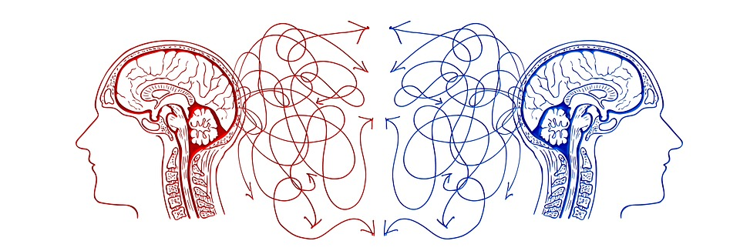
Why, What, and How
Consider this series of steps:
Identify what is happening
Assess the scale and scope of the impact to the organization
Acknowledge concerns and emotions
Articulate what agency does exist or how it is being created
Reframe the change
Seek the opportunities
Set clear expectations
“We are willing to commit ourselves if we understand what it’s all about, and we believe the proposal will bring benefits, that it is possible and that we can influence the final result.” ~ Kari Tuominen
Notes:
In The Heart of Change, Kotter and Cohen say that we should “Compellingly show people what the problems are and how to resolve the problems.”. We can do this using this series of steps:
Identify what is happening
Assess the scale and scope of the impact to the organization
Acknowledge concerns and emotions
Articulate what agency does exist or how it is being created
Reframe the change
Seek the opportunities
Set clear expectations
“We are willing to commit ourselves if we understand what it’s all about, and we believe the
proposal will bring benefits, that it is possible and that we can influence the final result.”
Tuominen, Kari.

Slide 9
Approaches & Associated Tools
Notes:
For the next part of our presentation, we will focus on frameworks/approaches and their associated tools that have influenced our thinking about human-centered change.

Slide 10
Can you think of a time when you have thrived through change? What made that possible?
Notes:
Time for another activity. Pause this video and take a few moments to think about a time when you thrived through change and what made that possible.
Welcome back. Thank you for participating in that short activity. As we continue our presentation, keep your list of “thriving through change” characteristics in mind. We’ll be sure to provide space during the Q&A for you to share back about your list.

Slide 11
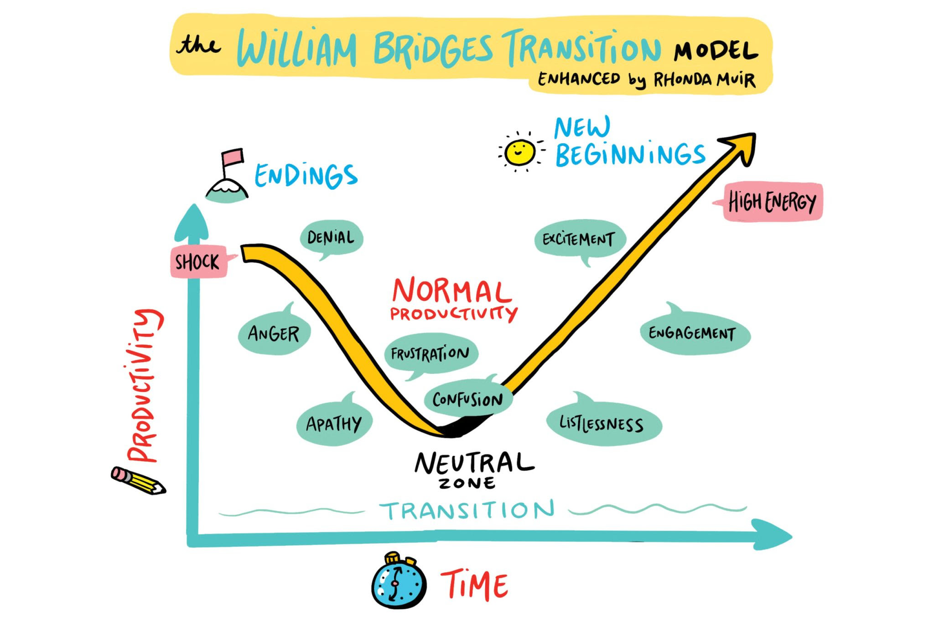
Bridges’ Transition Model
Three phases:
Endings
Neutral Zone
New Beginnings
Focus is on recognition, empathy, and compassion (you + others)
Acknowledges the past, look toward the future
(Image: https://www.imagethink.net/leadership-through-uncertainty/)
Notes:
Developed by William Bridges about 30 years ago, the Bridges’ Transition Model provides a framework to help think about the human experience of change by dividing the transition into three phrases: Endings, Neutral Zone, and New Beginnings.
Endings: This phase acknowledges the (often overlooked fact) that before something new begins, something old has to end.
Neutral Zone: This is the space between the old way of doing things and the new way of doing things. One of the things I appreciate about this visual depiction of the Bridges Model is that it demonstrates the typical drop in productivity during the Neutral Zone.
New Beginnings: This phase is when the change begins to be felt in minds & hearts. There are new values, new attitudes, new identities
The focus here is on recognizing the emotions associated with each phase (both in yourself and others) and to build empathy and compassion for colleagues who are living through the change at their own pace. By using this model, one can acknowledge the past and help colleagues look towards the future. And while presented in a linear fashion, one often moves back and forth between the phases.

Slide 12
Bridges’ Transition Model: In practice
Endings
Acknowledge the loss and the past
New beginnings
Communicate vision & plan
Neutral zone
Provide space to turn losses → new opportunities
Notes:
One very practical way to use the Bridges’ Transition Model is to guide your communication and feedback strategy during a change.
Endings: As you begin your change effort, acknowledge the loss that your colleagues are experiencing and honor the past work and efforts that have gotten you this far.
Neutral Zone: This phase can feel incredibly uncomfortable and frustrating (remember the dig in productivity/motivation). Create space for colleagues to share ideas for how to turn the losses identified during the Endings phase into new opportunities.
New beginnings: Based on what you learned during your conversations during the Neutral Zone, use this phase to communicate the vision and plan for the new beginning you are hoping to create during your change

Slide 13
Feedback Loops
Input
Design feedback loops as part of your communication strategy
Important tool for engagement change leadership
Mechanism to demonstrate organizational values
System
Output
Notes:
As you begin to plan communication strategy, one approach to adopt is the creation of feedback loops. Feedback loops create an opportunity to gather information/input from colleagues about a particular topic, provide an opportunity to influence the change to the system you are trying to make, and then closing the loop by sharing back what you learned.
In our experience the creation of feedback loops is an important tool for engaged change leadership and a mechanism to demonstrate organizational values in action.

Slide 14
Empathetic Listening & Communications
Active Listening on a new level to:
Build trust and respect,
Enable the release of emotions,
Reduce tensions,
Encourage the surfacing of information, and
Create an environment that is conducive to collaborative problem solving
As you prepare to communicate with empathy:
Put yourself in other’s shoes
Articulate your values
Anchor in your purpose
Focus on the short and long term relationship
Show compassion
Consider:
Clarity
Consistency
Concerns
Care
Confident humility
Notes:
The Tao Te Ching states that “Your conversations help create your world. Speak of delight, not dissatisfaction. Speak of hope, not despair. Let your words bind up wounds, not cause them.” This serves as an invitation to consider how we speak to others, both tone and word choice. For example, using Always/Never can exercibate issues, and using But invalidates the previous part of the statement. This does not mean ignoring problems and concerns. It does mean encouraging an abundance or solution-focused mindset by:
Psychologist Carl Rogers wrote, "Real communication occurs when we listen with
understanding - to see the idea and attitude from the other person's point of view, to sense
how it feels to them, to achieve their frame of reference in regard to the thing they are
talking about." Listening with empathy allows us to create connection and new understanding.
Not only is empathetic listening a mindset and philosophy. It is active listening on a new level:
build trust and respect,
enable the release of emotions,
reduce tensions,
encourage the surfacing of information, and
Create an environment that is conducive to collaborative problem solving
As you prepare to communicate with empathy:
Put yourself in other’s shoes
Articulate your values
Anchor in your purpose
Focus on the short and long term relationship
Show compassion
Consider:
Clarity
Consistency
Concerns
Care
Confident humility
As we communicate about our change, we can demonstrate our values, by modeling behaviours and actions in our messages and approach, Put our guiding principles into action, Utilize the feedback loops we created during the planning phase to ensure ongoing engagement and pathways for others to use voice, Create & sustain positive relationships that will help current and future change initiatives to be successful

Slide 15
Appreciative Inquiry
The co-evolutionary search for the best in people, their organizations, and the relevant world around them
Asking questions that strengthen a system’s capacity to apprehend, anticipate, and heighten positive potential
Asking the questions in a positive frame
Seeking the strength as opposed to the problem
Appreciation
Inquiry
Wholeness
Notes:
Appreciative Inquiry (AI) is "about the co-evolutionary search for the best in people, their organizations, and the relevant world around them”
AI distinguishes itself from other organizational visioning and change models by focusing on the best of what is and using this as a platform to build future directions. While many traditional methods begin by focusing on pitfalls and problems, Appreciative Inquiry asks people to explore strengths and successes that already exist, both internally and externally by
Asking questions that strengthen a system’s capacity to apprehend, anticipate, and heighten positive potential
Asking the questions in a positive frame
Seeking the strength as opposed to the problem
Three concepts form the foundation, sometimes called the “three-legged stool” of Appreciative Inquiry: appreciation, inquiry, and wholeness.
Appreciation: To appreciate is to recognize the best in people, or the world around us. These strengths become the foundation on which the future can be built.
Inquiry: To inquire is to ask questions. It invites participants to ask questions so they can learn from one another, and together identify a shared vision of the future. Participating in an AI process requires an attitude of curiosity and a hunger for discovery.
Wholeness: The final AI tenant of wholeness encourages participation from all levels of an organization, knowing that the best ideas often emerge from unexpected places. Additionally, AI encourages seeking outside perspectives. It is a whole-system process.

Slide 16
Appreciative Inquiry: 5 D cycle
1. DEFINE
What is the focus?
Clarifying
2. DISCOVER
What is good? What gives life?
Appreciating
Can be used in whole or in parts
Provides space to imagine infinite possibilities
Brings joy to the process of change definition
Positive Core
5. DESTINY
What will be?
Innovating
3. DREAM
What might be?
Envisioning
4. DESIGN
How can it be? How might we?
Co-constructing
Notes:
Can be used in whole or in parts
Provides space to imagine infinite possibilities
Brings joy to the process of change definition
Define – What is the topic of inquiry? – It is important to define the overall focus of the inquiry (what the system wants more of). The first question is fateful. In this phase, the guiding question is, “What generative topic do we want to focus on together?”
Discover – Appreciating the best of ‘what is’ – Discovery is based on a dialogue, as a way of finding ‘what works’. It rediscovers and remembers the organization or community’s successes, strengths and periods of excellence.
Dream – Imagining ‘what could be’ – Imagining uses past achievements and successes identified in the discovery phase to imagine new possibilities and envisage a preferred future. It allows people to identify their dreams for a community or organization; having discovered ‘what is best’.
Design – Determining ‘what should be’ – Design brings together the stories from discovery with the imagination and creativity from dream. We call it bringing the ‘best of what is’ together with ‘what might be’, to create ‘what should be – the ideal’.
Deliver/Destiny – Creating ‘what will be’ – identifies how the design is delivered, and how it’s embedded into groups, communities and organizations. In early appreciative inquiry development, it was called ‘delivery’, based on more traditional organizational development practice. The term ‘destiny’ is more prevalent now.

Slide 17
Appreciative Inquiry: Generative Questions
Generates reflection and creativity by:
Asking open-ended questions
Starting with “What if”, “why”, “how might we”
Includes a clear scope and positive intent of inquiry to move forward
Anchored in positive intent
Example: Moving to generative
Does our decision lack perspective? >>>> What would someone who had a very different set of beliefs than we do say about our decision?
Remember: powerful questions are generative, thought-provoking, and meaningful
Notes:
First indented bullet:
Open ended questions allows the speaker to imagine what could be, and explore what is. Close ended question invite efficiency and yes/no answers. They do not generate conversation
* Second Indented bullet:
The linguistic construction of questions affects its effectiveness and importance. It was found out that questions starting with “Why,” “How,” and “What” are more powerful as compared to queries that start with simple “Who,’ “When,” “Where,” and “Which” which may fall under the less powerful category. This is because powerful questions motivate more reflective thinking and more profound level of conversation.
One caveat: Why can be a trigger of judgement for some. Rephrasing Why questions to “How might we?” or “Help me understand” can help you move past accidental icebergs.
Second bullet:
The second dimension is the scope of the question which simply means knowing how to tailor the kind of question to our needs. The extent of asking the question must only be within the needs of the situation and realistic goals.
Lastly, the assumptions embedded into most of the questions must be appropriately applied. To demonstrate it, you might as well ask “What can be done to prevent it from happening again?” instead of “Why did you fail to do it?” The first question stimulates reflective thinking in contrast to the second question.
http://www.exforsys.com/career-center/questioning-skills/how-to-ask-powerful-questions.html
Another resource is: Vogt, E., Brown, J., and Issacs, D. (2003). The Art of Powerful Questions: Catalyzing Insight, Innovation, and Action.
By asking a question, you may be introducing unconscious bias. Before going forward with your questions, consider the following:
What assumptions or beliefs are we introducing with this question?
How would we approach this issue if we had an entirely different belief system?
Is this a question to which we do not know the answer? If we already know the answer or have a preset “right” response, it is not inquiry.

Slide 18
Appreciative Inquiry: Name It > Flip It > Frame It
Name It
Flip It
Frame It
Name the problem or concern - often a negative statement
“Why have we failed?”
Flip it to its opposite - often a positive statement
“We want to succeed.”
Frame it in reality: a generative question(s) that drives to flipped
“What could success look like? What did go well, and how do we build on that? What would you like more of? How would we feel safe to try again?”
Notes:
Name it > Flip It > Frame It is a practical tool for
Cognitive reframing is a psychological technique that consists of identifying and then changing the way situations, experiences, events, ideas, and/or emotions are viewed.The main goal of reframing is to refashion negative thoughts and to turn them into positive ones. It is important to highlight the opportunities, the good, and also be transparent about the difficulties and challenges. Framing what is good can not be done by invalidating the realities of others involved in the change.

Slide 19
Liberating Structures
Facilitation tools meant to:
Be “easy-to-learn microstructures that enhance relational coordination and trust”
“Foster lively participation in groups of any size, making it possible to truly include and unleash everyone”
Be “a disruptive innovation that can replace more controlling or constraining Approaches”
https://www.liberatingstructures.com/
Notes:
The creators of liberating structures want everyone to learn to foster big changes by inviting people to make small structural changes in how they work. Liberating Structures as facilitation tools are meant to:
Be “easy-to-learn microstructures that enhance relational coordination and trust”
“Foster lively participation in groups of any size, making it possible to truly include and unleash everyone”
Be “a disruptive innovation that can
replace more controlling or constraining
Approaches” together. They offer facilitation tools that are meant to

Slide 20
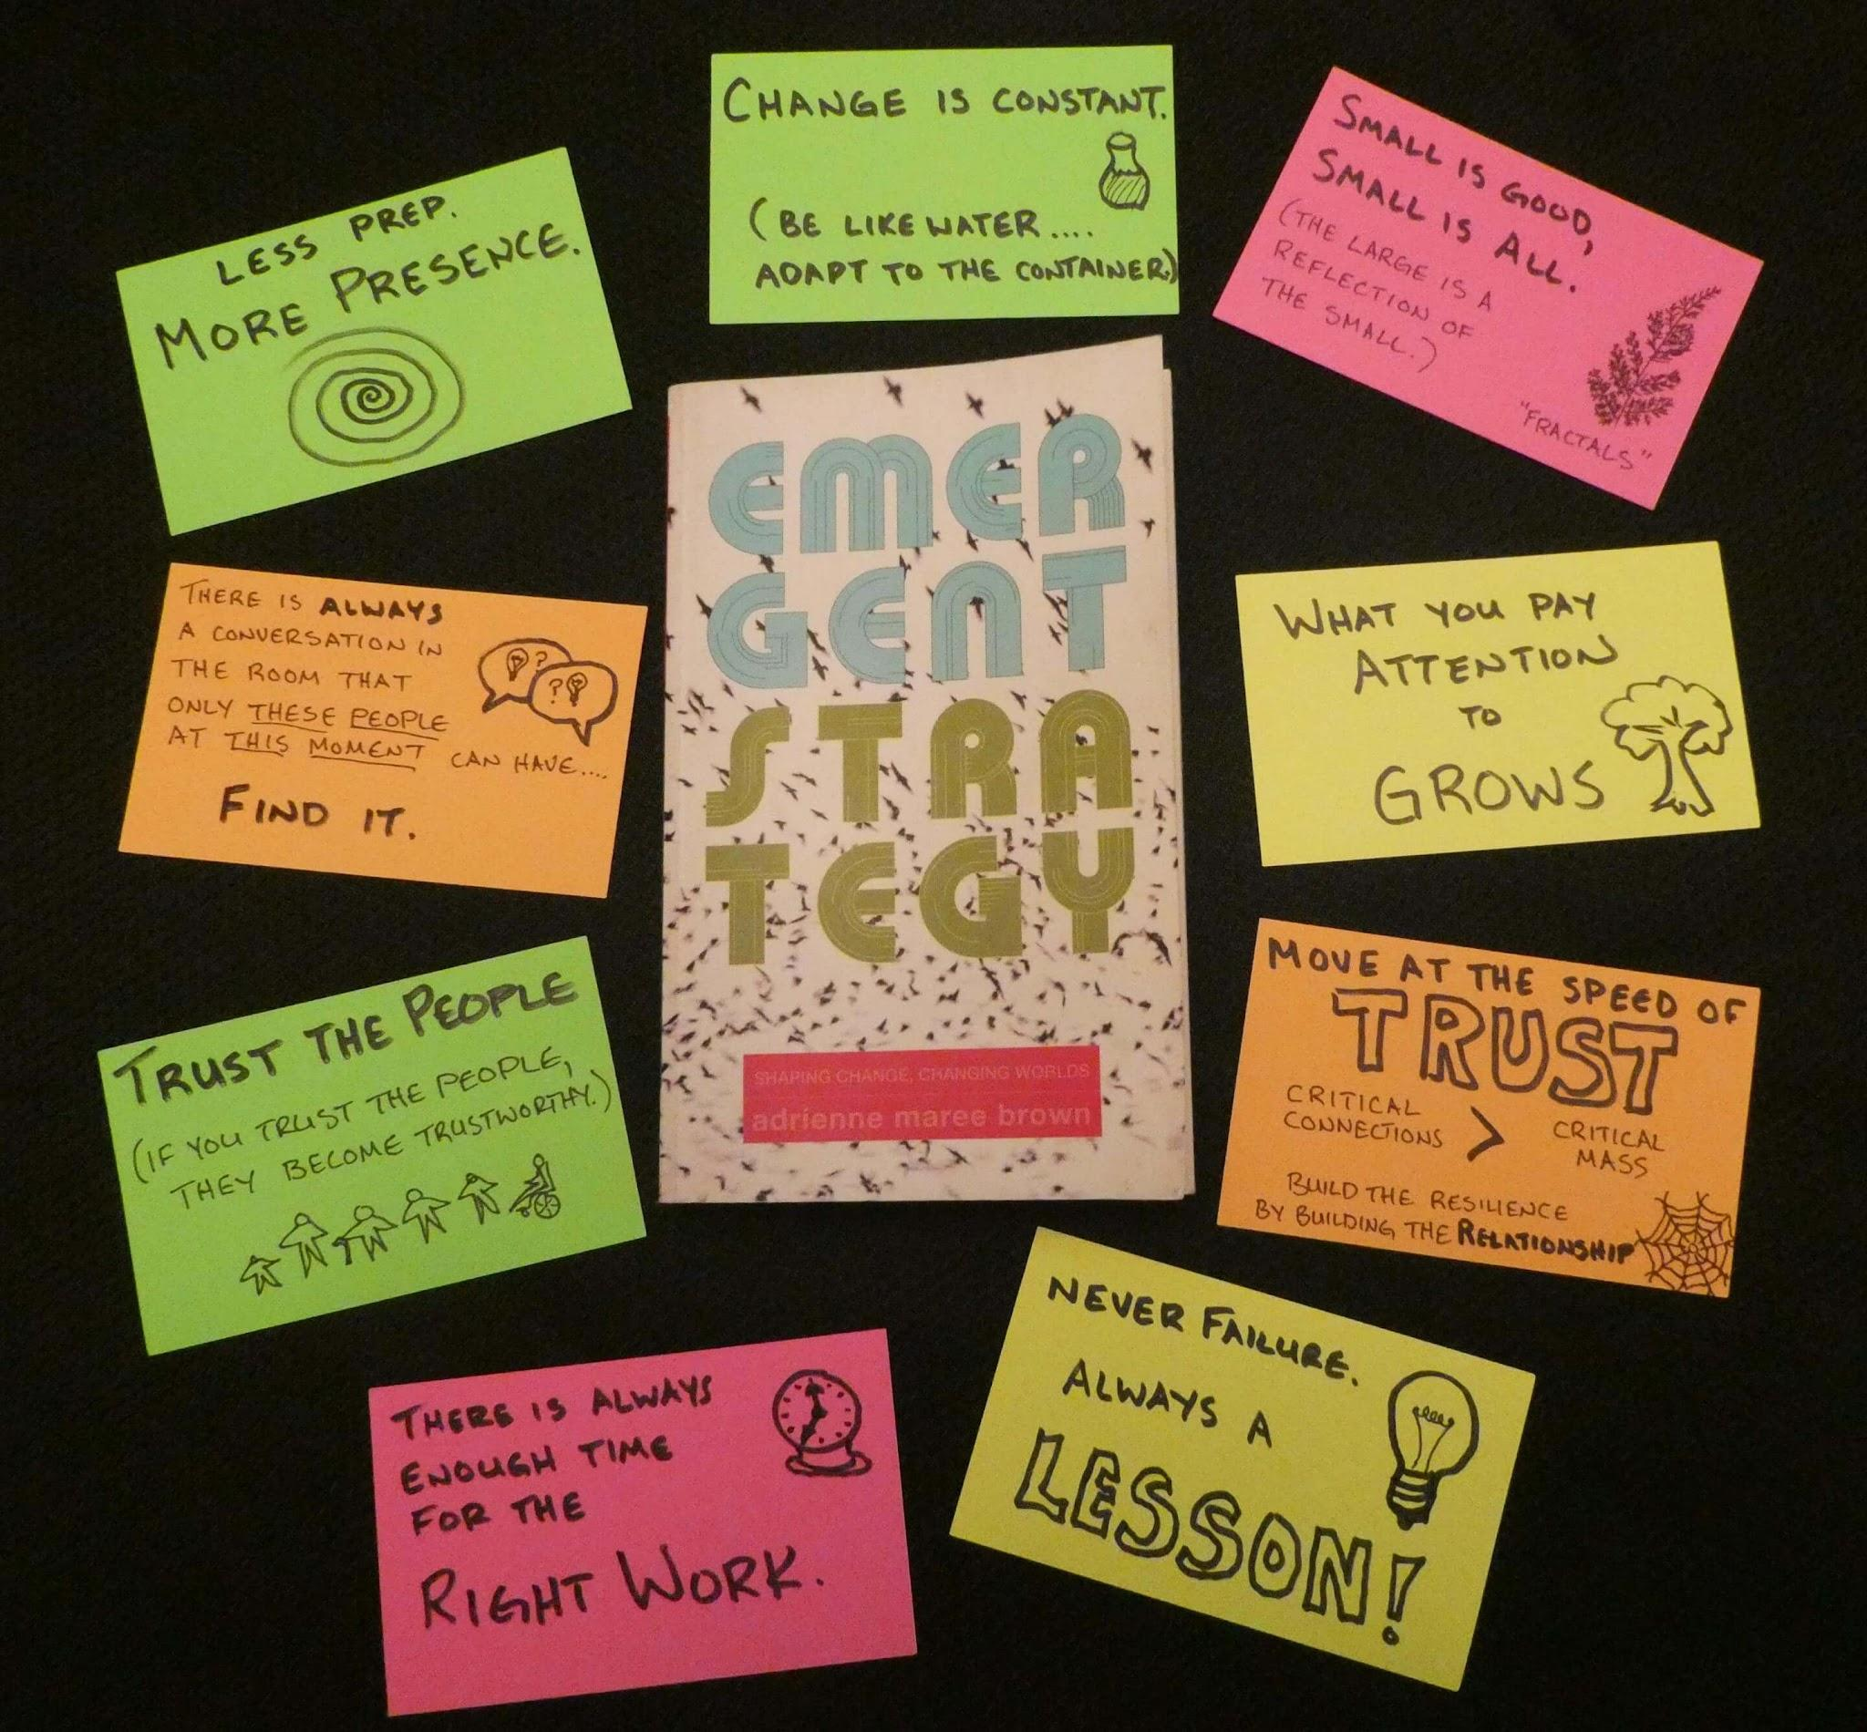
brown’s Emergent Strategy
Set of 9 core principles that can guide behaviours & actions
Recognizes the powerful lesson we can learn about change in the natural world
Powerful for facilitation, change leadership
(Image: https://www.uua.org/leadership/library/emergent-linear-thinkers)
Notes:
Another framework that has influenced my approach to change is adrienne maree brown’s Emergent Strategy:
Set of 9 core principles that can guide behaviours & actions
Recognizes the powerful lesson we can learn about change in the natural world
Powerful for facilitation, change leadership
A couple of principles that I have found particularly helpful:
Change is constant (be like water).
Move at the speed of trust. (Reflect back on trust being an integral part of our definition of change)
There is always enough time for the right work.

Slide 21
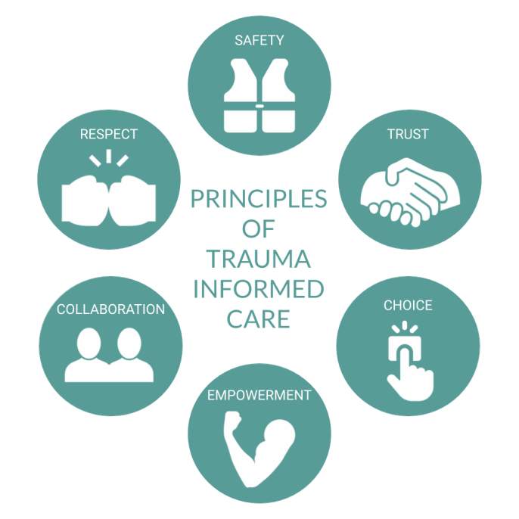
Trauma-Informed Practices
Trauma = event + experience + effects
Focus is on the whole-person
Recognition that past trauma has occurred and will inform future change efforts
(Image: https://theseedsower.files.wordpress.com/2020/12/principles_of_trauma_informed_care_cotwa-1.png?w=686)
Notes:
Another helpful approach is trauma-informed practice. I’m just beginning my journey with trauma-informed practice and care with help from my library colleague Marna Clowney-Robinson, but it has served as powerful reminder that past trauma (defined as the result of an event that is experienced as harmful that has lasting adverse effects on an individual’s well-being) will inform future change efforts and to consider the whole-person when planning and communicating about change within my community.

Slide 22
Mixology: Influencing How We Do Our Work
Use whatever you got: Values, mission statements, operating agreements, guiding principles, etc.
Some examples:
Tap into an extended and diverse set of advisory voices to inform the work of all teams. (Re-entry Guiding Principle)
Install confidence: Staff will be provided with the support (training, tools, and workflows) to be successful in their jobs.(LSP Guiding Principle)
Flexibility and compassion: We are committed to recognizing that we are people first, and we will be understanding of distractions and delays in work. (Employee Survey Team Value)
We will endeavor to be intentionally inclusive and not tokenistic in our approach to bringing voices and perspectives to the table. We acknowledge that our intent and our impact are two different things and will take responsibility for any negative impact we have. (Digital Scholarship Service Team commitment)
Documenting commitments can be powerful, can inform the work, and ensure accountability
Notes:
Sometimes it can seem we have little power and/or opportunity to influence how our colleagues experience change, especially within a larger context. For my mixology example, I recommend using whatever tools are available to you for your change initiative (values, mission statements, operating agreements, guiding principles) and use them to articulate your commitment to human-centered change. You can see some examples on the slide from my colleagues doing just that. Documenting these commitments can help inform the work, change behaviours, and ensure accountability. And while this may seem like a small thing, brown’s Emergent Strategy principles remind us that “small is good, small is all” and “what you pay attention to grows.”

Slide 23
Mixology - Resetting an Departmental Culture
Used the 5Cs to articulate what would happen
Crafted shared values starting from I to foster connection
Used Appreciative Inquiry to ask what should be preserved while we change - what matters most (Discover)
Used TRIZ to have them name the problems without blame or shame
Used Appreciative Inquiry to have them dream of their ideal culture
Used a 15% solutions exercise to add ownership and accountability
Developed working principles through brain writing
What led to this mix?
A high-performing team with human interactions difficulties
Desire to co-create the new culture
Need to foster human connection
Increasing participatory approaches across the Libraries
Notes:
The example I’m sharing showcases a A high-performing team with human interactions difficulties, which had:
Desire to co-create the new culture
Need to foster human connection
Increasing participatory approaches across the Libraries
This was a multi-month process that mixed many of the tools:
Used the 5Cs of communication to articulate what would happen and reduce anxiety
Crafted shared values starting from the personal values with index cards and yarn so no censoring could occur
Used Appreciative Inquiry to ask what should be preserved while we change - what matters most (Discover)
Used TRIZ to have them name the problems without blame or shame
Used Appreciative Inquiry to have them dream of their ideal culture
Used a 15% solutions exercise to add ownership and accountability
Developed working principles through brain writing
The important point in both of our mixology is that you need to first focus on who is impacted by the change, where are they, how can they gain more agency in the change. There is no one set protocol - so experiment with compassion and care!

Slide 24
References:
William Bridges. Managing Transitions: Making the Most of Change.
adrienne maree brown. Emergent Strategy.
SAMHSA’s Concept of Trauma and Guidance for a Trauma-Informed Approach
Jackie Stavros and Cheri Torres. Conversations worth having: Using appreciative inquiry to fue productive and meaningful engagement
Sarah Lewis, Jonathan Passmore, and Stefan Cantore. The Power of Conversation from Appreciative Inquiry for change management: Using AI to facilitate organizational development.
David L. Cooperrider, Jacqueline M. Stavros, and Diana K. Whitney. Appreciative Inquiry Handbook for Leaders of Change.

Slide 25
Other readings:
Karina Hagelin. Moving Towards Healing: A Trauma-Informed Librarianship Primer.
Juanita Brown, and David Isaacs Eric E. Vogt. The Art of Powerful Questions: Catalyzing Insight, Innovation, and Action.
Diana Whitney and Amanda Trosten-Bloom. The Power of Appreciative Inquiry: A Practical Guide to Positive Change (2nd edition 2010)
Sue Annis Hammond. Thin Book of Appreciative Inquiry (3rd edition 2013)
GR Bushe. Appreciative Inquiry Is Not About The Positive.
5-D Cycle of Appreciative Inquiry.
adrienne maree brown. Holding Change.

