Slide 1
Journey to IDEA 2.0: Moving from Education to Action
Annie Bélanger, Stacey Burns, Samantha Minnis, Ashley Rosener
Conference of Academic Library Management
April 2022
Notes:
Samantha- Welcome, thank you all for coming to Journey to IDEA 2.0: Moving from Education to Action. Today we will be sharing a bit about our committee’s journey. We are all members of Grand Valley State University’s inclusion, diversity, equity and accessibility (IDEA) committee. And as you can see on our title slide, we are actually the IDEA 2.0 committee because we are the second iteration of this committee and we are here to tell you all about how we made that journey from our original IDEA committee, which was focused largely on education, to this second iteration which is focused on action and systemic issues.
Slides from: Copy of Cordelia · SlidesCarnival

Slide 2
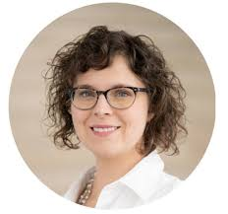
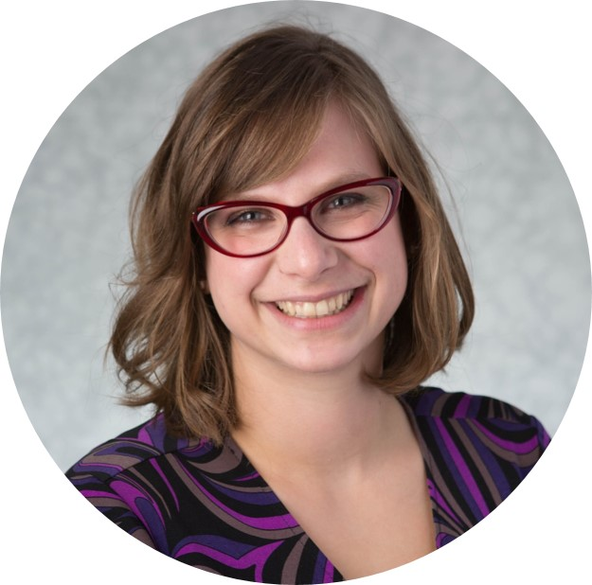
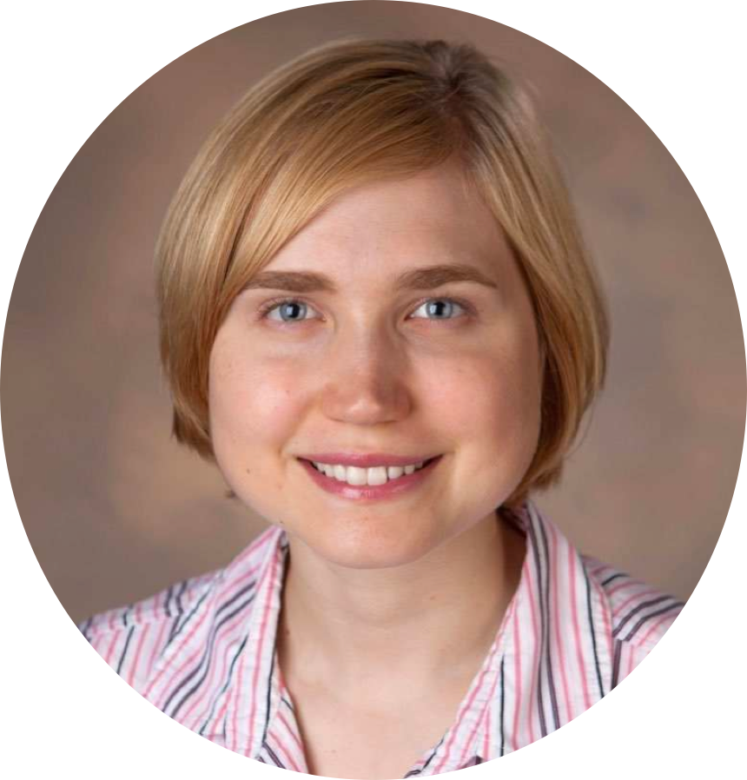
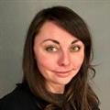
Our team
Annie Bélanger Dean of University Libraries
Sponsor, IDEA Committee
Co-Chair IDEA 2.0 Committee
(She/her)
Stacey Burns Programs & Operations Manager
Member, IDEA 2.0 Committee
(ze/zir or they/them)
Samantha Minnis
Social Sciences Liaison Librarian
Chair, IDEA Committee
Member, IDEA 2.0 Committee
(She/her)
Ashley Rosener Liaison Librarian
Co-Chair IDEA 2.0 Committee
(She/her)
Notes:
Samantha- My name is Samantha Minnis, I am a liaison librarian at GVSU and a member of both the original IDEA committee and the IDEA 2.0 committee. These are my co-committee members and co-presenters who will introduce themselves as we move through our presentation today.

Slide 3
Overview of Our Context
Grand Valley State University
Public university in West Michigan with just over 22 thousand students.
Predominantly White Institution (PWI)
38% first generation college students, hispanic serving institution, veteran certified
Notes:
Samantha-For those of you not familiar with Grand Valley State University or GVSU, we wanted to give you a quick snapshot of our context (read slide)

Slide 4
Overview of Our Context
University Libraries
Four locations across three campuses
62 employees in three employment classes, plus adjunct and temporary employees
Primarily white, seeing results from inclusive hiring practices
From 2% 2017 to 12.5% 2022
Key leadership and stakeholder buy-in on IDEA work
Inclusion a value, still have opportunities for growth as an organization
Notes:
Samantha-: However, our IDEA work is focused more internally to the libraries, so we want to dig a little deeper into our context at the library.
The libraries consists of four library locations across three campuses
At this moment there are 62 permanent employees including both faculty and staff, plus adjunct and temporary employees
The demographics of our staff are primarily white, although we are seeing results from our inclusive hiring practices
We have key leadership and stakeholder buy-in on IDEA work, including dean belanger who is one of the cochairs of our IDEA committee and one of the copresenters ere today
Inclusion is a value in our organization, but we have opportunities to grow, which we’ll be exploring more in this presentation

Slide 5
Collective Engagement Principles
We will not speak for others, and we will not ask someone else to speak for others
We will practice active listening and listen more than we individually speak, prioritizing the voices of BIPOC individuals (may self-identify with an * before a question/comment)
We will respect people’s names and gender pronouns
We will give credit where credit is due
We will hold most questions for the end while welcoming questions throughout and will try to answer in the chat
Notes:
Samantha -At this point in the conference, we should all have seen and be familiar with the code of conduct for the conference. We would like to propose these collective engagement principles which align with the code of the conduct for this conference. If you’d like anything added, please share to the chat. (Read slide)

Slide 6
Share to the chat your current role
Notes:
Samantha Now that you know about us, we’d like to learn more about you all if you’re comfortable, please share to that chat your current role, such as library director, manager/supervisor, aspiring manager or library employee.

Slide 7
Moving from performative to systematic as PWI Library
Notes:
ANNIE

Slide 8
Organizational Values & Philosophy
Respect & cognitive empathy
Compassion
IDEA & equity-minded
Participatory management
Engaged, communicative, accountable leadership
“Focus on personal responsibility while fostering a culture of accountability that recognizes shared humanity and intentionality toward growth”
Notes:
ANNIE
As part of my onboarding as the new Dean, I engaged deeply with colleagues across the Libraries. As I considered what would be needed to build on and honor the existing culture, we created workplace principles that centered demonstrable respect for one another and cognitive empathy in all that we did.
During this time, a group of colleagues set out to ask “What if we brought the same compassion and learner mindset that we use with students to our interactions with colleagues?” Inspired by change management through the lens of appreciative inquiry and interpersonal effectiveness, they led a program to deepen our interpersonal skills. This built on the many years of IDEA development that the Libraries had engaged in.
In parallel, the leadership model shifted to participatory management, anchored in a strengths-based approach to build a culture of care. The Leadership worked actively to grow their skills, offer leadership growth opportunities to others, enhance communications and engagement, and make explicit the implicit that existed in many processes. These changes were anchored in developing an equity-minded approach to our workplace.
In many ways, we set out to “Focus on personal responsibility while fostering a culture of accountability that recognizes shared humanity and intentionality toward growth”

Slide 9
From Working Group to Committee to Structural Taskforce
Articulated our commitments and a path forward to move to an active practice of inclusion. Engaged in user facing changes
Developed and organized shared professional development to advance understanding of DEI
Revamped hiring practices and approach to center candidates and equity. From 2% to 12.5% BIPOC colleagues
Everyone’s Work
Internal Inclusion Working Group
Facilitation & IDEA Committee
Inclusive Hiring Practices
Creates milestones and goals to advance the library's commitment more deeply in our structures and culture. Collaborates with Leadership and colleagues to advance shared accountability.
IDEA 2.0 Taskforce
Adding accountabilities and qualifications into every role. Leadership has clear responsibilities for IDEA in their areas.
1
2
3
5
4
Notes:
ANNIE
Looking on our path towards inclusion, we noticed that we were one organization and yet we have used three methods. Each build upon one another, allowing our colleagues to engage in the process.
Starting in 2016, the Libraries took active steps to become more inclusive for their users. They engaged in trainings and professional development to understand where bias may exist and how to be allies. During this time, a working group led the professional development efforts. In 2017, we challenged our colleagues to move from desiring a culture of inclusion to having an active practice of inclusion. As part of these efforts, we engaged in a multi-month facilitation to identify what our commitment to inclusion, diversity, equity and accessibility were. We created a standing committee at that time to craft a statement, values, definitions and early efforts for visible engagement with the campus community around IDEA. The committee was very active and successful. By 2020, we had normalized their work and built it into job descriptions. We wanted to seek more systemic changes within the organization - creating a task force that would work with the Libraries and the leadership to activate the work while fostering the fact that this would be everybody’s work.
Recent accomplishments include:
Developed and enhanced inclusive hiring practices, particularly in considering a virtual hiring environment - from 2% BIPOC to 12.5%
Replacing collection labels (need correct term) for visibility
Learning Circles on IDEA topics
Exhibition: "Conversations from Matamoros" with Humanitarian Initiative (formerly Refugee Outreach Collective)
Library representative added to the Undocumented/DACA Student Taskforce
Updated Steelcase Service Desk for more accessibility
Created & implemented Inclusive & Accessible Customer Service Learning Guides for student employment
Local fines ending
Oversampling identity-based student groups during listening tour
Exploring ‘safe space’ and ‘brave space’ agreements and approaches
Student senate DEI book displays

Slide 10
Lessons Learned
Start from where you are with a clear vision and why
Build IDEA into every aspects of the work
Build values check-in as part of whole employee lifecycle from hiring to reviews
Empower others to lead from where they are
Locus of control, agency, and sphere of influence
As PWI, there is a need for clear signaling (performative) and systems change (the work)
Notes:
ANNIE
Start from where you are with a clear vision and why: Acknowledge where you are without judgment. Articulate why this is important work and find connections to the personal values of the group. This first step is about hearts and minds. Then create a compelling vision of the benefits and positive movement it will create. Be clear on your purpose, ensure others understand the why. Move authentically and with integrity through the work
Build IDEA into every aspects of the work: Having a desire for inclusion is not enough, it needs to be embedded throughout the work and the organization, to be part of the hiring and review processes. If we want systems level sustained change, we need to ensure all are contributing to the efforts.
Build values check-in as part of whole employee lifecycle from hiring to reviews: Don’t hire for fit - hire for values alignment. Be open about your culture so they can make an informed decision as well as know what you won’t condone.
Empower others to lead from where they are: Good leadership is about clarity of expectations and of role. Empower others to join in the work, to lead where they are from, and to be recognized for their contributions. I talked a lot about Locus of control, agency, and sphere of influence
As PWI, there is a need for clear signaling (performative) and systems change (the work). We need to signal clearly that people are welcome, that we are not in fact neutral. We can adapt how we do our work so that folks with marginalized identities see the space as theirs too, that their comfort is also accounted for. AND we need to be digging deeply into questioning our processes, practices, policies, and systems with intentionality to surface where white supremacy culture is at play, where perfectionism is creating barriers.
In this work, I found it important to acknowledge that while equity lives in our systems, inclusion is done or undone through daily acts.

Slide 11
Why is the IDEA 2.0 Committee All White?
Notes:
STACEY - INTRO (Z mgr new) >
As Annie mentioned, GVSU is a predominantly white institution (PWI) and there is a need for clear signaling and systems change work. We want to share our observations as to why our IDEA 2.0 committee is all white and reflect on our position at this early juncture of the IDEA Committee efforts. The first observation being that currently over 85% of the Libraries’ employees are white. In the next two slides we’ll unpack more context and perspective.

Slide 12
Observations
Environment
Capacity for this work
Power and accountability
Fear of making mistakes
Compelled to action
Notes:
In the question of the composition of UL IDEA committee, we want to use a model of inquiry that we intend to cultivate as a habit in all our work, particularly regarding IDEA. The first step is to take stock and ask, “What is going on?” In addressing this question we seek to gather information coming from a place of critical, nonjudgmental curiosity. We do this to develop context and get a better understanding of limitations. It is important to note the limitations of each of our individual perceptions and keep this in account, working to avoid making assumptions and recognizing when we do misstep so we may recalibrate and move forward.
Environment -
Wicked Problems - The call for participation took place near the start of the pandemic in 2020 when many of us felt strains on our capacity and time and resources were redirected toward the modification of our programs for remote operations. Our front line staff were managing variable services, schedules and in-person operations. Complexity grew as there were staff changes due to early retirement incentives and other waves of change
Nationally with presidential elections and the murder of George Floyd on May 25, 2020 the Visibility of Systemic Racism in the U.S. increased and was met with the growing voice of the Black Lives Matter (BLM) movement
Historical context - There is also growing awareness of the structural layers of inequity in our world. We recognize PWI within a historically white industry and profession
Power & Accountability:
We surfaced that it is not the responsibility of our BIPOC colleagues to change a PWI. The responsibility lies with those who have them most capacity, resources, and privilege. The greatest opportunity to change a system is held by those who the system was created for. It isn’t fair to ask those experiencing the most oppression to dismantle their oppression. Those with formal power at our library invited others to use our informal power to join the effort and approach the work from all available angles.
We observed that while some people stated and interest or an appreciation for the committee concept, few came forward to formally participate in the committee. We gather some factors to be:
An individual’s position within in the library. Roles in an HEI hierarchy afford different opportunities
Individual positionality, values, and individual framing of equity and inclusion
Some BIPOC colleagues articulated the stress of the mental load of national events compounded by navigating immediate environment and daily experiences left them with a need to prioritize self care
Observe what may be culture of academia at play, where some white colleagues were hesitant to be on the committee because they didn’t want their growth areas made visible to all (counter to the concept of ‘expertise’ and vulnerability framing)
My story, I (Stacey) felt compelled to join the committee upon receiving the UL-wide invitation as it spoke to my values. I am a department manager so I started with checking in with colleagues/direct reports to explore their interest/encourage their participation first, particularly get perspective of BIPOC colleagues. They felt beyond capacity. As no dept. Colleagues felt compelled to participate I then accepted invitation to: 1) represent dept. (employee class) 2) As program manager, felt an efficient/effective way to address this work during the pandemic (eg. in-person activity tabled, way to build critical knowledge, self awareness and skills for discourse
Critical to creating more inclusive environments and events in the libraries

Slide 13
Multi-directional Work
Visible
IDEA committee work
Leadership Team commitments & actions
Workplace principles & values
Library IDEA goals
Professional Development Activities
Invisible
Library colleagues leading IDEA work in informal leadership roles
Small daily acts
Local collective engagement agreement
Engaging in difficult conversations
Notes:
STACEY
COmmittee is one facet. The work of IDEA is multidirectional. It has both visible and invisible components. The visible elements tend to be those that are structural and public-facing. The structures include things like formal committees, espoused values (put in plans and on websites) and professional development. Structural frames tend to be well-utilized in higher education. Change through a structural frame is easiest with top-down support. At Grand Valley, we are fortunate to have top-down support from our university president and our library dean. Our work is also supported by GVSU’s robust Division of E&I and colleagues within other departments. Each institution, depending on where it is in its journey has its own ratio of visible:invisible work. In your place of work, you may find you have more work occurring at a grassroots level and may be working on advocacy to leadership. We believe BOTH the visible and invisible, the theoretical and practice, and the words and actions must work toward alignment as IDEA is the work of all (‘not a spectator sport’ we’ cannot be neutral on a moving train. Looking at Inclusion, Diversity, Equity and Accessibility, the true work of inclusion is the culmination small moments and daily acts that may seem invisible/less significant, but are the scaffolding of trust and respect on which the lives of all are improved or that stays at the level of rhetoric.
https://ezproxy.gvsu.edu/login?url=https://search.ebscohost.com/login.aspx?direct=true&AuthType=ip,sso&db=edselp&AN=S1551741117307064&site=eds-live&scope=site

Slide 14
Assessing Our Culture
Notes:
SAMANTHA- As Stacey just described, IDEA work is multidirectional, and we want to investigate the current IDEA work happening in the library as well as assess how inclusive our culture is. Therefor, one of our current projects as a committee has been determining how we can best assess our culture in relation to IDEA. As Annie stated before, it’s important to know where we are as we move to the next steps of our work, and when we reconvened as the 2.0 version of this committee, we felt it was important to gather that information.

Slide 15
Policy Assessment
A goal of the original IDEA committee
Culture
More oral and procedure based vs policy
Framework
MCOD resonated with our goals
Method
Created a survey with partners
Looking Forward
Evaluate survey results for recommendations
Notes:
Samantha- Assessment had actually been a goal since the original committee. We had originally planned or hoped for a policy audit. We struggled with how to assess our policies, we looked for models and weren’t able to find a road map that would fit us perfectly, so we had to create one. Our first realization was that we are not a very policy heavy culture, we operate more with an oral tradition and through procedures or best practices. So our “dreams” of finding all of these policies and rating them on a rubric were dashed. Instead, we needed to assess our culture. As a committee, we tried a few assessments and found them tricky because they were more suited for a business structure or asked questions that were difficult to answer depending on your knowledge of the organization and your particular sphere of influence. Eventually, we found the multicultural organization developmental framework (MCOD), which I’ll explain in greater detail shortly. We then created an assessment tool, in our case a survey based on our chosen framework, that we could use to gather input from everyone in our organization. We partnered with a student colleague and our institution’s statistical consulting center to create our tool. We plan to open up the survey soon and once we get the results, we plan to evaluate it and compare it to the framework and make recommendations to our library’s leadership as part of the larger organizational goal setting process.

Slide 16
Multicultural Organizational Development (MCOD) Levels
Monocultural Organizations
Exclusionary Organization
Non-Discriminating Organizaitons
The Compliance Organization
Multicultural/Inclusive Organizations
The Redefining Organization
1
3
5
2
4
6
Monocultural Organizations“
“The Club”
Non-Discriminating Organizaitons
The Affirming Organization
Multicultural/Inclusive Organizations
The Multicultural Organization
Notes:
Samantha- This visual gives you an idea of the MCOD framework we are using as the basis for our assessment. There are six stages that are grouped in three broader stages: monocultural organizations, non-discriminating organizations, multicultural/inclusive organizations. We liked this framework for a few reasons, first, it felt applicable to everyone’s work. All of the members of the committee work in different departments in the library but we all felt like we could relate to this framework despite our disparate work spheres. Second, the fullest version of the framework, which you can find in our toolkit, includes recommendations for actions members of the organization can do to move from one stage to the next.

Slide 17
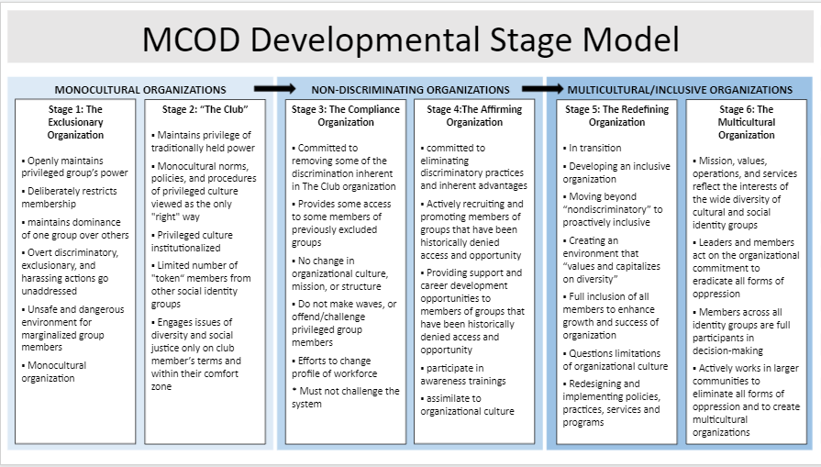
How would you classify your organization?
Notes:
Samantha- Here is a graphic that gives you more detailed information about each stage of the MCOD. At this point, we’d like to give you a couple of minutes to read through the stages and reflect on where you would rank your organization. Feel free to share in the chat if you’d like to do so!

Slide 18
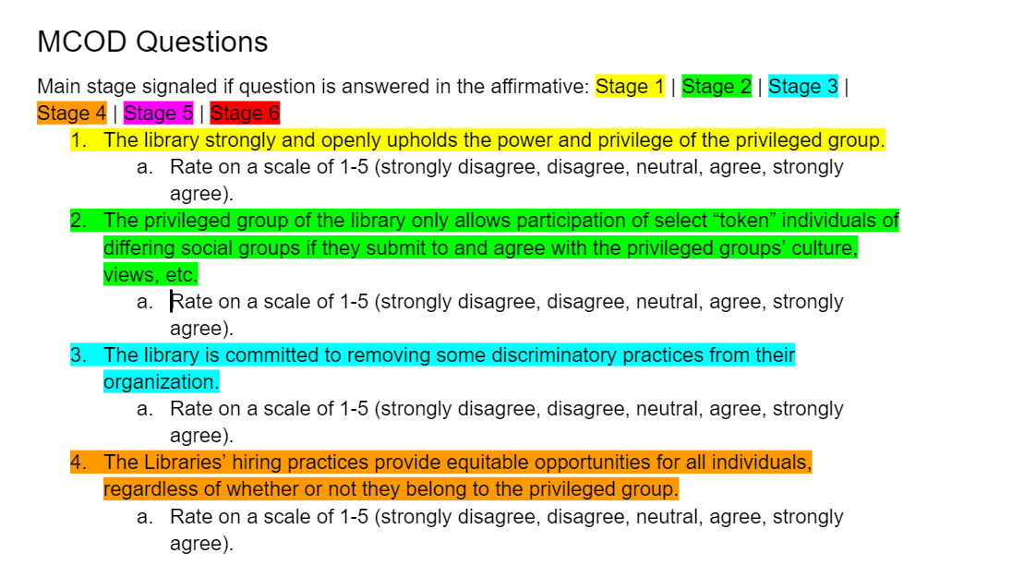
Translating the Tool for our Library
MCOD Survey
Collaboration with Statistical Consulting Center
Careful data management plan
Notes:
Samantha- Once we had chosen our framework, we wanted to turn it into an assessment tool that we could use to get input from everyone in our organization. We decided to turn elements of the framework into a survey. At this point I need to give credit to our student colleague who is not presenting with us today but who has truly done the lion’s share of work on creating this survey, their name is Alex Hicks and they have done a brilliant job. Each survey question asks the taker to rate on a scale of 1-5 their agreement with statements that come from the MCOD. Each answer correlates with a different stage of the MCOD, as you can see with the color coding in the picture on this slide. As we designed this survey, a major concern of ours was managing the data that comes out of the survey. We are asking some demographic questions of the survey takers, and we want to make everyone taking the survey feel as comfortable as possible so they can be as honest as possible in their ratings. To help protect the confidentiality of the survey participants, as well as to get advice about how to best construct a survey, we have partnered with our campus’ statistical consulting center. They have given us so much help with the design of the survey and have really strengthened the final product. They also have agreed to be the ones actually sending out the survey and will have access to the raw data. We can then make requests from them to see the data divided in different ways, but with the assurance that if what we ask for will accidentally identify anyone, they will deny our request. We have also essentially made all demographic questions optional, so people taking the survey can decline to share any information they’d like to keep private. We hope to distribue the survey very soon and begin to process the results and make our recommendations during this summer.

Slide 19
Obstacles and Challenges
Notes:
ASHLEY
Next I will share the obstacles and challenges we’ve encountered as well as some that we see generally in this type of work.

Slide 20
Obstacles
Resources
Human, financial, physical
Formal and informal policies
Systems in higher education
Resistance from leadership
Environment
Campus community
West Michigan
Notes:
ASHLEY We define obstacles as barriers encountered in our committee’s work. These barriers and obstacles must be addressed even if they cannot be fully solved in order to move forward. At our library, we have primarily encountered human resource obstacles, as in individuals having little time to take on new projects as well as fewer colleagues as folks retire.
Existing or missing policies are another obstacle many encounter and can take time and energy to change as they are approved by committees and bureaucratic procedures are followed. Our strategy was to make changes and incorporate new practices alongside looking at and changing policies rather than waiting until policies were changed to do the work. Related to policies are systems in higher education that have strong historical and cultural foundations and were NOT designed with IDEA in mind.
Resistance to change from Leadership at an organization can be a difficult obstacle to overcome. We are fortunate not to have faced that within our libraries. Environmental obstacles can be challenging as well. While our campus continues to grow in being actively anti-racist, we are well-supported in our IDEA work on campus. Our university has an active Division on Inclusion and Equity and there is an explicit charge for racial equity and inclusion with an action plan and resources. One’s larger environment can be an obstacle as well. For us, our main campus and library are located in Allendale, a rural/suburban conservative community in West Michigan.
(There is a GVSU charge with Presidential priority, active DEI department, initiatives in other large campus departments: https://www.gvsu.edu/inclusion/charge-for-racial-equity-inclusion-163.htm )
Would ‘informal policies’ be culture or something else?

Slide 21
Challenges
Time
Capacity and pacing
Communication
Emergent needs/strategies
This is everyone’s work
Requires: tools, coaching, using an equity lens
Culture
Activating formal and informal leaders
Notes:
ASHLEY Challenges can be ongoing issues, sometimes beyond our control, that impact our ability to establish a multicultural and inclusive organization but we can continue moving this work forward even with these challenges. We have identified challenges relating to time, communication and culture.
We want to acknowledge that culture change takes time and the pandemic complicated this. progress needs to be communicated to show what’s happening since not all the work has explicit outcomes/outputs and it’s important to recognize all aspects of progress
As for communication, we worked to share out progress and efforts and calls for input and feedback often. We held space for emerging needs, noting how important it is to make time for the right work. Throughout this, we worked to show all our library colleagues this was everyone’s work and all could contribute in different ways, such as by using an equity lens. We led library-wide activities on how to use an equity lens and how to look for 15% solutions and what small changes were within the locus of control of individuals. Since IDEA is everyone’s work we made sure to share TOOLS for everyone.
We also want to note that changing culture is a complex challenge since organizational culture can include unconscious biases. In order to accomplish this over the years, we’ve worked to activate leaders throughout the organization, which means encouraging both formal and informal leaders and acknowledging and rewarding their work.

Slide 22
Doing the Work
Notes:
Ashley We want to conclude with some examples of the IDEA work that’s being done around our library.

Slide 23
Engaging with colleagues
Workplace Principles and Collective Engagement Agreements
Leveraging inclusive practices
15% solutions exercise (Liberating Structures)
Making it everyone’s work
Visiting department meetings to gather feedback on the UL IDEA Framework
Notes:
While our IDEA committee serves as champions of the work, we’re involving all our colleagues in a number of ways such as those show on this slide. We are providing spaces for our colleagues to collaborate on IDEA work so as to make it everyone’s work. We’ve established workplace principles though conversations with all colleagues and a few departments have set up their own collective engagement agreements to ensure inclusive practices. Members of our IDEA committee have held some facilitated conversations and workshops such as one using the 15% solutions exercise from liberatingstructures.com This site describes 15% Solutions as showing that there is no reason to wait around, feel powerless, or fearful. They get individuals and the group to focus on what is within their discretion instead of what they cannot change. We used this activity to make space for folks to see what small actions they can take in their individual work to advance inclusion, diversity, equity and accessibility. More recently IDEA committee members visited all library department meetings to gather feedback on our University Libraries IDEA Framework to ensure transparency in our process and decision making in order to co-create the Framework. We completed the feedback loop by responding to all questions and concerns that arose during those meetings in a google doc we then shared out with an invitation for additional questions and feedback.

Slide 24
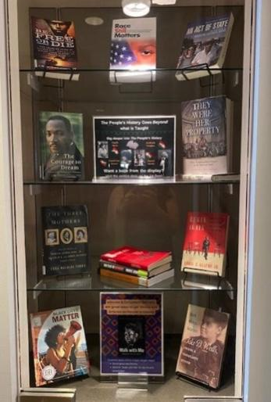
IDEA efforts by all colleagues
Book displays
Wiki-Edit-a-Thon for Social Justice
Partnering with student affinity groups
Inclusive hiring practices
Changing subject headings: Undocumented immigrants in place of Illegal Aliens
Learning circles
Using an equity lens for decision making
Notes:
While our IDEA committee has spearheaded conversations, policy change, and workshops, the IDEA work at our library is multidirectional and our colleagues have looked for ways to further inclusion, diversity, equity and accessibility in many different ways. Some examples are shown on this slide and pictured is a book display for Black History Month this year. A couple colleagues also organized a virtual Wiki-Edit-a-Thon for Social Justice.
Over the summers our library has multiple learning circles, and some are on IDEA topics such as reading and discussing the book “How to be an Anti-Racist”. Finally we’ve held discussion on how to utilize an equity lens for individual and collective decision making.
Student affinity groups - cartoneras project

Slide 25
Equity Lens
For what purpose?
Who benefits?
Whose comfort and sense of safety is centered?
Who is/could be harmed?
Who has agency & voice?
Who can experience and express joy in engaging with the Libraries?
What assumptions are we making?
Notes:
Our University Libraries IDEA Framework includes a section on using an equity lens. According to the Center for Nonprofit Advancement “The purpose of an equity lens is to be deliberately inclusive as an organization makes decisions. It introduces a set of questions into the decision that help the decision makers focus on equity in both their process and outcomes.” (https://www.nonprofitadvancement.org/files/2020/12/What-is-an-Equity-Lens.pdf)
In order to center an equity lens in our work, we ask questions of our work. The questions listed on this slide are for all of us to reflect on individually and collectively as appropriate. Individually and collectively, we take ownership of our education and generously question the work we do, the plans we make, and the decisions that are implemented with the following questions. These questions were inspired from James Madison University Libraries and edited with input from our University Libraries’ colleagues.
For what purpose?
Who benefits?
Whose comfort and sense of safety is centered?
Who is/could be harmed?
Who has agency & voice?
Who can experience and express joy in engaging with the Libraries?
What assumptions are we making?

Slide 26
What is one action you can commit to at your institution in the next month?
Notes:
Ashley We hope our session today gave you some ideas as well as questions to take to your institution. Before we transition into Q&A, Please share to the chat one action you can commit to at your institution in the next month.

Slide 27
Thanks!
Any questions?
Check out our toolkit: http://gvsu.edu/s/1ZQ
Notes:
Budget 10-15 minutes post to scholarworks and share bit.ly here

Slide 28
Credits
Special thanks to all the people who made and released these awesome resources for free:
Presentation template by SlidesCarnival
Photographs by Unsplash

