Slide 1
Practicing organizational care
Using human-centered approaches to facilitate change in your library
Annie Bélanger & Meghan Musolff
MiAlA 2022
Notes:
MEGHAN
Good afternoon. Thank you so much for joining us this afternoon. My name is Meghan Musolff and I work for the University of Michigan Library as the Lead Project Manager.
[Annie introduction]
Today we’re going to talk about Practicing Organizational Care and using a human-centered approach to facilitate change in your library. In our experience, most traditional change management practices seek to mitigate risk. They focus on process and implementation over listening, empathy, compassion, and healing. By using what we call “human-centered change approaches”, we will explore ways to tailor change efforts (regardless of the scale & scope) in ways that honor the individuals AND the work of the organization, that harness the strengths of the team, and make space for all voices to be heard.

Slide 2
Learning outcomes
Session participants will:
Understand the basic components of human-centered change
Gain awareness of tools/behaviors to facilitate AND advocate for engaged change leadership
Deepen your understanding of how to communicate effectively and compassionately during change efforts
Notes:
MEGHAN
Here’s what we hope you all get out of today’s session:
Understand the basic components of human-centered change
Gain awareness of tools/behaviours to facilitate AND advocate for engaged change leadership
Deepen your understanding of how to communicate effectively and compassionately during change efforts

Slide 3
Human-Centered Change
Most change management mitigates risk. What if it could promote good? What if we were compassionate to each other?
Centering the human-experience
Engaging colleagues as partners
Providing opportunities to plan and take action
Articulating why, what, and how
Seeking to co-create as an ideal
Notes:
ANNIE
Traditional change mgt is about mitigating risks. What if it could promote good? Human-centered layers in order to promote good by:
Centers the human-experience
Engages colleagues as partners
Provides opportunities to plan and take action
Articulates why, what, and how
Seeks to co-create as an ideal

Slide 4
Empower Others to Advance Change
Participation increases empowerment, which reduces helplessness and leads to action
Provide clarity
Ask how might we
Leverage compassion and empathy
Communicate what you know and don’t know
Model bravery through change
Acknowledge difficulties
Notes:
ANNIE
Whether change is planned or unplanned, directed or self-driven, participatory or imposed, we control and can control how we proceed through a change. Even when we have no agency in defining the change, we can be intentional in our reaction, our engagement in making it happen, and using the power of strategic yes and no to recapture a level of agency. Leveraging change management encourages everyone to engage with change efforts and to rapidly, completely and proficiently make the required changes to their day-to-day work. We can help empower others by providing clarity, asking how might we, and leveraging compassion and empathy.
Participation increases empowerment, which reduces helplessness and leads to action

Slide 5
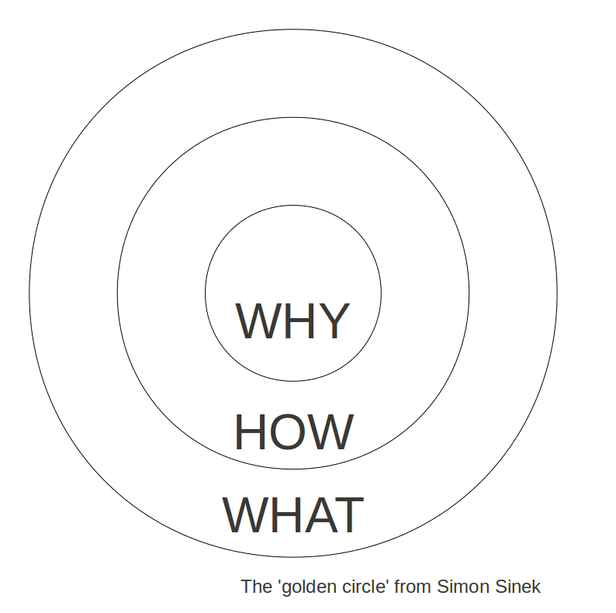
Why, What, and How
Consider this series of steps:
Identify what is happening
Assess the scale and scope of the impact to the organization
Acknowledge concerns and emotions
Articulate what agency does exist or how it is being created
Reframe the change
Seek the opportunities
Set clear expectations
“We are willing to commit ourselves if we understand what it’s all about, and we believe the proposal will bring benefits, that it is possible and that we can influence the final result.” ~ Kari Tuominen
Notes:
ANNIE
Most people start with WHAT because it's the easiest thing to communicate. Then they may discuss the HOW, but rarely the WHY. In order to inspire, invert the order. Start with WHY (purpose), then HOW (values and actions and differentiators), and then WHAT (products and results). Simon provides a useful framework for his approach to leadership: the Golden Circle. At the center of the Golden Circle is WHY. The next concentric circle is HOW. And finally, the outermost circle is WHAT.
Consider this series of steps:
Identify what is happening
Assess the scale and scope of the impact to the organization
Acknowledge concerns and emotions
Articulate what agency does exist or how it is being created
Reframe the change
Seek the opportunities
Set clear expectations
“We are willing to commit ourselves if we understand what it’s all about, and we believe the proposal will bring benefits, that it is possible and that we can influence the final result.” ~ Kari Tuominen

Slide 6
Tool: Organizational Values
Questions to consider:
What are the aspirational values of your organization?
How do those compare with the lived, day-to-day values that individuals experience?
How well aligned are individuals to these values as seen through their actions and behaviors?
How well aligned are processes and structures to the values?
How could we work towards our values through this change effort?
Notes:
MEGHAN
An important tool for human-centered change is your library’s values. (We’re going to assume that your organization has values. If not, going through the values creation process is something we highly recommend). All too often organizations create values and then put them on the shelf, where they get dusty and covered in cobwebs. Launching a change effort provides an opportunity for an organization to put their values into practice.
Some questions to consider as you get started:
What are the aspirational values of your organization?
How do those compare with the lived, day-to-day values that individuals experience?
How well aligned are individuals to these values as seen through their actions and behaviors?
How well aligned are processes and structures to the values?
By taking the time to conduct this quick value gap analysis (current state vs. future state), you can center the humans involved in the change and begin to live and put into practice these values towards your colleagues through your change effort.

Slide 7
Connection Between Mission & Human-Centered
“Why not bring the same compassion we bring to our users to our colleagues?” ~Emily Frigo
Fulfilling our mission of service starts by being in service together and for one another.
Notes:
ANNIE
Before moving on, we feel it is important to acknowledge that there are situations where taking a human-centered approach can feel in tension with the mission our our organizations and that is is sometimes challenging to hold both of these principles in our minds at the same time: How do we provide flexibility in work schedules while also ensuring our spaces are staffed? How do we maintain our service commitments to our users while also dealing with staffing shortages?
Libraries’ missions are anchored in a service ethos. We teach each other to bring respect, empathy, care, and compassion to our users. In bringing human-centered approaches we are advancing this mission to our colleagues, to our organization, and to our long-term health. We simply see that if we are to walk our talk of service ethos, we must first treat ourselves. Physician heal thyself here apply to care within our organization. We are in no way saying that we will simply care for colleagues and let our external facing mission go unfulfilled, but rather why not bring joy and care to the work. Making work harder and unhealthy is not supportive of our mission fulfillment.

Slide 8
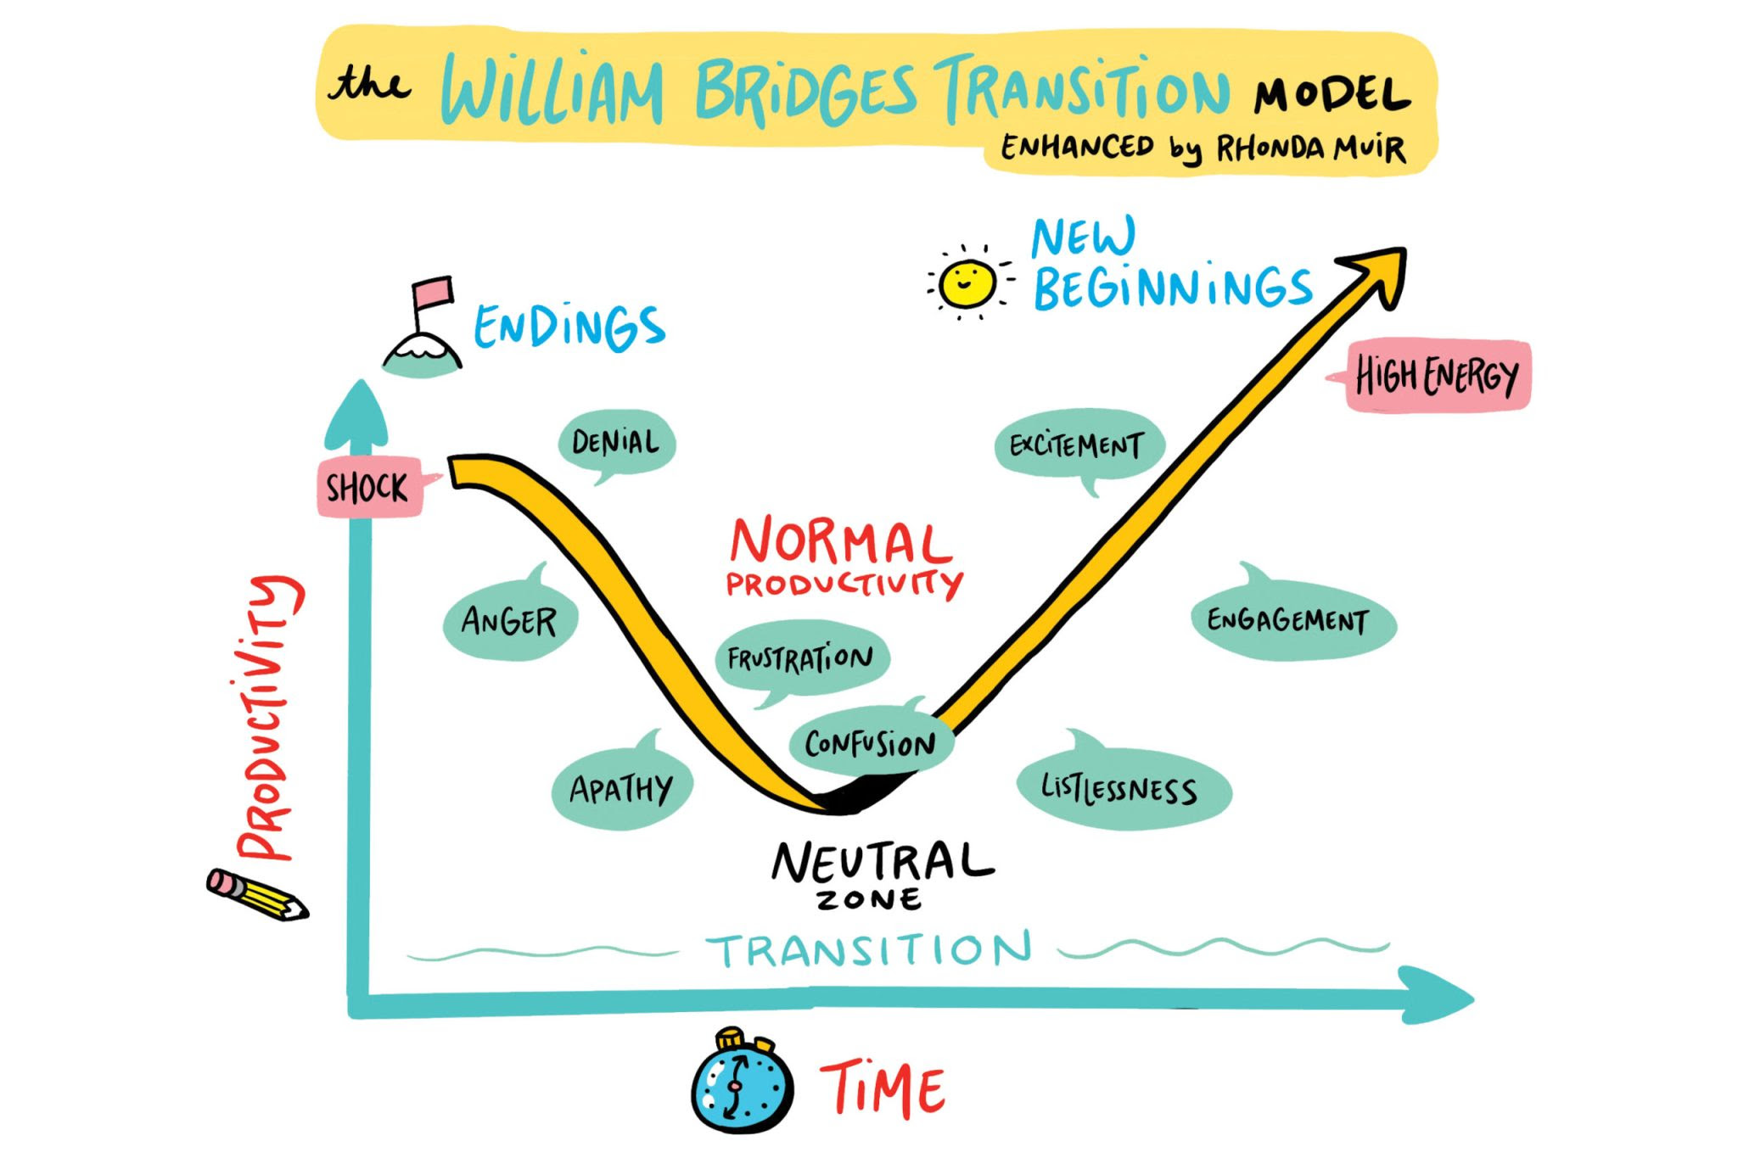
Tool: Bridges’ Transition Model
(Image: https://www.imagethink.net/leadership-through-uncertainty/)
Notes:
MEGHAN
Developed by William Bridges about 30 years ago, the Bridges’ Transition Model provides a framework to help think about the human experience of change by dividing the transition into three phrases: Endings, Neutral Zone, and New Beginnings.
Endings: This phase acknowledges the (often overlooked fact) that before something new begins, something old has to end.
Neutral Zone: This is the space between the old way of doing things and the new way of doing things. One of the things I appreciate about this visual depiction of the Bridges Model is that it demonstrates the typical drop in productivity during the Neutral Zone.
New Beginnings: This phase is when the change begins to be felt in minds & hearts. There are new values, new attitudes, new identities
The focus here is on recognizing the emotions associated with each phase and to build empathy and compassion for colleagues who are living through the change at their own pace. By using this model, one can acknowledge the past and help colleagues look towards the future. And while presented in a linear fashion, one often moves back and forth between the phases.

Slide 9
Bridges’ Model in Practice
As an individual contributor:
A reminder that I have agency over my own path/journey
Helps me bring empathy & compassion for colleagues (and myself)
As a change leader:
Use the framework to create a shared vocabulary
Center emotions throughout a change: Ask people how they are feeling AND validate those feelings
Guide communication strategy
Keep top-of-mind that I’m usually in a different place than others (slow down, keep communicating, keep checking-in because people move back and forth)
Notes:
MEGHAN
As we introduce some of the tools we use in our human-centered change approach, we want to provide specific examples of how we use these tools in practice, how these tools have influenced our behaviors. So here’s how the Bridges’ Transition Model has influenced my work:
As an individual contributor:
A reminder that I have agency over my own path/journey
Helps me bring empathy & compassion for colleagues (and myself)
As a change leader:
Use the framework to create a shared vocabulary
Center emotions throughout a change: Ask people how they are feeling AND validate those feelings
Guide communication strategy
Keep top-of-mind that I’m usually in a different place than others (slow down, keep communicating, keep checking-in)

Slide 10
Tool: Feedback Loops
Input
Design feedback loops as part of your communication strategy
Important tool for engagement change leadership
Mechanism to demonstrate organizational values
System
Output
Notes:
MEGHAN
As you begin to plan communication strategy, one approach to adopt is the creation of feedback loops. Feedback loops create an opportunity to gather information/input from colleagues about a particular topic, provide an opportunity to influence the change to the system you are trying to make, and then closing the loop by sharing back what you learned.
In our experience the creation of feedback loops is an important tool for engaged change leadership and a mechanism to demonstrate organizational values in action.

Slide 11
Feedback Loops In Practice
As an individual contributor:
Recognize my own feedback loop behavior and its impact on trust
Ask about opening a feedback loop
Express gratitude
As a change leader:
Bring intentionality & purpose when opening a loop: Why this group of people? Where can they help/influence? Where do they have agency? Where are the opportunities to co-create?
Design loops towards full participation & inclusion
Close the loop AND demonstrate that you’ve listened
Express gratitude
Notes:
MEGHAN
So, again. Here’s how I incorporate feedback loops in my work:
As an individual contributor:
Recognize my own feedback loop behaviour and its impact on trust
Identify opportunities to encourage the opening of a loop
Express gratitude
As a change leader:
Bring intentionality & respect to how I open a loop: Why this group of people? Where can they help/influence? Where do they have agency? Where are the opportunities to co-create?
Design loops towards full participation & inclusion
Close the loop AND demonstrate that you’ve listened
Express gratitude

Slide 12
Appreciative Inquiry
The co-evolutionary search for the best in people, their organizations, and the relevant world around them
Asking questions that strengthen a system’s capacity to apprehend, anticipate, and heighten positive potential
Asking the questions in a positive frame
Seeking the strength as opposed to the problem
Appreciation
Inquiry
Wholeness
Notes:
ANNIE
Appreciative Inquiry (AI) is "about the co-evolutionary search for the best in people, their organizations, and the relevant world around them”
AI distinguishes itself from other organizational visioning and change models by focusing on the best of what is and using this as a platform to build future directions. While many traditional methods begin by focusing on pitfalls and problems, Appreciative Inquiry asks people to explore strengths and successes that already exist, both internally and externally by
Asking questions that strengthen a system’s capacity to apprehend, anticipate, and heighten positive potential
Asking the questions in a positive frame
Seeking the strength as opposed to the problem
Three concepts form the foundation, sometimes called the “three-legged stool” of Appreciative Inquiry: appreciation, inquiry, and wholeness.
Appreciation: To appreciate is to recognize the best in people, or the world around us. These strengths become the foundation on which the future can be built.
Inquiry: To inquire is to ask questions. It invites participants to ask questions so they can learn from one another, and together identify a shared vision of the future. Participating in an AI process requires an attitude of curiosity and a hunger for discovery.
Wholeness: The final AI tenant of wholeness encourages participation from all levels of an organization, knowing that the best ideas often emerge from unexpected places. Additionally, AI encourages seeking outside perspectives. It is a whole-system process.

Slide 13
Appreciative Inquiry: 5 D cycle
Can be used in whole or in parts
Provides space to imagine infinite possibilities
Brings joy to the process of change definition
1. DEFINE
What is the focus?
Clarifying
2. DISCOVER
What is good? What gives life?
Appreciating
Positive Core
5. DESTINY
What will be?
Innovating
3. DREAM
What might be?
Envisioning
4. DESIGN
How can it be? How might we?
Co-constructing
Notes:
ANNIE
“The task of leadership is to create an alignment of strengths, in ways that make our system’s weaknesses irrelevant.” ~ Peter Drucker
Can be used in whole or in parts
Provides space to imagine infinite possibilities
Brings joy to the process of change definition
Define – What is the topic of inquiry? – It is important to define the overall focus of the inquiry (what the system wants more of). The first question is fateful. In this phase, the guiding question is, “What generative topic do we want to focus on together?”
Discover – Appreciating the best of ‘what is’ – Discovery is based on a dialogue, as a way of finding ‘what works’. It rediscovers and remembers the organization or community’s successes, strengths and periods of excellence.
Dream – Imagining ‘what could be’ – Imagining uses past achievements and successes identified in the discovery phase to imagine new possibilities and envisage a preferred future. It allows people to identify their dreams for a community or organization; having discovered ‘what is best’.
Design – Determining ‘what should be’ – Design brings together the stories from discovery with the imagination and creativity from dream. We call it bringing the ‘best of what is’ together with ‘what might be’, to create ‘what should be – the ideal’.
Deliver/Destiny – Creating ‘what will be’ – identifies how the design is delivered, and how it’s embedded into groups, communities and organizations. In early appreciative inquiry development, it was called ‘delivery’, based on more traditional organizational development practice. The term ‘destiny’ is more prevalent now.

Slide 14
5 D Cycle In Practice
Define - How can we be an inspiring library for ourselves and others?
Discover - Share high points, listen, identify shared patterns
Dream - Generate images of a shared future based on the patterns of the interviews by writing a cover story or making an image
Design - Answer how might we become that reality by:
Brainstorming practical ideas the dream
Rapid prototyping a concrete initiative to bring to reality
Deploy
What outcomes 1-2 months?
What benchmarks in 6 months?
“One great conversation can shift the direction of change forever!” ~ Linda Lambert
Notes:
ANNIE
Define - what do you seek to explore together
Discover - Appreciative Interview to learn what is best
Dream - Generate images of a shared future based on the patterns of the interviews
Design - Answer how might we by
Brainstorming practical ideas the dream
Rapid prototyping a concrete initiative to bring to reality
Deploy
What outcomes
What benchmarks

Slide 15
Appreciative Inquiry: Generative Questions
Generates reflection and creativity by:
Asking open-ended questions
Starting with “What if”, “why”, “how might we”
Includes a clear scope and positive intent of inquiry to move forward
Anchored in positive intent
Example: Moving to generative
Does our decision lack perspective? >>>> What would someone who had a very different set of beliefs than we do say about our decision?
Remember: powerful questions are generative, thought-provoking, and meaningful
Notes:
ANNIE
Psychologist Carl Rogers wrote, "Real communication occurs when we listen with understanding - to see the idea and attitude from the other person's point of view, to sense how it feels to them, to achieve their frame of reference in regard to the thing they are talking about." In asking generative questions, we are seeking to understand and to foster dialogue toward shared understanding. We shift from being right and knowing to inquiring. We seek to generate reflection and creativity.
Open ended questions allows the speaker to imagine what could be, and explore what is. While close ended question invite efficiency and yes/no answers, they do not generate conversation. Additionally, the linguistic construction of questions affect their effectiveness and importance. It was found that questions starting with “Why,” “How,” and “What” are more powerful as compared to queries that start with simple “Who,’ “When,” “Where,” and “Which” which may fall under the less powerful category. This is because powerful questions motivate more reflective thinking and more profound level of conversation. One caveat: Why can be a trigger of judgement for some. Rephrasing Why questions to “How might we?” or “Help me understand” can help you move past accidental icebergs.
The second dimension is the scope of the question which simply means knowing how to tailor the kind of question to our needs. The extent of asking the question must only be within the needs of the situation and realistic goals. We are not engaging in dialogue for dialogue’s sake. Lastly, the assumptions embedded into most of the questions must be appropriately applied. To demonstrate it, you might as well ask “What can be done to prevent it from happening again?” instead of “Why did you fail to do it?” The first question stimulates reflective thinking in contrast to the second question.
Be anchored in positive intent, not positivity. The intent is positive in that you seek to make it better. Realize that by asking a question, you may be introducing unconscious bias. Before going forward with your questions, consider the following:
What assumptions or beliefs are we introducing with this question?
How would we approach this issue if we had an entirely different belief system?
Is this a question to which we do not know the answer? If we already know the answer or have a preset “right” response, it is not inquiry.

Slide 16
Appreciative Inquiry: Name It > Flip It > Frame It
Name It
Flip It
Frame It
Name the problem or concern - often a negative statement
“Why have we failed?”
Flip it to its opposite - often a positive statement
“We want to succeed.”
Frame it in reality: a generative question(s) that drives to flipped
“What could success look like? What did go well, and how do we build on that? What would you like more of? How would we feel safe to try again?”
Notes:
ANNIE
Name it > Flip It > Frame It is a practical tool for
Cognitive reframing is a psychological technique that consists of identifying and then changing the way situations, experiences, events, ideas, and/or emotions are viewed.The main goal of reframing is to refashion negative thoughts and to turn them into positive ones. It is important to highlight the opportunities, the good, and also be transparent about the difficulties and challenges. Framing what is good can not be done by invalidating the realities of others involved in the change.

Slide 17
Questions & Discussion
Annie Bélanger
belange1@gvsu.edu
@annie_belanger
Meghan Musolff
musolffm@umich.edu
@MooseOff
Notes:
Prompt questions to get the conversation started: Can you think of a time when you have succeeded through change? What made that possible? How did the change effort center engage those impacted? How did the change effort align with organizational values?

Slide 18
References:
William Bridges. Managing Transitions: Making the Most of Change.
adrienne maree brown. Emergent Strategy.
Jackie Stavros and Cheri Torres. Conversations worth having: Using appreciative inquiry to fue productive and meaningful engagement
Sarah Lewis, Jonathan Passmore, and Stefan Cantore. The Power of Conversation from Appreciative Inquiry for change management: Using AI to facilitate organizational development.
David L. Cooperrider, Jacqueline M. Stavros, and Diana K. Whitney. Appreciative Inquiry Handbook for Leaders of Change.
Notes:
http://www.exforsys.com/career-center/questioning-skills/how-to-ask-powerful-questions.html
Another resource is: Vogt, E., Brown, J., and Issacs, D. (2003). The Art of Powerful Questions: Catalyzing Insight, Innovation, and Action.

Slide 19
Further readings:
Karina Hagelin. Moving Towards Healing: A Trauma-Informed Librarianship Primer.
Juanita Brown, and David Isaacs Eric E. Vogt. The Art of Powerful Questions: Catalyzing Insight, Innovation, and Action.
Diana Whitney and Amanda Trosten-Bloom. The Power of Appreciative Inquiry: A Practical Guide to Positive Change (2nd edition 2010)
Sue Annis Hammond. Thin Book of Appreciative Inquiry (3rd edition 2013)
GR Bushe. Appreciative Inquiry Is Not About The Positive.
5-D Cycle of Appreciative Inquiry.
adrienne maree brown. Holding Change.

Slide 20
Further Resources
SAMHSA’s Concept of Trauma and Guidance for a Trauma-Informed Approach
https://www.liberatingstructures.com/
https://learningforsustainability.net/facilitation/
https://www.hydrafoundation.org/training-support/facilitator-training
https://www.sessionlab.com/blog/facilitation-technique-toolkits/

