Slide 1
Centering Our Collective Humanity through Inclusive Leadership Practices
ACRL Leadership Discussion Group
Annie Bélanger
October 2022
Notes:
Abstract: What if we brought the same compassion that we reserve for our users to our colleagues? This session will explore what inclusive leadership is and the traits and practices it encompasses. It will consider how leaders, whether formal and informal, can center empathy and compassion in their practice to increase equity-minded practices and fostering an inclusive organization. Attendees will be provided with approaches, frameworks, and tools to explore for their continued growth.
Keywords: Leadership, Empathy, Inclusion, Compassion, Human-Centered

Slide 2
Learning Outcomes
Understand what inclusive leadership is
Gain awareness of traits and practices of inclusive leadership
Deepen your understanding of how to center empathy and compassion to foster equity-minded practices
Explore tools for continued growth

Slide 3
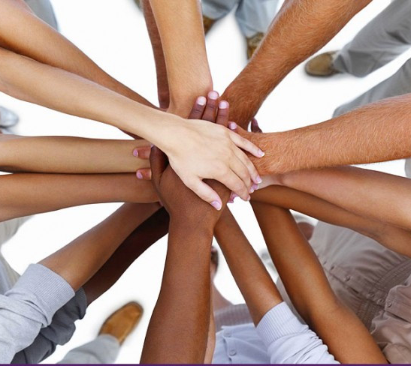
What does Inclusive Leadership mean to you?

Slide 4
Definition: Inclusive Leadership
“Inclusive leaders are individuals who are aware of their own biases and actively seek out and consider different perspectives to inform their decision-making and collaborate more effectively with others.”
Center for Creative Leadership: https://www.ccl.org/articles/leading-effectively-articles/when-inclusive-leadership-goes-wrong-and-how-to-get-it-right/
Notes:
The Center for Creative Leadership provides the following definition: “Inclusive leaders are individuals who are aware of their own biases and actively seek out and consider different perspectives to inform their decision-making and collaborate more effectively with others.”
In my work, I use the following statement to center organizational and leadership development work:
Libraries are committed to inclusive, participatory leadership through ongoing development of our leaders. As leaders, we foster a culture of care in order to have strong, engaged libraries for our campuses. As colleagues, we work towards diversity, equity, inclusion and accessibility through the use of systems thinking, active learning, and empathy.
Anchored in the premise that inclusion is everyone’s work, it appears that inclusive leadership is a core component of a journey towards inclusion for an organization. Currently, leadership development and inclusion workshops often exist as distinct entities, leading to limited intersections of the concept.

Slide 5
How might this concept improve our workplaces and professions?

Slide 6
Why Care?
Volatility, uncertainty, complexity, and ambiguity
Diversity does not equate inclusion
Workplace expectations of leadership are rising
Moral imperative to work towards inclusion, equity, accessibility, and belonging
Notes:
Racism and inequity have existed in capitalism and continue to exist, in ways that are often invisible to those benefiting from the systems that perpetuate it. There are many aspects of the world that are changing. The changing landscape means that leaders need to change as well.
Research has demonstrated the power of diversity and inclusion. Research shows that diversity is powerful when it has strong facilitator to help the group reap the benefits of divergence and convergence. “Managers and leaders draw out the unique perspectives and contributions on their teams and build on differences effectively.” (https://www.betterup.com/blog/what-makes-an-inclusive-leader-and-6-ways-to-up-your-game)
“Only 31% of employees believe their leaders are inclusive. That is, less than a third of employees believe their leaders see, value, and respect them as a whole person”.(https://www.betterup.com/blog/what-makes-an-inclusive-leader-and-6-ways-to-up-your-game)
Deloitte’s “research revealed that when people feel that they are treated fairly, that their uniqueness is appreciated and they have a sense of belonging, and that they have a voice in decision making, then they will feel included.”
They found that inclusive leadership was about:
Treating people and groups fairly—that is, based on their unique characteristics, rather than on stereotypes
Personalizing individuals—that is, understanding and valuing the uniqueness of diverse others while also accepting them as members of the group
Leveraging the thinking of diverse groups for smarter ideation and decision making that reduces the risk of being blindsided
The key then is inclusion - more specifically, inclusive leadership.
Further, Deloitte defines 3 elements of inclusion:
Fairness & Respect
Foundational element underpinned by ideas about equality of treatment and opportunities. Growingly, this should be about equity of opportunities
Value & Belonging
Feeling that their uniqueness is known and appreciated while feeling a sense of connectedness
Confidence & Inspiration
Creating the conditions for individuals to have the confidence to speak up and the motivation to do great work

Slide 7
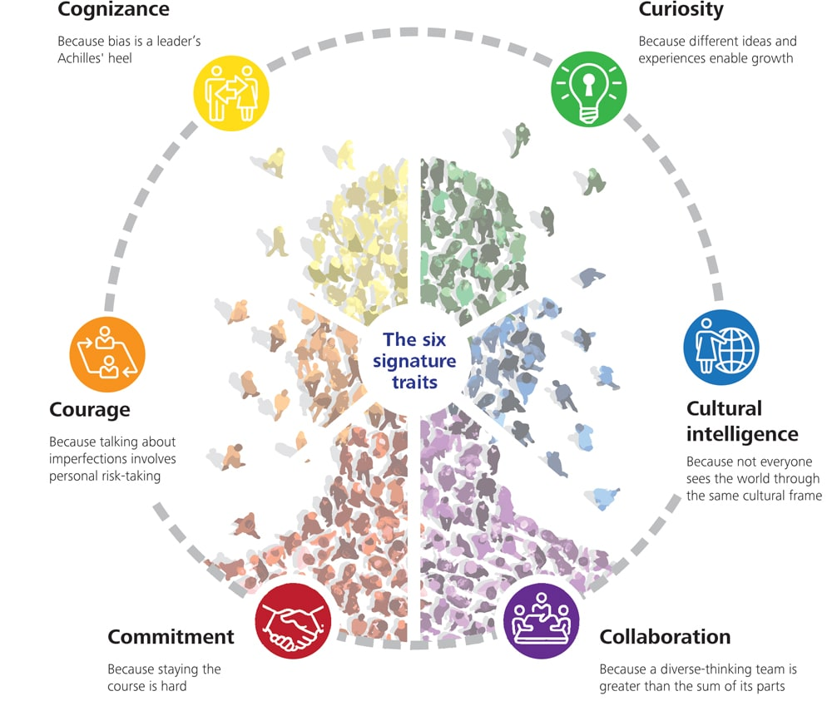
6 Traits of Inclusive Leaders
Graphic: Deloitte University Press accessed online at: https://www2.deloitte.com/us/en/insights/topics/talent/six-signature-traits-of-inclusive-leadership.html
Notes:
Deloitte’s research (https://www2.deloitte.com/us/en/insights/topics/talent/six-signature-traits-of-inclusive-leadership.html) across thousands of leaders pointed to 6 traits that inclusive leaders have:
Trait 1: Commitment: Highly inclusive leaders are committed to diversity and inclusion because these objectives align with their personal values, sense of fairness, and because they believe in the case being made. These leaders then display personal risk-taking, humility, and empowerment in their approach
Trait 2: Courage: Highly inclusive leaders speak up and challenge the status quo, and they are humble about their strengths and weaknesses.The courage to speak up—to challenge others and the status quo—is a central behavior of an inclusive leader, and it occurs at three levels: with others, with the system, and with themselves. Instead of shying away from the challenge of imperfection, highly inclusive leaders adopt an attitude of humility.
Trait 3: Trait 3: Cognizance of bias: Highly inclusive leaders are mindful of personal and organizational blind spots, and self-regulate to help ensure “fair play.” At the individual level, they are very self-aware, and they act on that self-awareness. And they acknowledge that their organizations, despite best intentions, have unconscious bias, and they put in place policies, processes, and structures in order to mitigate the unconscious bias that exists. Fairness” does not necessarily equate to “same.”
Trait 4: Curiosity: Highly inclusive leaders have an open mindset, a desire to understand how others view and experience the world, and a tolerance for ambiguity. Inclusive leaders accept their limitations and hunger for the views of others to complete the picture. They withhold fast judgment to hear.
Trait 5: Culturally intelligent: Highly inclusive leaders are confident and effective in cross-cultural interactions.This curiosity leads them to value cultural differences, defying ethnocentric tendencies that cause people to judge other cultures as inferior to their own, and enabling them to build stronger connections with people from different backgrounds.Inclusive leaders are tolerant of ambiguity, which enables them to manage the stress imposed by new or different cultural environments as well as situations where familiar environmental or behavioral cues are lacking.
Trait 6: Collaborative: Highly inclusive leaders empower individuals as well as create and leverage the thinking of diverse groups. Inclusive leaders understand that, for collaboration to be successful, individuals must first be willing to share their diverse perspectives.

Slide 8
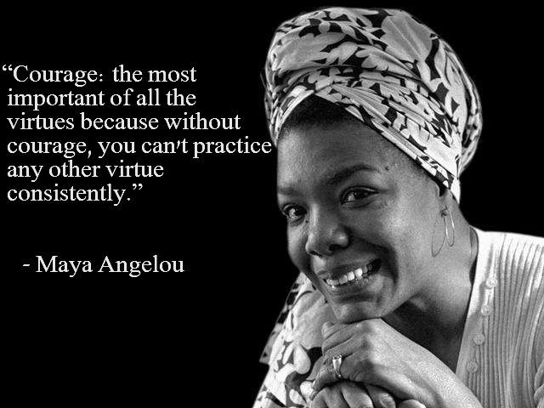
Inclusive Leaders
Humble
Empathetic
Ethics of care
Strong sense of self and their values
Courage
Clarity of purpose
Notes:
Feeling seen, heard, and valued are critical to fostering inclusion, belonging, and ultimately, high functioning organizations. Yet, as mentioned earlier, few believe their leaders value them. “By shifting to an inclusive leadership style, the leader [formal or informal] sets the tone and models the behaviors for their team to create an environment where each person feels seen, valued, respected, and able to contribute — in short, where they feel they belong and are included.” (https://www.betterup.com/blog/what-makes-an-inclusive-leader-and-6-ways-to-up-your-game)
In my judgment, there are characteristics that the literature on inclusive leadership points out. Leaders that are inclusive:
Are humble
Are empathetic - using cognitive empathy to understand and validate experiences they may never have in order to find shared understanding
Hold an ethics of care in their approach seeking to not only mitigate harm but to promote good by holding that action center on interpersonal relationships, care, and benevolence
Have a strong sense of self and their values, holding to their core values and acting with integrity
Courage to speak up and speak out
Clarity of purpose
To enact these traits, they will often engage in 6 core behaviors:
Relationship building to invest time in getting to know their teams as a whole person, understanding what matters to them, and how they can succeed
Recognition to recognize people for their work and support their efforts and growth. This includes appreciation, praise, and active sponsoring
Empathy to fosters inclusive spaces by having an appreciation for others’ perspectives and experiences
Social connection by encourage colleagues to recognize each other as humans, creating opportunities to engage with each other in ways that support relationships building amongst peers
Encouraging participation by using a variety of means and venues to gather input and feedback from colleague. “Inclusion is an invitation, extended day after day.”
Alignment - they can share a vision of what could be, what is important to the organization, and why. They help colleagues see how they contribute to the larger whole.

Slide 9
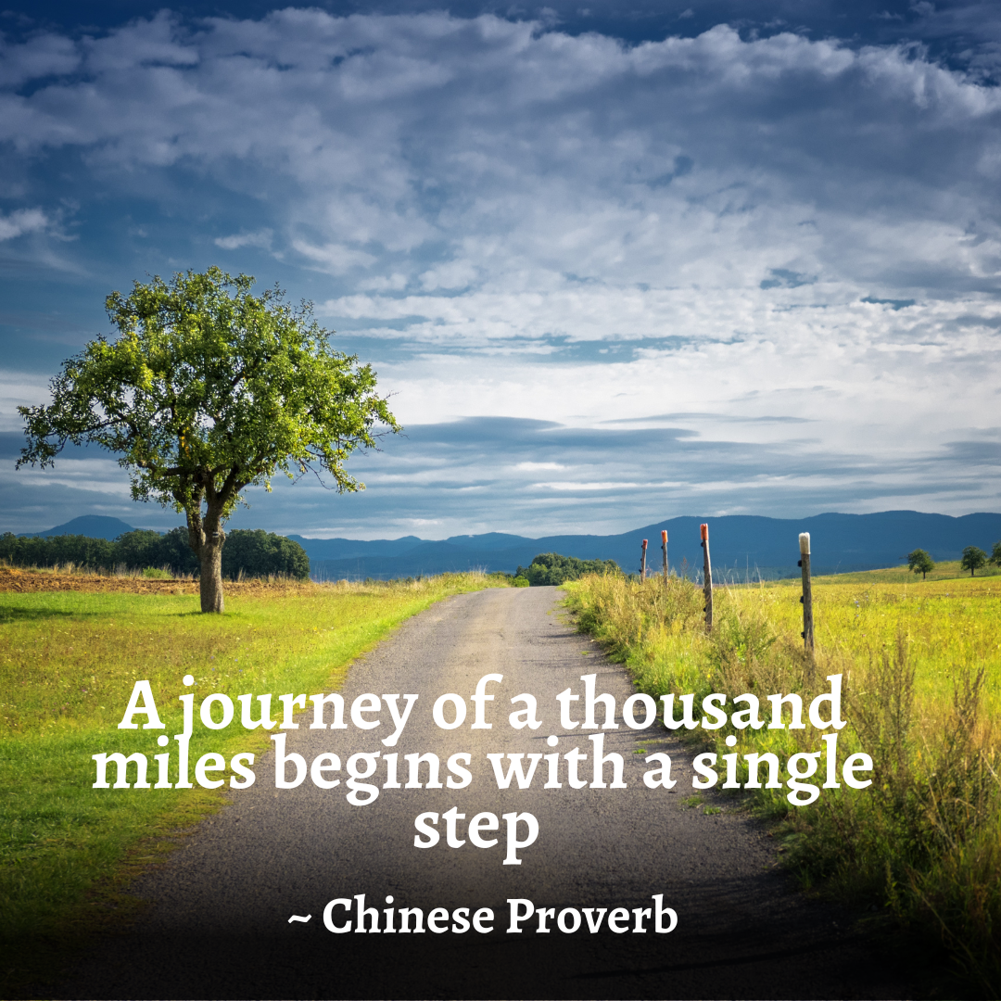
Intertwining Inclusive Leadership & Your Personal Leadership Style
Notes:
Inclusive leadership can be intertwined with other leadership theories, such as transformational, servant, participatory, and authentic leadership. It is about centering equity, compassion, and clarity within your existing styles.

Slide 10
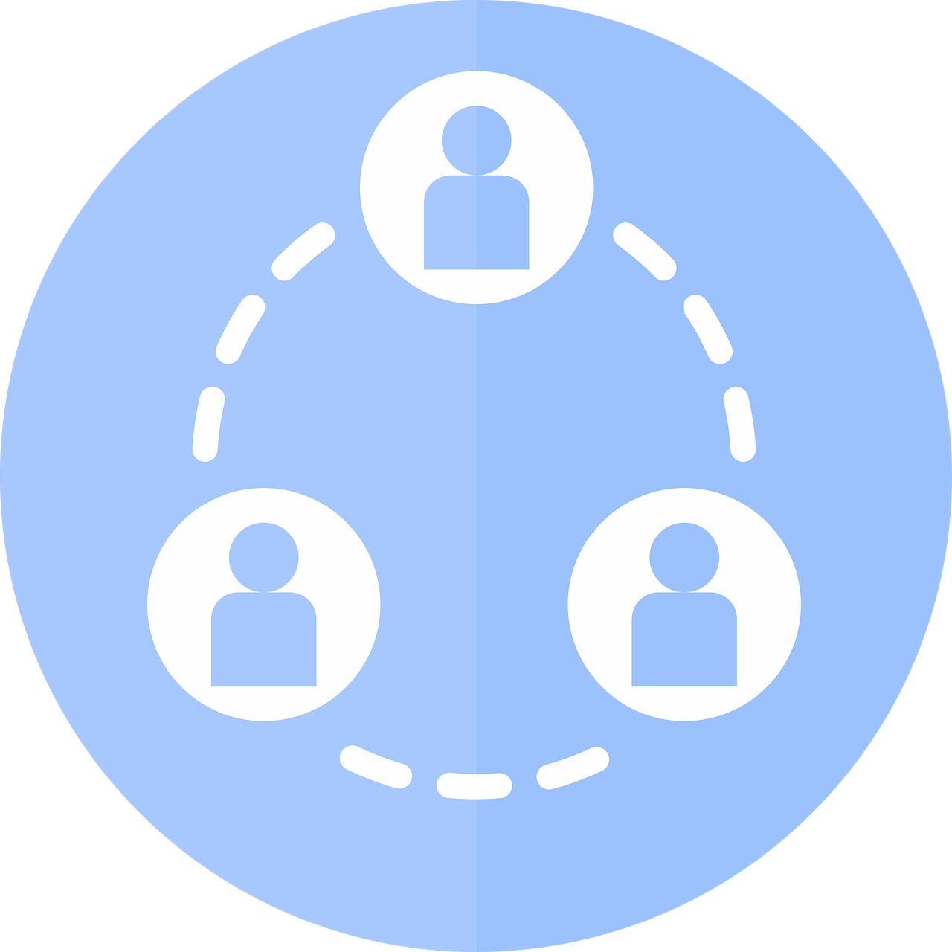
Building Trust Through Communication
Demonstrate your values
Put your guiding principles into action
Reinforce the core messaging
Create & sustain positive relationships
Hear and respond to feedback
“Every act of communication is a miracle of translation”
~ Ken Liu
Notes:
One of the greatest opportunities is to build trust through your communication efforts.
As we communicate about our change, we can:
Demonstrate our values, by modeling behaviours and actions in our messages and approach
Put our guiding principles into action, instead of a list of things we create and then look at again. In our communications, we are able to walk our talk as leaders and colleagues. We can articulate how the guiding principles are guiding us through the change, how are they impacting our decisions and approaches
Reinforce the core in our messages and help others to see what is in fact stable and remains important to us
Utilize the feedback loops we created during the planning phase to ensure ongoing engagement and pathways for others to use voice
Create & sustain positive relationships that will help current and future change initiatives to be successful

Slide 11
Compassion by Centering Humans in Your Leadership
Center the human-experience
Empower others
Engage colleagues as partners
Provide opportunities to plan and take action
Articulate why, what, and how
Seek to co-create as an ideal
Empower by:
Providing clarity
Asking how might we
Leveraging compassion and empathy
Edited from Thriving through Human-Centered Approaches to Change by Annie Bélanger & Megan Musolff
Notes:
Traditional management is about mitigating risks. What if it could promote good? Human-centered approaches layers in order to promote good by:
Centers the human-experience
Empower others
Engages colleagues as partners
Provides opportunities to plan and take action
Articulates why, what, and how
Seeks to co-create as an ideal
All of this requires that we bring intentionality and reflections to the processes we are using, the formal and informal channels we are fostering, and how we support one another.

Slide 12
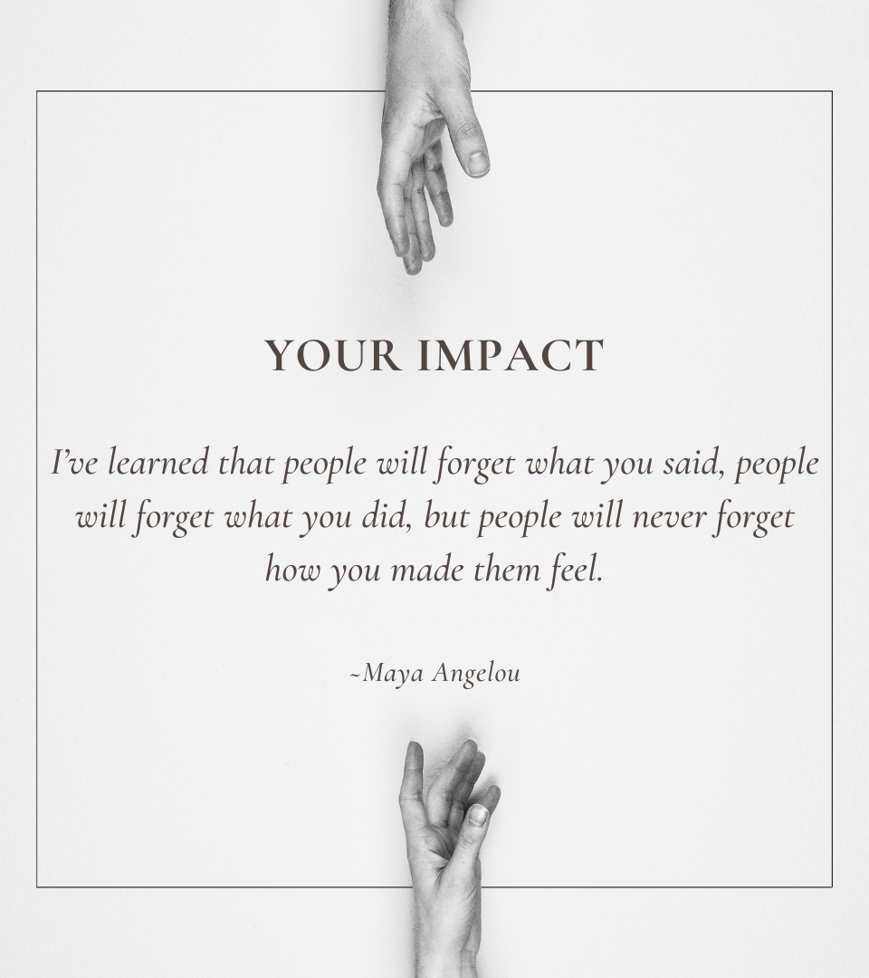
Grow Your Emotional Intelligence
Listen closely and withhold judgment
Connect with colleagues on a personal level
Unlock motivations
Seek to understand more about others and yourself
(Center for Creative Leadership, 2022, Emotional Intelligence and Leadership Effectiveness: Bringing Out the Best, https://www.ccl.org/articles/leading-effectively-articles/emotional-intelligence-and-leadership-effectiveness/)
Notes:
Maya Angelou said, “I’ve learned that people will forget what you said, people will forget what you did, but people will never forget how you made them feel.”
Popularized by psychologist Daniel Goleman, emotional intelligence is defined as our capacity to be aware of, to control, and to express emotions. It is also the ability to recognize and influence the emotions of those around you. Emotional intelligence enables us as leaders to handle interpersonal relationships judiciously and empathetically.
There are 4 spheres within emotional intelligence:
“Self-Awareness: The ability to know emotions, as well as your strengths and weaknesses, and recognize their impact on performance and relationships.
Self-Management: The ability to control both positive and negative emotions and impulses and be flexible and adaptive as situations warrant.
Social Awareness: The ability to have empathy for others, navigate politically, and network proactively.
Relationship Management: The ability to inspire through persuasive communication, motivation, building bonds, and disarming conflict among individuals”
How to grow:
Listen closely and withhold judgment: It starts with empathetic listening, which we will dig into on the next slide.
Connect with colleagues on a personal level: Show you care for them as individuals, building trust.
Unlock motivations: to understand what matters most to them, what drives them, and how they like to be recognized
Seek to understand more about others and yourself: learn how identities impact how work is approached, how relationships are formed. Learn about emotional triggers and areas of growth.
The Center for Creative Leadership says: “Leader effectiveness is constrained or amplified based on how well leaders understand themselves, their awareness of how others view them, and how they navigate the resulting interactions.”
(https://www.ccl.org/articles/leading-effectively-articles/emotional-intelligence-and-leadership-effectiveness/)

Slide 13
Empathetic Listening & Communications
Active Listening on a new level to:
Build trust and respect,
Enable the release of emotions,
Reduce tensions,
Listen to understand
Encourage the surfacing of information, and
Create an environment that is conducive to collaborative problem solving
As you prepare to communicate with empathy:
Put yourself in other’s shoes
Articulate your values
Anchor in your purpose
Focus on the short and long term relationship
Show compassion
Consider:
Clarity
Consistency
Concerns
Care
Confident humility
Edited from Thriving through Human-Centered Approaches to Change by Annie Bélanger & Megan Musolff
Notes:
The Tao Te Ching states that “Your conversations help create your world. Speak of delight, not dissatisfaction. Speak of hope, not despair. Let your words bind up wounds, not cause them.” This serves as an invitation to consider how we speak to others, both tone and word choice. For example, using Always/Never can exercibate issues, and using But invalidates the previous part of the statement. This does not mean ignoring problems and concerns. It does mean encouraging an abundance or solution-focused mindset by:
Psychologist Carl Rogers wrote, "Real communication occurs when we listen with understanding - to see the idea and attitude from the other person's point of view, to sense how it feels to them, to achieve their frame of reference in regard to the thing they are talking about." Listening with empathy allows us to create connection and new understanding.
Not only is empathetic listening a mindset and philosophy. It is active listening on a new level:
build trust and respect,
enable the release of emotions,
reduce tensions,
encourage the surfacing of information, and
Create an environment that is conducive to collaborative problem solving
As you prepare to communicate with empathy:
Put yourself in other’s shoes
Articulate your values
Anchor in your purpose
Focus on the short and long term relationship
Show compassion
Consider:
Clarity
Consistency
Concerns
Care
Confident humility
As we communicate about our change, we can demonstrate our values, by modeling behaviours and actions in our messages and approach, Put our guiding principles into action, Utilize the feedback loops we created during the planning phase to ensure ongoing engagement and pathways for others to use voice, Create & sustain positive relationships that will help current and future change initiatives to be successful

Slide 14
Leverage Participatory Approaches
Supporting voice and agency
Participation increases empowerment, which reduces helplessness and leads to action
Notes:
Participation increases empowerment, which reduces helplessness and leads to action
Participatory management refers to a set of organizational values and leadership behaviours that can contribute to employees becoming more committed to their organization and its goals, and cultivating better staff-management relationships. It also helps bridge the typical chasm that often exists between leaders/managers and their staff, and contributes to a more adaptive, resourceful and resilient behaviour during periods of change. Participative leadership is an essential component of empowered, high-involvement organizations.
Participatory leadership can range from a minimum of clear input paths into change and decisions all the way to broad participation in decision making. There are many benefits from leveraging participatory approaches as doing so:
Provides clarity as to how decisions will be made
Defines when and how input will occur for colleagues
Creates a sense of ownership and agency in the change
Increases motivation to move the work forward
Provides a wider view of the organization. This in turn break down the us vs them
Makes transition to implementation will be easier

Slide 15
Define Decision Making Processes
Create clarity
Which decisions are most important?
Who is deciding?
What are they deciding?
Who is doing the work?
Who is impacted?
How is consultation happening?
When and how will people be informed?
Notes:
With more human-centered, inclusive behaviors, there is the risk to not provide clarify of decision making and accountability
“Decision making frameworks can help an organization spell out decision-making roles and responsibilities. In turn, this clarifies and can improve organizational decision-making processes.” The framework can be used to think through specific decision processes in advance and to identify who should be involved and what role they should play. Additionally, it will provide a way to create a key decision inventory.
Decision making frameworks help answer critical questions:
“What are we deciding? Is it one decision, or multiple smaller decisions?
Who should be involved and what role should they play?
How will we make the decision? What process will we use, what criteria will help us decide among options, and how will we communicate and follow through?
When does the decision need to get made?” (https://www.bridgespan.org/insights/library/organizational-effectiveness/rapid-decision-making)
As every change is different, it is beneficial to define responsibilities, accountabilities, and where decision-making will occur.
It is most self-evident that responsibilities will vary depending on how the change activities and project are organized. For everyone, knowing who is responsible and how accountabilities are organized will help 1) refine the scope and 2) articulate how the group responsible will be working with other people to bring about the change.
Several questions will rise to the top for many:
Who is making the decision?
Who is doing the work?
How will I be consulted?
When will I be informed?
What are the outcomes?
By clarifying who is accountable and who is responsible, you can reduce uncertainty. By defining how and when consultations and information will occur, you can reduce anxiety. By state what the sought-after outcome, you can strengthen buy-in and uphold the scale of change.

Slide 16
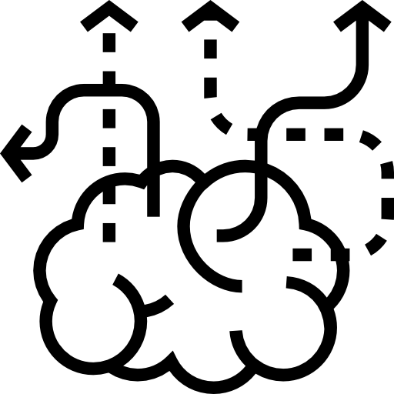
Decision Rights vs
Improvement Rights
Who is empowered to make decisions?
Who can commit resources?
Who must have voice in a decision?
Who will implement the decision, and with what flexibility in the how?
Who must be heeded in making decisions?
Notes:
Extracted from Getting Decision Rights Right by Deloitte
With more human-centered, inclusive behaviors, there is the risk to not provide clarify of decision making and accountability. Sometimes this is referred to as the transparency trap.
‘Decision rights’ refers to an organization’s rules and practices—whether explicit or implicit. Deloitte recommends that 3 questions be answered when it comes to decision rights:
“Who are the individuals or groups empowered to make decisions? Decision rights models help outline an organization’s hierarchy of decision-makers or decision-making groups. When decisions must be made in groups, decision rights models specify which cross-functional leaders must belong to each decision-making body. [...]
What decisions must be made? A decision inventory lists the decisions that an organization—that is to say, its leaders, teams, and operating units—must make. Note that a decision inventory does not need to be comprehensive to be useful. Rather, it should identify the organization’s most important decisions at various organizational levels — [library administration], [department] leaders, etc. While it may also be helpful to identify certain subsidiary decisions at each of those levels, many of these lower-order decisions can often be inferred from an understanding of the most important, top-level ones.
How do operating processes and tools help support decision-making? A decision-making process defines the forums and procedures through which decision-makers across the organization make their decisions. Factors to consider here include how often a decision-making body should convene, what stakeholders decision-makers need to consult, and what evidence (such as data, research, or expert analysis or guidance) might be useful and available to inform these decisions.”
Decision rights are a distinct organizational component, distinct from organizational structure, processes, and workflows. By defining decision rights, the organization provides structure to enable alignment with organizational goals and encourage greater collaboration by focusing on collective outcomes.
‘Improvement rights’ refer to the organization’s engagement with those that do not hold decision making in shaping the decision. Improvements rights should be awarded to a broader part of the organization, regardless of roles. We can think of improvement rights in 3 types:
Input - early in the process having lots of space to shape the recommendations
Feedback - further in the process, giving thoughts that may or may not be used
Implement the decision with flexibility in the how
In creating empowerment, we may delegate decision making. IF you reserve the right to a veto, you should be clear that you do own the decision and what criteria you would use to escalate the decision back to yourself.

Slide 17
What might be problematic about this concept?

Slide 18
Tools for Inclusive Leadership

Slide 19
Feedback Loops
Input
Design feedback loops as part of your communication strategy
Important tool for engagement change leadership
Mechanism to demonstrate organizational values
System
Output
Edited from Thriving through Human-Centered Approaches to Change by Annie Bélanger & Megan Musolff
Notes:
As you begin to plan communications, it is key to adopt is the creation of feedback loops. Feedback loops create an opportunity to gather information/input from colleagues about a particular topic, provide an opportunity to influence the change to the system you are trying to make, and then closing the loop by sharing back what you learned.
In my experience, the creation of feedback loops is an important tool for engaged leadership and a mechanism to demonstrate organizational values in action.

Slide 20
Appreciative Inquiry
The co-evolutionary search for the best in people, their organizations, and the relevant world around them
Asking questions that strengthen a system’s capacity to apprehend, anticipate, and heighten positive potential
Asking the questions in a positive frame
Seeking the strength as opposed to the problem
Appreciation
Inquiry
Wholeness
Edited from Thriving through Human-Centered Approaches to Change by Annie Bélanger & Megan Musolff
Notes:
Appreciative Inquiry (AI) is "about the co-evolutionary search for the best in people, their organizations, and the relevant world around them”
AI distinguishes itself from other organizational visioning and change models by focusing on the best of what is and using this as a platform to build future directions. While many traditional methods begin by focusing on pitfalls and problems, Appreciative Inquiry asks people to explore strengths and successes that already exist, both internally and externally by
Asking questions that strengthen a system’s capacity to apprehend, anticipate, and heighten positive potential
Asking the questions in a positive frame
Seeking the strength as opposed to the problem
Three concepts form the foundation, sometimes called the “three-legged stool” of Appreciative Inquiry: appreciation, inquiry, and wholeness.
Appreciation: To appreciate is to recognize the best in people, or the world around us. These strengths become the foundation on which the future can be built.
Inquiry: To inquire is to ask questions. It invites participants to ask questions so they can learn from one another, and together identify a shared vision of the future. Participating in an AI process requires an attitude of curiosity and a hunger for discovery.
Wholeness: The final AI tenant of wholeness encourages participation from all levels of an organization, knowing that the best ideas often emerge from unexpected places. Additionally, AI encourages seeking outside perspectives. It is a whole-system process.

Slide 21
Appreciative Inquiry: Generative Questions
Generates reflection and creativity by:
Asking open-ended questions
Starting with “What if”, “why”, “how might we”
Includes a clear scope and positive intent of inquiry to move forward
Anchored in positive intent
Example: Moving to generative
Does our decision lack perspective? >>>> What would someone who had a very different set of beliefs than we do say about our decision?
Remember: powerful questions are generative, thought-provoking, and meaningful
Edited from Thriving through Human-Centered Approaches to Change by Annie Bélanger & Megan Musolff
Notes:
Open ended questions allows the speaker to imagine what could be, and explore what is. Close ended question invite efficiency and yes/no answers. They do not generate conversation
The linguistic construction of questions affects its effectiveness and importance. It was found out that questions starting with “Why,” “How,” and “What” are more powerful as compared to queries that start with simple “Who,’ “When,” “Where,” and “Which” which may fall under the less powerful category. This is because powerful questions motivate more reflective thinking and more profound level of conversation.
One caveat: Why can be a trigger of judgement for some. Rephrasing Why questions to “How might we?” or “Help me understand” can help you move past accidental icebergs.
The second dimension is the scope of the question which simply means knowing how to tailor the kind of question to our needs. The extent of asking the question must only be within the needs of the situation and realistic goals.
Lastly, the assumptions embedded into most of the questions must be appropriately applied. To demonstrate it, you might as well ask “What can be done to prevent it from happening again?” instead of “Why did you fail to do it?” The first question stimulates reflective thinking in contrast to the second question.
By asking a question, you may be introducing unconscious bias. Before going forward with your questions, consider the following:
What assumptions or beliefs are we introducing with this question?
How would we approach this issue if we had an entirely different belief system?
Is this a question to which we do not know the answer? If we already know the answer or have a preset “right” response, it is not inquiry.

Slide 22
Appreciative Inquiry: Name It > Flip It > Frame It
Name It
Flip It
Frame It
Name the problem or concern - often a negative statement
“Why have we failed?”
Flip it to its opposite - often a positive statement
“We want to succeed.”
Frame it in reality: a generative question(s) that drives to flipped
“What could success look like? What did go well, and how do we build on that? What would you like more of? How would we feel safe to try again?”
Notes:
Name it > Flip It > Frame It is a practical tool for
Cognitive reframing is a psychological technique that consists of identifying and then changing the way situations, experiences, events, ideas, and/or emotions are viewed.The main goal of reframing is to refashion negative thoughts and to turn them into positive ones. It is important to highlight the opportunities, the good, and also be transparent about the difficulties and challenges. Framing what is good can not be done by invalidating the realities of others involved in the change.

Slide 23
Liberating Structures
Facilitation tools meant to:
Be “easy-to-learn microstructures that enhance relational coordination and trust”
“Foster lively participation in groups of any size, making it possible to truly include and unleash everyone”
Be “a disruptive innovation that can replace more controlling or constraining approaches”
https://www.liberatingstructures.com/
Edited from Thriving through Human-Centered Approaches to Change by Annie Bélanger & Megan Musolff
Notes:
The creators of liberating structures want everyone to learn to foster big changes by inviting people to make small structural changes in how they work. Liberating Structures as facilitation tools are meant to:
Be “easy-to-learn microstructures that enhance relational coordination and trust”
“Foster lively participation in groups of any size, making it possible to truly include and unleash everyone”
Be “a disruptive innovation that can
replace more controlling or constraining
Approaches” together. They offer facilitation tools that are meant to

Slide 24
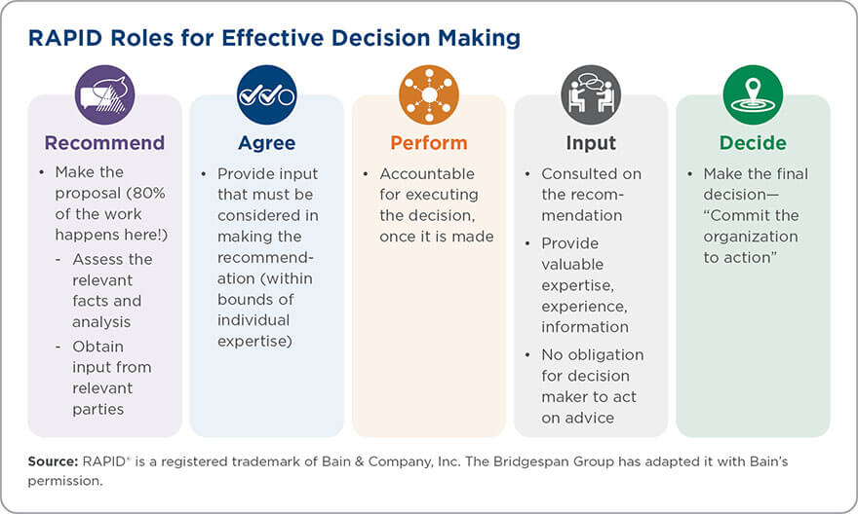
RAPID & Clear Decisions
Image from: https://www.bridgespan.org/insights/library/organizational-effectiveness/rapid-decision-making
Notes:
Earlier, I touched on the importance of clear decision making processes and boundaries as human-centered approaches are embedded in your leadership practice. The RAPID model comes from nonprofit organizations and may be easier to translate to a library’s culture. This model gives us a way to assign roles in a decision process by clarifying “who provides input to a decision, who shapes the decision and ultimately decides on it, and who carries out the decision once it is made” .
The Bridgespan Group gives “Two important caveats. RAPID is an acronym—an easy way to think about five important roles in most decision processes (Recommend, Agree, Perform, provide Input, and Decide)—but the acronym doesn’t specify the order in which things should be done. And the name “RAPID” may imply that speed is paramount, but the intent of the tool is to help organizations make decisions with clarity and accountability—at the appropriate speed, not necessarily as quickly as it can.
Arching back to decision rights. In this model, there are two types of decisions rights:
Recommend as you filter and finalize the recommendation, even deciding to recommend at all
Decide where you are owning the decision
Arching back to improvement rights. In this modell, there are three types of improvement rights:
Agreement - People in this role provide information and input that must be considered by the recommenders within the bounds of individual expertise and role. It is about getting to the best approach, not a veto
Performance - People in this role are accountable for implementing and executing the decision once it is made. They are empowered to develop the “how” within established boundaries
Input - People in this role are consulted to fine-tune the recommendation by helping to find improvements or missed opportunities
(Adapted from https://www.bridgespan.org/insights/library/organizational-effectiveness/rapid-decision-making)
(https://www.bridgespan.org/insights/library/organizational-effectiveness/rapid-decision-making)

Slide 25
Equity Lens
A set of questions that help an organization see from a new perspective, hold to their values, and increase participation by those holding non-dominant identities.
“What decision is being made?
Who is at the table?
How is the decision being made?
What assumptions are at the foundation of the issue? Be explicit in naming these and the values and cultural bases for them
What is [the] likely impact?
What is your decision?
(Center for Nonprofit advancement, 2020)
Notes:
A critical tool to support a focus on equity, accessibility, and inclusion is an equity lens. An equity lens is a set of questions that help an organization see from a new perspective, hold to their values, and increase participation by those holding non-dominant identities. The Center for Nonprofit Advancement (2020) describes “[t]he purpose of an equity lens is to be deliberately inclusive as an organization makes decisions.It introduces a set of questions into the decision that help the decision makers focus on equity in both their process and outcomes.”
The power of equity lenses lies in drawing explicit attention to power, the inclusion of marginalized identities, and holding leadership accountable. The Nonprofit Association of Oregon (2019) believes that an equity and inclusion lens, aka as equity lens, can help to:
“Strengthen everyone’s awareness of and ability to incorporate difference.
Create teams that are relevant to and representative of [the] community.
Create energizing and innovative work environments.
Collectively address systemic barriers and inequities.”
While an equity lens can be used daily, it should at minimum be used at the start and the end of a service, program, or partnership development process.
The questions contained within an equity lens can be modified and adapted from different organizations and different processes. For example, an organization could have an equity lens used for its community outreach and one for fostering partnerships within the community. Equity lenses typically contain questions such as:
“What decision is being made?
What beliefs, values and assumptions (some of which will be cultural) guide how the topic is being considered?
Who is at the table?
Who or what informs their thinking on the issue?
Who is most affected by these decisions, and thus should be at the table?
How can they be included?
How is the decision being made?
What participatory structures can be added to hear from more voices, to equalize participation, and elements of consensus be used?
What assumptions are at the foundation of the issue? Be explicit in naming these and the values and cultural bases for them.
What is [the] likely impact?
Does the policy, program, or decision improve, worsen, or make no change to existing disparities? Does it result in a systemic change that addresses institutional inequity?
Does the policy, program, or decision produce any intentional benefits or unintended consequences for the affected groups?
What is the real impact likely to be for different groups who are important to the organization?
What is your decision?
Based on the above responses, what are the possible revisions to the policy, program, or decision under review that could address inequity/promote equity?”
(Center for Nonprofit advancement, 2020)

Slide 26
Collective Engagement Agreements
How will we be together as a group of humans
Groups generate them
Establish communication norms
What is in and out of bounds
Create shared understanding
Are referenced often to center the group
Example
Past patterns need not define future patterns.
We are empowered in our process
We are working toward the formation of shared understandings
We ask clarifying questions before assuming intent
Each takes care of comfort needs
Notes:
In order for us to do anything with each other, we first have to understand how we want to be with each other. Having stated and understood rules of engagement, shared agreements for participation, helps create a brave space for individual participation. Defining norms for a conversation, community, or organization helps people understand "this is who we are and how we will do things here." As Margaret Wheatley has said, “To create learning organizations, we must understand the underlying agreements we have made about how we will be together.”
Collective Engagement Agreements, also called rules of engagement, operate best when a group itself generates them, as well as identifying how they are to be applied and when and how the group's alignment with them should be evaluated.
Because some individuals will see no need for the exercise, I generally begin with a very brief discussion of the following question: When you've been part of a group that really produced some amazing results, what helped make that possible? Inevitably, individuals will suggest a clarity of roles and responsibilities, shared goals or direction, and an understanding of how to work with each other. These responses then make it easier to answer the next question: Given the work that we are to do with each other, what are some of the agreements or ground rules we should make to guide our efforts?
For more information, https://blog.lucidmeetings.com/blog/using-ground-rules-improve-engagement-excellent-team-meetings

Slide 27
Annie Bélanger
Belange1@gvsu.edu
@Annie_belanger
Your turn:
What questions?
What thoughts do you have?
Full presentation with speaking notes will be available at: https://scholarworks.gvsu.edu/library_presentations/

Slide 28
References
Annie Bélanger & Megan Musolff, 2021, Thriving through Human-Centered Approaches to Change, 2021 ALAO Conference, https://scholarworks.gvsu.edu/library_presentations/100/
Juliet Bourke, 2016, The six signature traits of inclusive leadership, Deloitte Insights, https://www2.deloitte.com/us/en/insights/topics/talent/six-signature-traits-of-inclusive-leadership.html
Center for Nonprofit advancement, 2020, What is an Equity Lens?, https://www.nonprofitadvancement.org/files/2020/12/What-is-an-Equity-Lens.pdf
Center for Creative Leadership, 2022, Inclusive Leadership: Steps Your Organization Should Take to Get It Right, https://www.ccl.org/articles/leading-effectively-articles/when-inclusive-leadership-goes-wrong-and-how-to-get-it-right/
Center for Creative Leadership, 2022, Emotional Intelligence and Leadership Effectiveness: Bringing Out the Best, https://www.ccl.org/articles/leading-effectively-articles/emotional-intelligence-and-leadership-effectiveness/
David L. Cooperrider, Jacqueline M. Stavros, and Diana K. Whitney. Appreciative Inquiry Handbook for Leaders of Change
Mike Ciccarone, Preeta Nayak, Yonatan Araia, & Bradley Seeman, 2022, The RAPID Decision-Making Tool for Nonprofits, The Bridgespan Group, https://www.bridgespan.org/insights/library/organizational-effectiveness/rapid-decision-making
Brigitte Fontaine, 2021,Could Radical Transparency Be the Solution to an Eroding Trust in Authority?, Catalyst, https://catalyst.iabc.com/Articles/could-radical-transparency-be-the-solution-to-an-eroding-trust-in-authority
Elise Keith, 2018, Using Ground Rules to Improve Engagement and Run Excellent Team Meetings, https://blog.lucidmeetings.com/blog/using-ground-rules-improve-engagement-excellent-team-meetings
David Mallon, 2020, Getting decision rights right, Deloitte Insights, https://www2.deloitte.com/us/en/insights/topics/talent/organizational-decision-making.html
Sarah Lewis, Jonathan Passmore, and Stefan Cantore. The Power of Conversation from Appreciative Inquiry for change management: Using AI to facilitate organizational development.
Jackie Stavros and Cheri Torres. Conversations worth having: Using appreciative inquiry to fue productive and meaningful engagement
Evan Sinar Maggie Wooll, 2021, What makes an inclusive leader? These 6 behaviors are a good start, BetterUp, https://www.betterup.com/blog/what-makes-an-inclusive-leader-and-6-ways-to-up-your-game

Slide 29
Other Resources:
5-D Cycle of Appreciative Inquiry.
William Bridges. Managing Transitions: Making the Most of Change.
adrienne maree brown. Holding Change.
adrienne maree brown. Emergent Strategy.
Jennifer Brown, How to Be an Inclusive Leader, https://www.youtube.com/watch?v=kXOBkHjXAl4
Juanita Brown, and David Isaacs Eric E. Vogt. The Art of Powerful Questions: Catalyzing Insight, Innovation, and Action.
GR Bushe. Appreciative Inquiry Is Not About The Positive.
Karina Hagelin. Moving Towards Healing: A Trauma-Informed Librarianship Primer.
Sue Annis Hammond. Thin Book of Appreciative Inquiry (3rd edition 2013)
Suzanna Haworth. RACI Chart Template For Project Managers + Example & How-To. https://thedigitalprojectmanager.com/raci-chart-made-simple/
MasterClass, 2022, Participative Leadership: 4 Types of Participative Leadership, https://www.masterclass.com/articles/participative-leadership#3InMVvk4u06vleV9q09zsR
SAMHSA’s Concept of Trauma and Guidance for a Trauma-Informed Approach
Diana Whitney and Amanda Trosten-Bloom. The Power of Appreciative Inquiry: A Practical Guide to Positive Change (2nd edition 2010)

