Slide 1
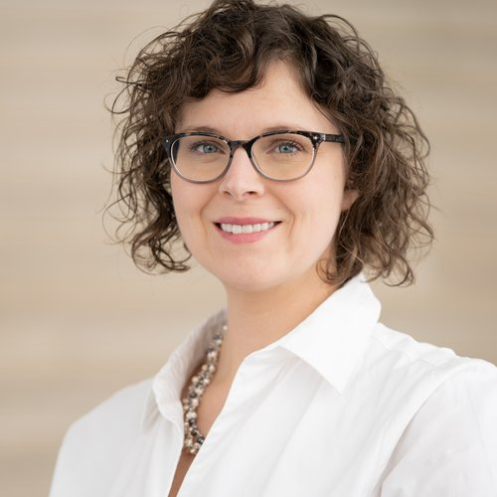
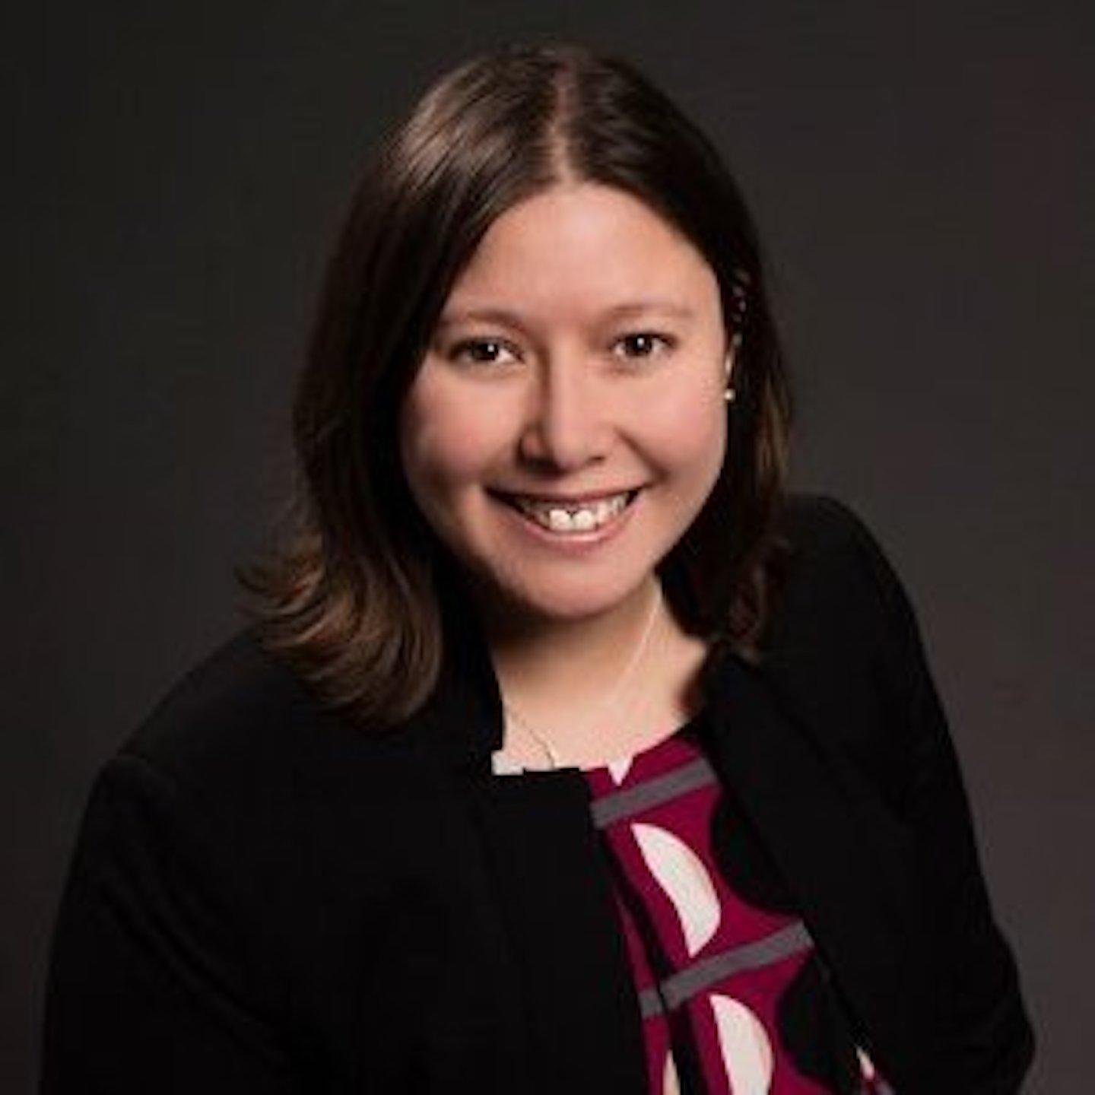
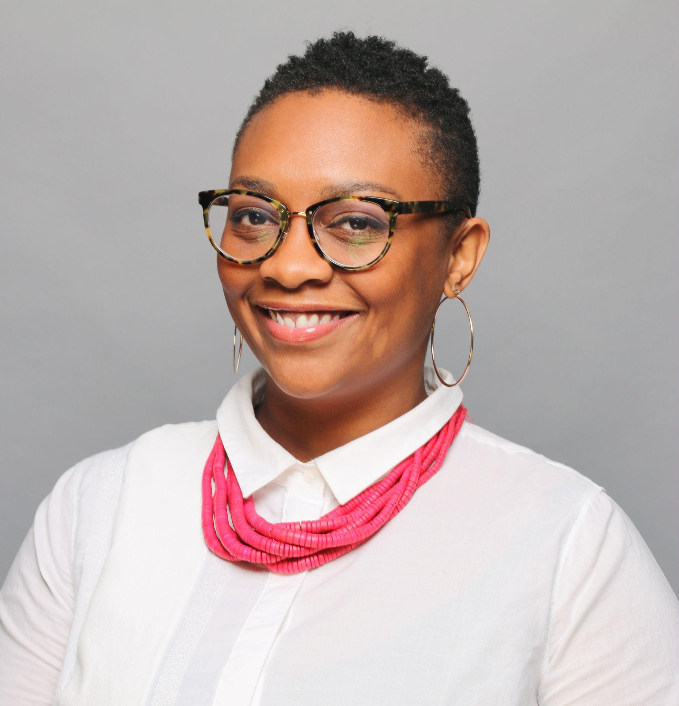
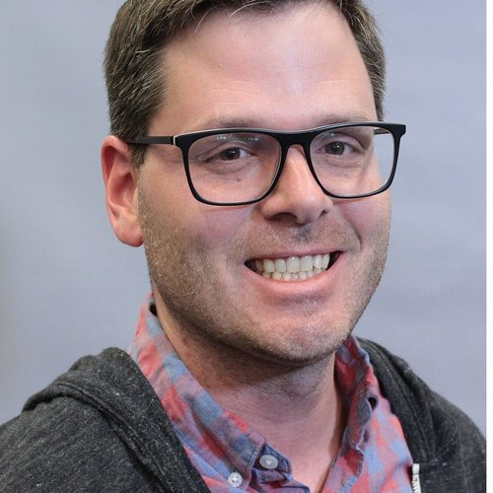
Care and Accountability in Library Leadership
Annie Bélanger | Kat Bell | Maisha Carey | Jon Jeffryes | Meghan Musolff
OLA Superconference 2023
Notes:
Kat
Leaders and managers have an outsized impact on workers’ wellbeing. In facing the reality of constant and unpredictable change, leaders and managers need to consider the humanity of their employees as part of their commitment to equity. We suggest that library leaders and managers need to consider human-centered approaches as part of their leadership toolkit. Human-centered leaders have a strong focus on people and the organizational culture. They layer compassion and empathy in taking actions to fulfill the organization's mission.
We acknowledge that there are situations when taking a human-centered approach to the needs of library employees can feel in tension with the externally-facing service mission of our organizations. There are times when it is challenging to hold both human-centered principles and mission fulfillment in our minds at the same time. Additionally, balancing accountability and empathy can at times be in direct tension. The application of transparency in decision-making and clear boundaries can proactively set clear expectations for both supervisors and employees. Articulating these tensions also invites employees to share feedback and identify where systemic bias and inequity have the potential to do harm.
Together, we will explore the principles of human-centered leadership, practical applications of these principles from different institutional perspectives, and how to navigate tensions with fulfilling our mission. We will explore how radical empathy, considering our transformational roles, and frameworks of accountability can help us, as leaders, to focus on the humanity of our colleagues. While we will focus on providing organizational care, we will also explore how to provide care for ourselves as leaders while still holding ourselves accountable.

Slide 2
Learning Objectives
Understand principles of human centered leadership and radical empathy
Identify and apply practices for balancing and negotiating tensions between individual and organizational needs
Incorporate generous accountability and other accountability frameworks into their leadership toolkit
Notes:
Kat

Slide 3
Collective Chat Engagement Agreements
Please use the chat!
Ask clarifying questions
Respond to each other with curiosity and care
Our Groundwater
Capitalistic world
Outcomes expected
Higher Ed as Gatekeeping Mechanism
No one size fits all
Notes:
Kat - do intro before this, everyone will present themselves as they come to their slides/stories

Slide 4
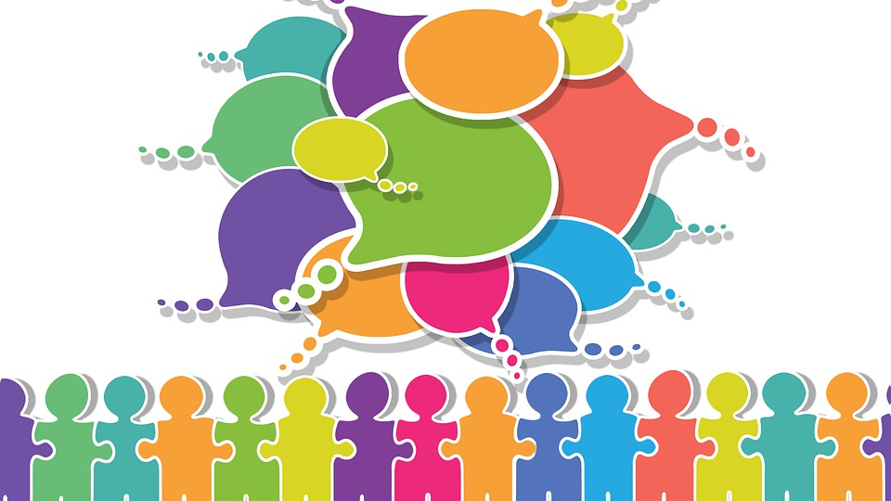
Principles & Definitions
Notes:
Annie
We want to center by starting with some key principles that serve as the foundation for today’s exploration.

Slide 5
Human Centered Leadership
Prioritize people and culture
Center humanity
Characteristics:
Compassion
Empathy
Genuine intention
Inclusive
Mission-focused
Values-driven
Deeply personalized style
Notes:
Annie
Simply put human-centered leaders put people first, prioritizing people and culture. It shape their communication style, their mindset, and how they approach opportunities and problems. Human-centered leaders are similar to inclusive leaders in that acknowledge their blind spots and seek wider perspectives. They actively engage those who have the details needed to make decisions. They work to remove barriers. They enable individuals to create, innovate, and charge full speed ahead. They recognize the humanity in others, cultivate growth in others, and create healthy, connected communities for others, in order to foster cultures of caring, mission-focus, and trust. It is a relational approach to leadership, not a transactional one focused on outcomes.
Also human-centered services, etc. However today we are focusing on the human within the organization, the colleagues are helping us function.
How do we make sure that our approach to engaging with staff is focused on building and sustaining relationships? Have we answered which humans are being centered and why?
I want to acknowledge danger of human-centered can be a focus on culture at the expense of mission fulfillment. It can be a focus on personal needs at the expense of organizational needs.

Slide 6
Radical Empathy
To actively consider another person's point of view in order to connect more deeply with them
Balanced with candor and compassion
Fosters:
Genuine connections
Feelings of belonging
Greater levels of trust
Wellbeing
Motivation
Shared understanding
Notes:
Annie
Empathy is the ability to understand and share the feelings of another. Empathy includes both cognitive (aka intellectually) and emotional (aka shared emotions) empathy. “Radical empathy is a concept that does exactly that – it encourages people to actively consider another person's point of view in order to connect more deeply with them.” Today, this trait enables us to see and understand another person's point of view.
A 2010 study carried out by researchers at the University of Michigan showed, rather alarmingly, that subjects exhibited 40 per cent less empathy than their 1979 counterparts, with the most dramatic decline in the ten years since the turn of the millennium, suggesting the downward trend was accelerating. Now research and leadership coach believe that empathy can be a cultivated skills, as it is part of emotional intelligence.

Slide 7
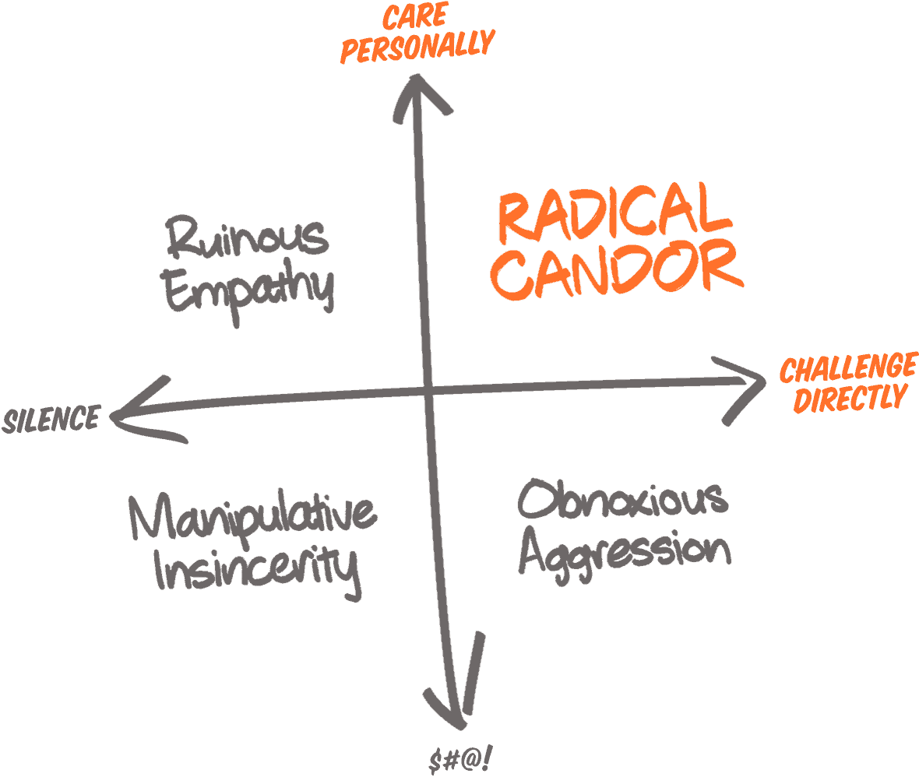
Human-Centered
+
Radical Empathy Radical Candor
Shifting the dialogue towards healthy, thriving individuals anchored in trusting relationships
Graphic from: https://www.radicalcandor.com/radical-candor-not-brutal-honesty/
Notes:
Annie
Graphics from: https://www.radicalcandor.com/radical-candor-not-brutal-honesty/
As we thought about how radical empathy can fit into human-centered leadership acknowledging that leaders are accountable for a healthy, productive organization, we considered that radical candor could be a simple framing to consider how to move into human-centered leadership that is focused on growth, empathy, and an ethic of care.
“Radical Candor is Caring Personally and Challenging Directly, Not Brutal Honesty. The whole point of Radical Candor is that it really is possible to Care Personally and Challenge Directly at the same time.” Kim Scott believes that leaders can move beyond the dichotomy of leader as jerk or leader as incompetent.
“Radical Candor is kind and helpful.
Obnoxious Aggression is mean but may be helpful. Obnoxious Aggression is also called “brutal honesty” or “front stabbing.”
Ruinous Empathy is “nice” but ultimately unhelpful or even damaging. It’s seeing somebody with their fly down, but, not wanting to embarrass them, saying nothing, with the result that 15 more people see them with their fly down — more embarrassing for them.
Manipulative Insincerity is a stab in the back.”
Holding someone accountable for something they have not been told is in fact cruel. This is also a place to let go of ‘they should know’ as that centers white middle-class professionalism and serves as a form of gatekeeping.
https://www.radicalcandor.com/radical-candor-not-brutal-honesty/

Slide 8
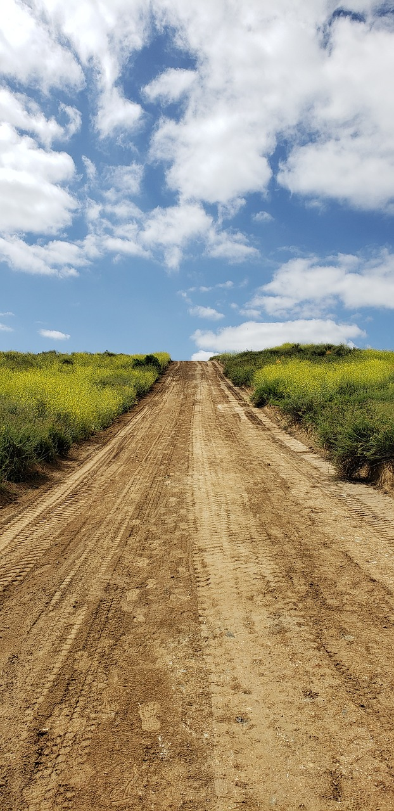
What is Accountability?
Acceptance: consenting to receive or undertake something offered
Obligation: accepting the binding power of promise
Ownership: taking responsibility for an idea or problem
Answerability: explaining actions or decisions.
Choice: making a decision when faced with two or more possibilities
Commitment: being emotionally compelled to an agreement or responsibilities
We are accountable to self and to others
Notes:
Annie
Shannon Perez-Darby share this definition that, “Accountability is taking responsibility for your choices and the consequences of those choices.” Connie Burk frames accountability as “an internal resource for recognizing and redressing harms we have caused to ourselves and others”. Within the context of organizations, accountability emcompasses fulfilling job responsibilities as well as impact on the workplace culture. BetterUp Blog defines accountability as “the recognition and acknowledgment of our responsibilities, and being answerable for the outcomes of our actions, decisions, and mistakes.” (https://www.betterup.com/blog/accountability-vs-responsibility-for-leaders-going-back-to-the-basics)
you are responsible for things and you’re accountable to people, but both are a conscious choice that comes from within.
How can we support those who have caused harm without defaulting to punishment?
What does real accountability look like?

Slide 9
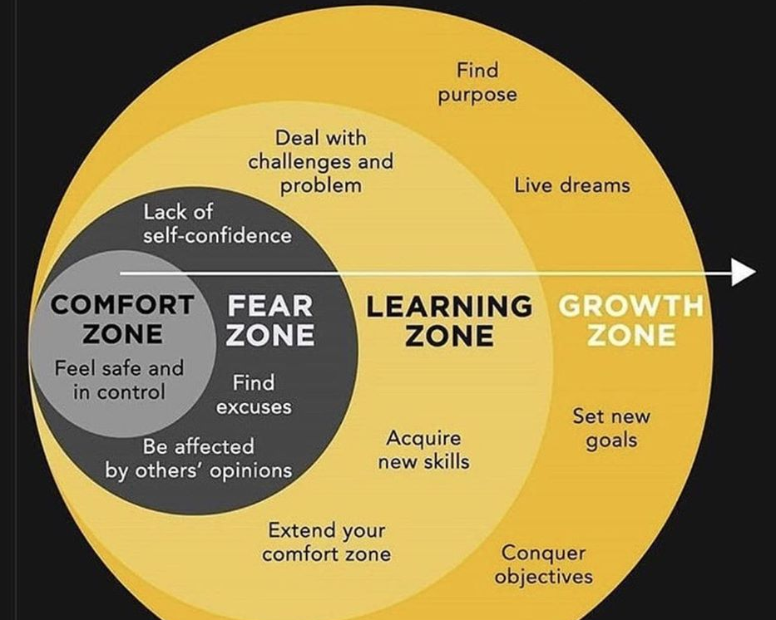
Why This Matters
Majority of our expenditures are people expenditures
Building an inclusive culture acknowledges the humanity of colleagues
Grow (and retain) talent for organizational health
Notes:
Hello - my name is Maisha Carey and I currently serve as Deputy University Librarian and Director of Organizational Learning at the University of Delaware and I use she/her pronouns. In my organizational context I lead HR and Organizational Development initiatives including data and assessment and professional development.
Salary expenditures can only be rivaled by collections in most library budgets. According to the ARL 2020 Statistics, 42% expenditures in university libraries was for salaries and that number goes up to 49% for non-university libraries. This is a huge financial investment which requires deliberate stewardship.
One key element of this stewardship is creating the environment in which employees can thrive - an inclusive, welcoming organizational culture that values diversity. Employee perceptions of how much the organization values diversity, integrates employees from underrepresented or marginalized backgrounds, and supports their inclusion via policy influences employee behaviors. Research has shown a strong link between feelings of inclusion and employee engagement, retention, and performance.
The image on the screen is likely familiar to many of you. Originally developed by psychologist Lev VyGotSky, the concept of the zone of proximal development or the learning zone describes the idea that for some discomfort is necessary for learning and subsequently for growth. In order to support employee growth and development we must push them beyond the comfort zone, but provide adequate support to not let them fall. This further supports the pairing of empathy and accountability in our praxis.

Slide 10
Interactive Component:
Where Accountability meets Care in Feedback
In chat, share examples that you have experienced in each quadrant
Graphic from: https://www.radicalcandor.com/radical-candor-not-brutal-honesty/
3 Minute Timer Lofi, Lofi Timer, CC BY-SA 4.0
Notes:
Maisha
So by now your mind is likely humming with examples of where you’ve seen the balance between accountability and empathy go really well or really poorly. So, for those of you attending the live session - we will take a 3 minute break for some discussion via chat. In the chat box, please share some examples of times that you have seen behavior in each of these quadrants. For those attending asynchronous - just take a moment and do some brainstorming. Any standouts? Times where you really nailed it or could’ve approached problem behavior with either more care or more directly?
3 minutes...
3 minute timer

Slide 11
Balancing Tensions
Notes:
Jon

Slide 12
Interactive Component
In chat, share what tensions have you noticed in your organization.
1 Minute Timer Lofi, Lofi Timer, CC BY-SA 4.0
Notes:
Jon
2 minute timer
Employing human-centered leadership requires an iterative approach and maintaining a balance between organizational needs, the needs of a department or team, and the needs of the individual. In our practice, we experienced needs to respond as tensions between these needs arise and recalibrate responses. We invite participants to share tensions they’ve experienced or tensions they foresee in the chat.

Slide 13
Tension 1: Which Humans are Being Centered?
Holistic analysis to ensure that a human-centered approach doesn’t have unintended negative consequences for others
Intentional approach to ensure that inequities aren’t reinforced
Notes:
Jon - 1 min
–Examples: We implemented a standing work from home schedule for our operations staff – the result was an overwhelming workload for scheduling staff and negative implications for utilizing benefits equitably as using benefits could impact another person’s ability to have their work from home day. Balancing accountability towards staff and accountability towards users.
–Are the same people carrying a burden to make a human-centered approach work (i.e. schedule flexibility for someone with caregiving responsibilities me less flexibility/more work for those that don’t have caregiving responsibilities; do we only privilege normative caregiving (children) or make space for inclusive application (chosen family)

Slide 14
Tension 2: Organizational Outcomes vs. Individual Outputs
Help employees see their individual outputs as contributing to their broader organizational outcomes
Address the tension and invite employees to the planning table
Notes:
Maisha - 1 min
For this next tension, let’s consider how we as leaders balance the expected outcomes of the organization as a whole with the outputs or the work of the individual members of the team. For clarity - we are defining outcomes here as what you are trying to achieve - the end result - while outputs represent the contributing actions. So a useful example is that while library instruction sessions are important outputs produced by our teaching librarians, the intended outcome is likely some improvement in student research or perhaps use of library services.
My organization participates in an annual performance planning and appraisal process. In preparation for this work, members of the library’s leadership team participate in a range of activities to share their vision for the year to come and set goals for the areas they lead. Most do at least some of this work collaboratively with their staff, however there is a tension that sometimes emerges when individual staff see (or don’t see) themselves and their work in the resulting priorities.
What happens when a staff member who really loves doing X just does not see as big a role for X in the changing work of the unit? That X may have become a fundamental part of their workplace identity, making it essential to help employees feel a connection to the broader organizational goals.
Or perhaps there is some disagreement about what these outcomes really mean and why they are important.
It is our job to help employees both understand the intended organizational outcomes and see how their individual outputs contribute to that effort - making them more willing to reimagine their work and take ownership of changing it as needed. OR perhaps the process will surface a need to in fact change those broader goals. The push and pull of this tension can lead to improvements and better approaches in both directions.

Slide 15
Tension 3: Saying No When Human-Centered
Agency to say no still exists!
As leaders, focus on modeling gratitude, clarity, and compassion
As individuals, seek clarity and involvement in decision-making
Notes:
Meghan
Good afternoon. My name is Meghan Musolff and I’m the Interim Director of Strategic Planning at the University of Michigan Library.
The tension I’m highlighting is saying no when you’ve adopted a human-centered approach. There is often a misperception that centering others means always saying yes to requests that come your way. This can feel true regardless of your position in your library, but it can feel especially true for folks in leadership positions. But taking a human-centered approach does not always mean saying yes. In fact, leaders are accountable to others to be good stewards of our organization’s resources, people, time and energy. Which means sometimes we say no. So the agency to say no still exists. The focus shifts to the delivery of the no and doing that in a way that models…
Gratitude: Thank you for this request and for demonstrating you care about this topic.
Clarity: These are the factors that when into why I’m saying no.
Compassion: I understand this response is disappointing. Let’s talk about that.
And as individuals, when presented with a no, we have the agency to seek clarity from our leaders by asking for more information about the decision and to request involvement in future decision-making around the topic.
I’m handing it over to Kat for our fourth tension.

Slide 16
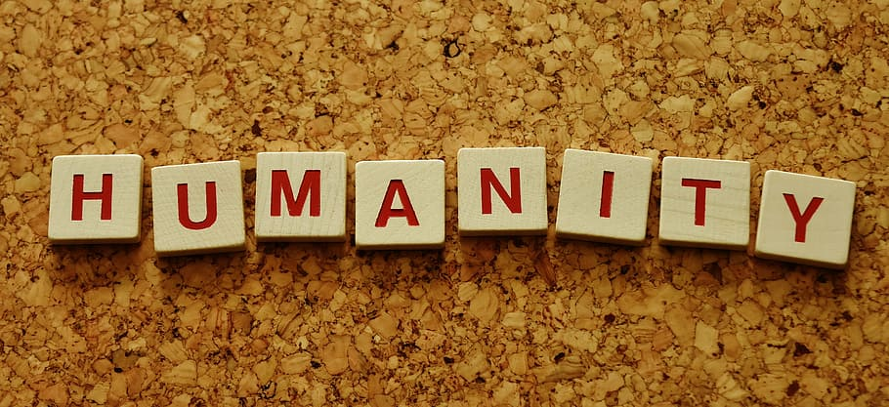
Tension 4: Leaders as Humans
Responsibility to yourself versus Responsibility to your team
Establishing guardrails creates organizational accountability, whereas boundaries are individually managed and easily compromised
Notes:
Kat - min

Slide 17
Values-Driven Leadership to Embody Care & Accountability
Notes:
Meghan
For the next couple of slides, we’ll discuss how we can use our values work as a tool to embody care & accountability within our organizations.

Slide 18
Values-
Anchored Leadership
Values are ever-present ideals that set intentions, guide behavior and inform decision-making.
University of Michigan: Excellence, Engagement, Diversity & Anti-Racism, Interdependence, Humanity
Everyone has a role to play:
Leadership: Activating values, diving deeper to foster shared understanding, and addressing gaps between espoused values and lived values
Everyone: Reflecting on the values and surfacing challenges/barriers
Notes:
Meghan
Starting with basics, values are ever-present ideals that set your organization’s intentions, guide behaviour, and inform decision-making. Listed on the slide you can see the University of Michigan Library’s set of values: Excellence, Engagement, Diversity & Anti-Racism, Interdependence, and Humanity.
Values work can be a powerful and aspirational mechanism to bring a community together (whether that community is the entire institution, the library, or a library department) and is foundational to supporting organizational change, especially if our focus is on fostering care & accountability,
Once values are set, everyone has a role to play:
In values work, leadership is accountable for…
Activating values (we’ll talk about that a bit more in the next slide)
Diving deeper into each value in order to create a shared understanding about how the value shows up in behaviours, practices, systems. (For example, we’ve had a number of conversations in our organization about the value of excellence:
How part of being an “excellent” library is actually interrogating the notion of excellence
Recognizing & talking about who and what are left out of conventional ideas of excellence in a research library
Addressing gaps between espoused values and lived values (this is especially true for us in regards to our values of diversity & anti-racism and humanity. This is what we’re saying, but this is the experience of our colleagues. What can we do to close the gap?)
And everyone in the community is responsible for reflecting on the values, using them as a north star to influence practice and behaviors, and surfacing culture and climate challenges that are barriers to living true to organization’s values

Slide 19
Values-Driven Systems & Structure
What does it mean to reimagine our systems and structure to be in alignment with our values?
Talk about your values
Incorporate values into day-to-day work
Be open to challenging conversations
Analyze our systems for oppression, bias and power; rebuild with our values
Accept & communicate that we’re talking about long-term change
Notes:
Meghan
Let’s dive deeper into how we can activate our values, including how we can reimagine our systems and structures to be in alignment with our values:
Talk about your values: This may seem simple, but it’s important for adoption, activation and organizational change. We want to avoid a situation where we create values, add them to library’s website and then never talk about them again. Talking about values can mean referencing them in all-staff communications, in onboarding activities, in departmental meetings, in budget documents, any of your foundational systems and structures. Just keep talking about them.
Incorporate values into day-to-day work: At Michigan, we encourage new teams and projects to review our set of values and discuss how the values will show-up in their work. So, when launching a project to replace our ILS, what does it mean to do this work in a way that is excellent? In a way that is engaging? In a way that is interdependent? In a way that demonstrates diversity, anti-racism, and humanity? Think about how to incorporate values work into new systems and structures you are creating.
Be open to challenging conversations: We want to foster meaningful engagement with our values in order to influence our work, so we need to be open to having difficult conversations around our values: To discuss inherent tensions within a set of values (excellence and humanity), to discuss different interpretations/perceptions of values by individuals (everyone has a different definition of engagement, humanity), and, as I said in the first slide, to talk about the gap between espoused and lived values. We need to have these conversations in order to lean into the possibilities.
Commit to taking the time to analyze and rebuild our systems and structures: This is the heart of the work we need to do to influence change in our systems and structures.
Reflect on where oppression, bias, and power show up in your system
Rethink the system’s objectives and create an inspiring vision
Rebuild the system by keeping the parts that are in alignment with your values and getting rid of the rest
Depending on the system, this can be a long process, but the effort is well worth it.
Accept & communicate that we’re talking about long-term change: We started our values work at Michigan in 2019 and it is still certainly a work in progress. Part of the work is setting expectations for values work, for culture and climate work, being a long-term change. And shifting the focus to incremental progress and communicating/demonstrating that progress to your community.
And I’m going to once again hand it over to Kat.

Slide 20
Accountability Frameworks for Your Leadership Toolkit
“Each person, human or no, is bound to every other in a reciprocal relationship” (Kimmerer, 115)
Generous Accountability from Bunny McKensie Mack
Reciprocal Accountability from Robin Wall Kimmerer, Leanne Betasamosake Simpson, and other Indigenous scholars
Notes:
Kat
“Each person, human or no, is bound to every other in a reciprocal relationship” (Kimmerer, 115)
“Alternative systems of accountability” (Simpson, 92) – healing begins with the perpetrator acknowledging the harm they have caused
Accountability is NOT punitive. Socialised through white supremacy culture to see accountability is a negative light.
Is Transformative
Healing
Working together in community
Accountability is not about causing harm. It’s about healing and preventing harm.
Accountable to ourselves
Healing transformative

Slide 21
Looking back to move forward
Prioritize people and culture and practice radical empathy
Identify and address tensions openly and often
Let your values drive your practice
Live in the growth zone
Notes:
Maisha
Radical empathy - listen to understand. Aim to connect and push yourself and your organization’s policies and practices on behalf of others
Don’t run from the tensions. Acknowledge them to address then. This makes your employees feel seen and heard and allows the organization to actually benefit.
If you have not taken the time to identify the values that guide you in your work I strongly suggest you do so. Talk about them, think about how they connect with your organization's values, and use them as a way to make hard choices and hold yourself accountable.
Finally - aim to live in the growth zone. Leadership is hard work. Don’t allow yourself to experience the discomfort of this work without the benefit of growth and evolution.

Slide 22
Reflection Component
Share in chat 1 commitment you can make after learning more today.
1 Minute Timer Lofi, Lofi Timer, CC BY-SA 4.0
Notes:
Maisha
So for our final moment of reflection, we ask that you join us in the chat to share 1 commitmtnet you can make toward your own learning after this session. I will invite my co-presnters to join in and share their own reach goals for this work. Where do you want to begin or continue your growth towards caring and accountable leadership?

Slide 23
Q&A
Thank you! Merci!
Annie Bélanger | Kat Bell
Maisha Carey | Jon Jeffryes
Meghan Musolff
Notes:
Maisha
Thank you so much for joining us for this session and for your thoughtful engagement in the live session. The floor is now open for continued Q&A. Beyond this session, we also invite you to reach out to us directly with questions, comments, or to just connect. You can find our contact information in the conference platform, as well as the full slide deck which includes additional tools for accountability and our resources list. Thank you.

Slide 24
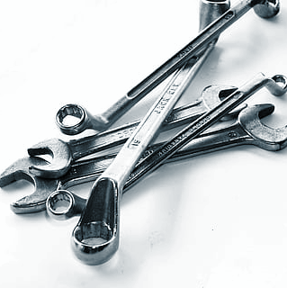
Additional Resources for Enhancing Your Leadership Toolkit

Slide 25
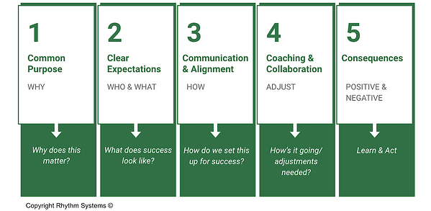
5 Cs of Team Accountability
Notes:
Maisha
https://www.teamstrength.com/the-5-cs-of-leadership-accountability/
Possible text:
Building accountability requires that we understand a few dynamics because it’s less straightforward than we recognize. It goes beyond the responsibility for the outcomes to a culture of accountability where team members provide the input needed to achieve the expected outcomes. Holding people accountable is critical for organizational alignment: when you have strategic aims, create a culture to implement them.

Slide 26
LEAD & Systems Thinking
L
E
A
D
Leverage
Engagement
Alignment
Development
Notes:
Jon
Stresses the importance of leadership setting the context in which work is being performed to connect work assignments and projects to the overall goals of a team or organization. Leaders also need to make sure that people responsible for a project or initiative have the power to hold accountability.
https://thesystemsthinker.com/accountability-leadership/#:~:text=The%20four%20cornerstones%20of%20accountability,greatly%20increases%20a%20manager's%20effectiveness.

Slide 27
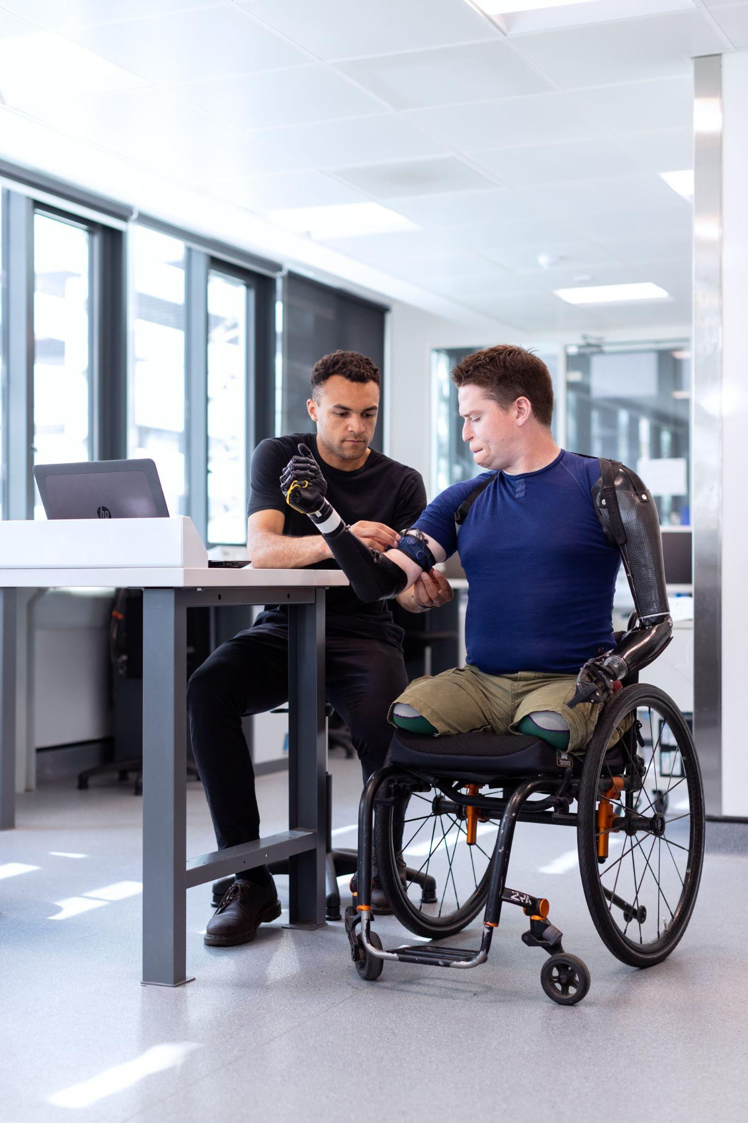
Disability Justice & Accountability
“Disabled people live at the intersection of all systems of oppression and social justice issues. There isn’t one issue or one intersection where you will not find disabled individuals advocating for or experiencing the effects of those issues.” ~Daphne Frias
There is no justice that neglects disability
Notes:
Annie
Photo by ThisisEngineering RAEng on Unsplash
It is our premise that human-centered leadership should be about transformation of hierarchical organizations, setting us up for an evolution towards justice. Many libraries are asking how they move to action when it come to diversity, inclusion and equity? Most advocates say that you start, that you start with good enough and humility to grow and learn, and you keep going. This is about persistence beyond the point of reason. We also argue that there is no inclusion, never mind justice, if disability is absent from the conversation.
“Disabled people live at the intersection of all systems of oppression and social justice issues. There isn’t one issue or one intersection where you will not find disabled individuals advocating for or experiencing the effects of those issues.” — Daphne Frias, youth activist, organizer, storyteller, and peacebuilder
“When we speak of disability we celebrate the brilliance and vitality of a vast community of people with non-normative bodies and minds whether disability is visible or not” (https://bcrw.barnard.edu/wp-content/uploads/2020/03/Moving-at-the-Speed-of-Trust-live-transcript.pdf)
Mia Magnus states “If we can’t even practice accountability and justice between each other, then how can we demand accountability from institutions or the state?”. We need to recognize that processes and the individuals needed to help shift these.
Often, we have focused this work on training and aspirations. The Disability Community would argue that it is time to shift to accountability. What is the natural consequence of not following through on our commitments? If there are none, then these are aspirations only.

Slide 28
Resources
Ettarh, Fobazi. January 2020. Vocational Awe and Librarianship: The Lies We Tell Ourselves. Into the Library With The Lead Pipe. https://www.inthelibrarywiththeleadpipe.org/2018/vocational-awe/
Fujikawa, Kiyomi, Shannon Perez-Darby, and Mariame Kaba. October 2018. Building Accountable Communities. Online Event. https://bcrw.barnard.edu/event/building-accountable-communities/
Kennedy, Kay, Susan Campis, and Lucy Leclerc. June 2020. Human-Centered Leadership: Creating Change From the Inside Out in Nurse Leader. https://doi.org/10.1016/j.mnl.2020.03.009
Kimmerer, Robin Wall. 2013. Braiding Sweetgrass. Milkweed Editions.
Kraines, Gerald A. N.d. Accountability Leadership. Systems Thinker Blog. https://thesystemsthinker.com/accountability-leadership/

Slide 29
Resources
Lakshmi Peipzna-Samarasinha, Leah, and Elliott Fukui. April 2020. Moving at the Speed of Trust: Disability Justice and Transformative Justice. Online Event. https://bcrw.barnard.edu/event/moving-at-the-speed-of-trust-disability-and-transformative-justice/
Levy, Lynne. August 2022. The Human-Centered Leader. Workhuman Blog. https://www.workhuman.com/blog/the-human-centered-leader/
Martin, Daniel E. March 2020. What is Human-Centered Leadership? Human Capital Leadership Institute. https://hcli.org/articles/does-compassion-have-place-leadership
McKensie Mack, Bunny. March 2020. Shifting the Center: Transforming Academic Libraries through Generous Accountability. ACRL 2020 President’s Program (https://www.youtube.com/watch?v=P2pnoUcF_o4)
McCullough, Cathy. August 2022. Leadership Accountability: Build Accountability Leadership in your Team. Rhythm Systems Blog. https://www.rhythmsystems.com/blog/the-five-cs-of-team-accountability

Slide 30
Resources
No author. 2021. The 5 C’s of Leadership Accountability. Team Strength Blog. https://www.teamstrength.com/the-5-cs-of-leadership-accountability/
No author. February 2022. What is human-centered leadership? Josh Bersin Academy. https://bersinacademy.com/blog/2022/02/what-is-human-centered-leadership
Paterson, Jacqui. N.d. Radical empathy: what is it and what are the benefits? https://www.happiness.com/magazine/relationships/radical-empathy-extreme-what-is-it
Peterson, Anne Helen. May 2022. The Librarians Are Not Okay. Culture Study Blog. https://annehelen.substack.com/p/the-librarians-are-not-okay

Slide 31
Resources
Pressley, Ayanna, and Rebecca Cokley. Winter 2022. There is Not Justice That Neglects Disability. Stanford Social Innovation Review. https://ssir.org/articles/entry/there_is_no_justice_that_neglects_disability#
Scott, Kim. n.d. Brutal Honesty and Radical Candor: 6 Ways You’re Getting Radical Candor Wrong and 5 Ways to Get It Right. https://www.radicalcandor.com/radical-candor-not-brutal-honesty/
Seale, Maural, and Rafia Mirza. December 2020. The Coin of Love and Virtue: Academic Libraries and Value in a Global Pandemic. Canadian Journal of Academic Librarianship. https://cjal.ca/index.php/capal/article/view/34457

Slide 32
Resources
Semaan, Deshani. May 2021. Mia Mingus on disability justice and the importance of starting locally. Ignite International Blog. https://ignitenational.org/blog/mia-mingus-on-disability-justice-and-the-importance-of-starting-locally
Sergeeva, Irina. March 2021. Accountability vs. responsibility for leaders: back to the basics. BetterUp Blog. https://www.betterup.com/blog/accountability-vs-responsibility-for-leaders-going-back-to-the-basics
Simpson, Leanne Betasamosake Simpson. 2017. As We Have Always Done: Indigenous Freedom Through Radical Resistance. University of Minnesota Press.
Yeo, Chuen Chuen. May 2020. Why Organizations Need Human-Centered Leaders, And Three Tips To Get Started. Forbes. https://www.forbes.com/sites/forbescoachescouncil/2020/05/08/why-organizations-need-human-centered-leaders-and-three-tips-to-get-started/

Slide 33
Resources
Lofi Timer, “3 Minute Timer Lofi,” https://www.youtube.com/watch?v=K5ldLDf_G6Q
Lofi Timer, “1 Minute Timer Lofi,” https://www.youtube.com/watch?v=hwap5XZ5kSM

Slide 34
Presenter Contact Information
Annie Bélanger | belange1@gvsu.edu | LinkedIn
Kat Bell | katkimbell@gmail.com | LinkedIn
Maisha Carey | maisha@udel.edu | LinkedIn
Jon Jeffryes | jeffryjo@gvsu.edu | LinkedIn
Meghan Musolff | musolffm@umich.edu | LinkedIn

