Slide 1
Building Inclusive Libraries One Step at a Time: Kindness, Equity, and Candidate Experiences in Hiring
OLA Superconference 2023
Sarah Beaubien, Annie Bélanger, and Preethi Gorecki
Notes:
Annie section
They can use the Q&A feature in Zoom to pose questions or ask in the Pheedloop session chat.
When you want to address their questions (ex. Throughout, half-way through, or at the end)
The session is being recorded and will be available on Pheedloop post-conference.
Closed captions are enabled.
Have you ever wondered if the interview process could be a kinder, more accessible experience anchored in equity that is ultimately meant to develop connections? Would you like to critically examine practices in the hiring process to ensure empathy for applicants going through the process? In taking a closer look at our own practices, we made significant improvements to our processes, which have led to a more positive experience for candidates and our organizational outcomes. Each component of the hiring process can be centered in equity and accessibility. It is key to ensure that each stage contends with bias, both positive and negative, through mitigation strategies. Each of the interview components should be relevant and necessary to both the search committee and candidate’s decision making. Additionally, others involved in the process, such as through open presentation, must be prepared to provide feedback that aligns with a commitment to equity. While each member of an organization has a differing level of agency to impact change, we all hold power to shape the process through micro-practices and living the change. Together, the presenters will explore leading hiring practices, the differences and benefits as compared to more traditional approaches to hiring, and the impact of these practices. They will explore implications for different components of the hiring process and how to transform each for a focus on equity, inclusion, and accessibility. Additionally, they will provide a toolkit that you can use or adapt in your context in order to support both the critical examination, such as equity lenses, and practical resources to develop more inclusive approaches from the job posting to making an offer. The presenters include the administrators who developed the new processes as well as someone who went through the reimagined process as a successful candidate. They are coming from a range of institutions, differing vantage points within the organizations in terms of hiring authority, and hold a variety of identities. Together, they will articulate ways to lead from each of their locus of control within an organization to influence, and at times enact change.

Slide 2
Learning Objectives
Foster inclusive hiring practices
Develop candidate-centered interview experiences
Center equity in processes
Materials in the toolkit
Notes:
ANNIE

Slide 3
Our Groundwater
Live in colonial, genocidal countries
Work in capitalistic, hierarchical organizations
Situated within fostering inclusion, not decolonization and justice
Notes:
ANNIE

Slide 4
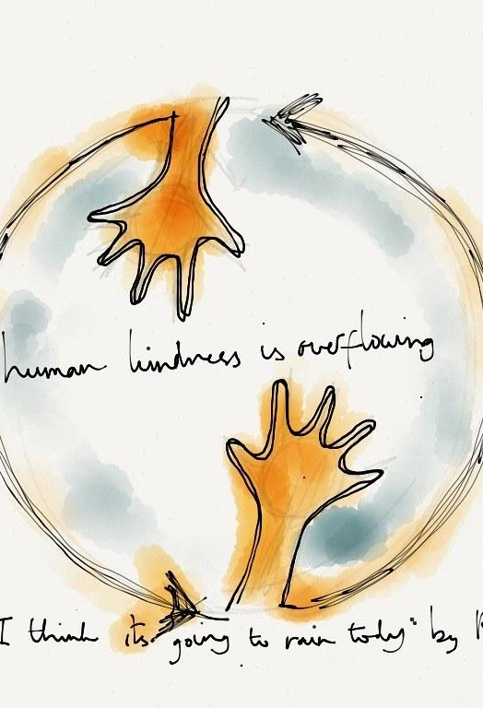
High-Empathy & Kind Hiring: Why?
Social responsibility to profession
Develop more diverse candidate and hiring pools
Model leading practices
Optimize candidate experience
Have empathy, kindness, and respect to support success for all
Center universal design approach
Learning opportunity for candidates
Notes:
ANNIE
Our professional values and core principles are meant to inform our practice as librarians and library professionals. What if we took those values and working principles into the realm of recruitment?
COVER BULLETS

Slide 5
Preparing To Hire
Notes:
ANNIE
Inclusive hiring is about creating a level playing field that brings equity to the heart of the hiring process. The goal is to directly reflect our Diversity, Equity, Inclusion, and Accessibility values and apply them to how we hire from start to finish for all positions in the university. Supervisors, employees, and any key decision maker involved in the job description writing process should use this tool.
An equity lens is a set of questions we ask ourselves when we plan, develop or evaluate a policy, program or decision. Using an equity lens will help us identify potential impacts on institutionally excluded and marginalized individuals and groups, and to identify and potentially eliminate barriers. Our toolkit includes an equity lens for each of phase of the recruitment process.

Slide 6
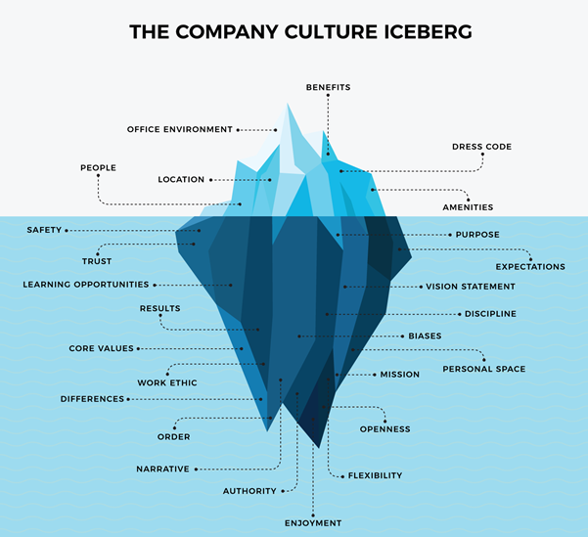
Prepare Your Organizational Culture
Be clear on why
Anchor in your values
Create accountability
Don’t focus on diversity first
Identify organizational culture areas for change
Train your white colleagues
Notes:
ANNIE

Slide 7
Writing Your Position Descriptions
Focus on role purpose
Articulate accountabilities clearly
State the minimum number of qualifications to be able to succeed
Writing Tips:
Be concise
Use inclusive language
Using the simplest language possible
Use descriptive action verbs, such as support, participate, and collaborate
Avoid abbreviations and acronyms
Notes:
ANNIE
Job descriptions are valuable in describing a position's purpose, critical tasks, duties, accountabilities, minimum education and experience qualifications, and the values of our organization. They also form the foundation for many important human resource processes: recruitment, hiring selection, employment classifications, compensation, training, and performance management. A job description gives an employee a clear and concise guide for job performance, helping them understand the essential tasks and how to best prioritize their work. It should answer “What does this role do?”
From a recruitment perspective, well-written, accurate job descriptions will ensure that the most relevant, qualified candidates apply for the job.
Inclusive language is important to reduce possible applicants from self-selecting out. Biased language can signal a gender bias, ableism, and racism. This can occur unintentionally, yet has a drastic impact on recruitment efforts. For example, a job being suited to a recent graduate may signal a desire to avoid older workers.
Keeping in mind that the purpose of the job description is to create a clear set of expectations for the role, consider:
Writing in a concise, direct style.
Using the simplest language possible.
Use descriptive action verbs, such as support, participate, and collaborate .
A more comprehensive list of action verbs: https://www.harding.edu/assets/www/academics/university-college/career/pdf/actions-verbs-a-to-z.pdf
Avoid abbreviations and acronyms.
When more details may be needed for clarity, use the word “by” to detail the processes, tasks, or operations performed. For example, if using verbs like “assists, handles, and performs,” describe “how” the position assists, handles, or performs, such as:
“Leads Automated Storage and Retrieval System (ASRS) support and planning by:
Tracking multi-year projects, liaising with Dematic for long-term planning purposes, and working with the Assistant Dean of Resource Management & Administration on cost projections.”
Use gender inclusive language and terminology.
Tools: Equity Fluent Leader Glossary of Key Terms from UC Berkeley Haas School of Business
See Inclusive Language section below
Reference other titles and departments, not individuals.
Include only relevant duties and accountabilities.
Limit the number of qualifications as well as consider how to broaden the language beyond libraries or GVSU Libraries’ specifics to widen the candidate pool.

Slide 8
More Inclusive Language
Male-coded: "who thrive in a competitive atmosphere…" to "who are motivated by goals…"
Female-coded: "have a polite and pleasant style…" to "are respectful and conscious of diverse needs…"
Ableist & ageist: “walks through the building” to “Circulates in the building” or “energetic” to “committed”
Racist: “Strong English language skills” to “Ability to communicate effectively”
Tools
Gender Decoder: https://gender-decoder.katmatfield.com/
Applied Text Analysis: https://textanalysis.beapplied.com/
Conscious Style Guide: https://consciousstyleguide.com/
Equity Fluent Leader Glossary of Key Terms from UC Berkeley Haas School of Business: https://haas.berkeley.edu/equity/industry/efl-knowledge-bank/glossary-of-key-terms/
Toolkit icons created by Freepik - Flaticon
Notes:
ANNIE
Feelings of belonging that are elicited by a job ad are important in creating job appeal; language that appears catered to one identity creates a barrier for applicants of other identities. Here are some common ism-coded words used in job descriptions that should be avoided:
Female-Coded Words: Agreable, empathetic, sensitive, affectionate, feel, support, collaborate, honest, trust, commit, interpersonal, understanding, compassion, nurture, and share
Male-Coded Words: Aggressive, confident, fearless, ambitious, decisive, head-strong, assertive, defend, independent, battle, dominant, outspoken, challenge, driven and superior
Racially-Coded Words: strong English-language skills, cultural fit,
Ableist-Coded Words: Energetic, athletic, able-bodied individual, talking with students, walking through the building

Slide 9
Position Descriptions Position Ads
Describe everything required to be successful in a role
Create shared understanding between incumbent and manager
Serve as basis for onboarding and review processes
Attract a strong, diverse pool of candidates
Inform about position and qualifications
Showcase the organization
Explain the working conditions
Notes:
ANNIE
Although job descriptions and job ads are similar, there are a few key differences between them as they perform different roles.
The function of a job advertisement is to attract a strong and diverse pool of candidates. The job ad needs to inform potential candidates about the position, including the skills and other attributes needed for the role (qualifications). It should also include information about the organization and what the working environment is like. It should use short, exciting language as well as keywords to bring interest to the role! It is not an exhaustive list of job duties and functions, which belong in a job description.
On the other hand, job descriptions serve as a summary of everything that a role requires for a candidate to be successful. The job description is a much more detailed document that is a reference for the manager and employee to create shared understanding, serve as the basis for onboarding, and to be used in performance reviews. When recruiting, you should consider sharing the job description with candidates – perhaps before their first interview – so that they have complete transparency and can gain a very clear understanding of the role.

Slide 10
Candidate Centered Ads
Be mindful of bias
Examine the language used
Keep number of qualifications in check
Look for aptitude and quality of experience
Be explicit about learning opportunities and benefits
State Inclusion, Diversity, Equity and Accessibility commitment
Invite dialogue and questions
List salary
Notes:
ANNIE

Slide 11
Interactive Moment
What is problematic here?
MadeUp Libraries are looking for an energetic, professional, and committed individual for their Cataloguing & Metadata Librarian.
[...]
Strong English language skills, including being clear spoken
Ability to lift 50 lbs
Notes:
ANNIE
Share in the chat or raise your hand

Slide 12
Interactive Moment
Answer Key
MadeUp Libraries are looking for an energetic, professional, and committed individual for their Cataloguing & Metadata Librarian.
[...]
Strong English language skills, including being clear spoken
Ability to lift 50 lbs
Notes:
ANNIE
Answer Key
Energetic is ableist, and unnecessary for this role
Professional is subjective and white-centered
Strong English language skills is racist and anti-immigrant
Ability to lift 50 lbs is ableist and too high of a weight for this role

Slide 13
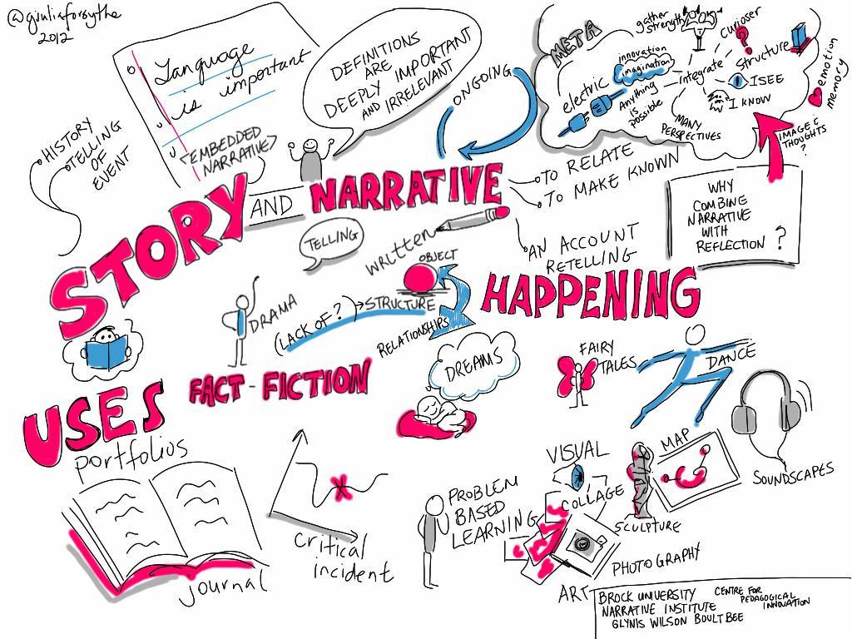
StoryTime
Ads fostering interest and a sense of belonging:
What drew you to apply?
Other experiences since?
Notes:
Preethi

Slide 14
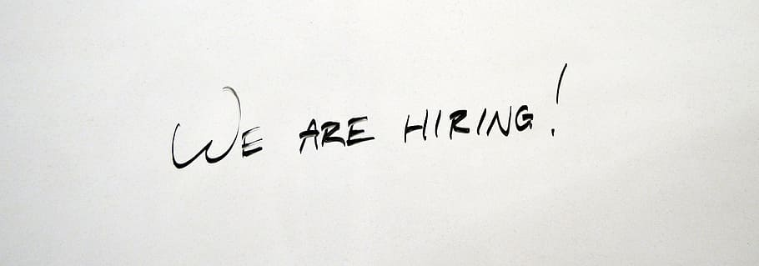
Interview Preparation
Notes:
Sarah Section

Slide 15
Committee Kick-Off Agenda
Confidentiality
Conflicts of interest
Position Overview
Clarity on qualifications & role purpose
Questions about ad
Process Overview
Reviewing & selecting candidates
Agenda development approach
Question development
Notes:
SARAH
The kick-off meeting helps set the tone and expectations for the committee. It will also provide a chance for committee members to gain clarity around the process and the rationale for each interview component. Your kick-off meeting may be tailored to your organization's needs, but here are some of the elements we recommend including. Confidentiality is critically important, whether the search is internal or external. All committee members must respect confidentiality - be clear on what is okay to share (e.g., where we are in the process) and what is not okay (information about specific candidates). Conflicts of interest should be disclosed, if applicable, with plans in place on how to mitigate them. The library world is small, so it’s not unusual for a committee member to know one or more of the candidates. Now is also the time to ask questions about the job ad, run through the process, and develop the interview agenda and questions. Doing this work in advance helps mitigate some of the implicit biases that can appear after having reviewed application materials.

Slide 16
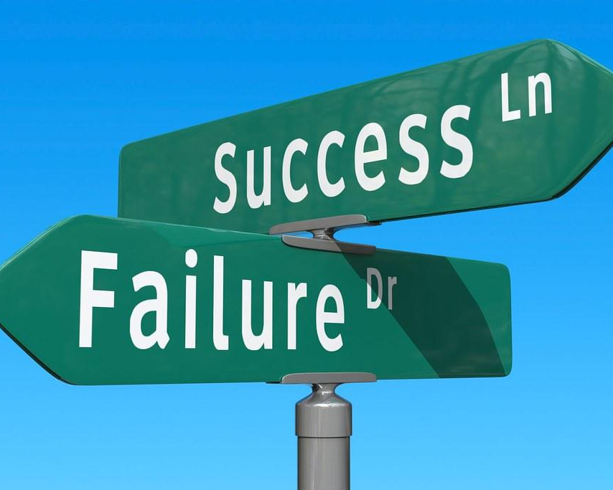
Defining a Successful Search
Center the candidates’ ability to succeed
Every interaction is an opportunity to build an ambassador for your library
Notes:
SARAH
Process Overview
By centering on the candidates’ ability to succeed, we are working to remove barriers to success and we can have inclusive high-empathy practices. When you think about the information, communications and tools most candidates need to make informed decisions, lean into discomfort to make bold choices that helps candidates bring their authentic self to the process, you are inherently bringing concept of universal design to play.
When we shift from candidates being thankful for applying to working to recruit long-term colleagues and allies, we look at it from a new angle. What if the ads are a means to help candidates early on not only learn what we are looking for, but also consider what is in it for them? Every interaction with a potential candidate is helping you build a network for future recruitment.
What is a failed search? A failed search is not the failure to hire. It is the failure to hire for success. Hire most likely to succeed vs. most qualified because most qualified on paper only compounds systematic privilege. Keep in mind that most qualified may be most likely to succeed.
Most qualified on paper means the most experienced, most degreed, or most certificates. It is not strongest demonstration or alignment with our required qualifications. Our qualifications also include commitment to inclusion, diversity, equity and accessibility as well as respect and cognitive empathy. Sometimes the most technical skills will not align with our user centered and inclusion focuses.
To climb the ladder, you have to have gotten on the first rung in the first place. Privilege allows you to get on sooner and climb faster, so hiring for aptitude, knowledge of, alignment with. Breaking down the skills for a required qualifications so we can see demonstrations and knowledge aside from if a person had an equivalent job or certification.

Slide 17
Advertising & Outreach
Advertise broadly
Focus on affinity groups advertising platforms
Have colleagues share on their listservs and social media
Reach out to possible candidates to invite them to apply or share the posting
Notes:
SARAH
Your organization may have data that helps you understand how and where most candidates find your job ads. If that’s available, use it to identify potential venues for sharing the job ad. Share broadly with your networks and encourage your colleagues to do the same. Where possible, send the job ad to affinity group platforms/listservs. If the position is a librarian role, also consider reaching out to MLIS programs or other venues that may reach those entering the profession.

Slide 18
Preparing the Interview Structure & Agenda
Create a purposeful agenda
Focus statements
Indicate participants
Open slot
Cover the span of job qualifications
Build in breaks
Consider physical accessibility and psychological safety throughout the day
Notes:
SARAH
To inform your and the candidates’ decisions:
Agenda Creation
Many interview include a dinner the night before. The best practice is to have the IA at the dinner if feasible. The dinner is meant for the candidate to ask questions about the next day, get to know the search chair(s). It is not part of the hiring assessment.
Each part of the daylong agenda needs to have a clear purpose as related to the job or the search. We articulate a focus statement that clarifies for the candidate why this meeting is on the agenda and who they’ll be meeting with.
We have adopted the leading practice of having an open slot for the candidate to select from a list or a meet and greet. Examples range from: Tour of building, tour of campus, meeting with HR for benefits discussion, meeting with any of our social justice centers, meeting with Inclusion and Equity, meeting with IDEA, meeting digital scholarship campus lead, etc.
We also will include many mini-breaks.

Slide 19
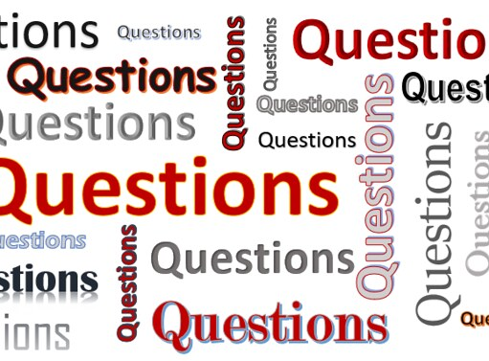
Developing Questions
Anchor and align with job qualifications
Simple, open questions
Define success criteria for each question
Define prompts to support candidates
Prepare the team to ask clarifying questions
Notes:
SARAH
Interview Questions
Anchor questions to the job requirements. Ensure all requirements are covered. If this is entry-level position, could someone without experience successfully answer?
Use open questions with as little leading text as feasible. We want to see how someone interprets a questions and where they naturally want to take it. We also can create some follow-ups or prompts to offer a high-empathy approach when they are struggling, and note that we did use them.
Define success criteria for each question. These are not the actual answers you’re looking for, but are the concepts that a successful answer would cover. This helps ensure that we have a shared understanding of what success could look like before we meet candidates.
Knowing how to ask questions is key to discuss. It is important that we do jot notes to remember, yet it is equally important that we keep some eye contact and engage with the candidate as they work through the interview. We are jotting a dialogue if you will. We can also note what we heard and what we observed.
Many worry about asking follow-ups. These follow-up questions are part of "peeling the onion” to understand the person's actual role, the results achieved and the process used to achieve the results. It is not expected that we ask the same follow-up questions for every candidate. If answers seem to be thin on detail, the interviewer can ask follow-up questions:
• What exactly did you do?
• What was your specific role in this?
• What challenges did you come across?
• Why precisely did you do that?
• Why exactly did you make that decision?
Even though each panel member will lead with predetermined questions (ideally from an interview guide), any panel member at any time can ask a probing follow-up question for more detail or clarification. This will not only enhance the likelihood of additional key information being captured but also demonstrate the engagement and rapport with the candidate with the entire panel. (https://www.zeroriskhr.com/learning-center/guides-and-tools/panel-interview-strategy)

Slide 20
Candidate Reviews
Prepare all interview materials before the candidate review
Create a rubric
Align with job qualifications
Consider organizational values
Identify strengths and areas of growth
Fight back on ‘fit’
Consider how to engage the whole committee
Notes:
SARAH
Preparing materials before candidate review
To reduce the insertion of bias, and to ensure that we are anchoring our process in the job requirements, we will work to have our materials ready before we begin the review of candidates. This means:
· Phone interviews
· Agenda
· Presentation topic
· Interview questions
Reviewing Candidates
We will create a rubric to review candidates. This will list the requirements. Rubrics can be as simple as yes / no in terms of the requirement or more sophisticated: not demonstrated / demonstrated somewhat / demonstrated strongly.
Please refrain from any social media screening of candidates.
Selecting candidates
We articulate the ability to succeed of each interviewee: strengths, areas of growth or flags. It is our practice to summarize after each candidate visit. We also will have a final meeting to review the summary that will be sent to the Dean.
Phone Screening
It has become our practice to phone screen. Typically, this is 30 minutes of questions and 10 for the candidate to ask us questions. We will screen candidates every 45 minutes. It is important for equity that we maintain the amount of time allotted to each candidates.
We send the questions to the candidates one hour ahead to support inclusion and equity. It allows people to not self-disclose.
If a pool is small, then phone screening is not required.
Interview Planning Equity Lens
Have we planned all of the interview components ahead of reviewing candidate materials?
Do all of the interview components help us make our decisions?
Can we articulate a clear purpose for each interview component?
Do we have criteria to assess each interview component?
Have we told the candidate the components, their purpose, and the assessment criteria?
Are we clear on the weight of different components, including feedback from interactions beyond the search committee interview?
Have we created an evaluation rubric that is bias-free and reflective of our values?
Are our questions aligned with the job qualifications?
Have we identified and documented what concepts a successful answer would include for each question?
Are we creating an accessible and inclusive environment for the candidates?
Are we providing breaks between meetings?
Are we highlighting where there is assistive mobility technology, such as elevators?
Did we ask about dietary needs or allergies?
Did we ensure that any open interview components can occur in accessible space?
If there is a public talk, is there an accessible podium or speaking location?
Are we supporting the candidates’ ability to make their decision whether to join us?

Slide 21
Interacting With Candidates
Notes:
PREETHI
When a candidate interviews with us, they get a glimpse into our workplace culture. It’s important that the candidate feels as comfortable as possible when interacting with us. If we put effort into making candidates feel comfortable before we hire them, they will trust us to continue that effort once they are hired.

Slide 22
Preparing Colleagues to Interact with Candidates
Every interaction is helping the candidate decide to join the organization, or not.
Best: How do you envision providing food bank services from different locations?
OK: How should downtown food banks offer services? [presumes knowledge that downtown tend to be urban and mixed populations]
Least: How should Replenish change its services in the next 3 years? [presumes knowledge that Replenish is your food bank, the location and environment of the food bank, and of the student population changes]
Notes:
PREETHI
Anyone who is participating in

Slide 23
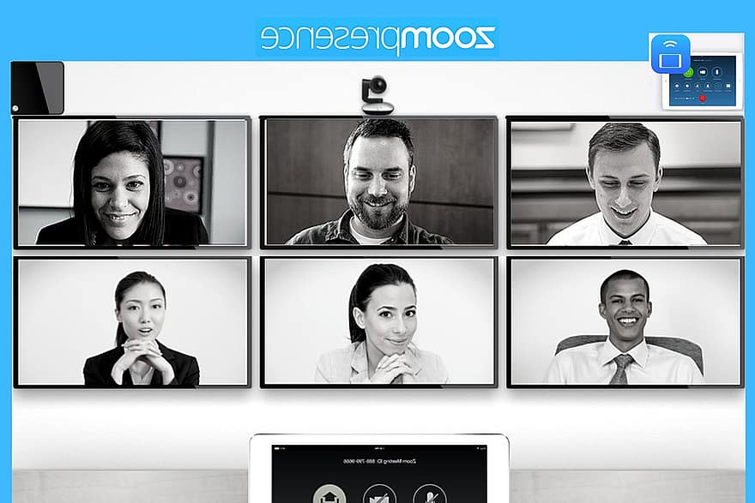
Inclusive Virtual Interview Day
Turn on Closed Captioning
Editing your screen name, include pronouns
Consider candidate interactions with camera use - and tell them!
Give clear guidance on how interview will proceed
Turn on waiting rooms to prevent accidental entries
Notes:
PREETHI
Turn on Closed Captioning
Editing your screen name, include pronouns
Consider candidate interactions with camera use - and tell them!
Ask about bandwidth to decide on camera use
Offer cameras off for the public presentation
Offer cameras on for the conversational components
Give clear guidance on how interview will proceed
Turn on waiting rooms to prevent accidental entries
For virtual interviews, this includes editing your screen name to the name you wish to be called, adding your pronouns to your screen name (if willing), ensuring everyone introduces themselves at each component, enabling the ability to turn closed captioning, and either having all cameras on or off.

Slide 24
Mitigating Bias in Interactions
Anchor in the criteria and qualifications
Define purpose for each component
Articulate what success would be
Be self-aware
Listen and observe
Ask clarifying questions of one another
Positive Bias
But we like them!
I love their scholarship!
That Library is great!
Negative Bias
They didn’t dress professionally
They haven’t done this exact job before
That job is not valuable
Notes:
PREETHI
Are you basing your evaluation on the ability to succeed? Or on who you would like to be friends with?
It's about committees sometimes expecting applicants to have already done the job rather than evaluating for their ability to succeed (and possibly discounting transferable or similar experience)

Slide 25
Interacting with Candidates Equity Lens
How are we communicating with all candidates?
Did we provide a list of interview questions to all participants prior to the interview? This will allow for people with various disabilities and neurotypes to be successful in the interview
What are our communication methods and with whom?
What is our process for ensuring we are being timely with our communication?
Have we shared best practices for interacting with candidates with all colleagues that will participate in any component of the interview?
If we are collecting feedback from open components, have we based the feedback form on the required and preferred qualifications being assessed in these components?
Toolkit icons created by Freepik - Flaticon
Notes:
PREETHI

Slide 26
Interactive Moment
What is problematic?
Jolene has requested that they be provided with an allergy-friendly meal and a set of microphones for the presentation.
When they arrive, the room is not accessible and no microphone is provided. Jolene has to self-declare they are hard of hearing. The search chair states they have a teaching voice, it will be ok as they will repeat the questions for her.
Notes:
PREETHI
Share in the chat or raise your hand

Slide 27
Interactive Moment
Answer Key
Jolene has requested that they be provided with an allergy-friendly meal and a set of microphones for the presentation.
When they arrive, the room is not accessible and no microphone is provided. Jolene has to self-declare they are hard of hearing. The search chair states they have a teaching voice, it will be ok as they will repeat the questions for her.
Notes:
PREETHI
Room is not accessible
Requested accommodation is not available
Candidate has to share disability at a moment of vulnerability
Search chair dismisses concern
Search chair misgenders Jolene

Slide 28
StoryTime
Experiences as a candidate
Notes:
Preethi & Annie

Slide 29
Closing the Deal
Notes:
SARAH

Slide 30
Making the Offer
Prepare your best offer
Prepare a script of all benefits and details
Be aware of what is negotiable
Have a transparent phone conversation
Follow-up with detailed email
Allow time for time for candidate reflection
Invite follow-up questions
Check-in and finalize the offer
Toolkit icons created by Freepik - Flaticon
Notes:
SARAH
Prepare your best offer
What are the criteria used to negotiate in ways that allow equity between candidates and current employees?
Are the same practices and/or people involved in all negotiations, ensuring consistency from one to the next?
Have we shared how we set compensation with the candidate?
Negative impact of negotiation on structurally excluded candidates
Prepare a script of all benefits and details
Have a phone conversation
Follow-up with email
Allow time for time for reflection
Invite follow-up questions

Slide 31
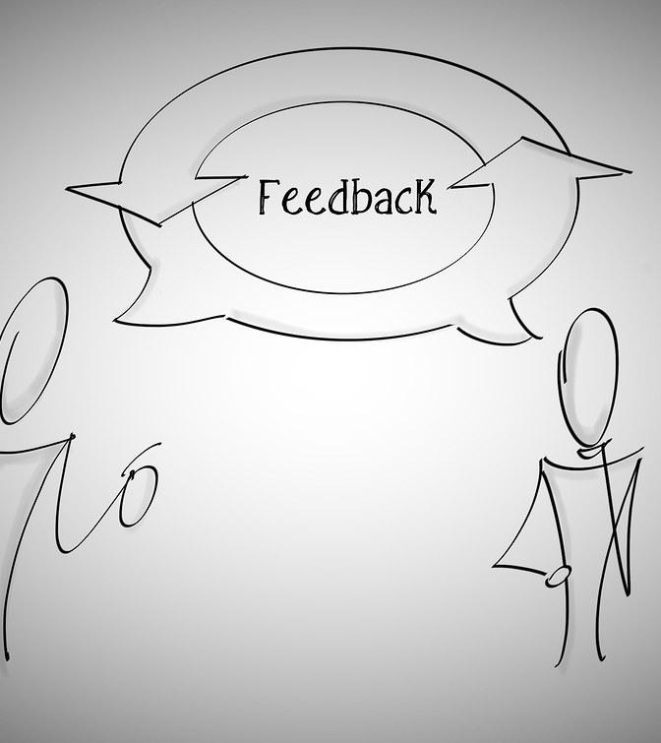
Giving Feedback to Non-Selected Candidates
Anchor in radical candor and empathy
Highlight strengths
Highlight areas of growth to be more competitive in future searches
Give the candidate the right to refuse
Caution: Never share why someone was not selected
Toolkit icons created by Freepik - Flaticon
Notes:
SARAH
Candidates invest a lot of time in search processes. By giving them feedback, we are honoring their commitment and giving back. The search committee should draft a list of strengths they saw as well as opportunities for growth for future interview. Give them the right to refuse. Once you share, be ready for a dialogue.

Slide 32
Inclusive Hiring & Onboarding Toolkit
https://scholarworks.gvsu.edu/library_reports/26/
Created by: Annie Bélanger, Sarah Beaubien, Kat Bell, Krista Benson, Takeelia Garrett, Lori Cawthorne, Emily Frigo, Sheila GarcÍa Mazari, Preethi Gorecki, Kristin Meyer, Jenna Vainner, and Jesus Espinoza

Slide 33
Questions & Answers
Sarah Beaubien sbeaubie@uoguelph.ca
Annie Bélanger belange1@gvsu.edu
Preethi Gorecki preethi.gorecki@gmail.com
Notes:
Be ready to share lessons learned

Slide 34
Resources
Bélanger, Annie; Beaubien, Sarah; Bell, Kat; Benson, Krista; Cawthorne, Lori; García Mazari, Sheila; Garrett, Takeelia; Gorecki, Preethi; Frigo, Emily; Meyer, Kristin; Vainner, Jenna; and Espinoza, Jesus, "Building Inclusive Libraries: Kindness, Equity, and Candidate Experiences in Hiring & Onboarding Toolkit" (2023). Library Reports and Communication. 26. https://scholarworks.gvsu.edu/library_reports/26/
Frigo, Emily; Bélanger, Annie; Meyer, Kristin; Durham, Jason; and Merry, Brian, "Inclusive Job Descriptions Toolkit" (2022). Library Reports and Communication. 25. https://scholarworks.gvsu.edu/library_reports/25
Indeed For Employers. N.d. Best Practices for Virtual Interviews. https://www.indeed.com/hire/c/info/best-practices-for-virtual-interview
Zero Risk HR. May 2017. Panel Interview Strategy: A How​-To Guide https://www.zeroriskhr.com/learning-center/guides-and-tools/panel-interview-strategy

