Slide 1
Focusing on Candidate Experience to Decenter White Professionalism in Hiring and Onboarding
2023 JCLC
Annie Bélanger, Kat Bell, Lori Cawthorne, Jesus Espinoza
Notes:
Photo by Christina @ wocintechchat.com on Unsplash

Slide 2
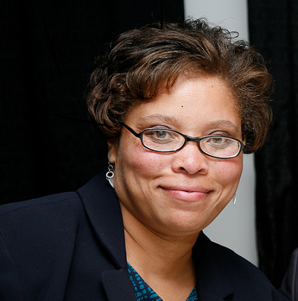
Speakers
Jesus Espinoza
Student Success Librarian
University of Michigan
Lori Cawthorne
Director of EDIBA Education and Outreach
Harvard University
Kat Bell
Head, Assessment & Planning
George Mason University
Annie Bélanger
Dean of
University Libraries
Grand Valley State University

Slide 3
Learning Outcomes
Understand inclusive practices related to hiring and onboarding
Be able to identify and mitigate bias and power dynamics in hiring and onboarding processes
Learn strategies to be empowered and self-advocate as candidates in hiring and onboarding processes

Slide 4
Agenda
Activity - Appreciative Inquiry Interview
Inclusive Practices Overview
Job Ads and Deciding to Apply
Mitigating Bias
Interview Experiences
Offers and Rejections
Inclusive Onboarding
Q&A
Activities will occur throughout the workshop
Ask clarifying questions as you go

Slide 5
Activity
Appreciative Inquiry Interview
1st reflect individually. Then, in pairs, take turns answering the following questions:
Consider a time you had a great interview experience - what happened? What made the difference?
Consider a time you had a good onboarding experience - what happened? Who was involved? How did they support this positive experience?
Notes:
ANNIE
20 mins

Slide 6
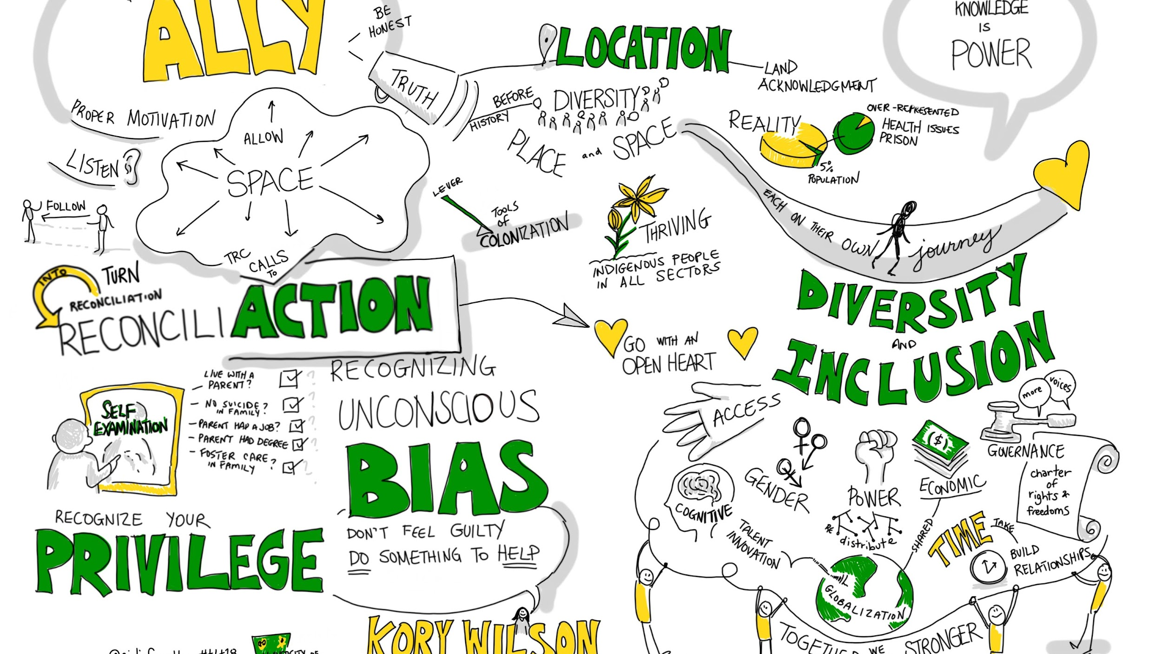
Inclusive Practices

Slide 7
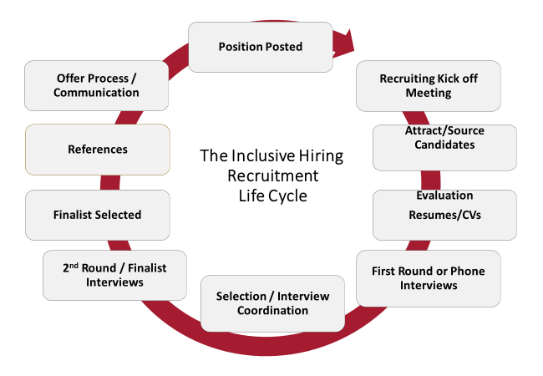
Notes:
LORI

Slide 8
Top Biases in the Selection Process
Bias | Definitions
Halo Effect | “Occurs when we perceive one great thing about a person and let that halo glow of that one thing color our opinions of everything else about that person”
Horns Effect | “Occurs when perception of someone is unduly influenced by one negative trait”
Affinity | Leads us to favor people to who we feel we have a connection or similarity
Pedigree | Tendency to focus on those with Ivy Leagues degrees or work experiences
Anchoring | “A trap we fall into when we have information to which we become rigidly attached”
Confirmation | “Tendency to search for, interpret, focus on, and remember information that aligns with our preconceived opinions”
Conformity | “Tendency to behave like others in a group, even if that behavior conflicts with our personal beliefs
Notes:
LORI

Slide 9
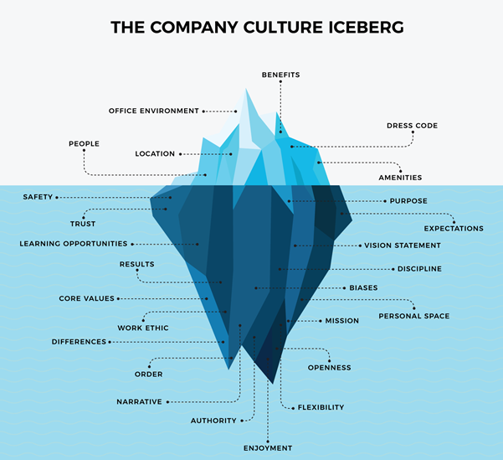
Organizational Culture Hazards
Power dynamics
Elitism
Microaggressions
Outright aggression
“How we do things here”
Communication approaches
What is success & how is it measured
Notes:
LORI

Slide 10
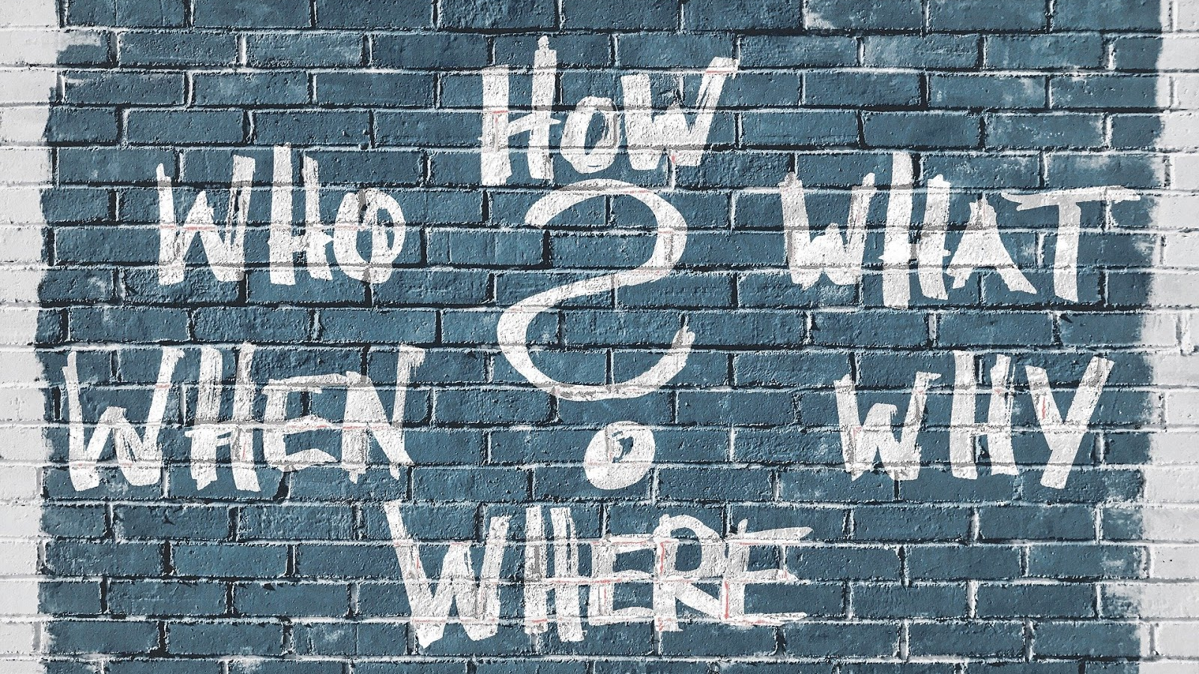
Job Ads

Slide 11
Inclusive
Job Ads Should:
Address:
The organization
Role purpose
Role accountabilities
Qualifications
Employment type and physical demands
What organization offer to candidates
Consider bias and language used
Align qualifications with experiences needed
Articulate organizational commitment to diversity, inclusion, equity, and accessibility
List salary and benefits
Invite questions
Notes:
ANNIE
Photo by The Jopwell Collection on Unsplash
Feelings of belonging that are elicited by a job ad are important in creating job appeal; language that appears catered to one identity creates a barrier for applicants of other identities. Here are some common ism-coded words used in job descriptions

Slide 12
Inclusive Language
Female-Coded Words: Agreeable, empathetic, sensitive, affectionate, feel, support, collaborate, honest, trust, commit, interpersonal, understanding, compassion, nurture, and share
Male-Coded Words: Aggressive, confident, fearless, ambitious, decisive, headstrong, assertive, defend, independent, battle, dominant, outspoken, challenge, driven and superior
Racially-Coded Words: excellent English-language skills, cultural fit, clear spoken, native English speaker, polite, professional, nice
Ableist-Coded Words: Energetic, athletic, able-bodied individual, talking with students, walking through the building
Notes:
ANNIE

Slide 13
Activity
Language in Ads
MadeUp Libraries are looking for an energetic, professional, and committed individual for their Cataloguing & Metadata Librarian.
[...]
Strong English language skills, including being clear spoken
Ability to lift 50 lbs
Notes:
ANNIE
Answer Key
Energetic is ableist, and unnecessary for this role
Professional is subjective and white-centered
Strong English language skills is racist and anti-immigrant
Ability to lift 50 lbs is ableist and too high of a weight for this role

Slide 14
Answer Key
Language in Ads
Answer Key
MadeUp Libraries are looking for an energetic, professional, and committed individual for their Cataloguing & Metadata Librarian.
[...]
Strong English language skills, including being clear spoken
Ability to lift 50 lbs
Notes:
Answer Key
Energetic is ableist, and unnecessary for this role
Professional is subjective and white-centered
Strong English language skills is racist and anti-immigrant
Ability to lift 50 lbs is ableist and too high of a weight for this role

Slide 15
Reading Job Ads
Read it through once
Identify what is considered important
Experiences that would help a person land or perform this job
Skills that would help a person land or perform this job
Education or training that would help a person land or perform this job
Organizational values
Read between the lines:
High-paced, flexible could mean chaotic working culture
Repetitive requirements could mean unrealistic expectations
Notes:
JESUS
Photo by Christin Hume on Unsplash
Read it “all the way through, top to bottom.” Then, do a quick gut check. Is this the type of job you could do and would want to do? If the answer is yes, read the job description again.
“A job ad should be balanced when it comes to information on the role responsibilities, requirements, salary, and benefits. As a candidate, you deserve to receive an accurate description of your potential future tasks, together with a reasonable set of skills and capabilities needed to perform the role successfully.
For example, job advertisements containing only a few brief bullet points on the scope. Combined with an extensive list of requirements, it might indicate that the company doesn’t have realistic expectations from their candidates, and, conclusively, the employees as well.”
https://www.linkedin.com/pulse/how-read-job-advertisement-cristian-maria

Slide 16
Reading Between the Lines
Leveraging resources and network
Library Green Book
We Here
NALCos
Let’s talk!
Notes:
JESUS

Slide 17
Activity
Review a Job Description for Inclusive Language
Review the job description by considering:
What language might be ageist, ableist, racist, or gendered?
What language might be creating barriers to those that are new to the field or area?
What other questions should you be asking as you review the job description to align with the Library’s commitment to diversity and inclusion?
What questions might a candidate want the position description to help them answer?
What would you need to know to apply?
Notes:
JESUS

Slide 18
ACTIVITY - Bias in Resumes

Slide 19
Notes:
Lori

Slide 20
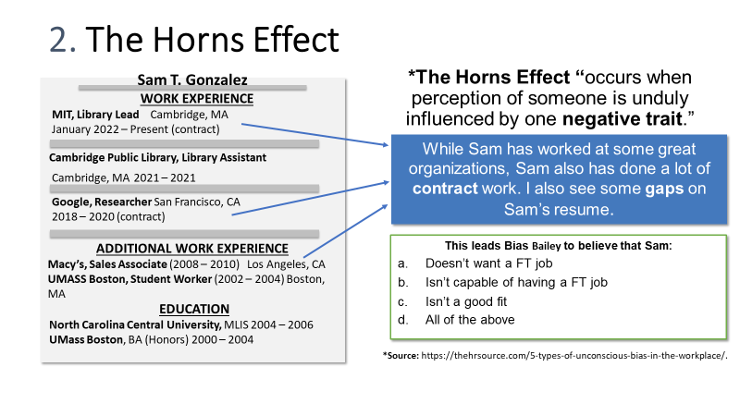

Slide 21
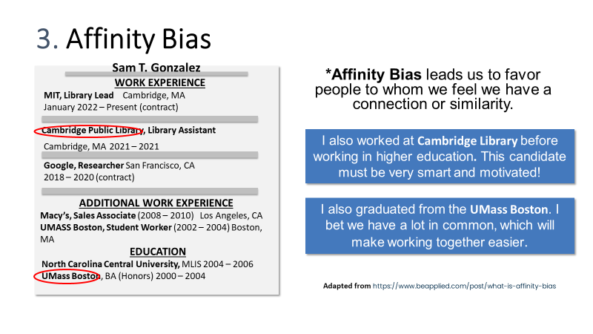

Slide 26
Getting Ready to Apply
Identify if a resume or CV is required for the application
Include a cover letter
List how you can meet the qualifications and perform the required duties
Use language in the job ad, especially when an application tracking system is in place
Articulate specific skills by describing an experience in which you gained/used that skill
Consider the STAR method:
Situation
Task
Action
Results
Notes:
KAT

Slide 27
Your Turn
What other tips do you have about applying?

Slide 28
Interview Experiences
Notes:
Lori

Slide 29
Interview Planning Leading Practices
Inclusion and equity is concretely defined for the organization
Fair processes centered throughout the hiring lifecycle
All search chairs trained to be inclusive hiring champions
Job search anchored in qualifications
Interview components support decision making for organization and candidate
Active recruitment
Positive candidate experiences are fostered throughout
Accommodations and universal design
High-levels of clear, timely communications
Salary range and benefits are shared
Travel arrangements made by university to remove financial barriers
Notes:
LORI

Slide 30
What To Expect: Inclusive & Timely Communications
Phone Interview Prep
In Person Interview Prep
Pre-Visit
Selection
Non-Selection
Expression of excitement for candidacy
Search Committee members information
Process & Timeline overview
How to request accommodations
Other things to know about organization
Building upon last message
Agenda with focus statements, who will be there, and evaluation criteria
Process & Timeline overview
Clarity on financial coverage
How to request accommodations
Requesting information food needs
Pickups - license plate and description of the vehicle for safety
Questions for search committee component
Presentation topic two weeks ahead
Organization should get permission to do reference check
Offer call
Excitement
Articulate how salary is set (and if negotiations can occur)
Benefits outline
Clear timeline for response
Answer questions
Scheduling a call to let people know
Thanks for investing in the search
An offer to share feedback: 1) What particular strengths and 2) What areas of growth to be more competitive in future
Bélanger, Annie and Gorecki, Preethi, "ACRL Diversity Alliance Webinar - Kindly Hire Me: The Process and Impact of Inclusive Hiring" (2022). Presentations. https://scholarworks.gvsu.edu/library_presentations/102
Notes:
LORI

Slide 31
What to Expect of an Inclusive Virtual Interview
Closed Captioning turned on
Edited screen names, including pronouns
Clear indication of candidate interactions and camera use - on or off
Clear guidance on how interview will proceed
Waiting rooms active to prevent accidental entries
Questions added to the chat (good) or sent ahead (best)
Notes:
LORI
Photo by Surface on Unsplash

Slide 32
What to Expect of an Inclusive In-Person Interview
Introductions using pronouns
Breaks between meetings
Indications of where assistive mobility technology is, such as elevators
Asks about dietary needs or allergies
Asks about accommodations
All open interview components in an accessible space
Supporting your ability to make a decision whether to join an organization
Notes:
LORI
Photo by Yash Raut on Unsplash
Don’t share more than you need to. While they legally can’t discriminate on disability, ableism is alive and well. Search committees can find other ways to rule a candidate out.

Slide 33
Activity
World Café
Travel from table to table to have small group dialogue about a series of questions
Share out primary themes
Notes:
KAT
World Cafe - 4-5 tables with the following questions to discuss
What is an inclusive interview practice that has surprised you in your own experience?
What is an inclusive interview practice that you felt was missing from your own experience?
What’s a norm of interview practices that you think should be critically questioned?
What is one unique idea for creating a different interview experience? Think big sky!

Slide 34
Navigating Power Dynamics
Be aware of your boundaries
Expect respect and timeliness
Reflect on questions in relation to the qualifications
Advocate for yourself
If the interview process is negative and disorganized, trust what the organization has shown you
Notes:
JESUS
Interviews are filled with power dynamics. Interviewers set the interview agenda, the assessment criteria, the pace, the setting, and the timing of an interview. The interview process sets out to find out about the candidates’ experiences, skills, abilities, values, and approaches. In turn, ideally, the interviewers will share about their approaches, their organizational culture, and their expectations. However, this is not always a given.
Few people are as knee-deep in our work-related anxieties and sticky office politics as Alison Green, who has been fielding workplace questions for a decade now on her website Ask a Manager. In Direct Report, she spotlights themes from her inbox that help explain the modern workplace and how we could be navigating it better. There are times when interviewers use their power to cross normal boundaries or treat candidates in ways that would otherwise be considered inappropriate. Examples from the Ask a Manager column include:
Search chairs asking candidates to clear a whole day for a 30 minutes phone interview
Search chairs asking to look at candidates’ personal belongings
Search committees keeping candidates waiting for over 2 hours
Search committees asking about personal situations, childhood, and more that is utterly irrelevant to the job qualifications
In navigating these power dynamics, consider that as a candidate you also have power to choose. This is easier said than done when facing financial difficulties.
Yet, going into a job interview process:
Be aware of your boundaries
I can’t clear the whole day, but could hold 2-4pm
Expect respect and timeliness
If more than 15 minutes late, ask if the time can be rescheduled
As we’re talking, I’m realizing that this is not quite the right fit for me, so I should remove myself from consideration
Reflect on questions
That’s an unusual question, why do you ask?
Advocate for yourself
I don’t generally let people go through my belongings, but I am glad to tell you that I stay organized at work
“Even if you’re not in a position to do those things—because you need the job and aren’t willing to risk losing out on it—there’s still huge benefit to being clear-eyed about that choice, so that you’re not blindsided by a difficult boss or dysfunctional culture after you’re hired.”
https://slate.com/human-interest/2018/04/how-the-weird-power-dynamics-of-job-interviews-can-brainwash-you-into-putting-up-with-bad-behavior.html

Slide 35
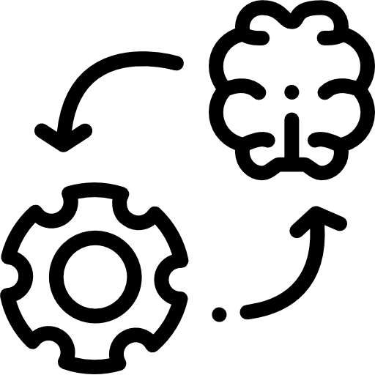
CALLING IN: 3-D Model
Define: What is the issue or challenge? What does success look like? What is the objective or purpose for the conversation?
Discuss: What is your perspective? What is their perspective? What do you have in common? What is different?
Decide: What are the commitments? What are the next steps? How can you continue to show up as an ally with them?
Notes:
JESUS

Slide 36
CALLING IN: Scripted Sentences
"I'm curious. What was your intention when you said that?"
“How might the impact of your words or actions differ from your intent?”
“How might someone else see this differently? Is it possible that someone else might misinterpret your words/actions?”
“Why do you think that is the case? Why do you believe that to be true?”
“What is making you the most fearful, nervous, uncomfortable, or worried?”
“I don’t find that funny. Tell me why that’s funny to you.”
“It sounded like you said ______. Is that what you really meant?”
“I need to push back against that. I disagree. I don’t see it that way.”
“It sounds like you’re making some assumptions that we need to unpack a bit.”
Notes:
ANNIE
(https://edib.harvard.edu/files/dib/files/calling_in_and_calling_out_guide_v4.pdf?m=1625683246)
Calling in and calling out are not mutually exclusive strategies. Depending on the situation, calling out could precede calling someone in for a follow-up conversation. The sentence above, from Harvard’ Diversity, Inclusion, & Belonging Calling In and Calling Out Guide, range from calling in to gentle calling out.

Slide 37
ACTIVITY: Identifying & Calling In Bias
Scenario 1: Feedback on hiring decision
You have two qualified candidates for a position within your office. One applicant is White and the other African American. While most of the team preferred the African American candidate based on their relevant job experience. The hiring manager overruled and selected the white candidate because they felt the candidate would be a better “ fit”. How would you address the hiring manager?
Scenario 2: Culture of inclusion
During a meeting, Rachel is boasting to the team about this great collaborative project Jamie is working on. However, during the discussion , Rachel keeps referring to the Jamie as, “he”, when their pronouns are actually, “they/them”. Everyone on the team can see Jamie is visibly upset. How would you address the situation?
Scenario 3: Virtual Exclusion
Your team has joined your weekly Zoom office meeting and one of your BIPOC team members is missing. It is now approaching five minutes after the meeting start time and someone says, “Where’s Sydney?”. The Team manager states to give them another minute before the meeting begins. While chuckling to themselves, Ryan puts in the chat, meant as a private message to a colleague, but instead, messages everyone, “Typical, their kind are always late.” What do you do?
Notes:
JESUS

Slide 38
Offers & Rejections
Notes:
KAT

Slide 39
Asking for Feedback
Ask as soon as possible
By email, 24 hours
By phone, right away
Ask about strengths they observed and how you might be more competitive in other searches
Thank them for their time
Don’t ask why specifically you didn’t get the job
Notes:
KAT
Photo by Adrian Swancar on Unsplash

Slide 40
What to Expect in an Offer Package
Salary
Hours worked per week
Year length: 9 months, 10 months, 12 months
Start date
Benefit package: health, vision, dental, life insurance, retirement
Paid time Off
Disability supports
Professional development funding and support
Moving expenses (if applicable)
Notes:
KAT
Photo by Andrew Neel on Unsplash

Slide 41
Questions About An Offer
How much time do I have to make my decision?
How is the salary set?
How are the moving expenses calculated?
How will I be assessed in the role?
How will I be made permanent/ongoing?
When can I start to use vacation?
Can unused vacation roll forward into the next year? If so, how much?
When do health benefits start?
When will I be vested into the retirement benefits?
What are the policies for sick leave and other leaves?
What should I expect of the onboarding process?
May I have this information in writing?
Notes:
KAT
Photo by Jennifer Bedoya on Unsplash

Slide 42
Storytime
What have we looked for in our experiences?
Lessons learned

Slide 43
Inclusive Onboarding
Notes:
LORI & ANNIE

Slide 44
Onboarding
Employee onboarding is the process of welcoming new colleagues to the workplace.
•An Inclusive onboarding experience accommodates and supports ALL new employees, not just some of them.
•Onboarding begins at the time of the accepted offer.

Slide 45
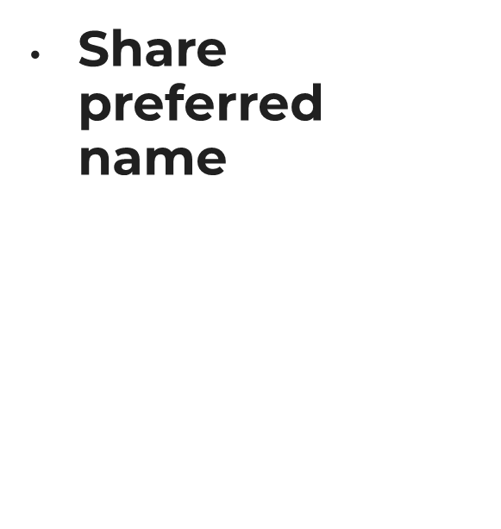
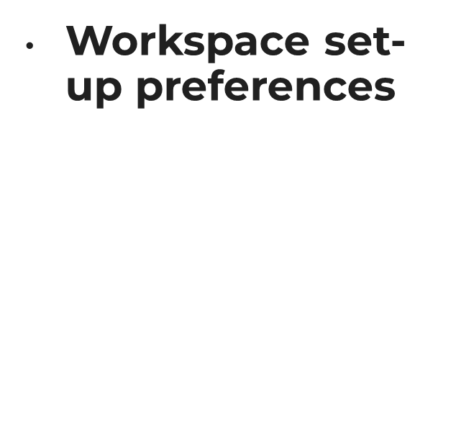
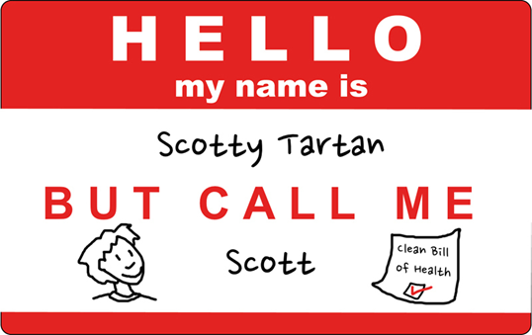
Pre-Onboarding

Slide 46
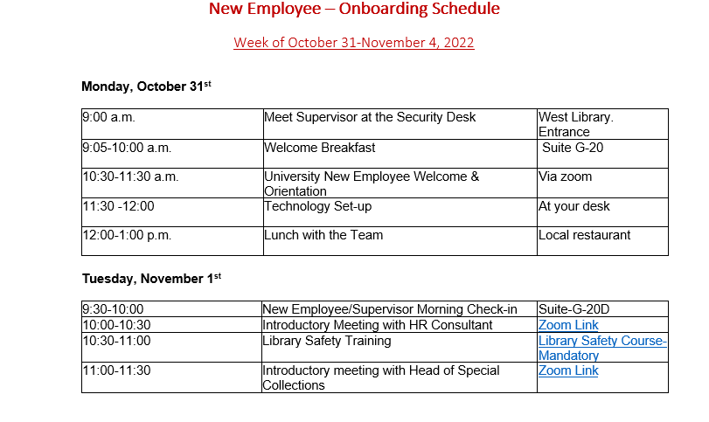
Sample Onboarding Schedule

Slide 47
Organizational Employee Onboarding

Slide 48
The Importance of EDI During Onboarding

Slide 49
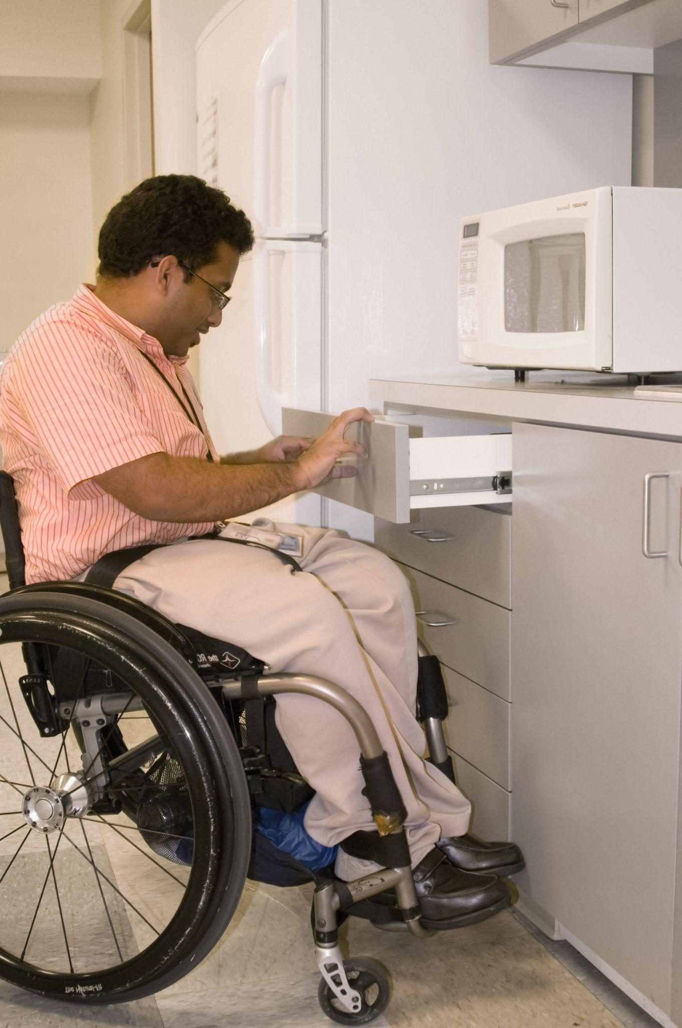
Disability & Accommodations
ADA is centered in the medical model of disability. Workplace inclusion is anchored in the social model of disability.
Disclosure is a requirement for accommodations
Legal requirement to provide reasonable accommodations
Core job requirements used to determine reasonable accommodation
If you can do the job without accommodations, no requirement to disclose
Notes:
ANNIE
Disability is not monolithic, and this leads to a range of experiences in the workplace and a range of supports needed to succeed. The fear of discrimination, unconscious bias and other negative consequences might lead many to withhold information about their physical or mental health from others. However, telling an employer about a disability may be necessary to help you receive adequate accommodations to perform your job.
It is my belief that If you plan to accommodate, you plan to exclude
Photo by CDC on Unsplash

Slide 50
Getting Ready to Disclose
Consider where and how supports are needed
Draft possible solutions to help you succeed to prepare for the discussion
Have medical paperwork assembled
Engage in open dialogue
Find an advocate if needed
Document everything
Notes:
ANNIE
While universal design and inclusive organizations can do a lot to reduce the need to request accommodation, there are still times where needs are specific and therefore need accommodation. Accommodation is articulated by the ADA. It is usually handled through a central office, such as disability supports. It is important for you to prepare to self-advocate by:
Considering where supports are needed and how
Drafting possible solutions to help you succeed to prepare for the discussion
Having medical paperwork assembled
Engaging in open dialogue
Finding an advocate if needed
Documenting everything
It is important that you document every step of the way to protect yourself in the event of discrimination.
Once you have an accommodation, this information is protected. Your supervisor will know the accommodations to put in place, but does not have the legal right to why an accommodation is needed. Self-disclosure is up to you. Additionally, your colleagues do not have a right to know why you have an accommodation, and at times, what that accommodation is.

Slide 51
Q&A

Slide 52
Resources
Asana. May 2022.19 unconscious biases to overcome and help promote inclusivity. https://asana.com/resources/unconscious-bias-examples
Frigo, Emily; Bélanger, Annie; Meyer, Kristin; Durham, Jason; and Merry, Brian, "Inclusive Job Descriptions Toolkit" (2022). Library Reports and Communication. 25. https://scholarworks.gvsu.edu/library_reports/25
Green, Alison. April 2018. The Employer Who Asked to Look Inside a Job Candidate’s Purse: How the weird power dynamics of job interviews can brainwash you into putting up with outrageous behavior. Slate. https://slate.com/human-interest/2018/04/how-the-weird-power-dynamics-of-job-interviews-can-brainwash-you-into-putting-up-with-bad-behavior.html
https://thehrsource.com/5-types-of-unconscious-bias-in-the-workplace/.
https://www.beapplied.com/post/what-is-affinity-bias
https://www.careerplug.com/blog/9-hiring-biases-that-are-hurting-your-recruiting-efforts/

