Slide 1
Decentering Whiteness, Dismantling Systemic Bias: Examining Empathetic, High-Communication, and Supportive Hiring Processes to Forge an Inclusive Future
Annie Bélanger, Sheila García Mazari, Preethi Gorecki
ACRL 2023
Notes:
PREETHI
Photo by Uriel SC on Unsplash
Our professional values and core principles are meant to inform our practice as library professionals. What if we took those values and principles into the realm of recruitment? How might hiring practices change? What if we brought the compassion and empathy reserved for users to candidates? What if we centered learning as part of the recruitment process? What if recruitment processes moved from a grueling challenge where only the worthy may be left standing to a learning opportunity for all?
The library embarked on a review of their recruitment processes to consider the intersection of diversity, lifelong learning, user-centered practice, empathy, and respect. They believed that they had a social responsibility to the profession to help each other learn what kind of librarian and library professional we want to be. They wanted to provide professional modeling of a strong, confident library where informed risk taking occurs and inclusion is woven right into the hiring process. They hypothesized that by centering the needs of the candidates as we prepare the day, they would challenge their habits and biases to ensure they are doing things that will truly inform their decisions and help them provide feedback to the candidates. They thought that by rooting our processes in empathy and respect, they would remember that they are not only interviewing candidates, the candidates are interviewing the library too. Lastly, they wanted to acknowledge that though job searches will always be stressful, it can be a smoother and healthy process.
The library believed that they could support candidates in their retention in the profession by providing constructive, impactful feedback through a dialogue model; providing strengths and areas of growth. They viewed the hiring process as a component of strong retention in the profession. They wanted the hiring process itself to model the profession we wish to have, one imbued with empathy, respect, and kindness as a way to undermine systemic bias.
This presentation will explore perspectives on inclusive hiring practices from both sides of the table - the hiring manager and the interviewees. In 2018, we conducted our first diversity residency search, which integrated recently developed inclusive recruitment and high-empathy hiring practices used for leadership roles. These practices were subsequently integrated into all hiring searches. The original search committee chair, one of the successful residency candidates, and a tenure-track faculty hired under this new approach, will team up to dissect the hiring process from their perspectives. They will discuss the work behind critically examining the existing hiring process, designing an inclusive recruitment plan, and implementing a new structure in order to ensure empathy towards applicants. They will then discuss the impact of inclusive hiring on perceptions of the work environment, satisfaction with the search, and overall experience of the hiring process. They will also provide practical tips and tools to explore your local hiring practices in order to center empathy as a way to advance inclusive and equitable processes.

Slide 2
Learning Outcomes
Understanding of inclusive hiring search practices
Understanding of impact on candidates of hiring search processes
Identify areas to improve local hiring search practices
Notes:
PREETHI

Slide 3
Principles & Definitions
Notes:
SHEILA
Photo by Riccardo Annandale on Unsplash

Slide 4
Performing Whiteness
Whiteness = cultural and social privilege conferred by proximity to whiteness
How does embodied generational trauma and white supremacy show up in our bodies and our actions?
Notes:
SHEILA
Crenshaw, in Demarginalizing the Intersection, articulates whiteness as the privilege conferred by whiteness and maleness, which is implicit and generally not perceived.
“our bodies are raised into a history so rife with violence that more than half of us won’t look at it, don’t really know it. This is history buried in our flesh, in our ancestry, in our shared nationhood. It works differently on Black people, Indigenous people, and people of color than it does on white folks, but we are all disciplined by it, made smaller by it.” ~ Sarah Bellamy
James Baldwin mused that “one of the reasons people cling to their hates so stubbornly is because they sense, once hate is gone, they will be forced to deal with pain.”
Bellamy, Sarah. June 2020. Performing Whiteness. The Paris Review. https://www.theparisreview.org/blog/2020/06/08/the-performance-of-white-bodies/

Slide 5
Empathy Defined
To actively consider another person's point of view in order to connect more deeply with them
Notes:
SHEILA
Empathy is the ability to understand and share the feelings of another. Empathy includes both cognitive (aka intellectually) and emotional (aka shared emotions). “Radical empathy is a concept that does exactly that – it encourages people to actively consider another person's point of view in order to connect more deeply with them.” Today, this trait enables us to see and understand another person's point of view.
Paterson, Jacqui. N.d. Radical empathy: what is it and what are the benefits? https://www.happiness.com/magazine/relationships/radical-empathy-extreme-what-is-it

Slide 6
Systems Thinking
The ability to identify underlying patterns and relationships within an environment which form wider systems and structures.
Notes:
SHEILA
Systems thinking is the ability to identify underlying patterns and relationships that exists within our environments. Acknowledging that we also are part of this system, systems thinking allows us to take a holistic view of events take place to understand how they form wider systems and structures. No one event exists in isolation, and seeing them in such a manner can cause more harm. Just how in libraries, siloes often prevent us from understanding what is happening in other areas of a library or lend to the replication of work, by taking a systems approach and viewing events through a circular rather than a linear lens, we’re able to determine our own role in the system and how we may work with the system to effect change.
Acaroglu, L. (2017, September 7). Tools for systems thinkers: The 6 fundamental concepts of systems thinking. Medium. https://medium.com/disruptive-design/tools-for-systems-thinkers-the-6-fundamental-concepts-of-systems-thinking-379cdac3dc6a

Slide 7
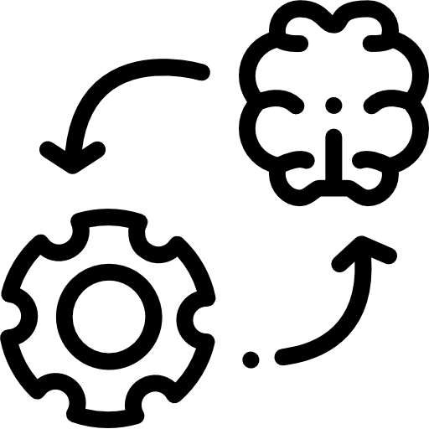
Leading Practices
Define what inclusion and equity means to your department
Write inclusive job descriptions and ads
Ensure the creation and execution of fair processes through the hiring cycle
Center the candidate experience in all interactions
Process icons created by Freepik - Flaticon
Notes:
Sheila

Slide 8
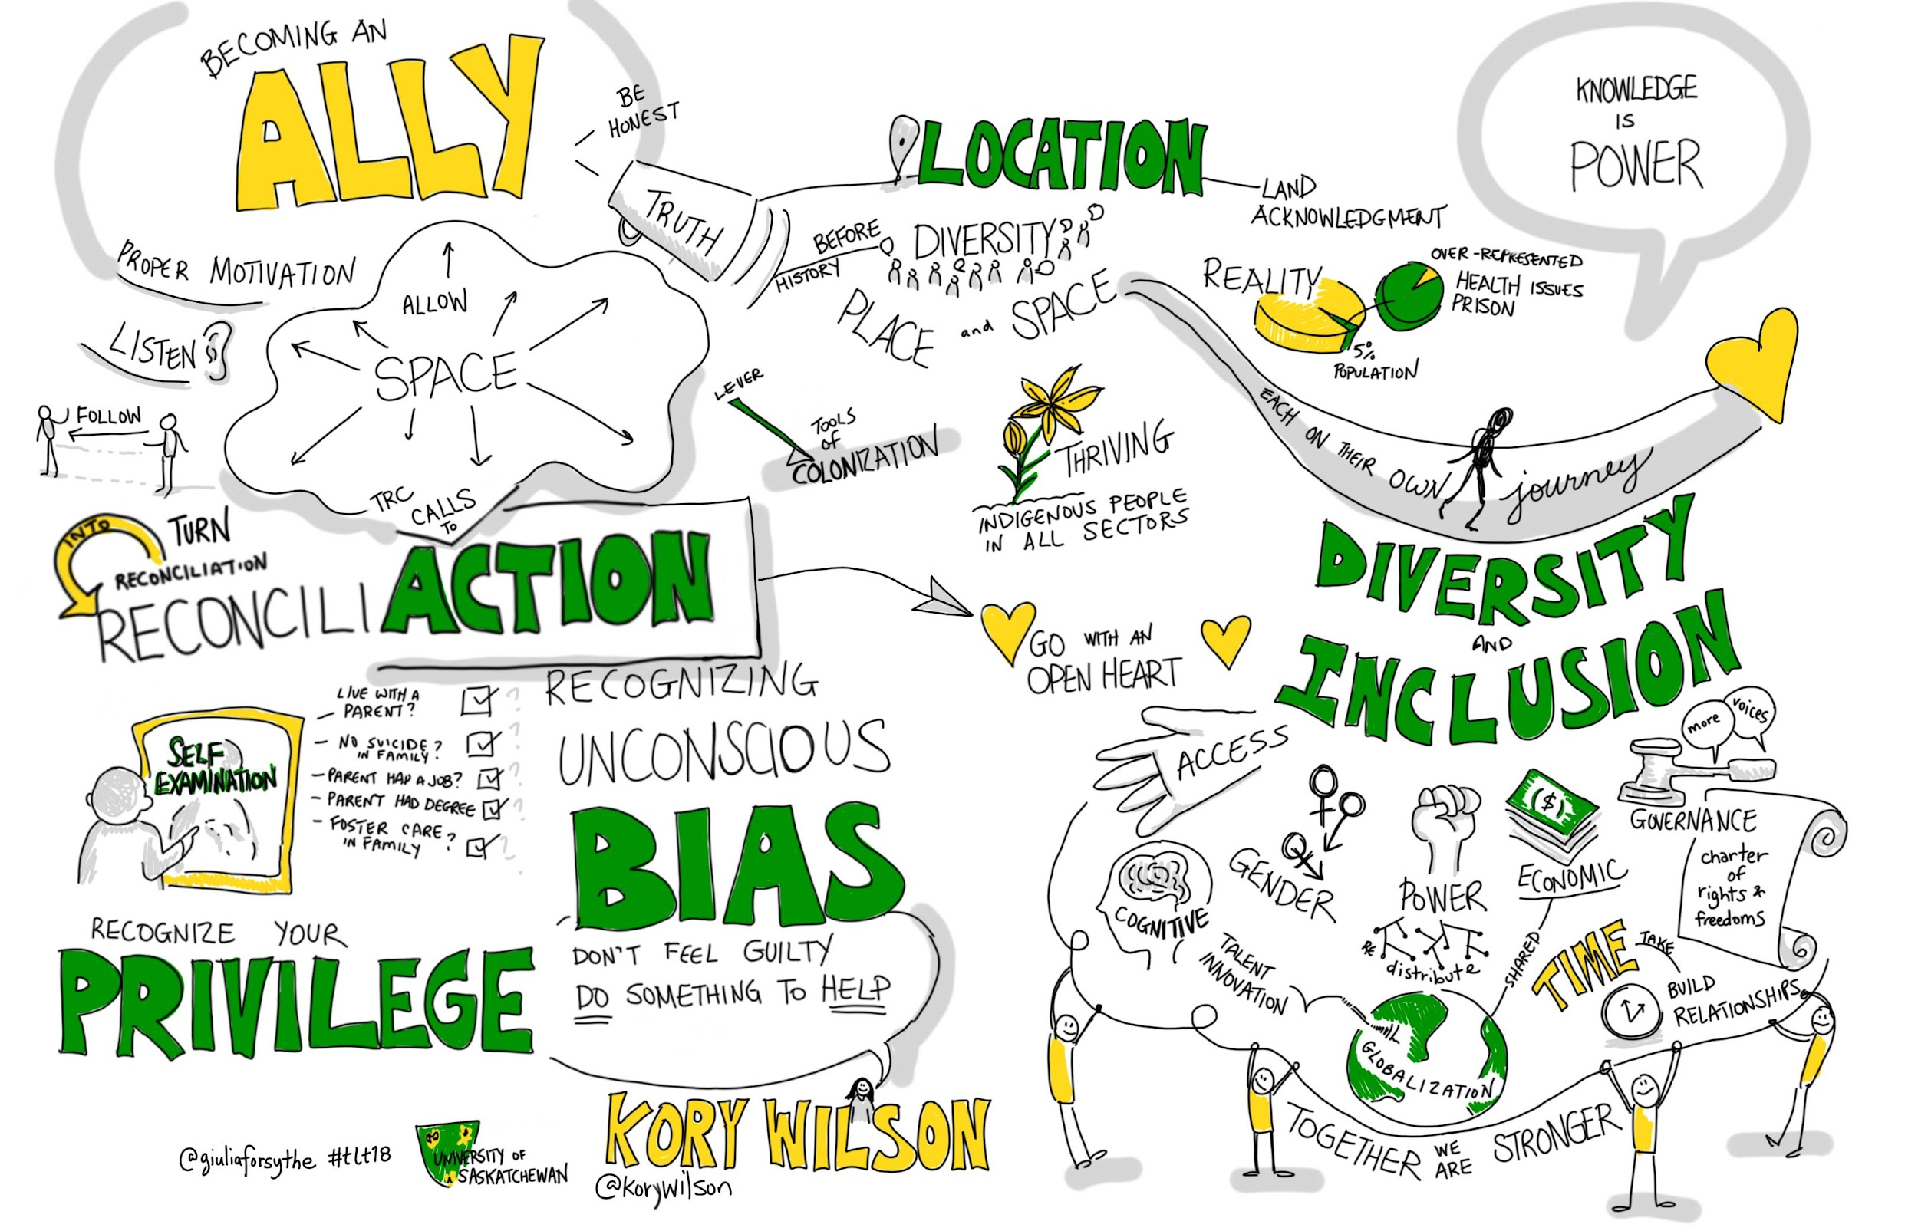
Inclusion Defined
The proactive effort through personal actions, programs, and policies to ensure that all individuals feel welcome, respected, supported, and valued.
Notes:
SHEILA
Inclusion is the proactive effort through personal actions, programs, and policies to ensure that all individuals feel welcome, respected, supported, and valued. Inclusion should always integrate equity, which recognizes structural issues and barriers that have prevented the full participation of individuals from marginalized groups. Inclusion itself actively seeks to create more equitable structures and by extension, uplift voices that have been historically excluded.
University of California Santa Cruz. (30, August 2022). What is meant by diversity, equity, and inclusion? https://apo.ucsc.edu/diversity.html

Slide 9
Bias & Impact to Hiring
Bias is a tendency, inclination, or prejudice toward or against something or someone
Bias can be negative or positive, however it can negatively impact hiring decisions when clear expectations are not communicated.
Notes:
SHEILA
Bias is a tendency, inclination, or prejudice toward or against something or someone. Bias can be negative or positive, it is not an inherently negative phenomenon. For example, you may have a bias for walking instead of driving or you may have a bias for waking up early because you concentrate better or staying up late because that works better for your system.
Bias however can quickly becomes problematic in the hiring process because the biases we hold in regards to other individuals can be based on stereotypes about an individual's race, gender, background, etc. When clear expectations are not communicated in terms of the skills and experience a candidate may need to be successful in a role to both search committee members and to candidates as well, bias can negatively influence the hiring process.
https://www.psychologytoday.com/us/basics/bias
Asana. May 2022.19 unconscious biases to overcome and help promote inclusivity. https://asana.com/resources/unconscious-bias-examples

Slide 10
Why might inclusive hiring be important?
Speak up or add in the chat
Notes:
SHEILA

Slide 11
Inclusive Hiring Practices
Notes:
ANNIE

Slide 12
Inclusive Recruitment
Candidate centered ads
List salaries and benefits
Center your organizational values
Limit qualifications
Articulate growth potential
Remove years of experience
Advertise widely
Active recruitment beyond ads
Reach out and make connections
Engage with potential candidates
Open to questions
Open learning sessions
Notes:
ANNIE
Active recruitment, engaging with potential candidates, where to advertise
Think about your ad

Slide 13
Activity
Language in Ads
MadeUp Libraries are looking for an energetic, professional, and committed individual for their Cataloguing & Metadata Librarian.
[...]
Strong English language skills, including being clear spoken
Ability to lift 50 lbs
Notes:
ANNIE
Answer Key
Energetic is ableist, and unnecessary for this role
Professional is subjective and white-centered
Strong English language skills is racist and anti-immigrant
Ability to lift 50 lbs is ableist and too high of a weight for this role

Slide 14
Answer Key
Language in Ads
Answer Key
MadeUp Libraries are looking for an energetic, professional, and committed individual for their Cataloguing & Metadata Librarian.
[...]
Strong English language skills, including being clear spoken
Ability to lift 50 lbs
Notes:
Answer Key
Energetic is ableist, and unnecessary for this role
Professional is subjective and white-centered
Strong English language skills is racist and anti-immigrant
Ability to lift 50 lbs is ableist and too high of a weight for this role

Slide 15
Inclusive Language in Ads
Female-Coded Words: Agreeable, empathetic, sensitive, affectionate, feel, support, collaborate, honest, trust, commit, interpersonal, understanding, compassion, nurture, and share
Male-Coded Words: Aggressive, confident, fearless, ambitious, decisive, headstrong, assertive, defend, independent, battle, dominant, outspoken, challenge, driven and superior
Racially-Coded Words: excellent English-language skills, cultural fit, clear spoken, native English speaker, polite, professional, nice
Ableist-Coded Words: Energetic, athletic, able-bodied individual, talking with students, walking through the building
All Gender Inclusive: They, candidate, role
Notes:
ANNIE
Feelings of belonging that are elicited by a job ad are important in creating job appeal; language that appears catered to one identity creates a barrier for applicants of other identities. Here are some common ism-coded words used in job descriptions that should be avoided:
Female-Coded Words: Agreeable, empathetic, sensitive, affectionate, feel, support, collaborate, honest, trust, commit, interpersonal, understanding, compassion, nurture, and share
Male-Coded Words: Aggressive, confident, fearless, ambitious, decisive, headstrong, assertive, defend, independent, battle, dominant, outspoken, challenge, driven and superior
Racially-Coded Words: excellent English-language skills, cultural fit, clear spoken, native English speaker, polite, professional, nice
Ableist-Coded Words: Energetic, athletic, able-bodied individual, talking with students, walking through the building
Tools
Gender Decoder: https://gender-decoder.katmatfield.com/
Applied Text Analysis: https://textanalysis.beapplied.com/
Conscious Style Guide: https://consciousstyleguide.com/
Equity Fluent Leader Glossary of Key Terms from UC Berkeley Haas School of Business
Making the Change
Away from male-biased phrasing:
Change "we're looking for strong…" to "we're looking for exceptional…"
Change "who thrive in a competitive atmosphere…" to "who are motivated by goals…"
Change "candidates who are assertive…" to "candidates who are go-getters…"
Away from female-biased phrasing:
Change "we are a community of concerned…" to "we are a team focused on…"
Change "have a polite and pleasant style…" to "are respectful and conscious of diverse needs…"
Change "nurture and connect with customers" to "provide great customer service"
Away from age-biased and ability-biased phrasing:
Change “walks through the building” to “circulates in the building”
Change “energetic” to “committed”
Change “lifts 50 lbs” to “lifts 30 lbs” or better to “can use equipment to move 50 lbs”
Change “speaks with users” to “communicates with users”
Change “young professionals” to “entry level role”
Away from racially-biased language:
Change “we invite Latino/Hispanic” to “we invite Latinx”
Change “excellent English-language skills, including being clear spoken” to “demonstrated ability to communicate effectively in written and verbal form”
Change “nice, polite demeanor” to “ability to interact with respect and empathy”

Slide 16
Preparing the Interview Structure & Agenda
Create a purposeful agenda
Focus statements
Indicate participants
Open slot
Cover the span of job qualifications
Build in breaks
Consider physical accessibility and psychological safety throughout the day
Notes:
ANNIE
To inform your and the candidates’ decisions:
Agenda Creation
Many interview include a dinner the night before. The best practice is to have the IA at the dinner if feasible. The dinner is meant for the candidate to ask questions about the next day, get to know the search chair(s). It is not part of the hiring assessment.
Each part of the daylong agenda needs to have a clear purpose as related to the job or the search. We articulate a focus statement that clarifies for the candidate why this meeting is on the agenda and who they’ll be meeting with.
We have adopted the leading practice of having an open slot for the candidate to select from a list or a meet and greet. Examples range from: Tour of building, tour of campus, meeting with HR for benefits discussion, meeting with any of our social justice centers, meeting with Inclusion and Equity, meeting with IDEA, meeting digital scholarship campus lead, etc.
We also will include many mini-breaks.
ANNIE
It is a leading practice for the search committee to collaboratively develop and implement a recruitment plan, write the job ad, create interview questions for a phone screening and in-person visits, and finalize an agenda for the interview day ahead of starting to review candidate materials.
The approach of developing the interview questions and agenda prior to reviewing applicant materials achieves several goals:
Helps the committee stay focused on the position qualifications and minimize the chances of introducing bias into interview questions based on applicant materials.
While it is more work at the outset of a search, it enables the committee to provide more dedicated focus during each stage of the search process.
Keeps the search moving as efficiently as possible, which ultimately is a more empathetic, candidate-focused process.
Developing the Search Agenda
It is also important to challenge interviewing habits by being able to articulate why each portion of the interview exists and how it is supporting the decision-making process of the search committee and the candidates. A focus statement should be developed for each component of the agenda, which helps candidates understand what is expected of them during each interview component.
In higher education presentation components are often the norm. Before deciding to have a presentation, ask whether:
Every librarian position requires a presentation?
What components will help you decide on core skills (qualifications)?
If the search committee decides on a presentation, it is important to ask if the presentation is:
Asking for free labor?
Asking someone to know more about the organization than is reasonable?
If a presentation or portfolio is required - will you retain the materials?
Interview Questions
Leading practices suggest that questions need to support hiring decisions by:
Eliciting the candidates experiences and background that enhances what is provided in the application materials
Providing a sense of how the candidates align with the position qualifications and related aptitudes
Only asking for information that will be used for the hiring decision
Covering the major responsibilities and accountabilities of the role
Connecting to how the information will be used in the hiring process
Eliciting thoughtful, nuanced answers - not yes/no
Preparing prompts or follow-up questions that could be asked to elicit a fuller answer in order to support candidates in the interview process to share their full abilities regardless of interviewing skills
Using a mix of question types
Avoiding using leading terminology

Slide 17
Candidate Centered Interactions
Notes:
PREETHI
When a candidate interviews with us, they get a glimpse into our workplace culture. It’s important that the candidate feels as comfortable as possible when interacting with us. If we put effort into making candidates feel comfortable before we hire them, they will trust us to continue that effort once they are hired.

Slide 18
Inclusive & Timely Communications
Phone Interview Prep
In Person Interview Prep
Pre-Visit
Selection
Non-Selection
Expression of excitement for candidacy
Search Committee members information
Process & Timeline overview
How to request accommodations
Other things to know about organization
Builds upon last message
Agenda with focus statements, who will be there, and evaluation criteria
Process & Timeline overview
Clarity on financial support
How to request accommodations
Requests information food needs
Pickups - license plate and description of the vehicle for safety
Provides questions for search committee component
Presentation topic two weeks ahead
Organization should get permission to do reference check
Offer call
Excitement
Articulate how salary is set (and if negotiations can occur)
Benefits outline
Clear timeline for response
Answer questions
Scheduled call to let people know
Thanks for investing in the search
An offer to share feedback: 1) What particular strengths and 2) What areas of growth to be more competitive in future
Bélanger, Annie and Gorecki, Preethi, "ACRL Diversity Alliance Webinar - Kindly Hire Me: The Process and Impact of Inclusive Hiring" (2022). Presentations. https://scholarworks.gvsu.edu/library_presentations/102
Notes:
PREETHI
Connect with the candidates as early as possible
Provide candidates with frequent updates
Be transparent about timelines and communicate any delays quickly
Give the candidate all the information they need to be successful upfront
Personalize emails to candidates and avoid generic HR email blasts

Slide 19
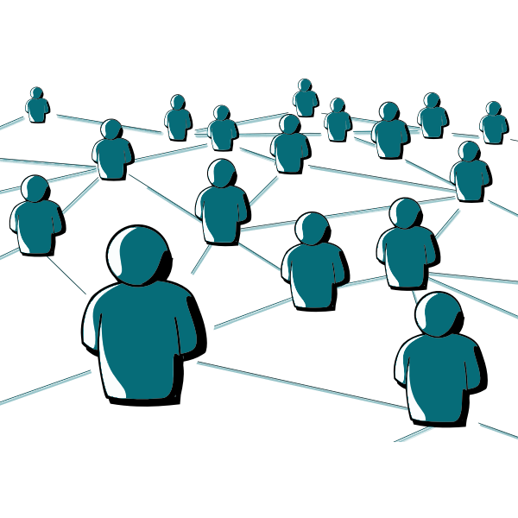
Preparing Colleagues to Interact with Candidates
Every interaction is helping the candidate decide to join the organization, or not.
Best: How do you envision providing food bank services from different locations?
OK: How should downtown food banks offer services? [presumes knowledge that downtown tend to be urban and mixed populations]
Least: How should Replenish change its services in the next 3 years? [presumes knowledge that Replenish is your food bank, the location and environment of the food bank, and of the student population changes]
Notes:
PREETHI
One way to make sure candidates have a good experience is to coach colleagues on how best to interact with candidates. This means avoiding questions of a personal nature, questions that assume institutional knowledge, and leading questions.

Slide 20
Inclusive Virtual Interview
Closed Captioning turned on
Edited screen names, including pronouns
Clear indication of candidate interactions and camera use - on or off
Clear guidance on how interview will proceed
Waiting rooms active to prevent accidental entries
Questions added to the chat (good) or sent ahead (best)
Notes:
PREETHI
If the interview is virtual, turn on closed captioning and edit your screen name, including pronouns. Ask about bandwidth to decide on camera use. Offer cameras off for the presentation and cameras on for the conversational components. Give clear guidance on how interview will proceed. Turn on waiting rooms to prevent accidental entries.

Slide 21
Inclusive In-Person Interview
Introductions using pronouns
Breaks between meetings
Indications of where assistive mobility technology is, such as elevators
Asks about dietary needs or allergies
Asks about accommodations
All open interview components in an accessible space
Supporting your ability to make a decision whether to join an organization
Notes:
PREETHI
If the interview is in-person, provide a private room/office for candidate to leave personal items and retreat to. Provide sufficient breaks between interview components to ensure the least stressful interview day possible. If candidates are being picked up or dropped off by members of the search committee, ensure that the candidate knows who will be picking them up, what they look like and what their car looks like–including license plate information. Ensure candidate knows what they are being evaluated for during each interview portion. For instance, be clear that the interview dinner is just to welcome the candidate and the only circumstance where it might bear weight on a hiring decision would be verbally harassing the waitstaff for instance..

Slide 22
Making the Offer
Prepare your best offer
Prepare a script of all benefits and details
Be aware of what is negotiable
Have a transparent phone conversation
Follow-up with detailed email
Allow time for time for candidate reflection
Invite follow-up questions
Check-in and finalize the offer
Notes:
PREETHI
Prepare your best offer
What are the criteria used to negotiate in ways that allow equity between candidates and current employees?
Are the same practices and/or people involved in all negotiations, ensuring consistency from one to the next?
Have we shared how we set compensation with the candidate?
Negative impact of negotiation on structurally excluded candidates
Prepare a script of all benefits and details
Have a phone conversation
Follow-up with email
Allow time for time for reflection
Invite follow-up questions

Slide 23
Giving Candidates Feedback
Anchor in radical candor and empathy
Highlight strengths
Highlight areas of growth to be more competitive in future searches
Give the candidate the right to refuse
Never share why someone was not selected
Notes:
PREETHI
Candidates invest a lot of time in search processes. By giving them feedback, we are honoring their commitment and giving back. The search committee should draft a list of strengths they saw as well as opportunities for growth for future interview. Give them the right to refuse. Once you share, be ready for a dialogue.

Slide 24
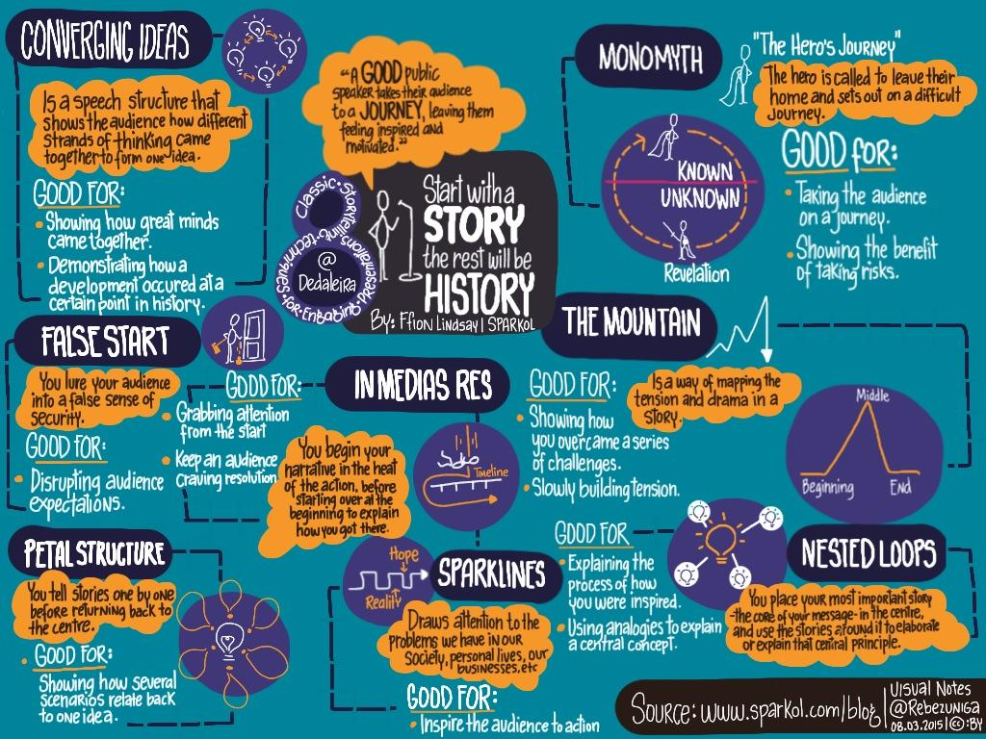
Stories
Personal experiences as candidates
Notes:
Preethi- positive and negative for interviewing
Sheila - positive and negative for receiving feedback
Encourage folks to share their positive and negative experiences as well if they would like (can take one or two people’s experiences)

Slide 25
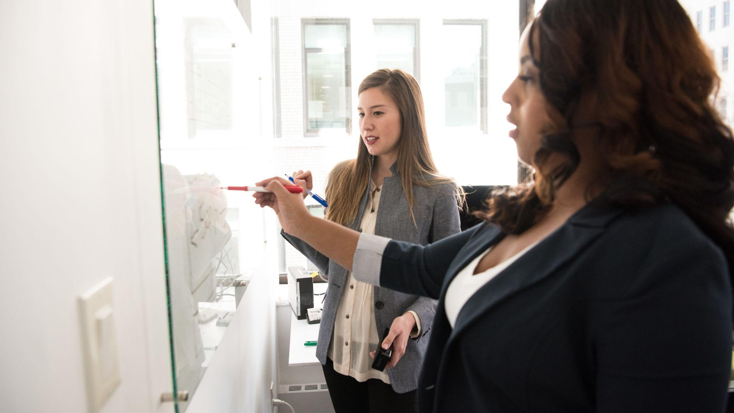
Improving Local Practices
Notes:
SHEILA
Photo by Christina @ wocintechchat.com

Slide 26
Inclusive Hiring & Onboarding Toolkit
https://scholarworks.gvsu.edu/library_reports/26/
Created by: Annie Bélanger, Sarah Beaubien, Kat Bell, Krista Benson, Takeelia Garrett, Lori Cawthorne, Emily Frigo, Sheila GarcÍa Mazari, Preethi Gorecki, Kristin Meyer, Jenna Vainner, and Jesus Espinoza
Notes:
SHEILA
Grounded in an understanding of leading recruitment practices as well as an understanding of the profession’s opportunities and challenges, the toolkit offers pragmatic approaches to move from the theory of inclusive hiring and onboarding to implementation. At each stage of the hiring lifecycle, tips and questions to consider are provided, from mitigating language bias in position announcements to methods for developing interview questions and to onboarding approaches. Supervisors, employees, and any key decision maker involved in the job description writing process could find this toolkit beneficial to their own hiring and onboarding processes.

Slide 27
Stereotyping
Neutral standards of success Define candidate profile ahead of review Call in stereotyping when it happens
Confirmation
Standardize processes Complete all materials before candidate reviews Use evaluation rubric
Halo/Horn/1st Impression Effect
Engage wider group in processes Challenge impressions with questions Use evidence-based decision-making
Non Verbal
Ask how observation relates to qualifications and role
Contrast/Recency
Take notes in each interview Debrief after each candidate Compare notes against rubric
Conformity
Gather feedback from other individuals Gather opinions before debrief Start debrief with straw poll
Affinity
Create a diverse search committee Ensure not to hire for ‘fit’ Use specific language to review candidates
Negativity
Challenge the scale of negative information to the weight it is being given
Notes:
SHEILA
Mitigating Bias
Asana. May 2022.19 unconscious biases to overcome and help promote inclusivity. https://asana.com/resources/unconscious-bias-examples
When interacting with candidates, be aware of any biases that may be impacting your assessment of them. To help mitigate bias, be sure to focus on the assessment criteria and qualifications. Committees sometimes expect applicants to have already done the job rather than evaluating for their ability to succeed (and possibly discounting transferable or similar experience). Each component of the interview should have a stated purpose- for instance, “the presentation portion of the interview is to assess the candidate’s ability to research and present information in an engaging and instructional format”. Have a clear understanding of what success would be ahead of the interview. Try to be self-aware and hold one another accountable by asking clarifying questions if bias is suspected. Are you basing your evaluation on the ability to succeed? Or on who you would like to be friends with?
Be aware that bias can be positive or negative. Some examples of positive bias include wanting to hire someone based on their personality, the reputation of their current employer, or simply because you have heard of them before. Negative bias is probably more familiar to you and includes instances such as discounting a candidate because of how they appear or dress, assuming that they cannot do the job well because they haven’t done that exact role before, and ignoring transferable skills and knowledge from a previous job because its a lower rank.
Mitigating Bias
Bias is always present because our world view is influenced by our beliefs, values, and experiences. Therefore, building safeguards to mitigate bias and its impact on our processes and decision-making is really important. Below are approaches that can be implemented systematically to mitigate different forms of bias.
Stereotyping
Set ‘neutral’ standards by defining ability to succeed in the role and strong candidate profile ahead of time and use it as an evaluation rubric
Ask clarifying questions and model calling in when stereotyping appears in discussions
Inconsistency in approach / Confirmation bias / Negative emphasis
Standardize interview process across all candidates
Complete all interview materials, including interview questions, before beginning to review candidates’ materials
Use a rubric for evaluation
Halo effect / Horn effect / First impression / Anchor bias
Engage a wider group in interviews
Challenge first impressions by asking questions of what the person observed that led them to the conclusion
Use evidenced-based decision making
Nonverbal bias
Ask how the observation relates to the qualifications and ability to do the role
Contrast effect / Recency bias
Take notes during each interview
Debrief about a candidate, and only that candidate, at the end of each interview
Compare interview responses and observations against the evaluation rubric
Conformity bias
Leverage surveys to gather feedback from individuals
Ask for opinions in advance of a debrief
Utilize rubrics as a way to provide a consistent and objective measure for decision making in evaluating applicants
Start candidate reviews with an anonymous straw poll to identify what search committee members are thinking about candidates’ ability to succeed before dialogue starts. This helps to undermine group think.
Affinity bias
Create a diverse search committee
Ensure that hiring for fit is not part of the process
Use specific language to review candidates

Slide 28
Using Equity Lenses
Sample Questions
Who is affected—positively, negatively, or not at all—by the way this job ad is written?
Are our mission and values explicitly articulated in the job ad?
Have we removed gendered/ableist/racist language from our job ads?
Are our qualifications aligned with the ability to succeed in the role in the first year?
Set of questions for an organization to be deliberately inclusive
Draws explicit attention to inclusion and equity
Adapted for different focuses
Notes:
SHEILA
The purpose of an equity lens is to be deliberately inclusive as an organization makes decisions. It introduces a set of questions that help the decision makers focus on equity in both their process and outcomes. It is explicit in drawing attention to the inclusion of marginalized populations, typically communities of color and Indigenous communities, and can be adapted to focus on other communities. An equity lens will not tell you what action to take. Rather, the lens helps you discuss and reflect on the equitableness of the action and decision-making process.
For each stage of the process, answer the following questions before and after to ensure that you are centering inclusion, equity, accessibility.

Slide 29
Create Equitable Processes
Use an equity lens before, during, and after the stages of the hiring process
Ensure all hiring managers are positioned to be inclusive hiring champions
Anchor job search in the job description requirements
Mitigate bias throughout the hiring process
Only include interview components that will help decide on the successful candidate
Expand where you advertise and move towards active recruitment
Human rights icons created by Freepik - Flaticon
Notes:
ANNIE

Slide 30
Center Candidate Experience
List salary ranges in job ads
Ensure high-levels of communications
Anchor in qualifications and org values
Leverage universal design to reduce the need for accommodations through the interview process
Articulate what is available so candidates are informed, such as accessible locations and technology
Ask for dietary requirements and other necessary accommodations to all candidates
Notes:
ANNIE

Slide 31
What is 1 Tool or Strategy You Want to Try in Your Organization?
Learning Loop:
What did I try?
Where did I succeed?
Where did I struggle?
What did I learn?
What will I try next?
Notes:
(3 mins)
https://michellemcquaid.libsyn.com/can-you-embrace-the-mess-magic-of-change-podcast-with-dr-michelle-mcquaid

Slide 32
Questions
Annie Bélanger belange1@gvsu.edu
Sheila Garcia Mazari shargarc@ucsc.edu
Preethi Gorecki raop@macewan.ca

