Slide 1
Equity-Minded Change Leadership
Leading Lakers
Session 2, Section 2
March 2023
Annie Bélanger
Notes:
Photo by Ian Schneider on Unsplash

Slide 2
Section Learning Outcomes
Be aware and able to apply Human Centered change leadership and management approaches
Articulate your values and your leadership vision
Understand core components of change management and tools to support healthy processes

Slide 3
What is Change?
How do you define change?
How does that change for you when you are leading it vs being impacted?
Notes:
5 mins
Change is most simply defined as the act or instance of making or becoming different. In this definition, it is process and object/deliverable focused. Yet, we know that change is about the humans experiencing the change and that emotions play a large role in change. Change is about hearts and minds, about the past, present, and future, about building trust within our community.
How does this definition compare to yours? What would you add?

Slide 4
Human-Centered Change Basics
Notes:
Photo by Joshua Hoehne on Unsplash

Slide 5
Human Centered Leadership
Prioritize people and culture
Center humanity
Characteristics:
Compassion
Empathy
Genuine intention
Inclusive
Mission-focused
Values-driven
Deeply personalized style
Notes:
1 min
Simply put human-centered leaders put people first, prioritizing people and culture. It shape their communication style, their mindset, and how they approach opportunities and problems. Human-centered leaders are similar to inclusive leaders in that acknowledge their blind spots and seek wider perspectives. They actively engage those who have the details needed to make decisions. They work to remove barriers. They enable individuals to create, innovate, and charge full speed ahead. They recognize the humanity in others, cultivate growth in others, and create healthy, connected communities for others, in order to foster cultures of caring, mission-focus, and trust. It is a relational approach to leadership, not a transactional one focused on outcomes.
How do we make sure that our approach to engaging with staff is focused on building and sustaining relationships? Have we answered which humans are being centered and why? Today we are focusing on the human within the organization, the colleagues are helping us function.
I want to acknowledge danger of human-centered can be a focus on culture at the expense of mission fulfillment. It can be a focus on personal needs at the expense of organizational needs.

Slide 6
Human-Centered Change
Most change management mitigates risk.
What if it could promote good?
What if we were compassionate to each other?
Center the human-experience by:
Engaging colleagues as partners
Providing opportunities to plan and take action
Articulating why, what, and how
Seeking to co-create as an ideal
Notes:
Traditional change mgt is about mitigating risks. What if it could promote good? Human-centered layers in order to promote good by:
Centers the human-experience
Engages colleagues as partners
Provides opportunities to plan and take action
Articulates why, what, and how
Seeks to co-create as an ideal
Whether change is planned or unplanned, directed or self-driven, participatory or imposed, we control and can control how we proceed through a change. Even when we have no agency in defining the change, we can be intentional in our reaction, our engagement in making it happen, and using the power of strategic yes and no to recapture a level of agency. Leveraging change management encourages everyone to engage with change efforts and to rapidly, completely and proficiently make the required changes to their day-to-day work. We can help empower others by providing clarity, asking how might we, and leveraging compassion and empathy.
Participation increases empowerment, which reduces helplessness and leads to action

Slide 7
Empathy Defined
To actively consider another person's point of view in order to connect more deeply with them
Notes:
Empathy is the ability to understand and share the feelings of another. Empathy includes both cognitive (aka intellectually) and emotional (aka shared emotions). “Radical empathy is a concept that does exactly that – it encourages people to actively consider another person's point of view in order to connect more deeply with them.” Today, this trait enables us to see and understand another person's point of view.
Paterson, Jacqui. N.d. Radical empathy: what is it and what are the benefits? https://www.happiness.com/magazine/relationships/radical-empathy-extreme-what-is-it

Slide 8
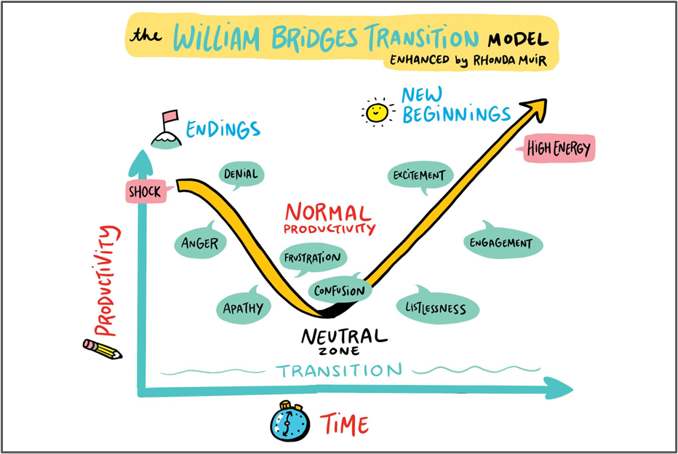
Impacts of Change
Notes:
Developed by William Bridges, the Bridges’ Transition Model provides a framework to help think about the human experience of change by dividing the transition into three phrases: Endings, Neutral Zone, and New Beginnings.
Change is something that happens to people, even if they don’t agree with it. Transition, on the other hand, is internal. It’s what happens in people’s minds as they go through change. Change can happen very quickly, while transition usually occurs more slowly.
People experience transition in differing intensity and move through them at different speeds depending on factors such as:
●the degree to which the change takes them by surprise
●the degree the change places them in an uncertain or unfamiliar situation
●their stage of life
●the number of other transitions they are experiencing at the same time
●their opportunity to talk about their feelings
●their individual temperament
●the impact upon them personally
The model highlights three stages of transition that people go through when they experience change and helps people understand why they are finding change difficult and then helps them move on psychologically.
Endings: This phase acknowledges the (often overlooked fact) that before something new begins, something old has to end.
Neutral Zone: This is the space between the old way of doing things and the new way of doing things. One of the things I appreciate about this visual depiction of the Bridges Model is that it demonstrates the typical drop in productivity during the Neutral Zone.
New Beginnings: This phase is when the change begins to be felt in minds & hearts. There are new values, new attitudes, new identities
The focus here is on recognizing the emotions associated with each phase and to build empathy and compassion for colleagues who are living through the change at their own pace. By using this model, one can acknowledge the past and help colleagues look towards the future. And while presented in a linear fashion, one often moves back and forth between the phases.

Slide 9
Living Organizational Values
Questions to consider:
What are the aspirational values of your organization?
How do those compare with the lived, day-to-day values that individuals experience?
How well aligned are individuals to these values as seen through their actions and behaviors?
How well aligned are processes and structures to the values?
How could we work towards our values through this change effort?
Notes:
The values alignment is critical to sustainable change. Consider:
What are the aspirational and lived values of your organization?
How well aligned are individuals to these values as seen through their actions and behaviors?
How well aligned are processes and structures to the values?
By starting with the humans involved in the change, we can live the values we hold towards our colleagues. We can enable champions rather than detractors. Few are truly, irreparably against change. Humans are often against change where they have no agency and feel powerless. In the absence of engagement, the human brain will fill in the blanks and often with the negativity bias that has helped us survive as a specie. the alignment between personal and organisational values to occur and, thereby, allowing the organisation to evolve and remain viable.

Slide 10
What is Accountability?
Acceptance: consenting to receive or undertake something offered
Obligation: accepting the binding power of promise
Ownership: taking responsibility for an idea or problem
Answerability: explaining actions or decisions.
Choice: making a decision when faced with two or more possibilities
Commitment: being emotionally compelled to an agreement or responsibilities
We are accountable to self and to others
Notes:
Shannon Perez-Darby share this definition that, “Accountability is taking responsibility for your choices and the consequences of those choices.” Connie Burk frames accountability as “an internal resource for recognizing and redressing harms we have caused to ourselves and others”. Within the context of organizations, accountability emcompasses fulfilling job responsibilities as well as impact on the workplace culture. BetterUp Blog defines accountability as “the recognition and acknowledgment of our responsibilities, and being answerable for the outcomes of our actions, decisions, and mistakes.” (https://www.betterup.com/blog/accountability-vs-responsibility-for-leaders-going-back-to-the-basics)
You are responsible for things and you’re accountable to people, but both are a conscious choice that comes from within.
How can we support those who have caused harm without defaulting to punishment?
What does real accountability look like?

Slide 11
Defining Your Leadership Values
& Vision
Notes:
Photo by KOBU Agency on Unsplash
How you lead impacts how you lead through change. Often leading change is fraught with obstacles, stressors, and pressure. Knowing who you want to be as a leader forms the basis of who you are as a change leader. Let’s dig into values and leadership vision.

Slide 12
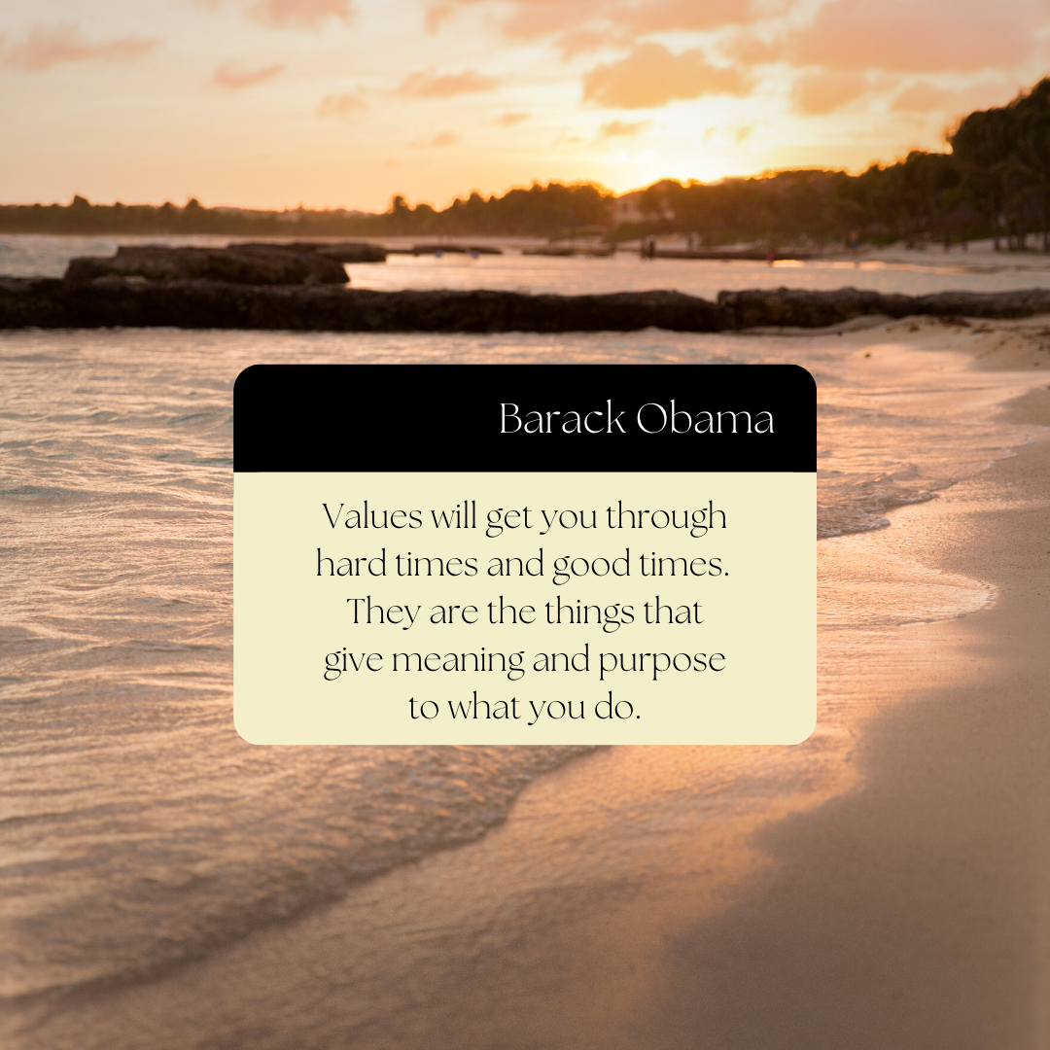
From Accidental Leadership to AIR
Anchored in values & mission fulfillment
Intentional vision as a leader
Responsible & accountable
Notes:
Values equal behaviors which in turn create our workplace culture. By choosing to embrace and practice good values every day, you choose the higher course in life. And your life goes in a direction that you will always feel good about. You may not always get what you desire, but you will always be the person you desire to be. —John Maxwell
Starting with basics, values are ever-present ideals that set your organization’s intentions, guide behaviour, and inform decision-making. Values work can be a powerful and aspirational mechanism to bring a community together (whether that community is the entire institution, the library, or a library department) and is foundational to supporting organizational change, especially if our focus is on fostering care & accountability.
If we don’t function from a set of core values, then what informs our daily decisions and behavior? Values are key to your sense of identity, beliefs, and actions. By anchoring in your values, you can be an authentic leader.

Slide 13
Values-
Anchored Leadership
Values are ever-present ideals that set intentions, guide behavior and inform decision-making.
Everyone has a role to play:
Leadership: Activating values, diving deeper to foster shared understanding, and addressing gaps between espoused values and lived values
Everyone: Reflecting on the values and surfacing challenges/barriers
Notes:
Once values are set, everyone has a role to play:
In values work, leadership is accountable for…
Activating values
Diving deeper into each value in order to create a shared understanding about how the value shows up in behaviours, practices, systems. (For example, we’ve had a number of conversations in our organization about the value of excellence:
How part of being an “excellent” library is actually interrogating the notion of excellence
Recognizing & talking about who and what are left out of conventional ideas of excellence in a research library
Addressing gaps between espoused values and lived values (this is especially true for us in regards to our values of diversity & anti-racism and humanity. This is what we’re saying, but this is the experience of our colleagues. What can we do to close the gap?)
And everyone in the community is responsible for reflecting on the values, using them as a north star to influence practice and behaviors, and surfacing culture and climate challenges that are barriers to living true to organization’s values

Slide 14
Values-Driven Systems & Structure
What does it mean to reimagine our systems and structure to be in alignment with our values?
Talk about your values
Incorporate values into day-to-day work
Be open to challenging conversations
Analyze our systems for oppression, bias and power; rebuild with our values
Accept & communicate that we’re talking about long-term change
Notes:
Let’s dive deeper into how we can activate our values, including how we can reimagine our systems and structures to be in alignment with our values:
Talk about your values: This may seem simple, but it’s important for adoption, activation and organizational change. We want to avoid a situation where we create values, add them to library’s website and then never talk about them again. Talking about values can mean referencing them in all-staff communications, in onboarding activities, in departmental meetings, in budget documents, any of your foundational systems and structures. Just keep talking about them.
Incorporate values into day-to-day work: At Michigan, we encourage new teams and projects to review our set of values and discuss how the values will show-up in their work. So, when launching a project to replace our ILS, what does it mean to do this work in a way that is excellent? In a way that is engaging? In a way that is interdependent? In a way that demonstrates diversity, anti-racism, and humanity? Think about how to incorporate values work into new systems and structures you are creating.
Be open to challenging conversations: We want to foster meaningful engagement with our values in order to influence our work, so we need to be open to having difficult conversations around our values: To discuss inherent tensions within a set of values (excellence and humanity), to discuss different interpretations/perceptions of values by individuals (everyone has a different definition of engagement, humanity), and, as I said in the first slide, to talk about the gap between espoused and lived values. We need to have these conversations in order to lean into the possibilities.
Commit to taking the time to analyze and rebuild our systems and structures: This is the heart of the work we need to do to influence change in our systems and structures.
Reflect on where oppression, bias, and power show up in your system
Rethink the system’s objectives and create an inspiring vision
Rebuild the system by keeping the parts that are in alignment with your values and getting rid of the rest
Depending on the system, this can be a long process, but the effort is well worth it.
Accept & communicate that we’re talking about long-term change: We started our values work at Michigan in 2019 and it is still certainly a work in progress. Part of the work is setting expectations for values work, for culture and climate work, being a long-term change. And shifting the focus to incremental progress and communicating/demonstrating that progress to your community.

Slide 15
Your Turn: What are Your Values as a Leader?
Think - Pair - Share at Your Table
When you are at your best, what are the 3-5 values that articulate how you approach leadership work?
How do you know you are living them?
Which ones do you live when you are at your worst as a leader?
List of Values from Brene Brown
Notes:
10 minutes

Slide 16
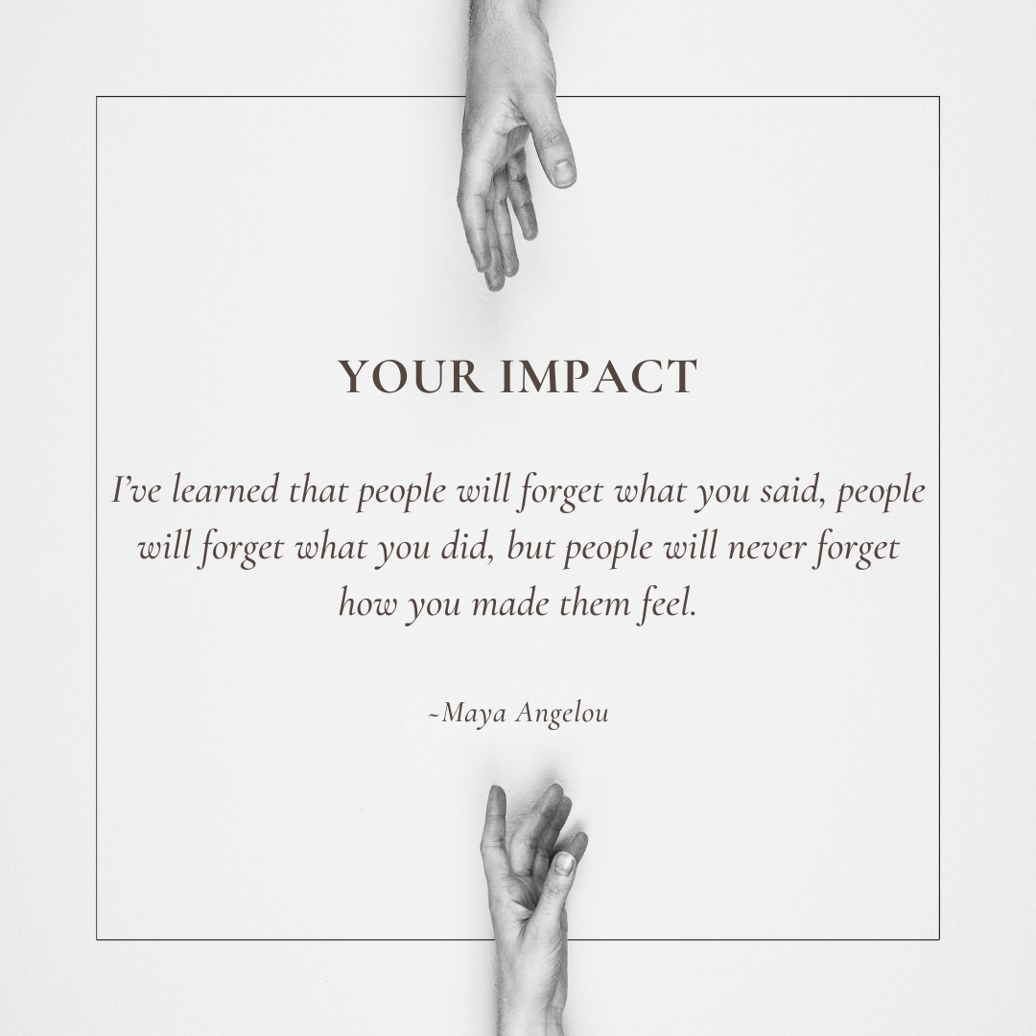
Values As Leader Debrief
How might your values impact your leadership?
How can you ensure you are living your values?
Notes:
5 mins
You can be values-based by seeking to be self-reflective, know your strengths and areas of growth, balance multiple perspectives, and bring genuine humility to appreciate the value of every person.
We need to balance human-centric approaches with the need to focus on fulfilling our mission. And in doing both, we need to remember we are responsible for and accountable.

Slide 17
Personal Leadership Vision
Articulates your WHY as a leader
A compelling image of an achievable future
Purpose driven
Anchored in values
Notes:
From HBR: https://hbr.org/2008/08/title
A personal leadership vision is an essential means for focusing attention on what matters most; what you want to accomplish in your life and what kind of leader you wish to be. A useful vision has to be rooted in your past, address the future, and deal with today’s realities. It represents who you are and what you stand for. It inspires you, and the people whose commitment you need, to act to make constructive change towards a future you all want to see.
Let’s look a bit more closely at the four key components:
A compelling story of the future is engaging; it captures the heart, forces you to pay attention. Those who hear it want to be a part of it somehow. And they are moved.
What does your future look like – what’s the image? If others could travel into the future with you, what would they find? A well-crafted leadership vision is described in concrete terms that are easy to visualize and remember.
The story of your future should be a stretch, but it must be achievable, too. If it were not achievable, you would have little motivation to even bother trying.
Finally, future simply means out there – some time from this moment forward, but not so far away that’s it’s out of reach.

Slide 18
Your Turn: Define Your Why
Your WHY Statement should be:
simple and clear
actionable
focused on how you’ll contribute to others, and
expressed in affirmative language that resonates with you
To _______________ so that ______________.
Think, Pair, Share
Notes:
10 mins

Slide 19
Define a Vision
Clear, distinctive and specific view of the future
Connected with mission
Fosters enthusiasm and commitment
Notes:
A strong leader builds trust in the vision by acting in consistent ways with the vision and by demonstrating to others what it takes to make the vision a reality.
Vision is an essential component of an organization’s success. A thriving organization will have a vision that is succinct, indicative of the direction that the company is heading, and widely understood throughout all levels of the organization. The more employees are aware of, understand, and believe in the vision, the more useful it is in directing their behavior on a daily basis.
Vision and mission are sometimes used interchangeably, but there is a useful distinction. A vision describes an organization’s direction, while its mission defines its purpose. By focusing on the value an organization creates, the mission helps prioritize activities and provides a framework for decision-making.
Vision also plays a significant role in a leader’s strategy for the organization. By setting the direction, a vision underscores the necessity of all the areas of a business working toward the same goal. This unity of purpose often involves changing what is done and how, and aligning the activities and behavior of people is critical to fulfilling a leader’s vision. A vision reduces ambiguity and provides focus—two benefits that are especially valuable in turbulent or rapidly changing times.
https://granite.pressbooks.pub/ld820/chapter/9/

Slide 20
We control how we proceed through change
Notes:
Whether change is planned or unplanned, directed or self-driven, participatory or imposed, we control and can control how we proceed through a change. Even when we have no agency in defining the change, we can be intentional in our reaction, our engagement in making it happen, and using the power of strategic yes and no to recapture a level of Agency.
Leveraging change management encourages everyone to engage with change efforts and to rapidly, completely and proficiently make the required changes to their day-to-day work.
When looking at transitions, you need to consider where you are in the change process both as an organization or an individual. While the organization moves through transitions, it is important to account that for those eager to engage in change, those that do participate in the change, those that come to it incrementally, and those that resist engagement in change. While you can work to minimize the numbers of resistors, and ensure there are opportunity for them to have voice, you can focus your energy in those that fall in the range of eager to making small steps. [Also important to realize that people throughout the organization may be at different places in the transition].
By breaking the change process into phases, landmarks can be provided to those experiencing and engaging in the change

Slide 21
Your Turn: Experiences with Change
At your table, in pairs:
Discuss a time when you experienced change positively?
Discuss a time when you experienced a change negatively?
What made the difference?
How did you manage yourself through the change?
Notes:
10 mins

Slide 22
Setting the Course for Change
Why is change needed?
What change do we need to make?
How will the change affect us – both positively or negatively?
When do we need to change?
Who will lead and facilitate the change?
How will we make change a success?
Notes:
Planned change is a purposeful effort. The catalyst for the change is often internal to the organization, and at times, it is driven by an external mandate. For example, a mandate to engage in a programmatic review may come from administration. It is predictable, and often, structured change process. Change is more likely to be successful and long-lasting if the culture is prepared for the change. By providing clarity, more energy and intention can be re-focused moving the change forward. The pitch for the change should be simple and compelling. “We are willing to commit ourselves if we understand what it’s all about, and we believe the proposal will bring benefits, that it is possible and that we can influence the final result.”
Tuominen, Kari. Change Management - Excellence Criteria, Benchmarking, 2002.
ProQuest Ebook Central,
http://ebookcentral.proquest.com/lib/gvsu/detail.action?docID=3384309.
To set up others to be prepared to engage in the change, organizations should seek to
answer these 6 questions:
1. Why is change needed?
2. What change do we need to make?
3. How will the change affect us – both positively or negatively?
4. When do we need to change?
5. Who will lead and facilitate the change?
6. How will we make change a success?
Since many people will be involved, it is important to establish which activities fall under the change effort. A scope note, a project charter, or a project plan are tools that help to articulate planned change. All of these tools help you establishing a clear scope include, This supports others engaging in the change or the project by helping them to:
● Identify the work at hand
● Set a boundary around the effort by answering what is out of scope
● Divide work and avoiding overlap between groups
● Ensuring that all key elements are addressed in the project
● Showing the relationship between methodology and approaches
● Articulate accountabilities
● Identify feedback loops and engagement opportunity
For large-scale change or projects, it is also important to set clear expectations of other efforts that are continuing and what can be paused/delayed to make space for the needed efforts.

Slide 23
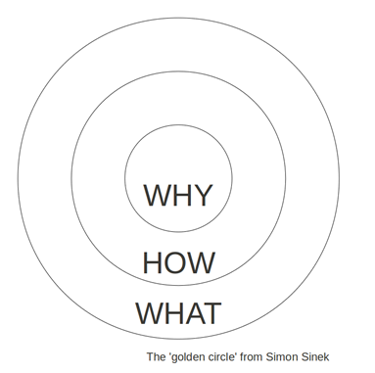
Help Others Understand Why, How, What
Consider this series of steps:
Identify what is happening
Assess the scale and scope of the impact to the organization
Acknowledge concerns and emotions
Articulate what agency does exist or how it is being created
Reframe the change/situation
Seek the opportunities
Set clear expectations
“We are willing to commit ourselves if we understand what it’s all about, and we believe the proposal will bring benefits, that it is possible and that we can influence the final result.” ~ Kari Tuominen

Slide 24
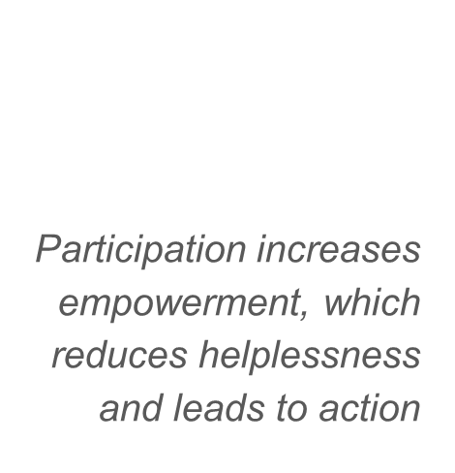
Empower Others to Advance Change
Provide clarity
Ask how might we
Leverage compassion and empathy
Communicate what you know and don’t know
Model bravery through change
Acknowledge difficulties
Notes:
Participation increases empowerment, which reduces helplessness and leads to action
We empower others by:
Providing clarity
Asking how might we
Leveraging compassion and empathy
Communicating what you know and don’t know
Modeling bravery through change
Acknowledging difficulties

Slide 25
Pace
Plan milestones
Celebrate small wins
Share where you are and what is next
State what is NOT changing
Notes:
All change, even positive change, is disruptive.
When looking at transitions, you need to consider where you are in the change process both as an organization or an individual. While the organization moves through transitions, it is important to account that for those eager to engage in change, those that do participate in the change, those that come to it incrementally, and those that resist engagement in change. While you can work to minimize the numbers of resistors, and ensure there are opportunity for them to have voice, you can focus your energy in those that fall in the range of eager to making small steps. [Also important to realize that people throughout the organization may be at different places in the transition].
By breaking the change process into phases, landmarks can be provided to those experiencing and engaging in the change. Think of the marathon runners - those that focus on running the current mile are more successful than those that look at the totality.

Slide 26
Use Equity Lenses
What beliefs, values and assumptions are guiding our decisions about this change?
Who is part of the change process?
Who is affected—positively, negatively, or not at all—by the change?
How will decisions about the change be made?
How are our mission and values explicitly articulated in our approach to change?
Notes:
If we want to be leading human-centered, values-anchored, and equity-minded change, we need to bring tools to help us center this.
“The purpose of an equity lens is to be deliberately inclusive as an organization makes decisions. It introduces a set of questions into the decision that help the decision makers focus on equity in both their process and outcomes. It is explicit in drawing attention to the inclusion of marginalized populations, typically Black communities, communities of color and Indigenous communities, and can be adapted to focus on other communities. The lens questions are designed to create a more inclusive perspective, drawing attention to how the decision holds potential to affect marginalized groups. An equity lens will not tell you what action to take. Rather, the lens helps you discuss and reflect on the equitableness of the action and decision-making process.” In other words, an equity lens is a set of questions that we ask ourselves about our work to center equity and ensure systems-level thinking.
Set of questions for an organization to be deliberately inclusive
Draws explicit attention to inclusion and equity
Leverages systems thinking
Adapted for different focuses

Slide 27
Communicate, Communicate, Communicate
Change
Concerns
Clarity
Consistency
Confidence
Competence
Communication Channels
Notes:
When stressful events occurs, it is easy for leaders to turn inward, to work with other leaders. If they don’t make sure to communicate out, then the official communication channels are shut down. Yet, communication does not stop because a leader is not communicating. In fact it can often increase. The problem is that these communications can be full of rumor, innuendo, inconsistencies, half truths, and exaggerations. More than this, the trust and confidence of staff in its leaders can be undermined, with often-damaging long term consequences. It is imperative to communicate with candor and in a timely manner.
This is where the best thing to do in a crisis is to communicate the facts and issues surrounding them clearly, quickly, and consistently. By using the 7Cs, you contain the message you want said. You are able to share information in an organized fashion. The 7Cs help you give adequate, honest information. In turn, people are less inclined to have alternate scenarios. Where possible, leave no room for best guesses and assumptions. In a void, people will invent scenarios, and with the reality of the negativity bias, the scenarios will often be worse than the truth. Often, we feel safer using vague language, giving wiggle room for changes that might occur. Unfortunately, vague communications imply that you are hiding something or at the very least only revealing partial truths.
Focus on the needs of the audience, or the recipients of the communication. It’s not focused on the leader, the organization’s image, or damage control. In the case of COVID, there is no damage control for many of us. Whenever appropriate, acknowledge the concerns of people and deal with them precisely. Try to see the situation from the audience's point of view. Deliver the message with the same sensitivity you would appreciate if you were in their position. Use humble, personal language and acknowledge the emotional elements involved in the situation. Try to emphasize the positive without minimizing the negative.

Slide 28
Feedback Loops
Input
Design feedback loops as part of your communication strategy
Important tool for engagement change leadership
Mechanism to demonstrate organizational values
System
Output
Notes:
As you begin to plan communication strategy, one approach to adopt is the creation of feedback loops. Feedback loops create an opportunity to gather information/input from colleagues about a particular topic, provide an opportunity to influence the change to the system you are trying to make, and then closing the loop by sharing back what you learned.
In our experience the creation of feedback loops is an important tool for engaged change leadership and a mechanism to demonstrate organizational values in action.

Slide 29
Communicate
with Empathy
As you prepare to communicate with empathy:
Put yourself in other’s shoes
Articulate your values
Anchor in your purpose
Focus on the short and long term relationship
Show compassion
Notes:
Photo by Cytonn Photography on Unsplash
As you prepare to communicate with empathy:
●Put yourself in other’s shoes
●Articulate your values
●Anchor in your purpose
●Focus on the short and long term relationship
●Show compassion
Demonstrate care
As we communicate about our change, we can demonstrate our values, by modeling behaviours and actions in our messages and approach, Put our guiding principles into action, Utilize the feedback loops we created during the planning phase to ensure ongoing engagement and pathways for others to use voice, Create & sustain positive relationships that will help current and future change initiatives to be successful

Slide 30
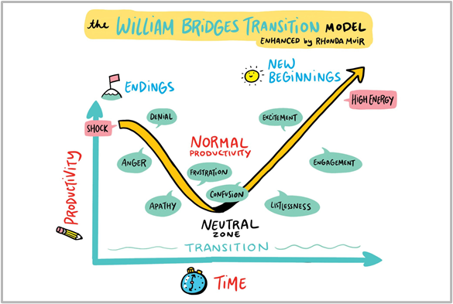
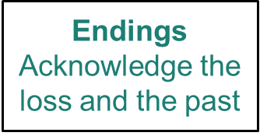
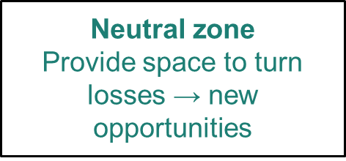
Communicate Using Bridges’ Model
Notes:
One very practical way to use the Bridges’ Transition Model is to guide your communication and feedback strategy during a change.
Endings: As you begin your change effort, acknowledge the loss that your colleagues are experiencing and honor the past work and efforts that have gotten you this far.
Neutral Zone: This phase can feel incredibly uncomfortable and frustrating (remember the dig in productivity/motivation). Create space for colleagues to share ideas for how to turn the losses identified during the Endings phase into new opportunities.
New beginnings: Based on what you learned during your conversations during the Neutral Zone, use this phase to communicate the vision and plan for the new beginning you are hoping to create during your change
As an individual contributor:
A reminder that I have agency over my own path/journey
Helps me bring empathy & compassion for colleagues (and myself)
As a change leader:
Use the framework to create a shared vocabulary
Center emotions throughout a change: Ask people how they are feeling AND validate those feelings
Guide communication strategy
Keep top-of-mind that I’m usually in a different place than others (slow down, keep communicating, keep checking-in because people move back and forth)

Slide 31
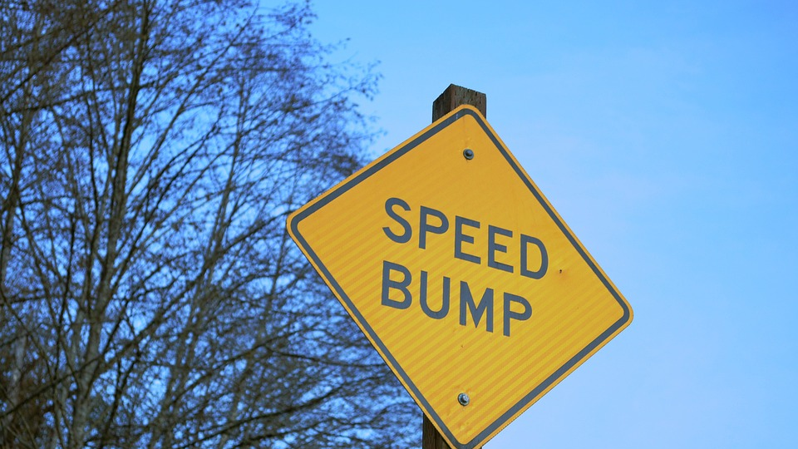
Handling Speed Bumps

Slide 32
Sunsetting: The Art of Stopping
To reduce fears around endings, clearly articulate what is core, what is not changing, and what will be preserved
Center on shared values
Provide space to mourn and grieve
Notes:
Angela Ruggiero once said “It feels right. But it’s emotional. Saying goodbye to anything you’ve done that long is hard.”
People have to accept that something is ending before they can begin to accept the new ideas. If you don't acknowledge the emotions that people are going through, you'll likely encounter resistance throughout the entire change process. [If you don’t acknowledge, there is the potential to impact future change initiatives.] So acknowledge the sense of loss. Almost all change involves letting go of something. Acknowledge any negative emotions so that you can deal with them.
At the same time, try to put things into perspective and look at the bigger picture. Ask yourself what is good about the change that’s happening. Identify potential opportunities to celebrate accomplishments. Then help others see this too. Remember to make the most of your Neutral Zone. You may be tempted to jump straight into planning for the future. Don’t. It may seem counterintuitive but a period of of taking taking a pause to provide time for more colleagues to get into the Neutral Zone. Remember that you might have been thinking about the change for much longer than some of your colleagues.
Clearer insights will surface as emotions calm down. Experiment with different mindfulness techniques as they have been proven to help lower stress, build a more positive mindset and open your mind to new ideas. As change leaders, it is important to focus not only on self-care during change, but also community-care. Meet people where they are emotionally.

Slide 33
Empathetic listening
Active Listening on a new level to:
Build trust and respect,
Enable the release of emotions,
Reduce tensions,
Encourage the surfacing of information, and
Create an environment that is conducive to collaborative problem solving
Notes:
The Tao Te Ching states that “Your conversations help create your world. Speak of delight, not dissatisfaction. Speak of hope, not despair. Let your words bind up wounds, not cause them.” This serves as an invitation to consider how we speak to others, both tone and word choice. For example, using Always/Never can exercibate issues, and using But invalidates the previous part of the statement. This does not mean ignoring problems and concerns. It does mean encouraging an abundance or solution-focused mindset.
Psychologist Carl Rogers wrote, "Real communication occurs when we listen with understanding - to see the idea and attitude from the other person's point of view, to sense how it feels to them, to achieve their frame of reference in regard to the thing they are
talking about." Listening with empathy allows us to create connection and new understanding.
Not only is empathetic listening a mindset and philosophy. It is active listening on a new level:
●build trust and respect,
●enable the release of emotions,
●reduce tensions,
●encourage the surfacing of information, and
●Create an environment that is conducive to collaborative problem solving
As you prepare to communicate with empathy:
●Put yourself in other’s shoes
●Articulate your values
●Anchor in your purpose
●Focus on the short and long term relationship
●Show compassion

Slide 34
Strategic Advocacy
Embrace the mission
Actively listen to understand their needs & priorities
Propose solutions when sharing problems
Be selective in what problems you bring
Showcase your team
Use a Strategic Yes
Ask yourself:
What is 1+ thing I can take care of in this request?
Who can I put on it?
What support do I need?
Notes:
The first step is to listen and understand their needs and priorities. Leaders also have a team they are accountable for, a set of priorities, and their own set of constraints. They also have a boss in turn. Aligning your language and pointing out how you are advancing their priorities can really help you gain credibility and trust in your work. The more strategic understanding you can bring, often the more your own messages will be heard.
It’s important to be solutions or outcomes focused. When sharing a problem, share your thoughts right away of how you would like to approach it. This gives you agency and continues to build trust that you can work in the right direction. Of course, issues and problems that could grow need to be flagged to our uppers, yet it’s important that we make sure to give more good news than bad. Your team is doing more good work than bad, tell that story!
When you can say yes, even if it’s through a discussion of rescoping the project, you are tapping into the psychology of agreement, of teamwork, etc. Here I’m not saying to simply roll over, not voice opinions, and not flag concerns. Using generative questions, flipping the problem to the success you seek, can help you to do so in a patternship way.
It also means that when you do say no, they are more likely to listen to you.

Slide 35
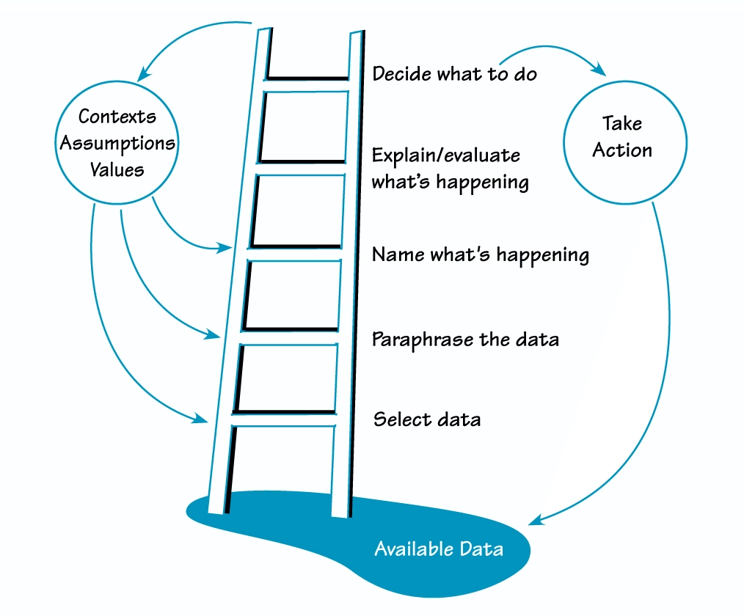
Ladder of Inference
Observe reality
Select data
Add context from experiences & beliefs
Make assumptions
Draw conclusions
Adopt beliefs based on conclusions
Act
Source: Senge, Peter, Et al. The Fifth Discipline Fieldbook: Strategies & Tools for Building a Learning Organization. New York: Doubleday, 1994
Notes:
ANNIE (1mins)
The ladder of inference is a tool that explains how we come to meaning making. Each step in the process is represented by a rung on the ladder—so you start at the bottom, then climb each rung before coming to a perspective. It was first developed in 1970 by Chris Argyris to explain how people make and sustain their assumptions about the world, also called mental models. Using the ladder of inference can help us to identify cognitive biases that reinforce our beliefs and biases regardless of validity. It can help us understand how others are perceiving an alternative reality.
Available data
This is the reality we are able to observe.
Selected data
We select what we pay attention to based on our prior experiences and existing beliefs. We don't have the mental capacity to take in every piece of data available, so we have to make this selection.
Interpretations
We give facts meaning. We paraphrase what we see or hear to make sense of it.
Assumptions
Based on our interpretation, we make our own personal assumptions.
Conclusions
We draw conclusions from our assumptions.
Beliefs
Our beliefs are then developed from the conclusions we make.
Actions
Finally, we take actions that are rooted in what we believe to be true.
Graphic from: https://thesystemsthinker.com/the-ladder-of-inference/

Slide 36
Walking Down the Ladder of Inference
Actions: Why do I believe this to be the right action? What are some alternative options?
Beliefs: What beliefs do I hold about this? What conclusions are they based on?
Conclusions: Why did I conclude this? What are my assumptions there?
Assumptions:Are my assumptions valid? Why am I assuming this?
Interpretations: Am I looking at this data objectively? What other meanings could they have?
Selected data: What did I ignore or didn't pay attention to? Are there other sources of data I didn't consider?
Notes:
Work your way down the ladder (1mins)

Slide 37
Your Turn
Individually, look at the picture:
What do you notice 1st? 2nd? 3rd?
Make up a story about those 3 things
In pairs, share:
What did you notice first?
What stories did you create?
Reflect on what differences exist and why?
Notes:
(5 mins)
https://americanart.si.edu/artwork/subway-8731

Slide 38
Generative Questions
Generates reflection and creativity by:
Asking open-ended questions
Starting with “What if”, “why”, “how might we”
Includes a clear scope and positive intent of inquiry to move forward
Anchored in constructive intent
Does our decision lack perspective? >>>> What would someone who had a very different set of beliefs than we do say about our decision?
Notes:
ANNIE
Psychologist Carl Rogers wrote, "Real communication occurs when we listen with understanding - to see the idea and attitude from the other person's point of view, to sense how it feels to them, to achieve their frame of reference in regard to the thing they are talking about." In asking generative questions, we are seeking to understand and to foster dialogue toward shared understanding. We shift from being right and knowing to inquiring. We seek to generate reflection and creativity.
Open ended questions allows the speaker to imagine what could be, and explore what is. While close ended question invite efficiency and yes/no answers, they do not generate conversation. Additionally, the linguistic construction of questions affect their effectiveness and importance. It was found that questions starting with “Why,” “How,” and “What” are more powerful as compared to queries that start with simple “Who,’ “When,” “Where,” and “Which” which may fall under the less powerful category. This is because powerful questions motivate more reflective thinking and more profound level of conversation. One caveat: Why can be a trigger of judgement for some. Rephrasing Why questions to “How might we?” or “Help me understand” can help you move past accidental icebergs.
The second dimension is the scope of the question which simply means knowing how to tailor the kind of question to our needs. The extent of asking the question must only be within the needs of the situation and realistic goals. We are not engaging in dialogue for dialogue’s sake. Lastly, the assumptions embedded into most of the questions must be appropriately applied. To demonstrate it, you might as well ask “What can be done to prevent it from happening again?” instead of “Why did you fail to do it?” The first question stimulates reflective thinking in contrast to the second question.
Be anchored in positive intent, not positivity. The intent is positive in that you seek to make it better. Realize that by asking a question, you may be introducing unconscious bias. Before going forward with your questions, consider the following:
●What assumptions or beliefs are we introducing with this question?
●How would we approach this issue if we had an entirely different belief system?
●Is this a question to which we do not know the answer? If we already know the answer or have a preset “right” response, it is not inquiry.

Slide 39
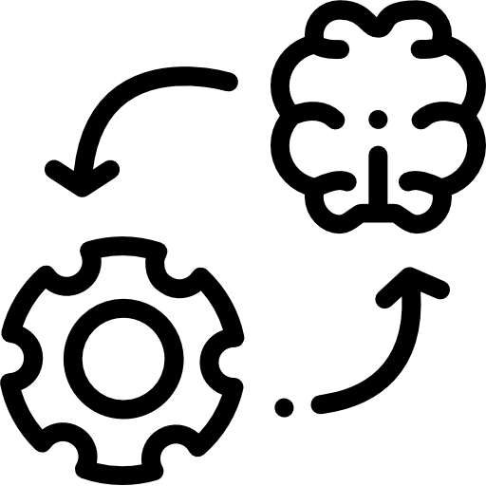
REFRAMING: Name It > Flip It > Frame It
Name It
Flip It
Frame It
Name the problem or concern - often a negative statement
We failed? Why did we fail?
Flip it to its opposite - often a positive statement
We want to succeed
Frame it in reality: powerful question(s) that help(s) actualize the “flipped” statement
What might success look like?
Notes:
ANNIE
Cognitive reframing is a psychological technique that consists of identifying and then changing the way situations, experiences, events, ideas, and/or emotions are viewed.The main goal of reframing is to refashion negative thoughts and to turn them into positive ones. It is important to highlight the opportunities, the good, and also be transparent about the difficulties and challenges. Framing what is good cannot be done by invalidating the realities of others involved in the change.

Slide 40
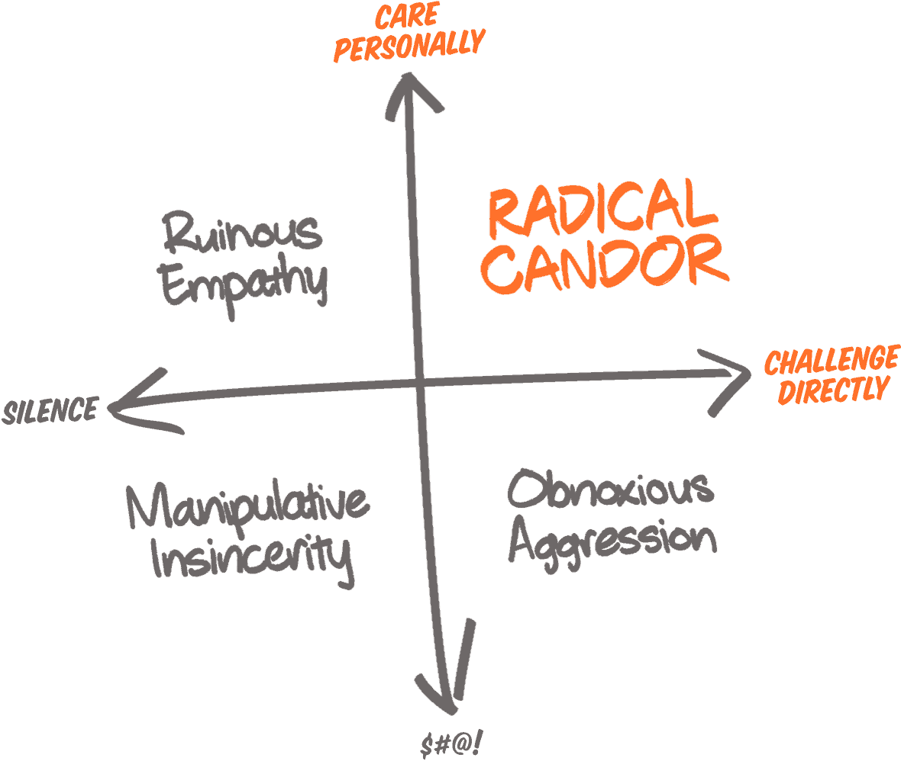
Human-Centered
+
Empathy Radical Candor
Shifting the dialogue towards healthy, thriving individuals anchored in trusting relationships
Graphic from: https://www.radicalcandor.com/radical-candor-not-brutal-honesty/
Notes:
Graphics from: https://www.radicalcandor.com/radical-candor-not-brutal-honesty/
Leaders are accountable for a healthy, productive organization. By marrying empathy with active feedback, radical candor offers simple framing to consider how to move into human-centered leadership that is focused on growth, empathy, and an ethic of care.
“Radical Candor is Caring Personally and Challenging Directly, Not Brutal Honesty. The whole point of Radical Candor is that it really is possible to Care Personally and Challenge Directly at the same time.” Kim Scott believes that leaders can move beyond the dichotomy of leader as jerk or leader as incompetent.
“Radical Candor is kind and helpful.
Obnoxious Aggression is mean but may be helpful. Obnoxious Aggression is also called “brutal honesty” or “front stabbing.”
Ruinous Empathy is “nice” but ultimately unhelpful or even damaging. It’s seeing somebody with their fly down, but, not wanting to embarrass them, saying nothing, with the result that 15 more people see them with their fly down — more embarrassing for them.
Manipulative Insincerity is a stab in the back.”
Holding someone accountable for something they have not been told is in fact cruel. This is also a place to let go of ‘they should know’ as that centers white middle-class professionalism and serves as a form of gatekeeping.
https://www.radicalcandor.com/radical-candor-not-brutal-honesty/

Slide 41
Self-Reflection
Learning Loop:
What did I try?
Where did I succeed?
Where did I struggle?
What did I learn?
What will I try next?
Notes:
Reflection and deepening self-awareness were a big part of my continued growth. Failure is often very personal. It is important that we use those moments to grow. We should ask how might I approach that differently (reflection) rather than what is wrong with me or why me (introspection). At the same time, we need to give ourselves enough compassion to feel our emotions and process them.

Slide 42
Reflection Questions
How do you process emotions through change?
How do you help others process their emotions?
How do the two align/differ?

Slide 43
References
William Bridges. Managing Transitions: Making the Most of Change.
adrienne maree brown. Emergent Strategy.
SAMHSA’s Concept of Trauma and Guidance for a Trauma-Informed Approach: https://store.samhsa.gov/sites/default/files/d7/priv/sma14-4884.pdf
Granite State College. Cultivating Your Leadership Capabilities - Chapter 9, A Leader’s Vision. https://granite.pressbooks.pub/ld820/chapter/9/
Stewart D. Friedman. August 2008. Define Your Personal Leadership Vision. Harvard Business Review. https://hbr.org/2008/08/title
Jackie Stavros and Cheri Torres. Conversations worth having: Using appreciative inquiry to fue productive and meaningful engagement
Sarah Lewis, Jonathan Passmore, and Stefan Cantore. The Power of Conversation from Appreciative Inquiry for change management: Using AI to facilitate organizational development.
David L. Cooperrider, Jacqueline M. Stavros, and Diana K. Whitney. Appreciative Inquiry Handbook for Leaders of Change.

Slide 44
Further Reading
The Equity-Driven Systems Change (ESC) Model: A Toolkit for Improving Institutional Practice and Student Outcomes: https://skylinecollege.edu/seeed/assets/resources/ESC-Toolkit.pdf

