Slide 1
Robert Hall Merrill
An American Engineer in China
Annie Benefiel, benefiea@gvsu.edu Grand Valley State University
Notes:
Hi Everyone, thanks for joining me today. I am Annie Benefiel, University Archivist and Digital Collections Librarian at Grand Valley State University. My talk today is entitled Robert Hall Merrill, and American Engineer in China. The archival materials I’m highlighting today come from the Robert Hall Merrill papers held in the Grand Valley State University Special Collections and University Archives. The papers were held in private hands until 2018 when they were sold to us alongside another collection. The materials were recently processed, and a finding aid to the collection is available online. We are now in the midst of a project to digitize the photographic materials found in the collection, which I’ll describe in more detail later in the presentation. Before I dive into the discussion about our specific object of interest, I want to give you a little biographical context about Merrill.

Slide 2
Biographical Notes
Born on January 18, 1881, in Grand Rapids, Michigan.
B.S. in Civil Engineering from University of Michigan in 1902.
Worked as a civil engineer in Michigan in New York from 1902 – 1918.
Moved to Tianjin, China in 1918 to work for the Grand Canal Improvement Board.
Notes:
Robert Merrill was born in Grand Rapids, Michigan in 1881. His father, Robert Wilkins Merrill, was a successful businessman who served as a plant manager for the Phoenix Furniture Company in Grand Rapids for over thirty years. Merrill was educated in the state, earning a bachelors in engineering from the University of Michigan in 1902. He then worked as a civil engineer in Michigan and New York. While in New York, he met and married his first wife, Lena Billington. The Merrills moved to Tianjin, China in 1918, where he went to work for the Grand Canal Improvement Board. From what I have gathered from the records, Merrill was a meticulous and hardworking perfectionist who had an insatiable curiosity and adventurous spirit.

Slide 3
Grand Canal Improvement Board
Tientsin (Tianjin), China, 1918-1921
Notes:
The Grand Canal Improvement Board in Tianjin was one of several corporations contracted to bring western engineering technology to improve China’s Grand Canal, which is the worlds oldest and longest canal system and is today a UNESCO World Heritage Site. The Grand Canal has sections dating back to 485 BC, though most of the development of the canal as it is known today occurred beginning in the 13th century CE. The image on this slide comes from the Merrill collection, it shows boat traffic on the Grand Canal near the city of Tianjin.
Merrill worked for the Grand Canal Improvement Board as Principal Assistant Engineer, in the Design Department, reporting to Chief Engineer Joseph Ripley. One of Merrill’s first tasks was to organize the surveying and mapping operations of the Board and produce a comprehensive survey report.

Slide 4
Final Report on Preliminary Surveys of the Grand Canal
Partial Copy of Appendices: Maps, Tables, and Charts
Notes:
So finally, we come to the “stuff” of this talk. This a partial copy of the Final Report on Preliminary Surveys of the Grand Canal. It’s about 200 pages, printed mostly on cyanotype (or blueprint) paper. It contains almost exclusively appendices of the report, although there is a small section of Design Department record creation and filing instructions. The appendices include numerous maps, diagrams, tables of data, and charts that record the rainfall, elevations, water levels, topography and physiography of the areas affecting the Grand Canal and Yellow River.
As I’m currently traveling, I do not have the materials with me, so the following slides are selected pages from the report to give you a sense of what kind of information is contained in it. Now, I am not an engineer, and this type of this data unfamiliar to me. So I’ll ask your forgiveness ahead of time if I mispronounce or mistake the importance of any of this information.

Slide 5
Slide title 29
Design Department Manual
Standard lettering for drawings of structures, October 31, 1919. Approved by Joseph Ripley, Chief Engineer
Notes:
This item is one of the data sheets in the Design Department section. It appears to provide the approved scale standard for different sizes of sheets used by the engineers. The Design Department section includes instructions on the correct way to measure and draw maps, how to number files, and how and where to store the files and documents in the offices.

Slide 6
Notes:
Any other recordkeeping enthusiasts in the audience will appreciate this spread, which defines the file system and directions for finding data sheets in the engineering department design section. Each Subject was classified with an integer 1 through 9. Then the subjects were subdivided with decimal numbers and letters to clarify. Examples of subject divisions include Canal subject number 2, General Consideration 2.0, Cross sections 2.1, Elevations 2.2, Excavation 2.3, and Excavations are further subdivided into various routes.

Slide 7
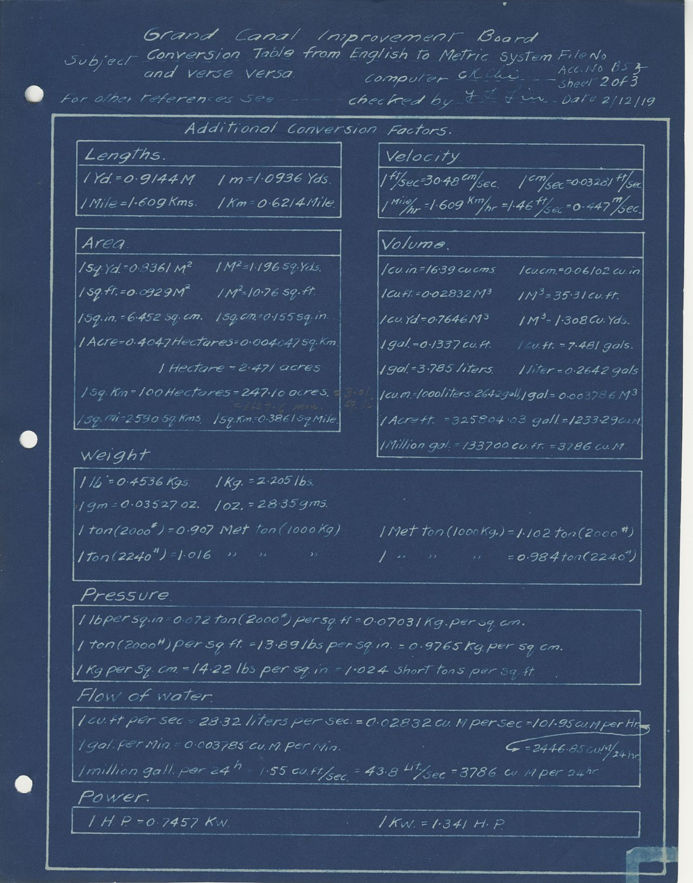
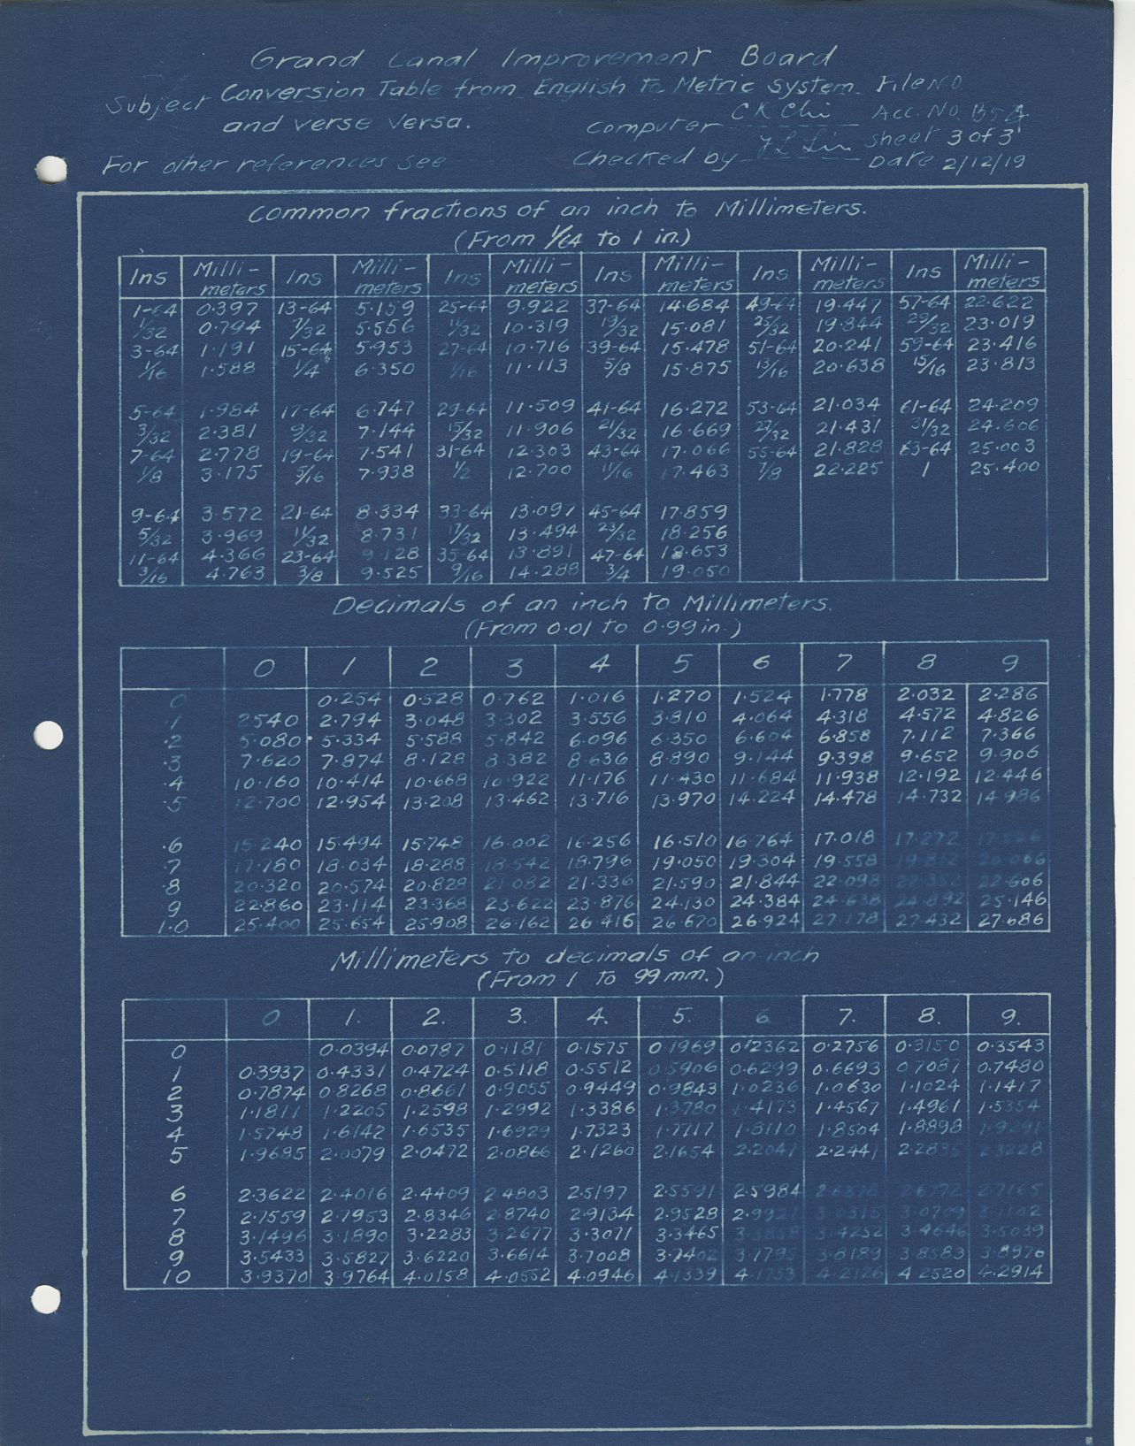
Notes:
Also included in the frontmatter of the report are numerous conversion charts – as it’s important to remember that all the calculations these engineers were doing were performed manually. Here I have two of five pages of conversion charts. These include lengths, velocity, area, volume, weight, pressure, flow of water, power, and imperial to metric conversions.

Slide 8
Maps
Index map illustrating the Stadia Survey of the Yellow River, mapped on 52 sheets to a scale 1:25,000; located as show by the small rectangles, each bearing the corresponding file number or letter.
The Shantung River Conservancy map, scale 1:60,000 is shown in broken outline.
The 10 larger rectangular tracings are based on the accepted longitude of the British map for Tianjin, and observed latitudes at Tianjin, Linqing, and Anshan.
Notes:
This index map combines three separate mapping systems, including a 52 sheet survey of the Yellow River, illustrated by the small numbered rectangles, the Shantung River Conservancy map, illustrated by a broken outline, and ten larger rectangles illustrating a 10-sheet British map of Tianjin, Linqing and Anshan.

Slide 9
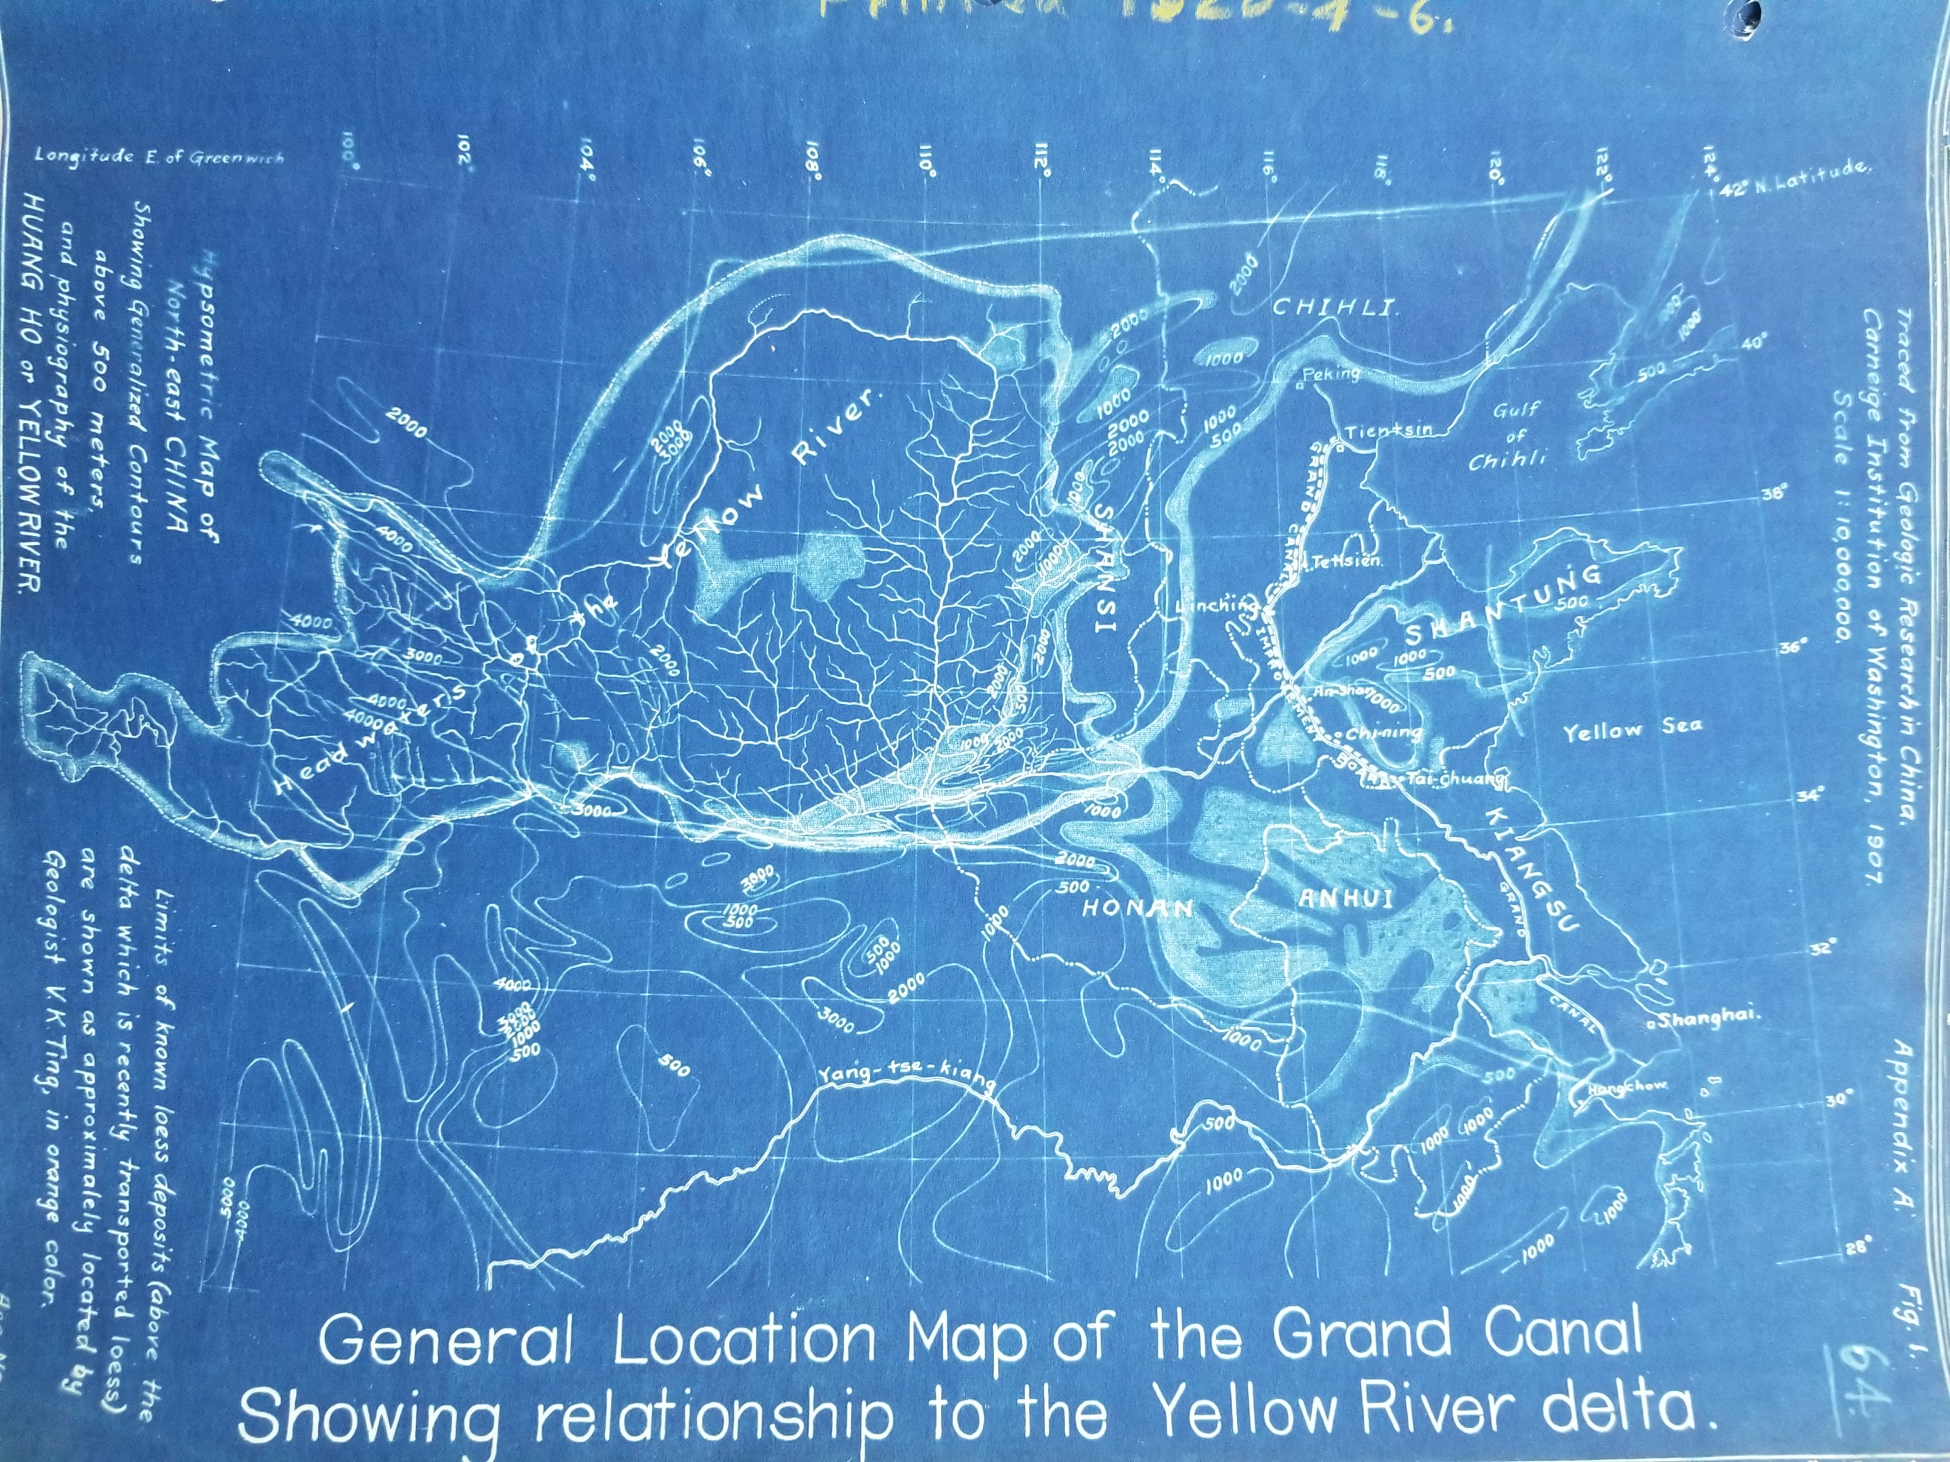
Grand Canal in Relation to Yellow River Delta
Hypsometric map of North-East China showing generalized contours above 500 meters and physiography of the Huang Ho or Yellow River.
Notes:
This is a hypsometric map of northeast China, showing the contours and physiography of the Yellow River delta.

Slide 10
Index Map of Plane Table sheets: 1915-1917 Shantung Canal Surveys
Original sheets are in the Chining office of Shantung Conservancy. Each sheet is 50 x 50 cm.
All canal and river surveys used scale 1:10,000.
All lake and swamp surveys used scale 1:20,000.
Sheets numbered as filed at Chining office.
Triangulation control used for sheets 1 to 70. All others used compass-stadia control.
Notes:
This is another index map of canal, river, and swamp surveys from 1915-1917 held in the Chining office of the Shantung Conservancy (which I believe is another Grand Canal improvement operation in a different area of China).

Slide 11
Reclamation Diagram
Curves for possible amount of area of lakes reclaimable, March 27, 1920.
Notes:
This is a reclamation diagram, showing the curves for elevations of water needed to reclaim lake land.

Slide 12
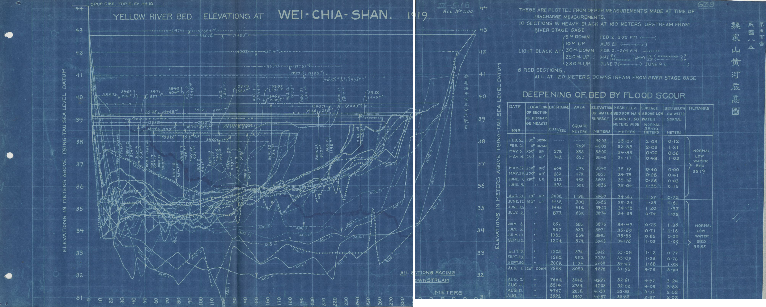
YELLOW RIVERBED ELEVATIONS AT WEI-CHIA-SHAN, 1919
Notes:
This page is one of several fold-out diagrams, and it includes both a chart and a table of data. It records the Yellow Riverbed elevations at Wei-Chia-Shan in 1920.

Slide 13
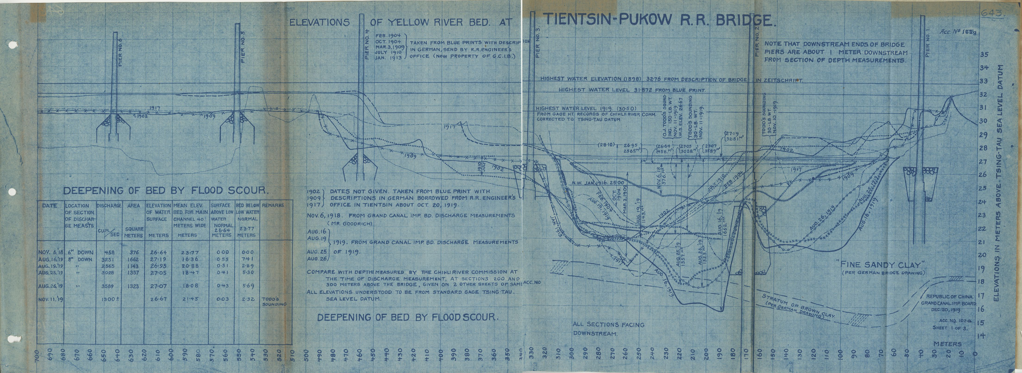
ELEVATIONS OF YELLOW RIVER BED AT TIENTSIN-PUKOW R.R. BRIDGE
Notes:
This diagram also documents the Yellow River Bed elevations, this time at the Tianjin-Pukow Railroad bridge. In this diagram, you can actually see the railroad bridge pilons drawn at intervals of the cross-section of the river bed.

Slide 14
Subject –summary Estimate for canal by various routes
Notes:
This is one of several charts that estimates the probable costs and revenues of the canal project once it has been completed. These figures are detailed in another report located in the collection, which explain the various tolls to be charged along the routes for different types of canal traffic and cargo.

Slide 15
Grand Canal Project correspondence
Notes:
In addition to the report, Grand Valley’s collection also includes Merrill’s file of correspondence with Chief Engineer Ripley and others working for the Grand Canal Improvement Board. Pictured here are two letters. On the left is a handwritten letter Mr. Ripley to Merrill dating from September 1919, responding to Merrill’s earlier letter complaining about the poor quality of previous surveys. On the right is a typescript letter from Merrill to Ripley’s replacement T.H. Wiggin in February 1921, detailing the work completed by the mapping department over the course of the previous month.

Slide 16
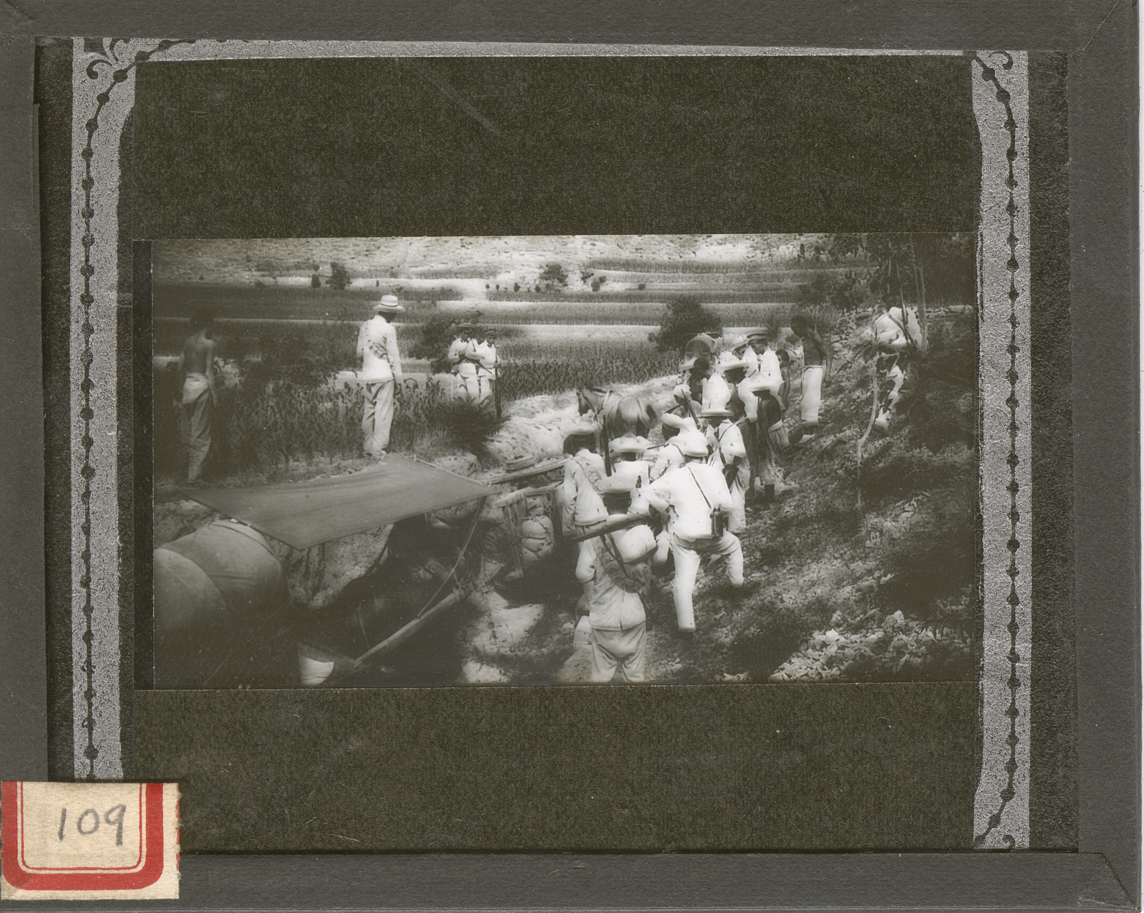
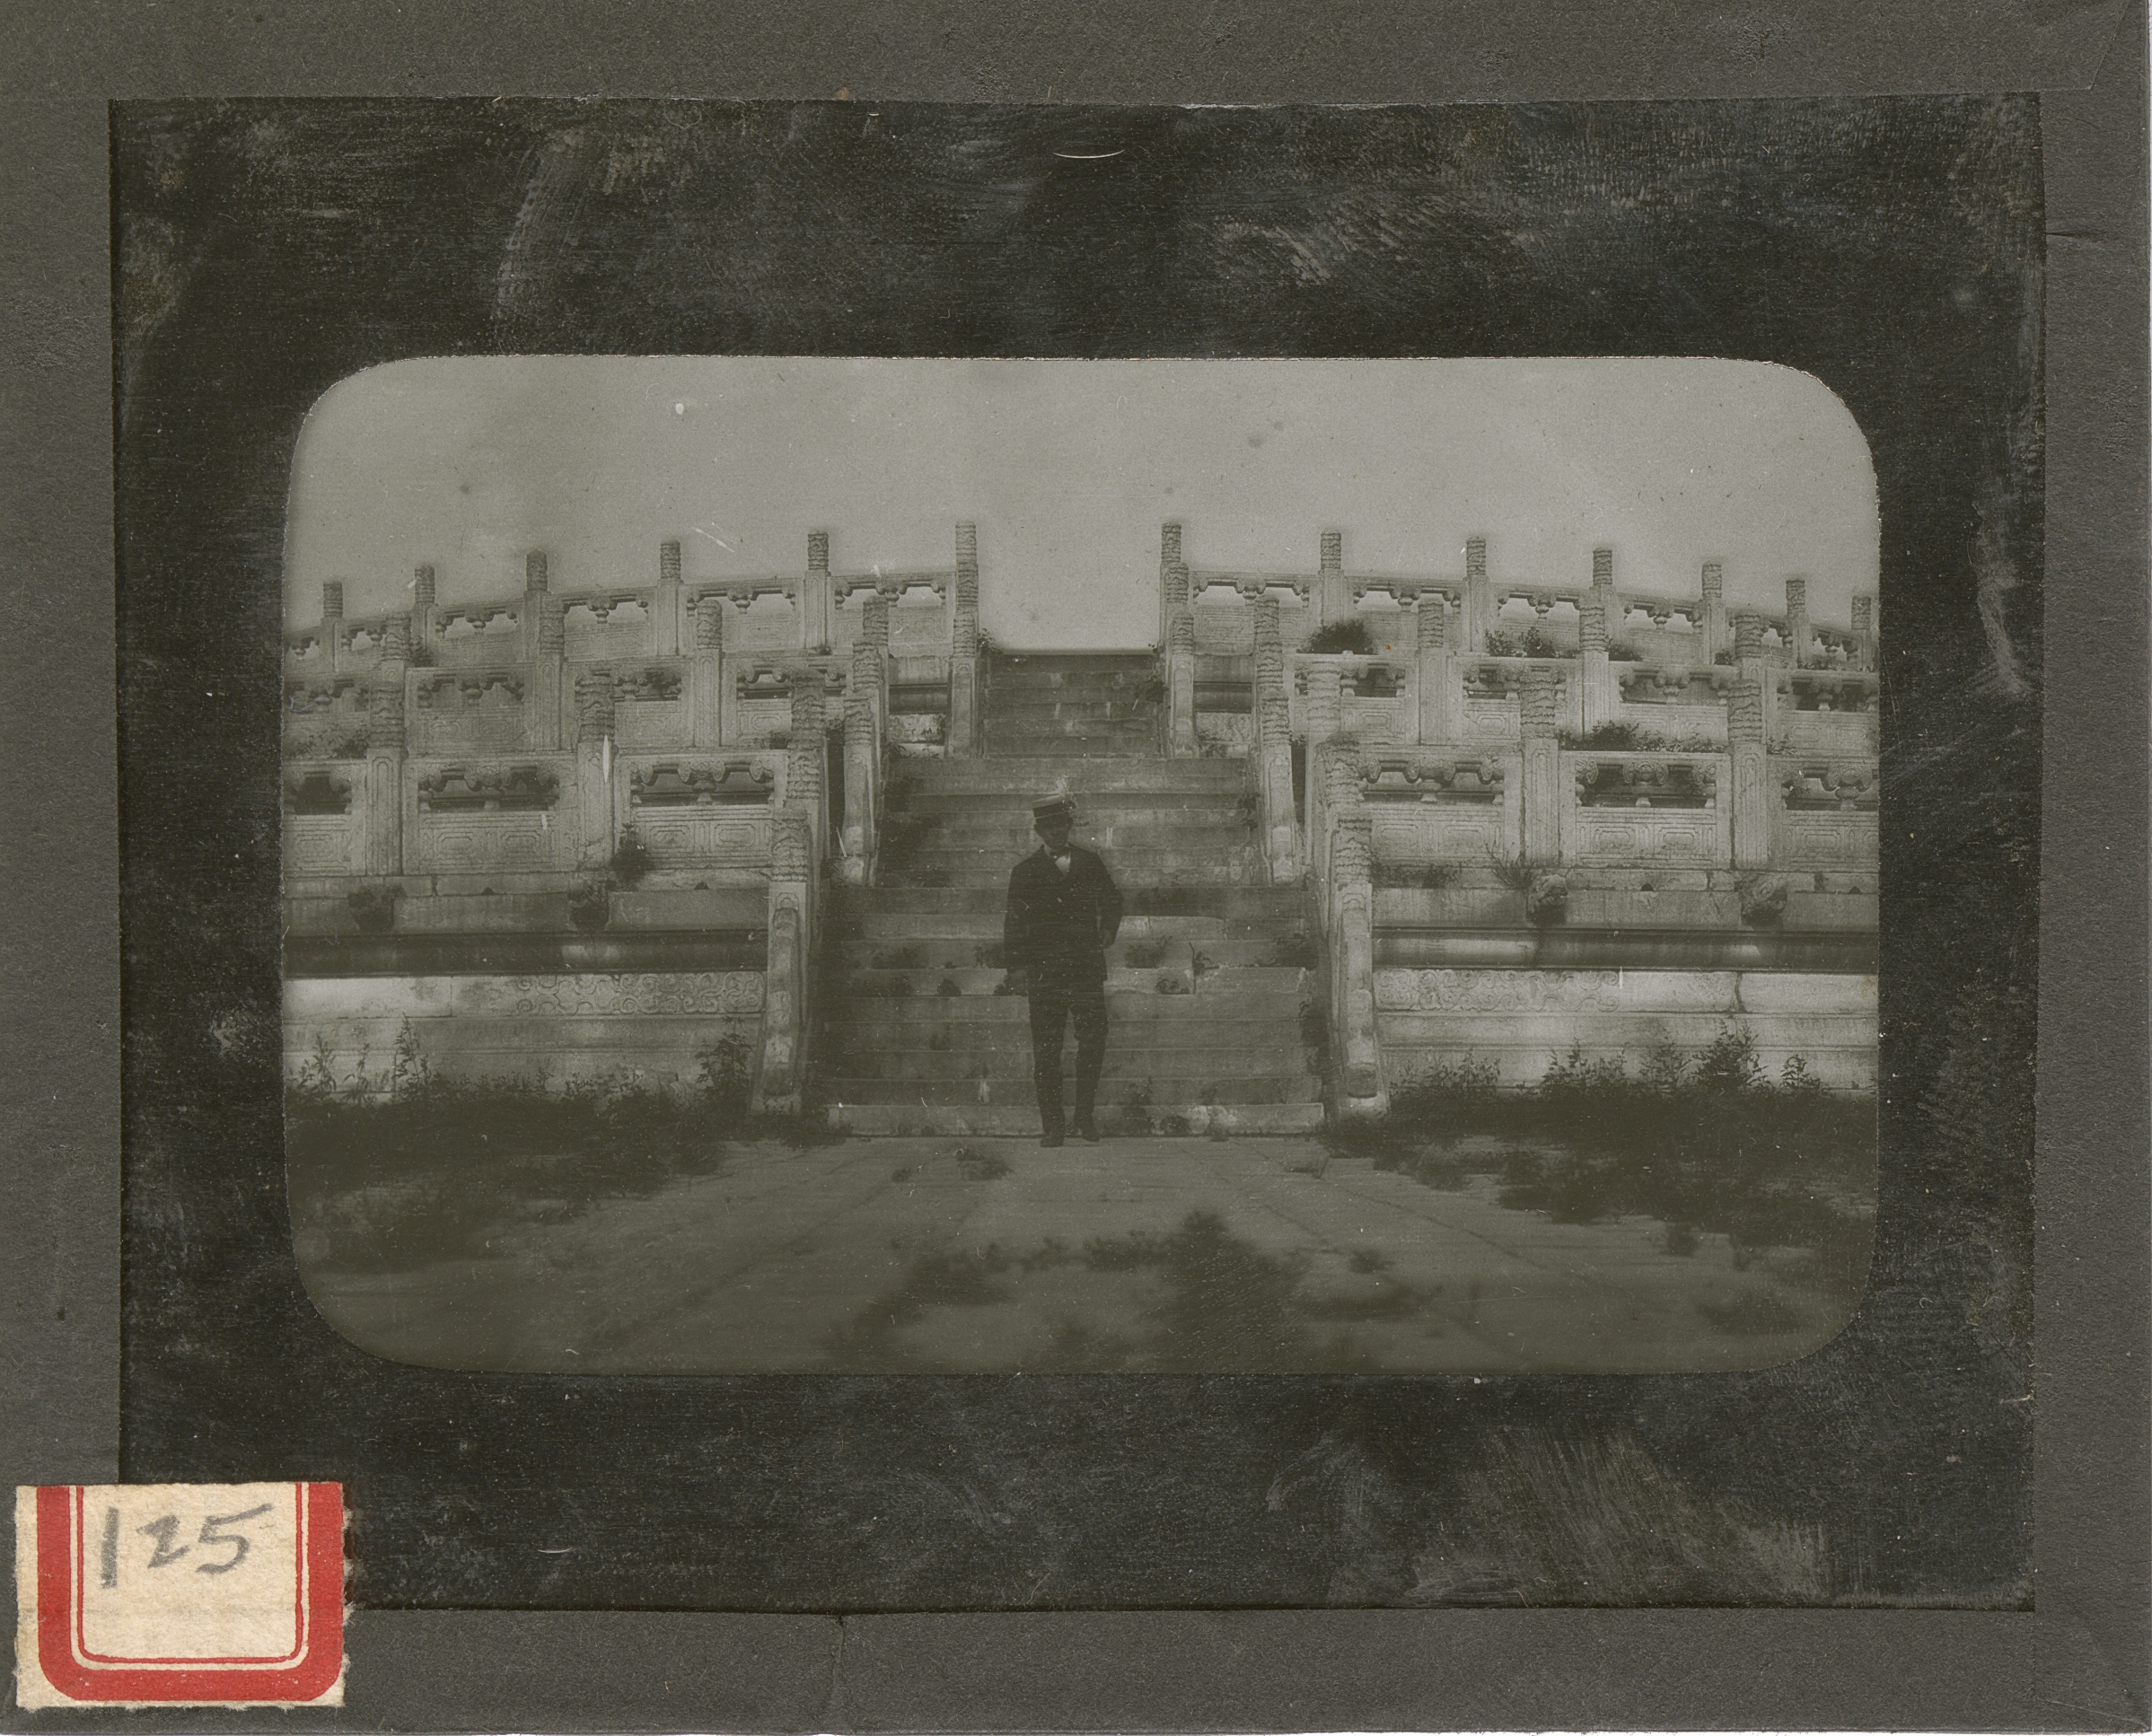
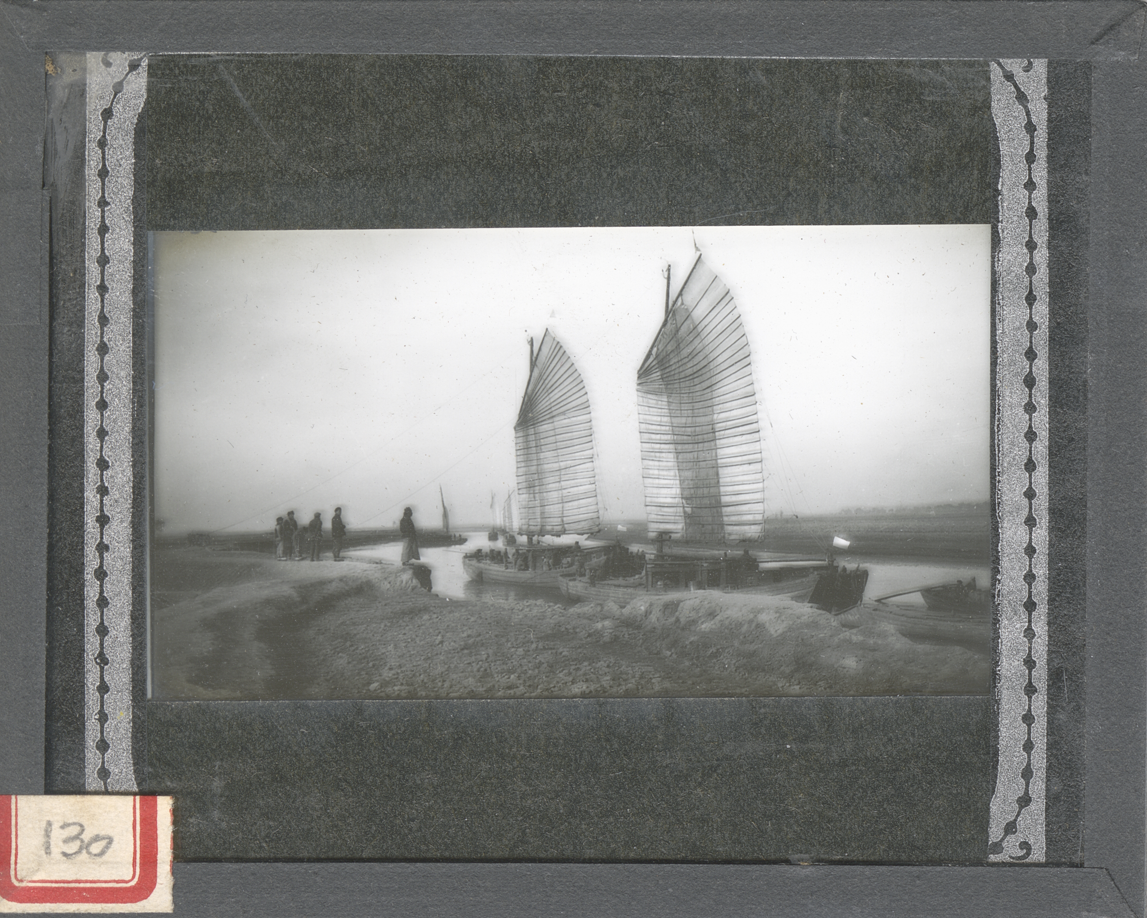
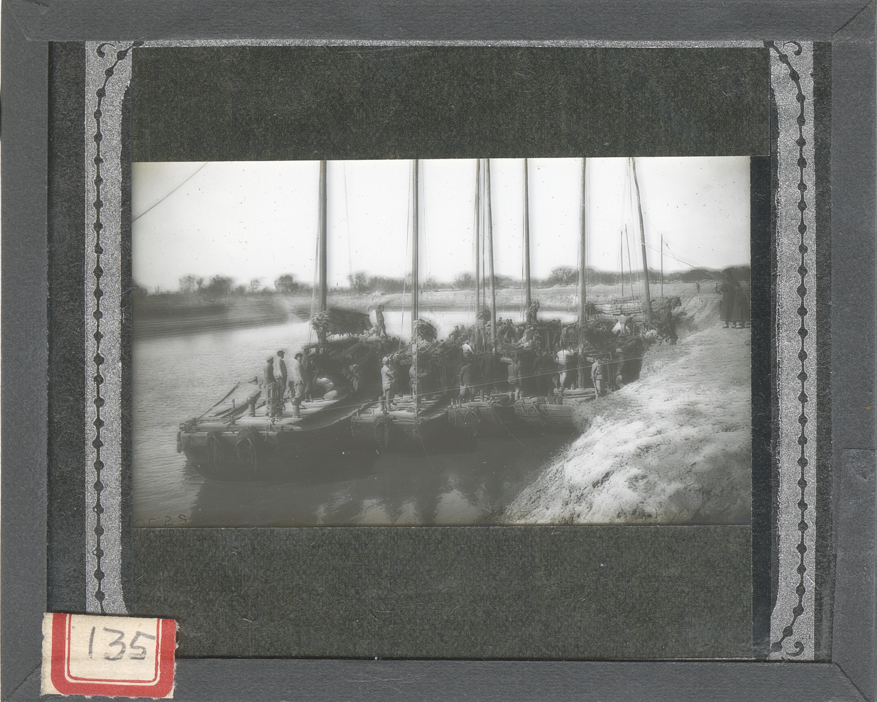
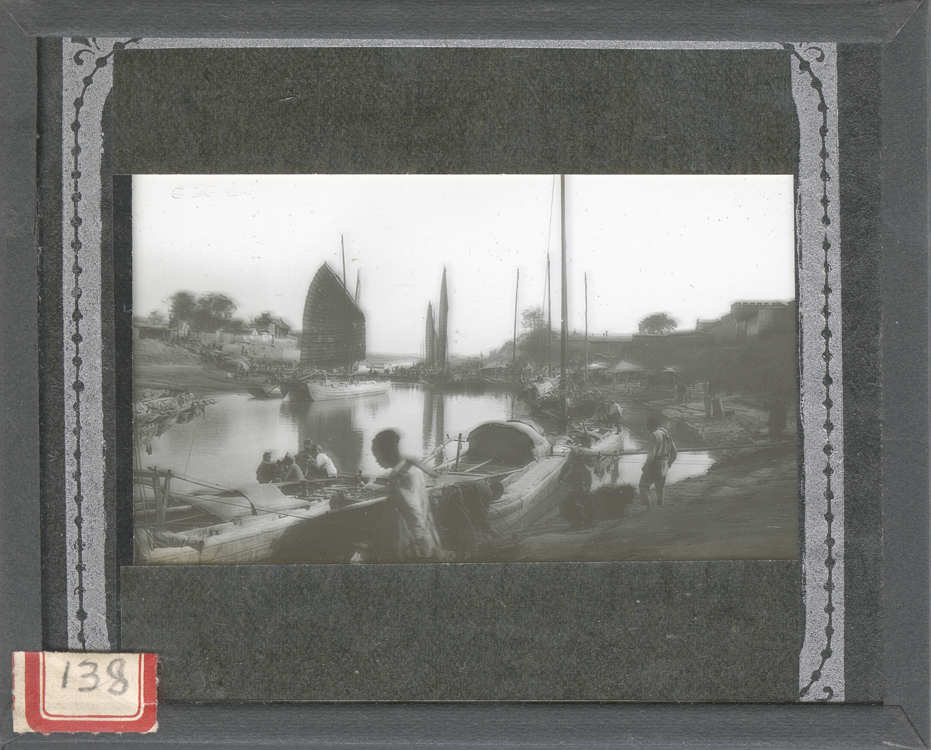
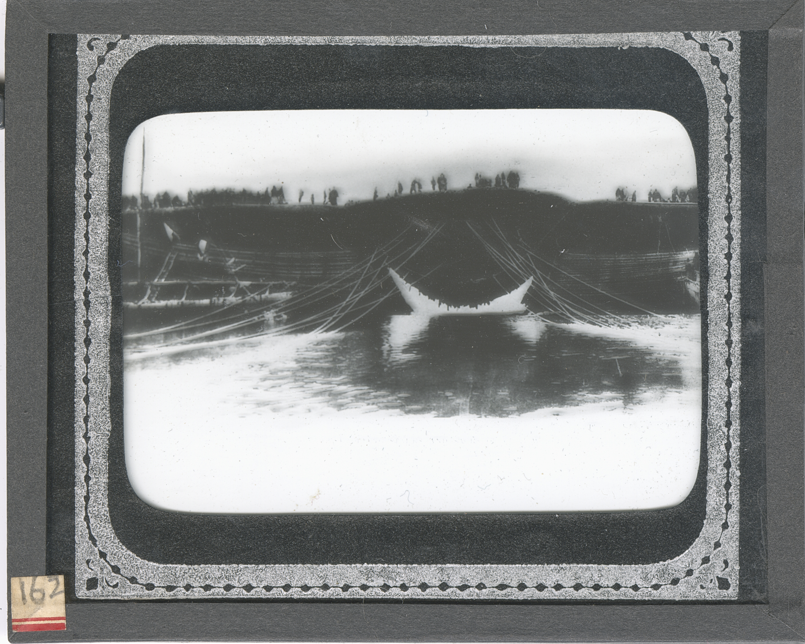
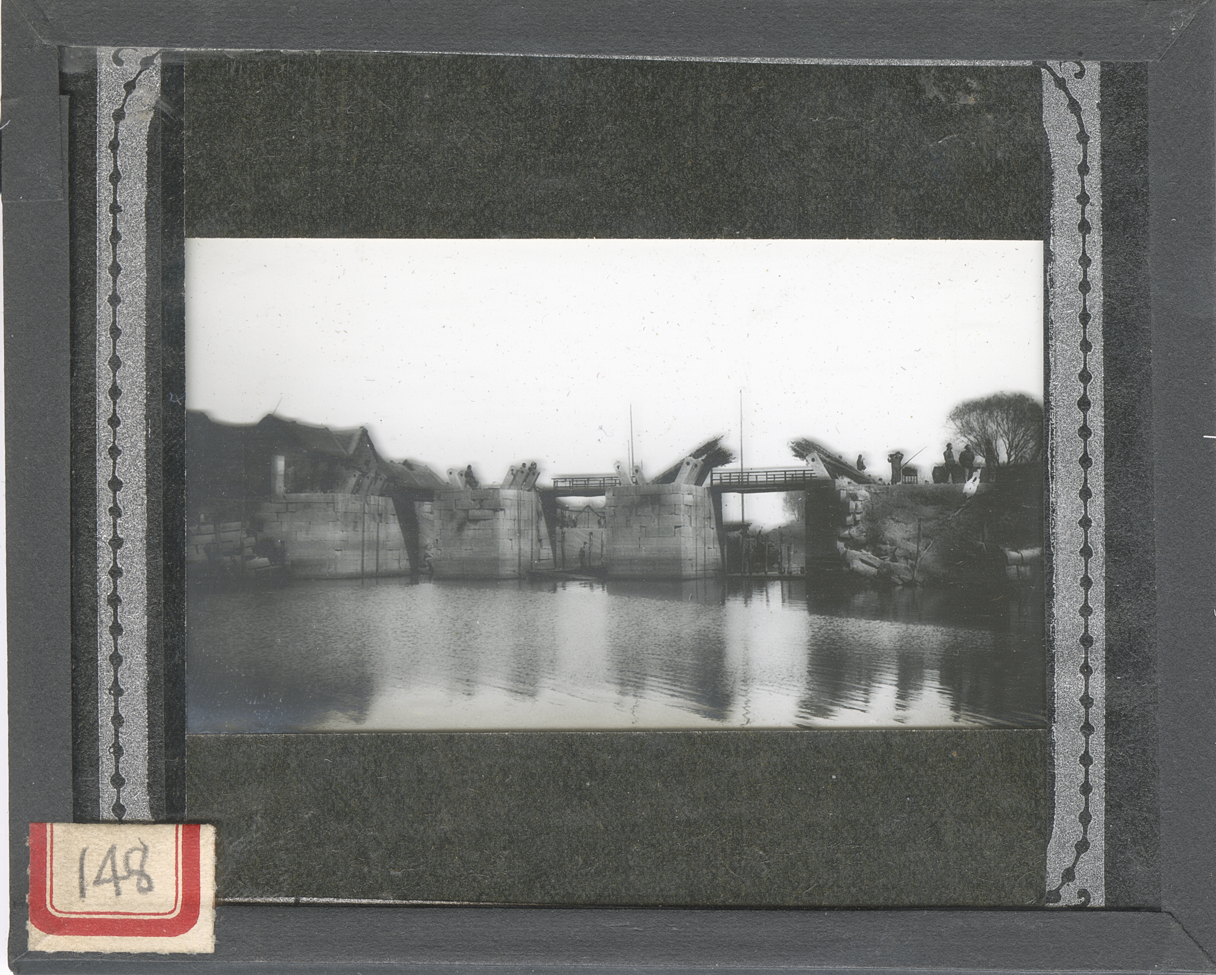
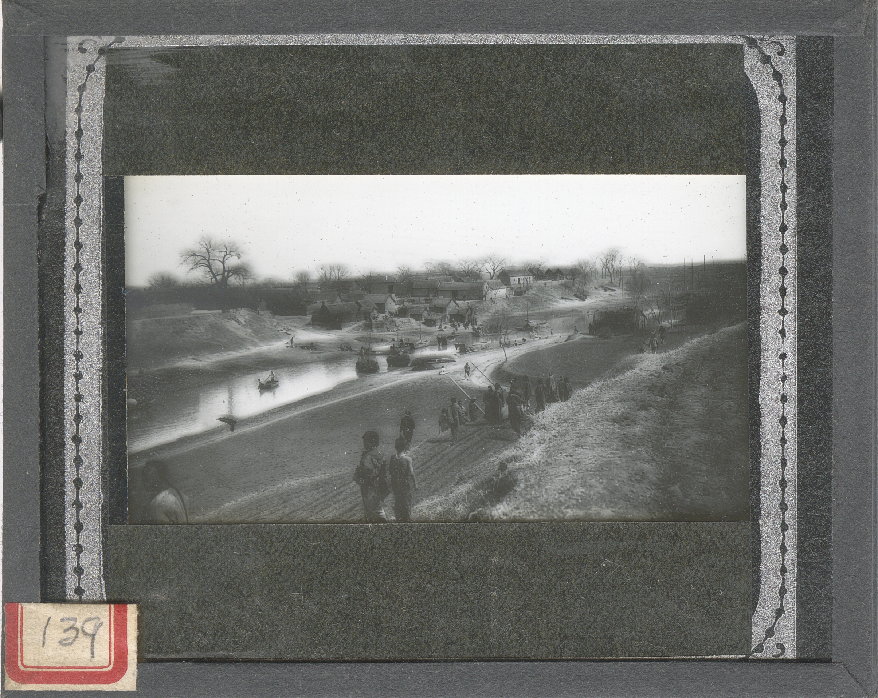
Photographs and Lantern Slides
Notes:
Additionally, the collection contains an abundance of photographic materials, including around 1,000 glass lantern slides documenting Merrill’s career and travels, as well as photographic prints and negatives. Around 150 of the lantern slides are of China and the Grand Canal. Pictured here is a collage of 8 black and white lantern slides that Merrill took around China, many showing the Yellow River and Grand Canal.

Slide 17
Biographical Notes (cont.)
Returned to Grand Rapids in 1921 and founded consulting firm Spooner & Merrill with Charles Spooner.
Merrill’s wife Lena passed away in 1933, and he remarried Audie Sinclair Weston in 1938.
Developed an abiding interest in archaeology and photography. Participated in expeditions in New Mexico, Alaska, Mexico, Italy, and Panama.
Merrill died in 1955.
Notes:
The couple returned to Grand Rapids in 1921 and he founded the engineering consulting firm Spooner & Merrill with Charles Spooner. Over the course of his life, he fostered an interest in archaeology and photography. He developed a camera rig that enabled top-down photography of excavation sites, and joined expeditions in New Mexico, Alaska, Mexico, Italy and Panama. Later in his life, he served on the Board of the Cranbrook Institute of Science, which also holds a small collection of his papers. His wife Lena passed away in 1933 and he remarried Audie Sinclair Weston in 1938. Merrill died in 1955.

Slide 18
Connect
Citations
Robert H. Merrill papers, RHC-222. Grand Valley State University Special Collections and University Archives. https://gvsu.lyrasistechnology.org/repositories/2/resources/837
“Grand Canal project --Final Report on Preliminary Surveys of Grand Canal.” Robert H. Merrill papers, 1902-1956 (RHC-222), Box 2, folders 5-7. Grand Valley State University, Special Collections and University Archives.
Tang, J., & Woudstra, J. (2018). The Chinese Grand Canal World Heritage Site: Living Heritage in the 21st century? (dissertation).
Ye, S. (2019). 'The Grand Canal in Republican China', Journal of the Economic and Social History of the Orient, vol. 62, no. 4, pp. 731-772. https://doi.org/10.1163/15685209-12341492
benefiea@gvsu.edu
GVSU.edu/Library/SpecialCollections
@gvsuarchives
Notes:
If this collection interests you, please feel free to get in touch or schedule a research visit. My target date for getting the digital collection of photographs online is in December of this year. Questions?

