Slide 1
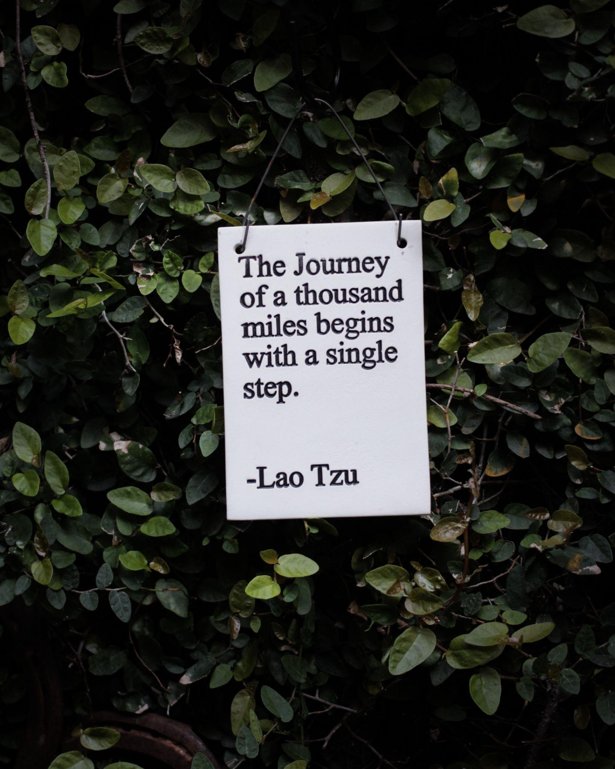
Moving from Learning to Active Accountability:
Inclusive Position Description Toolkit to Advance and Cement All Colleagues’ Work Towards a Just Library
CALM 2023
Annie Bélanger; Emily Frigo; Kristin Meyer; Jason Durham; Brian Merry; Joseph VanArendonk
Notes:
EMILY
Photo by Hester Qiang on Unsplash

Slide 2
Beyond GVSU’s Land Acknowledgement
GVSU’s Land Acknowledgement
https://www.gvsu.edu/oma/land-acknowledgement-54.htm
Collectively: Learning, questioning, reading, action
Emily Frigo: Unlearning, questioning, researching
Annie Bélanger: Before: reclaiming garden space for bees; Now: donations to Indigenous Organizations, institutional sponsor for American Indian Library Association
Jason Durham: Creating awareness, researching/learning
Kristin Meyer: Learning, reading, researching local organizations
Joseph VanArendonk: Learning, and donating to the NAEP (GRPS)
Notes:
EMILY
Based on the request of the CALM organizers, we are providing a link to our land acknowledgement (or see below) and we put our names on the slide to acknowledge how we are addressing the land acknowledgement. This was a humbling activity and we have more growth to make on this journey.
GVSU Land Acknowledgement:
Today, we would like to recognize the People of the Three Fires: the Ojibwe, Odawa, and Bodawademi peoples on whose land we are gathered on today. The Three Fires People are Indigenous to this land which means that this is their ancestral territory. Every university in this country was built on Indigenous land. We conduct land acknowledgments as a reminder of the histories, teachings, traditions, and the first people who originated here and who tend to Mshkiikii (land/earth) always.
We conduct these acknowledgments to be good visitors, as these were always done before colonial contact. To continue to be good visitors, we have the responsibility to learn about the history of settler colonialism and its impact on Indigenous people.

Slide 3
Agenda
Why is this work important?
Creating a shared baseline
Practical approaches to starting a project like this
Preparing to update/develop job descriptions
Practical tips for inclusive job descriptions
Living into inclusive job descriptions
Q&A
Notes:
EMILY

Slide 4
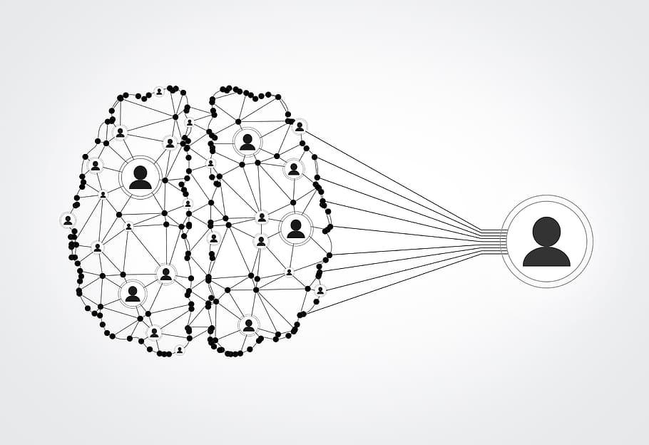
Join at slido.com #1617291
ⓘ Start presenting to display the joining instructions on this slide.
Notes:
EMILY
📣 This is Slido interaction slide, please don't delete it. ✅ Click on 'Present with Slido' and the joining instructions will appear when you get to this slide.

Slide 5
What are you hoping to take away from today's session?
ⓘ Start presenting to display the poll results on this slide.
Notes:
EMILY
📣 This is Slido interaction slide, please don't delete it. ✅ Click on 'Present with Slido' and the poll will launch automatically when you get to this slide.
We are asking this question to help us know where to focus content because we are going quickly for questions.

Slide 6
Why is this work important?
Notes:
About living our values. This integration makes it everybody’s work and ties it to accountability.
We also acknowledge that we are PWI. Over the last 5 years, we have moved from ~2% to ~13% BIPOC colleagues. Our leadership team is still currently all white and several hold other structurally excluded identities
Additional reasons:
Scaffolding:
Job responsibilities connect to our inclusive, high empathy hiring practices
Accountabilities connect to our annual performance reviews (performance management) and individual, departmental, and organizational goal setting
Growth orientation. In our work and annual reviews, we take a strength based, developmental approach to provide time for folks to build from year-to-year from awareness, learning, and towards action.
Part of generous element in “generous accountability”
Align with organizational and university priorities
In 2021, we adopted the MultiCultural Organizational Development model to guide our application of IDEA organizationally

Slide 7
How we got here
IDEA job-specific accountabilities included in some newly hired job descriptions, but many job descriptions are very out- of-date
IDEA-related required requirement(s) included in job descriptions for new hires
We are here!
Every employee has at least (1) IDEA-related goal in all annual planning and performance review documentation (often learning-based)
Developed toolkit to write more inclusive job descriptions. Work-in-progress: We are working on using the toolkit to update every job description
Notes:
KRISTIN
We wanted to give you an overview of our journey with this work and to share that our journey is still ongoing. We’re still learning and hope to continue to learn from all of you today, too.
For more than five years, we’ve included at least one Inclusion, Diversity, Equity, and accessibility-related requirement in job descriptions for new hires. One requirement that had been listed in many roles was “Develops and maintains the intercultural understanding and awareness required to work in a diverse workplace and serve a diverse population.”
Around five years ago, we had the Libraries-wide goal that every employee would have at least 1 IDEA-related goal in their annual planning and performance review documentation, and these were often learning-based. So an example might be “Attend an inclusive pedagogy workshop series.” I want to note here that we have three different employee types in our Libraries - library faculty, administrative professional staff, and professional support staff. While their annual planning and annual review processes are different, this goal was shared across all employment types.
A couple of years ago, we started including job-specific accountabilities into some newly hired job descriptions. An example of this for a cataloging position might be: “Actively seeks to update controlled vocabularies and other metadata to keep them in line with our commitment to IDEA.” This starts to articulate how specific roles might advance IDEA within their core job functions. Although we started to look for opportunities to add this into newly hired positions, many of our job descriptions for existing employees were really out of date.
That brings us up to where we are now. Last academic year a small task force created a toolkit for supervisors at all levels to write inclusive job descriptions for all employee types. And we’re currently working on using the toolkit to update every job description in our Libraries. Our hope is to have an updated and more inclusive job description that articulates specific IDEA accountabilities related to the role for every employee by the end of 2023. And after that, we hope to continue to use the toolkit as we write new and maintain existing job descriptions. As we’ve started to use the toolkit, we’ve already found things that we’ve changed, and we know that leading practices will continue to evolve, and it will be necessary for our toolkit to evolve over time, too.

Slide 8
Creating a Shared Baseline
Notes:
ANNIE
We want to set a shared baseline so that we can grow together. We will flex based on the poll results.

Slide 9
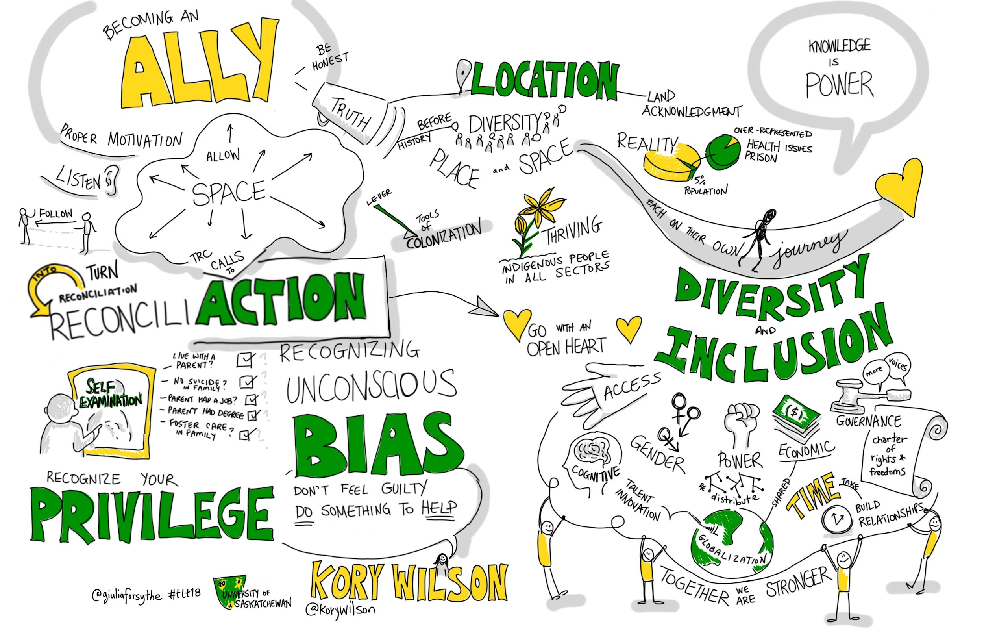
Inclusion Defined
The proactive effort through personal actions, programs, and policies to ensure that all individuals feel welcome, respected, supported, and valued.
Notes:
ANNIE
“Inclusion is the proactive effort through personal actions, programs, and policies to ensure that all individuals feel welcome, respected, supported, and valued. Inclusion should always integrate equity, which recognizes structural issues and barriers that have prevented the full participation of individuals from marginalized groups. Inclusion itself actively seeks to create more equitable structures and by extension, uplift voices that have been historically excluded.”
University of California Santa Cruz. (30, August 2022). What is meant by diversity, equity, and inclusion? https://apo.ucsc.edu/diversity.html

Slide 10
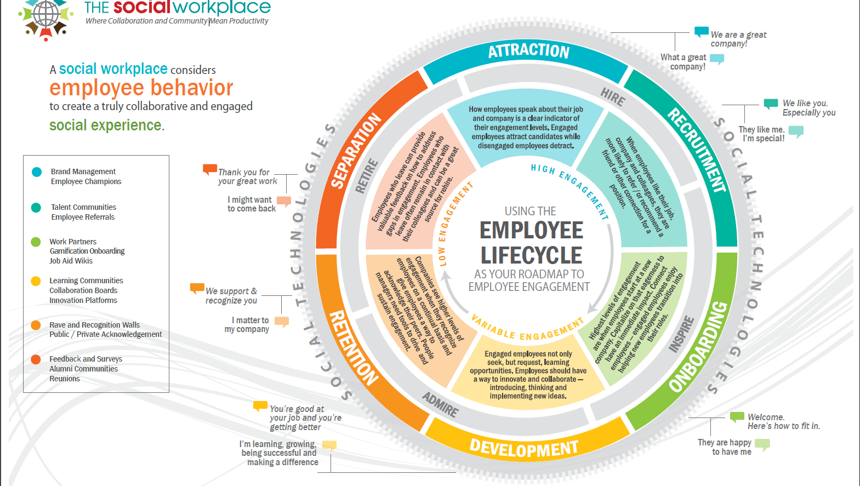
Notes:
ANNIE
The employee lifecycle model is a model used in organizational development and talent acquisition functions. It is used to identify the various critical stages that an employee goes through as they engage with an organization. The Social Workplace has created the graphic on the slide, which articulates the stages as well as the critical questions to consider in each stage from both the perspective of the manager and the employee.
Graphic credit: Elizabeth Lupfer, 2017, “Using the Employee Lifecycle as your Roadmap to Employee Engagement”, The Social Workplace: https://thesocialworkplace.com/2017/11/the-employee-lifecycle-is-your-roadmap-to-building-an-engaged-employee-experience/

Slide 11
Job Description Basics
Bridge between employer’s needs & employee’s understanding of the role
Typically include: title, key responsibilities, necessary qualifications/skills, working conditions, organizational culture, etc.
Used for recruitment, serve as a reference for performance management, compensation planning, and legal documentation
Align with institutional [and contract] requirements
The art of crafting job descriptions is evolving. We will dive deeper into this.
Notes:
JOSEPH
In simple terms, a job description is a bridge that connects the employer's needs to the employee's understanding of their job role. It’s crucial in the recruitment process to get this right.
In many ways, the job description is the job. That’s all applicants initially see, and they really make their application decision on, that's what they refer back to when making their final decision.
Job descriptions usually include the job title, key responsibilities, necessary qualifications, and skills. It also outlines the working conditions, and, importantly, gives a glimpse into the organization's culture.
The power of job descriptions doesn't stop at recruitment. They're also used as a guiding tool for setting expectations, and evaluation of an employee's performance. They also serve as the framework for compensation planning, and function as a legal document to comply with labor laws.
Job descriptions touch a lot more aspects of an organization than one may first realize. Therefore, it’s essential that they are created with an equity mindset, which could and should change the way we write and perceive job descriptions.
Job descriptions are an art, which has and is evolving.

Slide 12
Should a job description focus on outcomes, process, or both?
ⓘ Start presenting to display the poll results on this slide.
Notes:
EMILY
📣 This is Slido interaction slide, please don't delete it. ✅ Click on 'Present with Slido' and the poll will launch automatically when you get to this slide.

Slide 13
Responsibility vs Accountability
Responsible for tasks
Accountable to self and to others
Acceptance: consenting to receive or undertake something offered
Obligation: accepting the binding power of promise
Ownership: taking responsibility for an idea or problem
Answerability: explaining actions or decisions.
Choice: making a decision when faced with two or more possibilities
Commitment: being emotionally compelled to an agreement or responsibilities
Notes:
ANNIE
Shannon Perez-Darby share this definition that, “Accountability is taking responsibility for your choices and the consequences of those choices.” Connie Burk frames accountability as “an internal resource for recognizing and redressing harms we have caused to ourselves and others”. Within the context of organizations, accountability emcompasses fulfilling job responsibilities as well as impact on the workplace culture. BetterUp Blog defines accountability as “the recognition and acknowledgment of our responsibilities, and being answerable for the outcomes of our actions, decisions, and mistakes.” (https://www.betterup.com/blog/accountability-vs-responsibility-for-leaders-going-back-to-the-basics)
We are responsible for things and we are accountable to people, but both are a conscious choice that comes from within.

Slide 14
Required vs Preferred Qualifications: Mental Models
ORD: objective, relevant, demonstrable
Required: non-negotiable and not easily teachable. Minimum skills, education, ability a candidate must have to perform a job effectively within the first 1-3 years
Preferred: “nice to have.” They could enhance a candidate’s ability to excel, but absolutely not essential for job performance. Should be explicitly described as desirable but NOT barriers to application
Most job descriptions have way too many of both. Narrowing them down is half the battle...
Notes:
JOSEPH
Firstly, they should be Objective, meaning they're rooted in fact and not influenced by personal feelings or opinions. They are based on measurable attributes.
Secondly, they should be Relevant, directly related to the job responsibilities.
And finally, they should be Demonstrable. Candidates should be able to prove or show these qualifications.
Required qualifications are non-negotiable and are often not easily teachable. They represent the minimum set of skills, education, and abilities a candidate must have to perform a job effectively within the first one to three years. We point out 1-3 years for two reasons: one, it will probably help you narrow them down, and two, in creating a job description, you need to focus on relevant requirements, not ones you think might be applicable down the road. Required qualifications then, are designed to perform a filtering function, helping to pare the list down to the most suitable applicants.
Preferred qualifications, often seen as "nice to haves," could enhance a candidate’s ability to excel, but they're not essential for job performance. And if possible, this should be spelled out within the JD itself. Something about them being desirable, but that they should NOT be perceived as barriers to application. Overall, many job descriptions have too many of both, which could lead to unintended bias and exclusivity.
Practicing minimalism in listing qualifications can promote inclusivity. By focusing on the core skills and knowledge truly needed for a role, AND being open to how candidates may have acquired these (through formal education, self-learning, or transferable skills from different but relevant experiences), employers can attract a far more diverse range of applicants.
So narrowing qualifications down is half the battle. And this starts from examining everything from the top down. Ask yourself what are the core responsibilities and accountabilities of this position? What are my organization’s values? What are the strengths and weaknesses of my current team? And, importantly, crucially, what qualifications are realistic given the level of the role, salary, and the current market conditions?

Slide 15
Things to Watch Out For in Required Qualifications
Ask yourself “Why?” if you notice...
Specific degree with no equivalency
High number of years of experience
Full-time availability with no flexibility
Subjective/vague qualifications
Avoid “stacking” qualifications, or exclusively centering a new job description on current/former incumbent.
Notes:
JOSEPH
I invite you to ask yourself “why” if you notice the following. "Specific Degree with No Equivalency": Ask yourself: Is the specific degree absolutely essential for the role, or could similar knowledge and skills be acquired through other means? This can create a barrier for people who may not have had the opportunity to earn the specific degree, but who have gained skills and knowledge through work or life experience. So if you’re going to ask for a specific degree or study, perhaps add "Or Equivalent Experience" as a possible alternative.
"A High Number of Years of Experience": Reflect on this: Is the number of years' experience required directly related to the complexity or level of responsibility of the role, or could someone with fewer years but high-quality experience be just as capable? This could potentially exclude younger candidates, career switchers, or those who have taken time out of the workforce, such as for family or health reasons.
"Full-Time Availability with No Flexibility": Consider this: Is full-time availability with no flexibility truly necessary for the role, or could tasks and responsibilities be managed effectively with a more flexible schedule? This can be detrimental to individuals who may have caregiving duties, or perhaps chronic illness.
Avoid “stacking” qualifications, or exclusively centering a new job description on the current or former incumbent. Each time you fill the role, you need to holistically reexamine the job description, instead of tacking on more things to an existing one. Every candidate brings unique experiences and skills, and the job description should be designed to welcome this diversity, not deter it.

Slide 16
Inclusive Language - Making Adjustments
Use inclusive pronouns
Avoid gender-coded words
Avoid -ism language, such as racist, ageist or ableist language
Reconsider “years of experience”
Notes:
JOSEPH
Photo by Mantas Hesthaven on Unsplash
Avoiding Gender-Coded Words: The language in job descriptions should not imply a preference for a particular gender. This includes using inclusive pronouns like “you,” “they/them” “people” instead of “he” or “she,” but also excluding words like "rockstar," "ninja," or "dominate," often perceived as masculine-coded.
Reconsider 'Years of Experience': Years of experience doesn't always directly translate into skill level or proficiency. Instead of strictly requiring a certain number of years of experience, some companies are providing necessary training or exploring alternative qualifications.
Avoiding Ageist/Ableist Language: Ageism can be an issue in job descriptions when phrases that suggest an age preference, like "enthusiastic and agile," are used. Instead, focus on describing the pace or environment of the job without implying a specific age bracket for or ability of the candidate.

Slide 17
Interactive Moment
What is problematic here?
MadeUp Libraries are looking for an energetic, professional, and committed individual for their Cataloguing & Metadata Librarian.
[...]
Strong English language skills, including being clear spoken
Ability to lift 50 lbs
Notes:
ANNIE
Share in the chat

Slide 18
Interactive Moment
Answer Key
MadeUp Libraries are looking for an energetic, professional, and committed individual for their Cataloguing & Metadata Librarian.
[...]
Strong English language skills, including being clear spoken
Ability to lift 50 lbs
Notes:
ANNIE
Answer Key
Energetic is ableist, and unnecessary for this role
Professional is subjective and white-centered
Strong English language skills is racist and anti-immigrant
Ability to lift 50 lbs is ableist and too high of a weight for this role

Slide 19
Getting Started on a Similar Project
Notes:
EMILY

Slide 20
Shared Engagement Plan
Bring together key people
Who will be the most impacted?
Look at engagement through a couple of lens
by employee class (faculty, staff, student)
job responsibilities (student supervision, management, etc.)
Related projects (inclusive student hiring taskforce)
New hires
Consultation via synchronous and asynchronous communication tools
Synthesis: connect to related, ongoing work
Notes:
Emily:
Project charter and engagement Plan: (who, what, when, how)
goals, deliverables, timeline, colleagues on committee, responsibilities, colleagues to be consulted
Synthesize- bring together key people and work that is currently be doing (project doesn’t occur in a vacuum). Who will be most impacted, directly or indirectly?
Find recently revised position descriptions (typically new hires)
Inclusive student task force (active, doing ongoing work)
Annie, our dean involved with larger campus efforts (network of advisors) and created inclusive hiring practices

Slide 21
Developing standardized language
Uniform competencies and accountabilities for:
student supervisor
supervisor
practicum and adjunct supervisor
Updated department head accountabilities
Standard IDEA language for qualifications by employment classification
Removed expectations of professional behavior
Notes:
EMILY
Interest was greatest around student colleagues (taskforce working on it when this project started) and expectations on professional behaviors (dated, boilerplate language that was in everyone’s position description). It was created about 11 years ago and had 11 bullet points. Removed former ‘expectations section” because “professional behaviors” problematic, white-coded workplace expectations, and in general, bullet points had vague language that was redundant to other content in position descriptions. Only one bullet point was kept but modified: “protects user privacy.”
We have 2 standard IDEA bullet points additional IDEA language in ‘essential functions’ and embedded in specific job responsibilities.

Slide 22
IDEA Qualifications
Required for Administrative Professional and Faculty positions:
● Demonstrated the intercultural understanding and awareness required to work in a diverse workplace and serve a diverse population to contribute to a healthy, inclusive working and learning environment.
● Demonstrated commitment and action to inclusion, diversity, equity, and accessibility.
Notes:
EMILY
We have 2 standard IDEA bullet points additional 3 IDEA bullet points in ‘essential functions’ and embedded in specific job responsibilities (i.e. job specific example for someone who works with metadata: “Actively seeks to update controlled vocabularies and other metadata to keep them in line with our commitment to IDEA.”)
Qualifications are paired with IDEA-specific accountabilities within each role. Accountability structure for
IDEA includes job accountabilities, goals, supervisor 1:1, and annual review processes.
IDEA Qualifications4
Required for Administrative Professional and Faculty positions:
● Demonstrated the intercultural understanding and awareness required to work in a
diverse workplace and serve a diverse population to contribute to a healthy, inclusive
working and learning environment.
● Demonstrated commitment and action to inclusion, diversity, equity, and accessibility.
Page 12 of toolkit:
For all Administrative Professional and Faculty positions:
As a member of the University Libraries:
● Aligns with and upholds University Libraries values in action and protects user privacy.
● Demonstrates the intercultural understanding and awareness required to work in a
diverse workplace and serve a diverse population to contribute to a healthy, inclusive
working and learning environment.
● Actively contributes to the Libraries’ Inclusion, Diversity, Equity, and Accessibility
Commitment.
IDEA Qualifications4
Required for Administrative Professional and Faculty positions:
● Demonstrated the intercultural understanding and awareness required to work in a
diverse workplace and serve a diverse population to contribute to a healthy, inclusive
working and learning environment.
● Demonstrated commitment and action to inclusion, diversity, equity, and accessibility.

Slide 23
Preparing to Develop or Update Job Descriptions
Notes:
KRISTIN

Slide 24
Considerations for planning
Factors to consider:
Is there an incumbent?
Has a vacancy occurred?
Has there been a workload reassignment?
Is it a new position?
Should an update occur before a personnel action, like a contract renewal or tenure promotion process?
If there’s an incumbent:
Explain why you’re updating the job description
Check in with them on where the current position description is accurate, what is no longer relevant, and what might need to be added. Considering crafting structured dialogue prompts to share in advance.
Position descriptions that are very out-of-date will require more engagement time with the incumbent than position descriptions that require only minor changes
Notes:
KRISTIN
Your planning will look different depending on whether there is an incumbent in the role, if a vacancy has occurred, or if you’re writing a job description for a new role. If there’s an incumbent, it will be important to explain why you’re updating the job description, and you’ll want to check in with them to get their insights about where the position description is accurate, what is no longer relevant and what might need to be added. Consider crafting structured dialogue prompts to share in advance. Position descriptions that are very out-of-date will require more engagement time with the incumbent than position descriptions that require only minor changes, so we’ve found that to be an important consideration as you think about a timeline for this work.

Slide 25
Assessing Work and Organizational Needs
Review the current and emerging needs of the organization, department and/or team
Consider scanning position postings from other institutions for inspiration
Consider what responsibilities require similar skill sets - pairing these together in one role can support success
While you’ll want to play to the strengths of the individual within a role, balancing this with organizational needs is important
Notes:
KRISTIN
Before you write or update a job description, you’ll also want to take some time to assess work and organizational needs. There are a lot of ways you could do this, and this could probably be a whole separate presentation, but we want to note that when you’re writing or updating a job description, this could be a good time to think holistically about the current and emerging needs of the organization, department, and/or team. I also like to get inspiration by scanning position postings from other institutions. And as you start to uncover new and emerging needs, it’s important to think about what skill sets specific responsibilities require - pairing together in one role responsibilities that have similar skill sets can support success. A presenter earlier this week referred to roles that have disparate responsibilities as a “Franeken-job” which really resonated with me. I’ll drop the link to that presentation in the chat in case you missed it - it was really excellent. And, finally, while you’ll want to play to the strengths of an individual within a role, balancing this with organizational needs is important.

Slide 26
Plan for sustainability over time
Make it an annual practice to check in with employees to see if the job description is still reflecting their work
Consider 30-40% new as a threshold for revision
Consider adding any new, sustained duties
A routine revision schedule might be every 2-3 years with a rotating schedule among departments
Empower individuals to request an off-cycle review of their role if they believe there has been significant change or if there is a concern about workload or classification level
Notes:
KRISTIN

Slide 27
Practical Tips for Inclusive Job Descriptions
Notes:
KRISTIN

Slide 28
Writing it
Write in a concise, direct style
Use the simplest language possible
Avoid abbreviations and acronyms
Use descriptive action words - participate, collaborate
Include only relevant duties and accountabilities
Limit number of qualifications
Consider how to broaden the language beyond libraries or your specific library
Notes:
KRISTIN.
Photo by Cytonn Photography on Unsplash

Slide 29
Apply an Equity Lens
Sample Equity Lens Questions:
Who is affected—positively, negatively, or not at all—by the way this job description is written?
Are our mission and values explicitly articulated in the job description?
Have we removed gendered/ableist/racist language from our job descriptions?
Are the working conditions reflective of the role’s reality? If there are physical requirements, are they truly the minimum requirements that cannot be accommodated further?
Set of questions to help organizations make deliberately inclusive decisions
Draws explicit attention to inclusion and equity
Adapted for different focuses
Does not tell you what action to take, but prompts reflection
Center for Nonprofit Advancement. 2020. What is an Equity Lens? https://www.nonprofitadvancement.org/files/2020/12/What-is-an-Equity-Lens.pdf
Notes:
KRISTIN
The purpose of an equity lens is to be deliberately inclusive as an organization makes decisions. It introduces a set of questions that help the decision makers focus on equity in both their process and outcomes. It is explicit in drawing attention to the inclusion of marginalized populations, typically communities of color and Indigenous communities, and can be adapted to focus on other communities. An equity lens will not tell you what action to take. Rather, the lens helps you discuss and reflect on the equitableness of the action and decision-making process.
For each stage of the process, answer the following questions before and after to ensure that you are centering inclusion, equity, accessibility.

Slide 30
Living into inclusive job descriptions
Notes:
JASON

Slide 31
Create Equitable Processes
Use an equity lens before, during, and after the stages of the job description process
Ensure all managers are positioned to be inclusive supervisors
Anchor job description requirements in department and organizational needs as well as values
Utilize and equity lens
Only include components required to be successful
Ensure engagement, explanation, and shared expectations clarification for the supervisor and incumbent
Human rights icons created by Freepik - Flaticon
Notes:
JASON
Use an equity lens before, during, and after the stages of the job description process
To ensure staying consistent, ensure that equity lens is applied throughout the entire process, on an ongoing basis.
Ensure all managers are positioned to be inclusive supervisors
Do so by ensuring that they have access to needed supports
Anchor job description requirements in department and organizational needs as well as values
Utilize an equity lens
Purpose of this is to be deliberately inclusive as the organization makes decisions
Answer the following questions before writing your job description to ensure that you are centering IDEA in the process:
Who is affected—positively, negatively, or not at all—by the way this position is written?
Are our mission and values explicitly articulated in the job description?
Have we removed gendered/ableist/racial language from our job descriptions?
These are just a few of the questions, more can be found in our toolkit
Only include components required to be successful
unrealistic expectations will not only limit your pool of potential candidates by discouraging some from applying but will set up the individual hired for possible failure
Ensure engagement, explanation, and shared expectations clarification for the supervisor and incumbent

Slide 32
Learning & Development
Have a plan
As an organization
Individual
Have resources available to share
Notes:
JASON
Photo by Trent Erwin on Unsplash
To be successful have a plan in place for how you’ll support your organization and individuals in this process.
Are there trainings, learning opportunities or supports you want everyone in the organization to have so they’re aware of the overall goals and giving them greater understanding
Are there more specific learning opportunities you want direct supervisors, or those writing job descriptions to have so they have an even deeper level of understanding
To be able to grow and provide opportunities, you have to be willing to commit resources to the process. Those resources could be:
Lists of existing trainings, articles/books, access to consultants you have available to share with people in the organization
Resources could be in the form of available funds for people to attend trainings or conferences.
One way to know what an organization is committed to is by looking at their budget. If they were undertaking a similar project as this but were not setting aside resources to support it, then i would suggest the commitment isn’t that great.

Slide 33
Check In
Utilize both formal and informal methods
Review role and job description during annual review
Notes:
JASON
Photo by Christina @ wocintechchat.com on Unsplash
Every organization is different. Some are more formal than others. No matter the approach, make sure you’re touching base with those that are impacted.
What’s working, what’s not working. Discuss as a team and individually.
Everyone has a different perspective so make sure you’re hearing those and making adjustments as needed.
A great time to review individual roles is during the formal annual review process.
During this time talk to the incumbent and go over the job description with them.
Does this still accurately reflect what you’re doing?
What changes need to be made?
Are there any workload issues?
While doing so, remember to keep in mind the equity lens

Slide 34
Inclusive Job Description Toolkit
Toolkit
Templates
Implementation Planning Guide
CCNCBY: http://bit.ly/40wbVJ8
Created by Emily Frigo; Annie Bélanger; Kristin Meyer; Jason Durham; Brian Merry
Notes:
JASON

Slide 35
Related project resources:
IDEA Statement: https://www.gvsu.edu/library/idea-inclusion-diversity-equity-and-accessibility-84.htm
Project Charter
Participatory engagement model
All other references are included in toolkit.

Slide 36
Q&A
Annie Bélanger: belange1@gvsu.edu
Jason Durham: durhamja@gvsu.edu
Emily Frigo: frigoe@gvsu.edu
Kristin Meyer: meyerkr@gvsu.edu
Joseph VanArendonk:
vanarejo@gvsu.edu

