Slide 1
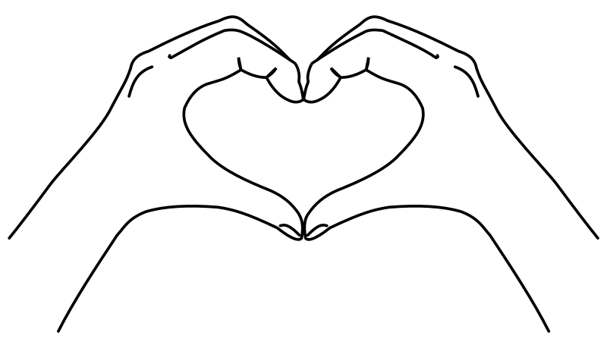
C.A.R.E.: Practical Tools for Sustaining Care, Accountability, and Radical Empathy in Difficult Times
OLA Community-Led Event
Sarah Beaubien, Annie Bélanger, & Meghan Musolff
June 2023
Notes:
SARAH
Abstract:
Join us to explore care, generous accountability, and radical empathy in our public libraries for one another and for our users. Together, we will dig into practical tools to enhance engaged, effective communications to sustain user-focused practices while meeting our own needs. We will engage in a dialogue to explore ways we can continue to meet the needs of users in difficult times while setting and upholding healthy boundaries. The presenters will share some self-reflective pre-work ahead of the session as well as a dialogue guide to use locally after the session.
Learning Outcomes:
Understanding of care, generous accountability, and radical empathy
Practical tools for empathetic listening, feedback loops, and setting boundaries
User focus through difficult times

Slide 2
Learning Outcomes Our Commitments
Understanding of care, generous accountability, and radical empathy
Practical tools for empathetic listening, feedback loops, and setting boundaries
Maintain a user focus through difficult times
Bring a user-focus to our work and services
Uphold the mission of public libraries
Are committed to strong working relationships with colleagues
Notes:
SARAH

Slide 3
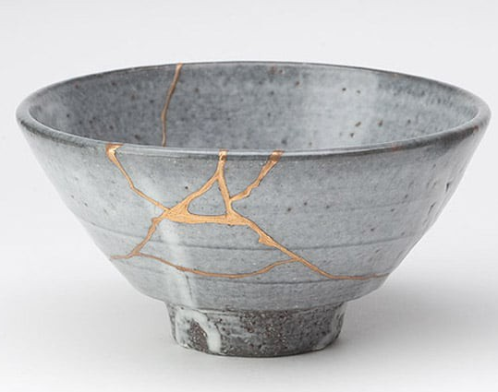
The wound is where the light enters ~ Rumi
The crack is where the light gets in. ~ Leonard Cohen
Rarely, if ever, are any of us healed in isolation. Healing is an act of communion. ~ Bell Hooks
Notes:
SARAH
Libraries are places of trauma lately. Each crack needs to be nurtured, healed, and celebrated for making us who we are. Kintsugi ("golden joinery"), also known as Kintsukuroi ("golden repair"), is the Japanese art of repairing broken pottery by mending the areas of breakage with lacquer dusted or mixed with powdered gold, silver, or platinum. As we consider how to fix the cracks, it is our values and our purpose that centers our work. It is in coming together that we are better. We had you think about your personal values and your why to center us in today’s topic as any work towards others starts from self.

Slide 4
Why Care & Compassion?
“You have to have compassion because it gives you the juice, the power, the passion to move”
~ Buddhist Joanna Macy
We are all whole people, in and out of work
In the chat: Share your most important value and what it means to you
Notes:
SARAH

Slide 5
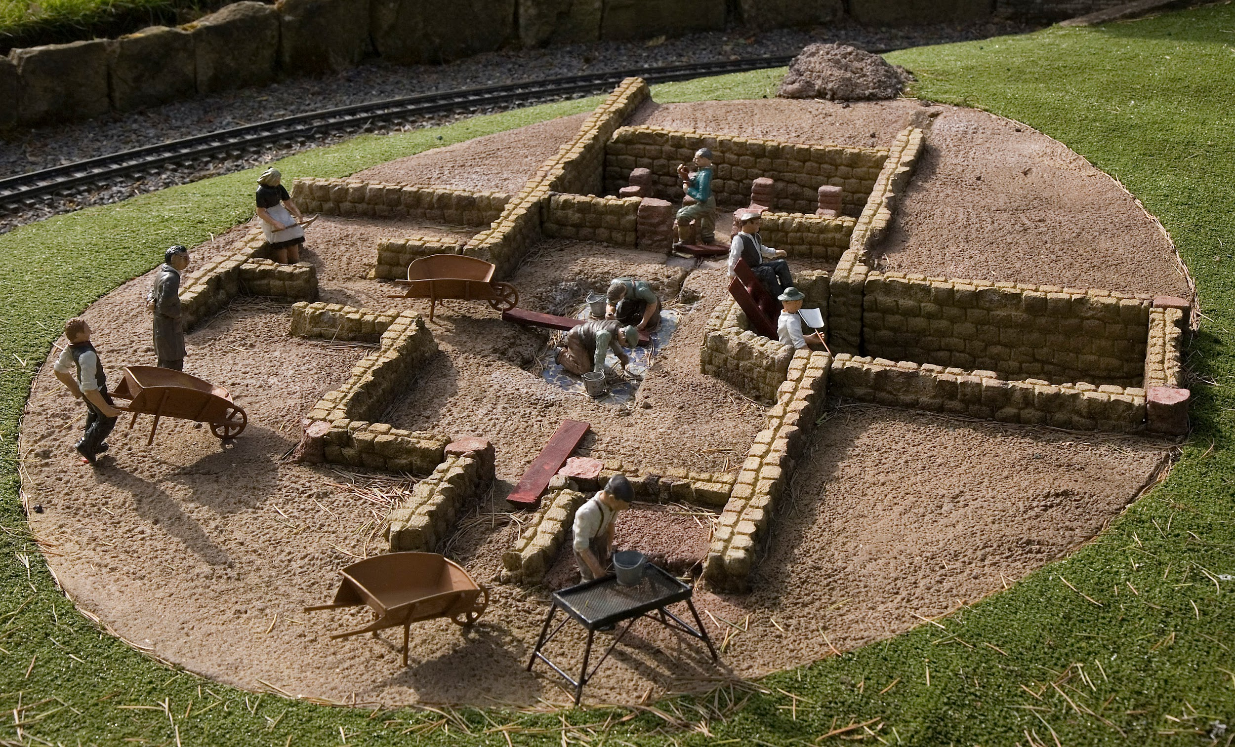
Foundational Ideas
Notes:
ANNIE

Slide 6
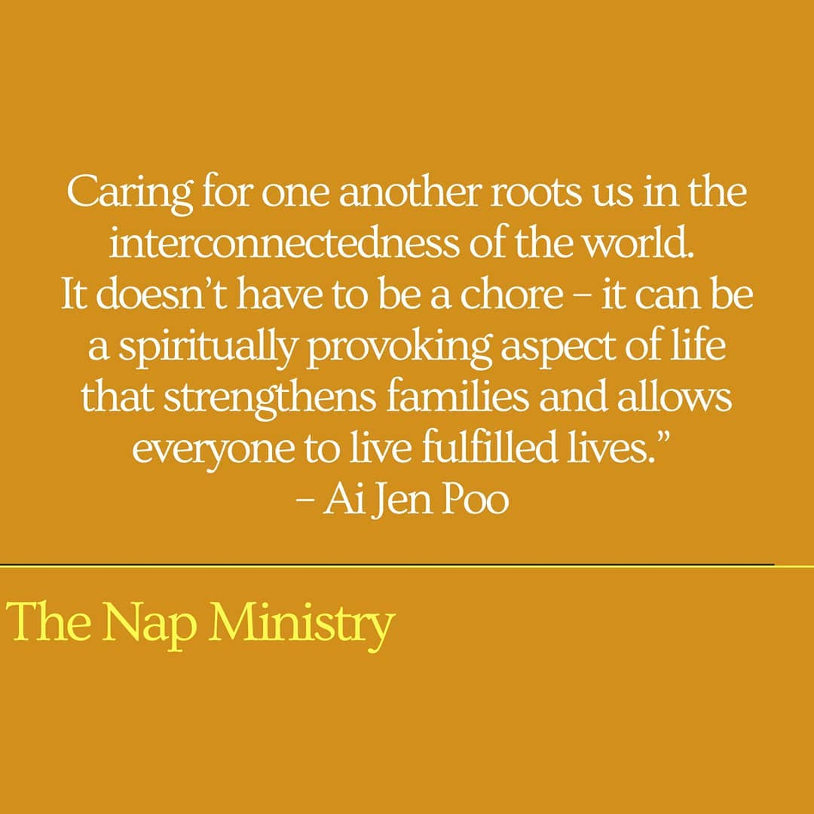
Care
For self
For our users
For our colleagues
Caring for others should not be in sacrifice of our needs
Upholding boundaries is an act of care
Discomfort does not prevent care
Notes:
ANNIE
Vocational Awe

Slide 7
What is Generous Accountability?
Acceptance: consenting to receive or undertake something offered
Obligation: accepting the binding power of promise
Ownership: taking responsibility for an idea or problem
Answerability: explaining actions or decisions.
Choice: making a decision when faced with two or more possibilities
Commitment: being emotionally compelled to an agreement or responsibilities
We are accountable to self and to others
Notes:
Annie
Shannon Perez-Darby share this definition that, “Accountability is taking responsibility for your choices and the consequences of those choices.” Connie Burk frames accountability as “an internal resource for recognizing and redressing harms we have caused to ourselves and others”. Within the context of organizations, accountability emcompasses fulfilling job responsibilities as well as impact on the workplace culture.
You are responsible for things and you’re accountable to people, but both are a conscious choice that comes from within.
How might we bring care to the accountability that we have for one another? For our users?

Slide 8
Radical Empathy
“To actively consider another person's point of view in order to connect more deeply with them"
Multi-dimensional
Balanced with candor and compassion
Fosters:
Genuine connections
Feelings of belonging
Greater levels of trust
Wellbeing
Motivation
Shared understanding
Notes:
Annie
Empathy is the ability to understand and share the feelings of another. Empathy includes both cognitive (aka intellectually) and emotional (aka shared emotions) empathy. “Radical empathy is a concept that does exactly that – it encourages people to actively consider another person's point of view in order to connect more deeply with them.” Today, this trait enables us to see and understand another person's point of view. https://www.happiness.com/magazine/relationships/radical-empathy-extreme-what-is-it/#:~:text=%E2%80%9CRadical%20empathy%20is%20a%20concept,another%20person's%20point%20of%20view.
Asking the right question, listening, and communicating back what you heard can help make these conversations easier. You’ll be able to create a safe space for vulnerability to exist, and hopefully, that will result in a more inclusive culture.”
Empathy is a great way to build connection and supportive collaborations. It is important to note that the goal is here is to build engagement. Empathy should inform a sense of radical accountability, that is centred on the goals and values of an organization for diversity, equity, and inclusion that fosters our belonging.
https://www.linkedin.com/pulse/importance-empathy-how-fuels-diversity-equity-success-gill-ccwp/

Slide 9
What Empathy is NOT?
Sympathy
Agreement
Disconnection
Walking in someone’s shoes
Tolerating abusive behavior
Notes:
ANNIE
Image is from Grammarly article
Empathy is NOT sympathy
Sympathy is characterized by sentiments of pity for another person, yet without fully comprehending what it feels like to be in their shoes
It is a form of disconnection: when someone says, "I feel sorry for you", "That is terrible", they are placing distance
Empathy says, "me too", "I get it" versus "NOT ME" , "We feel bad for you”
Requires you to be present in someone's pain
Those not willing to do that, it's not real empathy
Switch from "walking in someone's shoes"
Learn to listen to the story without being in their shoes
“Walking in someone’s shoes” places you, the listener, at the center of the story instead of the speaker
Believe it even if it doesn't match your experiences

Slide 10
Limits to Care and Empathy
“Vocational awe describes the set of ideas, values, and assumptions librarians have about themselves and the profession that result in notions that libraries as institutions are inherently good, sacred notions, and therefore beyond critique.”
~ Fobazi Ettarh
(https://www.inthelibrarywiththeleadpipe.org/2018/vocational-awe/)
Caring for others cannot be at the cost of sacrificing ourselves
Empathy does not mean we allow our safety to be compromised or our boundaries to be trampled
Care and empathy does not excuse bad behavior
Harm is in the eye of the beholder
In the chat: What other limits should we collectively uphold?
Notes:
ANNIE

Slide 11
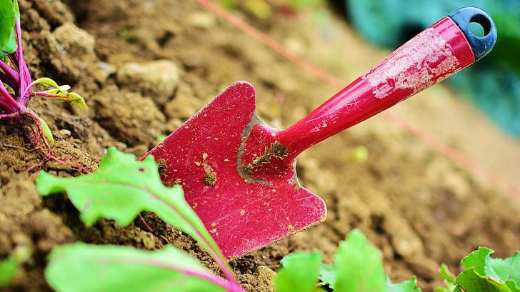
Let’s Get Practical
Notes:
Sarah

Slide 12
6 Steps to Radical Empathy
Just because you empathize with someone does not mean you are taking their position, and you may still disagree with them, [...] But showing empathy means you are willing to listen and develop that relationship.
~Dr. Terri Givens
A willingness to be vulnerable
Becoming grounded in who you are
Opening yourself to the experiences of others
Practicing empathy
Taking action
Creating change and building trust
Notes:
Sarah https://www.keuka.edu/blog/dr-terri-givens-offers-lessons-radical-empathy-during-keuka-college-appearance#:~:text=She%20also%20outlined%20her%20Six,creating%20change%20and%20building%20trust.

Slide 13
Empathetic Listening
“The truly good listeners of the world do more than just listen. They listen, seek to understand, and then validate. That third point is the secret sauce—the magic ingredient” ~Sorensen
Happens when the listener exerts sincere intention for understanding other people’s values, opinions, and ideas.
Does not mean you have to agree with everything you hear
Is an effort to truly shift out of one's own and limited frame of reference
Active listening +++
Notes:
Sarah
Psychologist Carl Rogers wrote, "Real communication occurs when we listen with understanding - to see the idea and attitude from the other person's point of view, to sense how it feels to them, to achieve their frame of reference in regard to the thing they are talking about." Listening with empathy allows us to create connection and new understanding.
“Empathetic listening asks you to go beyond the surface of what is being said to unpack why and how it’s being said and get to know someone’s emotional experience—and empathize with it.”
Not only is empathetic listening a mindset and philosophy. It is active listening on a new level in order to:
Build trust and respect
Develop stronger understanding
Hear the words and the emotion
Validate feelings, without needing agreement
Encourage the surfacing of information
Create an environment that is conducive to collaborative problem solving

Slide 14
3 Levels of Empathetic Listening
Cognitive Empathy
Emotional Empathy
Compassionate Empathy
Being able to know how another person is feeling and what they are thinking.
Which occurs when you absorb the feelings of another person, often leading to a physical reaction.
Understanding someone’s situation, feeling for them, and being driven to help.
Sounds like:
Have you tried reaching out for support? Sometimes Office X can help with this.
Sounds like:
Is everything ok?
Sounds like:
What’s going on? How can I help?
Notes:
Sarah https://charityvillage.com/empathy-a-key-ingredient-in-effective-diversity-equity-and-inclusion/

Slide 15
Advocacy & Inquiry
Inviting Inquiry
Inviting and accepting questions from others to prompt deeper understanding and creative collaboration
Self-Advocacy
Asking others to consider your point of view, act on your expressed needs
Advocacy: Stating one’s view to increase understanding, encourage support, or influence an outcome
Inquiry: asking a question to invite, listen to, and understand others’ perspectives
Inquiring of Others
Proactively inviting another’s point of view; authentically exploring what’s been shared
Advocating for Others
Inviting others to share ideas, give credit, introductions, and supporting credibility
Notes:
SARAH
“Advocacy is stating one’s views. Describing what I think, disclosing how I feel, expressing a judgment, urging a course of action, and giving an order are all forms of advocacy. Inquiry is asking a question. With genuine questions, the speaker seeks information. Rhetorical or leading questions are a kind of advocacy in disguise.” https://thesystemsthinker.com/productive-conversations-using-advocacy-and-inquiry-effectively/
“Self-Advocacy happens when you ask others to consider your point of view or act on your expressed needs. Note that I say “expressed needs.” Self-advocacy requires that you are able and willing to share with at least one person what you want or need in a way that clarifies for them the actions they can take to support you.
advocating for others happens when you invite another person to share their ideas, you give credit to a person for their contributions, out loud, or you take the initiative to introduce someone to others who may not know them as a way of helping them broaden their network or because you know that by virtue of your reputation you can help them establish credibility.
Advocating for others is most helpful when you have more power or privilege than those in the group and can use that privilege to open a door, make sure credit is appropriately placed, or extend your privilege to someone who may not be otherwise given access to a particular group.”
https://blog.deettajones.com/blog/advocacyandinqury

Slide 16
Emotions in Dialogue
Emotions lie at the heart of language
Language is a whole-body activity
Emotions are both personal and social
Significant human needs surface when people disagree.
~ Makau & Marty
Notes:
ANNIE
(1-2 mins)
Emotions lie at the heart of language
Langue is a whole-body activity
Emotions are both personal and social
(Social) In dialogue, emotions help people to connect, build understanding, and make meaning
(Personal) Emotions and feelings are embodied
Emotions are bodily, cognitive, relational
A few words about strong emotions–being overcome, emotional regulation (esp. w/ regard to issues of identity)
“A self more present with its feelings is a self more in tune with the, sometimes contradictory, demands of the social world.” (Burkitt, 2018) https://eds.p.ebscohost.com/eds/detail/detail?vid=26&sid=72253547-7da7-4298-a843-e7010ebf9adc%40redis&bdata=JkF1dGhUeXBlPWlwLHNzbyZzaXRlPWVkcy1saXZlJnNjb3BlPXNpdGU%3d#AN=129512126&db=asn
And
Stains Jr., R. R. & Sarrouf, J., (2022) “Hard to say, hard to hear, heart to heart: Inviting and harnessing strong emotions in dialogue for deliberation”, Journal of Deliberative Democracy 18(2). doi: https://doi.org/10.16997/jdd.979

Slide 17
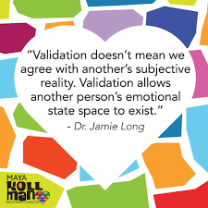
Validation
Show interest in the other person: through verbal and nonverbal cue
Use an accurate reflection
“Read” into a person’s behavior to imaging what they could be feeling, thinking and wishing. Check-in, don’t make assumptions
Validate the behaviors in terms of past and present events as triggers
Communicate what is reasonable, meaningful, and effective in the behavior.
Treat the person as valid
Notes:
ANNIE
Validating feelings means acknowledging the humanity and validity of someone’s feelings.
It does not mean that you agree with them, or that you would condone negative behaviors
related to the feelings.
There are 6 stages of validation, which layer upon one another. Each being increasingly
difficult, and all requiring authenticity:
1) Show interest in the other person: through verbal and nonverbal cue
2) Use an accurate reflection - “So you’re frustrated because they are not being timely
in answering your emails”
3) “Read” into a person’s behavior to imaging what they could be feeling, thinking and
wishing. Remember here to check that your perceptions are accurate; don’t make
assumptions
4) Validate the behaviors in terms of past and present events as triggers: For
example, Since your new boss reminds you of a past one, I can see why you are
anxious to meet with them”
5) Communicate what is reasonable, meaningful, and effective in the behavior. “It
seems normal to be nervous before your job appraisal”
6) Treat the person as valid.
This all said, clear expectations have to be set about what behavior is expected AND what
will not be condoned. Validation is never a way to allow and support destructive behavior. I
like to think about the fact that conflict is normal and expected, HOWEVER, fighting
behavior will never be acceptable in a work setting.
https://psychotherapyacademy.org/dbt/six-levels-of-validation/

Slide 18
Creating Work Relationship Boundaries as Meeting Places
Boundaries allow people to be present with one another in their own terms.
Boundaries can help to define a relationship as well as keep it healthy and safe.
In the chat: What work relationships boundaries do you need to be engaged at work?
Identify your boundaries
Reflect upon your boundaries
Communicate your boundaries
Co-create shared boundaries
Abide by shared boundaries
Repair missteps
Notes:
ANNIE
We often think of boundaries as walls. What if boundaries were places of meeting and agreements?
1. Identify your boundaries
Think about your values and principles
What do you need in place in order to be able to stay true to yourself?
Think about things that make you uncomfortable
What do you need in order to be able to take care of yourself?
2. Reflect upon your boundaries
Think through the implications of setting this boundary (for yourself and for others in your life)--This will allow you to be clear with yourself about your boundaries
3. Communicate your boundaries
Using “I” statements, articulate your boundaries with the other person(s)
Remember to stay focused on your part of the communication
4. Abide by your boundaries
Once you have established your boundaries, you may find it helpful to refer back to them occasionally for support
Boundaries allow people to be present with one another in their own terms.
Boundaries can help to keep a relationship safe.
What conversation-boundaries do you need?

Slide 19
Boundaries as Meeting Places - Our Collective Agreement
What else might you need to agree to in order to be present and able to engage deeply with each other? What else might we need to be brave and uncomfortable in this space together?
Speak from your experience
Take space, make space
Ask questions with curiosity
Be present
Own your impact
Care for your body and mind
______________________________
______________________________
Notes:
Annie

Slide 20
Restoring Self and Others After an Incident
If you were affected
What did you think when you realized what happened?
What impact has this incident had on you and others?
What has been the most difficult thing for you?
What do you need to make things right?
If you affected others
What happened?
What were you thinking at the time?
What have you thought about since?
Who has been affected by the situation, and how?
What do you need to make things right?
Notes:
MEGHAN
Even when we do the work of setting boundaries, there will still be times when they are crossed, when incidents happen. If you are like me, lists of prompt questions are helpful to start processing what happened, to help guide my self-reflection. On the slide, you’ll see a list of questions for two possible scenarios: When you are affected AND when you have affected others (because if we are honest with ourselves, sometimes we are the creators of harm). [read questions]. These questions are rooted in principles of restorative justice, where it’s important to give those affected agency to describe the impact of the incident AND for those affecting others to take responsibility for their actions.

Slide 21
Feedback Loops
An intentional tool to help guide the feedback process
Three steps: Open, Body, Close
An opportunity to practice care, boundaries, accountability, and empathy
Image: https://www.flickr.com/photos/ericts/3730205491/
Notes:
MEGHAN
Once you’ve take time to process & self-reflect, you have the agency to decide what to do next. One option is to open a feedback loop in order to share what you’ve learned. A feedback loop is an intentional tool that guides the feedback process. I personally find this structure helpful, especially for difficult conversations. A feedback loop has three parts:
Open: Set the stage, purpose of the feedback, what do I hope to learn/what is the giver trying to give, suggestion or a must-do
Body: Have the conversation, exchange information, practice active listening, problem-solving, empathy
Close: An important step! CLOSE THE LOOP. What happens next? What are the follow-ups? What have I learned? Important for accountability. Can happen in the moment or you can make a request for time.
Important to set boundaries, expectations for self and others. Listen, but you get to decide what happens next (most of the time)
Feedback loops can be used in all types of situations: For sure when boundaries are crossed, but also when getting feedback on services, spaces, or collections.

Slide 22
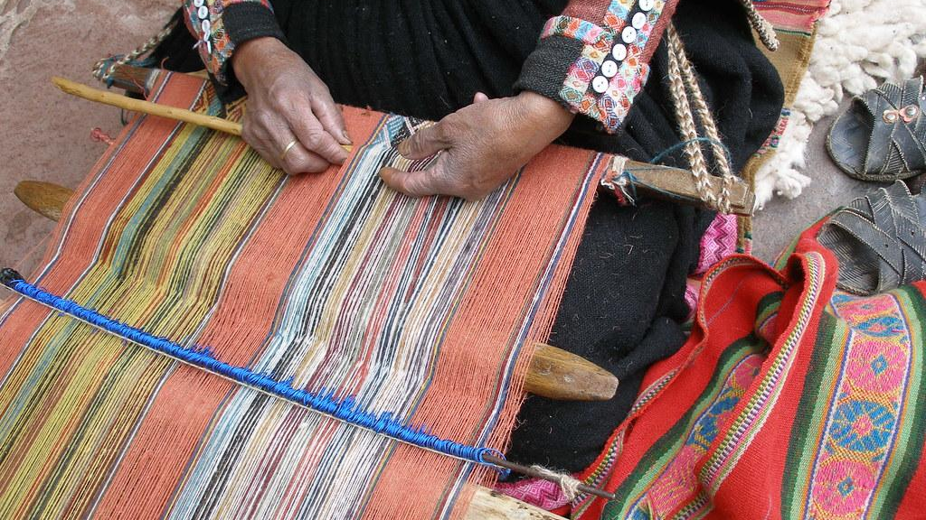
Tying It Together
Notes:
MEGHAN
Up until now, the majority of our conversation has been focused on the self and what we can do as individuals to incorporate aspects of radical empathy, care, boundaries into our professional practice. For this third and final section of today’s presentation, we’re going to shift the discussion slightly and talk about what our organizations/institutions can do to help promote care, accountability, and empathy. Because while self-care is important, there is also an obligation for our libraries to put systems in place to enable organizational-care.

Slide 23
Values-Driven Services & Structure
What does it mean to reimagine our services and structure to be in alignment with our values?
Incorporate care, empathy, and accountability into your values
Talk about how these concepts influence day-to-day work
Be open to challenging conversations
Analyze your systems for oppression, bias and power; rebuild with our values at the center
Notes:
MEGHAN
At an organizational-level, one place we can start to bring these concepts into our work is our values.
Incorporate care and empathy in your values (and all the other things): This may seem simple, but including these key concepts in your library’s values is an important step. Our organizational values are ever-present ideals and incorporating these concepts into our values work allows for opportunities to influence our behaviours and decision-making and create a built-in mechanism for accountability.
Talk about how this influences day-to-day work: It’s important for adoption, activation and organizational change. We want to avoid a situation where we create values, add them to library’s website and then never talk about them again. Talking about values can mean referencing them in all-staff communications, in onboarding activities, in departmental meetings, in budget documents, any of your foundational systems and structures. Just keep talking about them. At Michigan, we encourage new teams and projects to review our set of values and discuss how the values will show-up in their work.
Be open to challenging conversations: We want to foster meaningful engagement with our values in order to influence our work, so we need to be open to having difficult conversations around our values: To discuss inherent tensions within a set of values, to discuss different interpretations/perceptions of values by individuals, and, as I said in the first slide, to talk about the gap between espoused and lived values. We need to have these conversations in order to lean into the possibilities.
Commit to taking the time to analyze and rebuild our systems and structures: This is the heart of the work we need to do to influence change in our systems and structures.
Reflect on where oppression, bias, and power show up in your system and where there are opportunities to incorporate care, empathy, and accountability
Rethink the system’s objectives and create an inspiring vision
Rebuild the system by keeping the parts that are in alignment with your values and getting rid of the rest
Depending on the system, this can be a long process, but the effort is well worth it.

Slide 24
Applying our concepts to your user services policies & procedures
“Each person, human or no, is bound to
every other in a reciprocal relationship”
(Kimmerer, 115)
Look for opportunities to:
Practice empathy and compassion; Acknowledge emotions
Center care for self and others in service interactions
Develop curiosity as a core habit
Work collaboratively to prevent harm
Design mechanism for feedback and accountability
Notes:
MEGHAN
Let’s look at a specific example of incorporating today’s key concepts into a specific aspect of our library work: User services. Reflecting on what we’ve already discussed today, look for opportunities to incorporate care, empathy, and accountability into your user services policies & procedures. Where can we? [read slides]

Slide 25
Looking back to move forward:
Opportunities for self-reflection
Prioritize people
Practice radical empathy for self and others
Identify and address tensions openly and often
Let your values drive your practice
Foster your ongoing growth
Find an accountability partner
Notes:
MEGHAN
In conclusion, we want to encourage you all to reflect on some of today’s themes:
Prioritize people: Both staff and users in order to hold true to the mission and values of our organizations.
Radical empathy: Listen to understand. Aim to connect. Advocate on behalf of others when designing/reviewing organizational policies and practices
Don’t run from the tensions. Acknowledge them to address then. This makes colleagues feel seen and heard and allows the organization to actually benefit.
Values: We asked you to reflect on your personal values as pre-work for today’s session. We hope you were able to do that. Share your values with others, think about how they connect with your organization's values, and use them as a way to hold yourself accountable.
Growth: Finally - aim to live in the growth zone. User service is hard work. Don’t allow yourself to experience the discomfort of this work without the benefit of growth and evolution. And look for support in an accountability partner.

Slide 26
“At every moment, we always have a choice, even if it feels as if we don’t. Sometimes that choice may simply be to think a more positive thought.”
~ Tina Turner in Happiness Becomes You
Notes:
MEGHAN
And finally, we’re going to leave you today with a quote from the late, great Tina Turner that we feel sums up our view of how we center our needs (as well as our users) through care, accountability, and empathy. [read quote]

Slide 27
Post Session Conversation
Notes:
And now, we’re going to send you along to break-out rooms to give you an opportunity to practice some of the concepts we discussed today. Aiming for 35 minutes. We’ll come back together to share one key takeaway from today’s conversation. See you soon!

Slide 28
Check-In
Your name
Pronouns
[In 1 sentence] What’s one colour you’re wearing today?
Notes:
5 mins

Slide 29
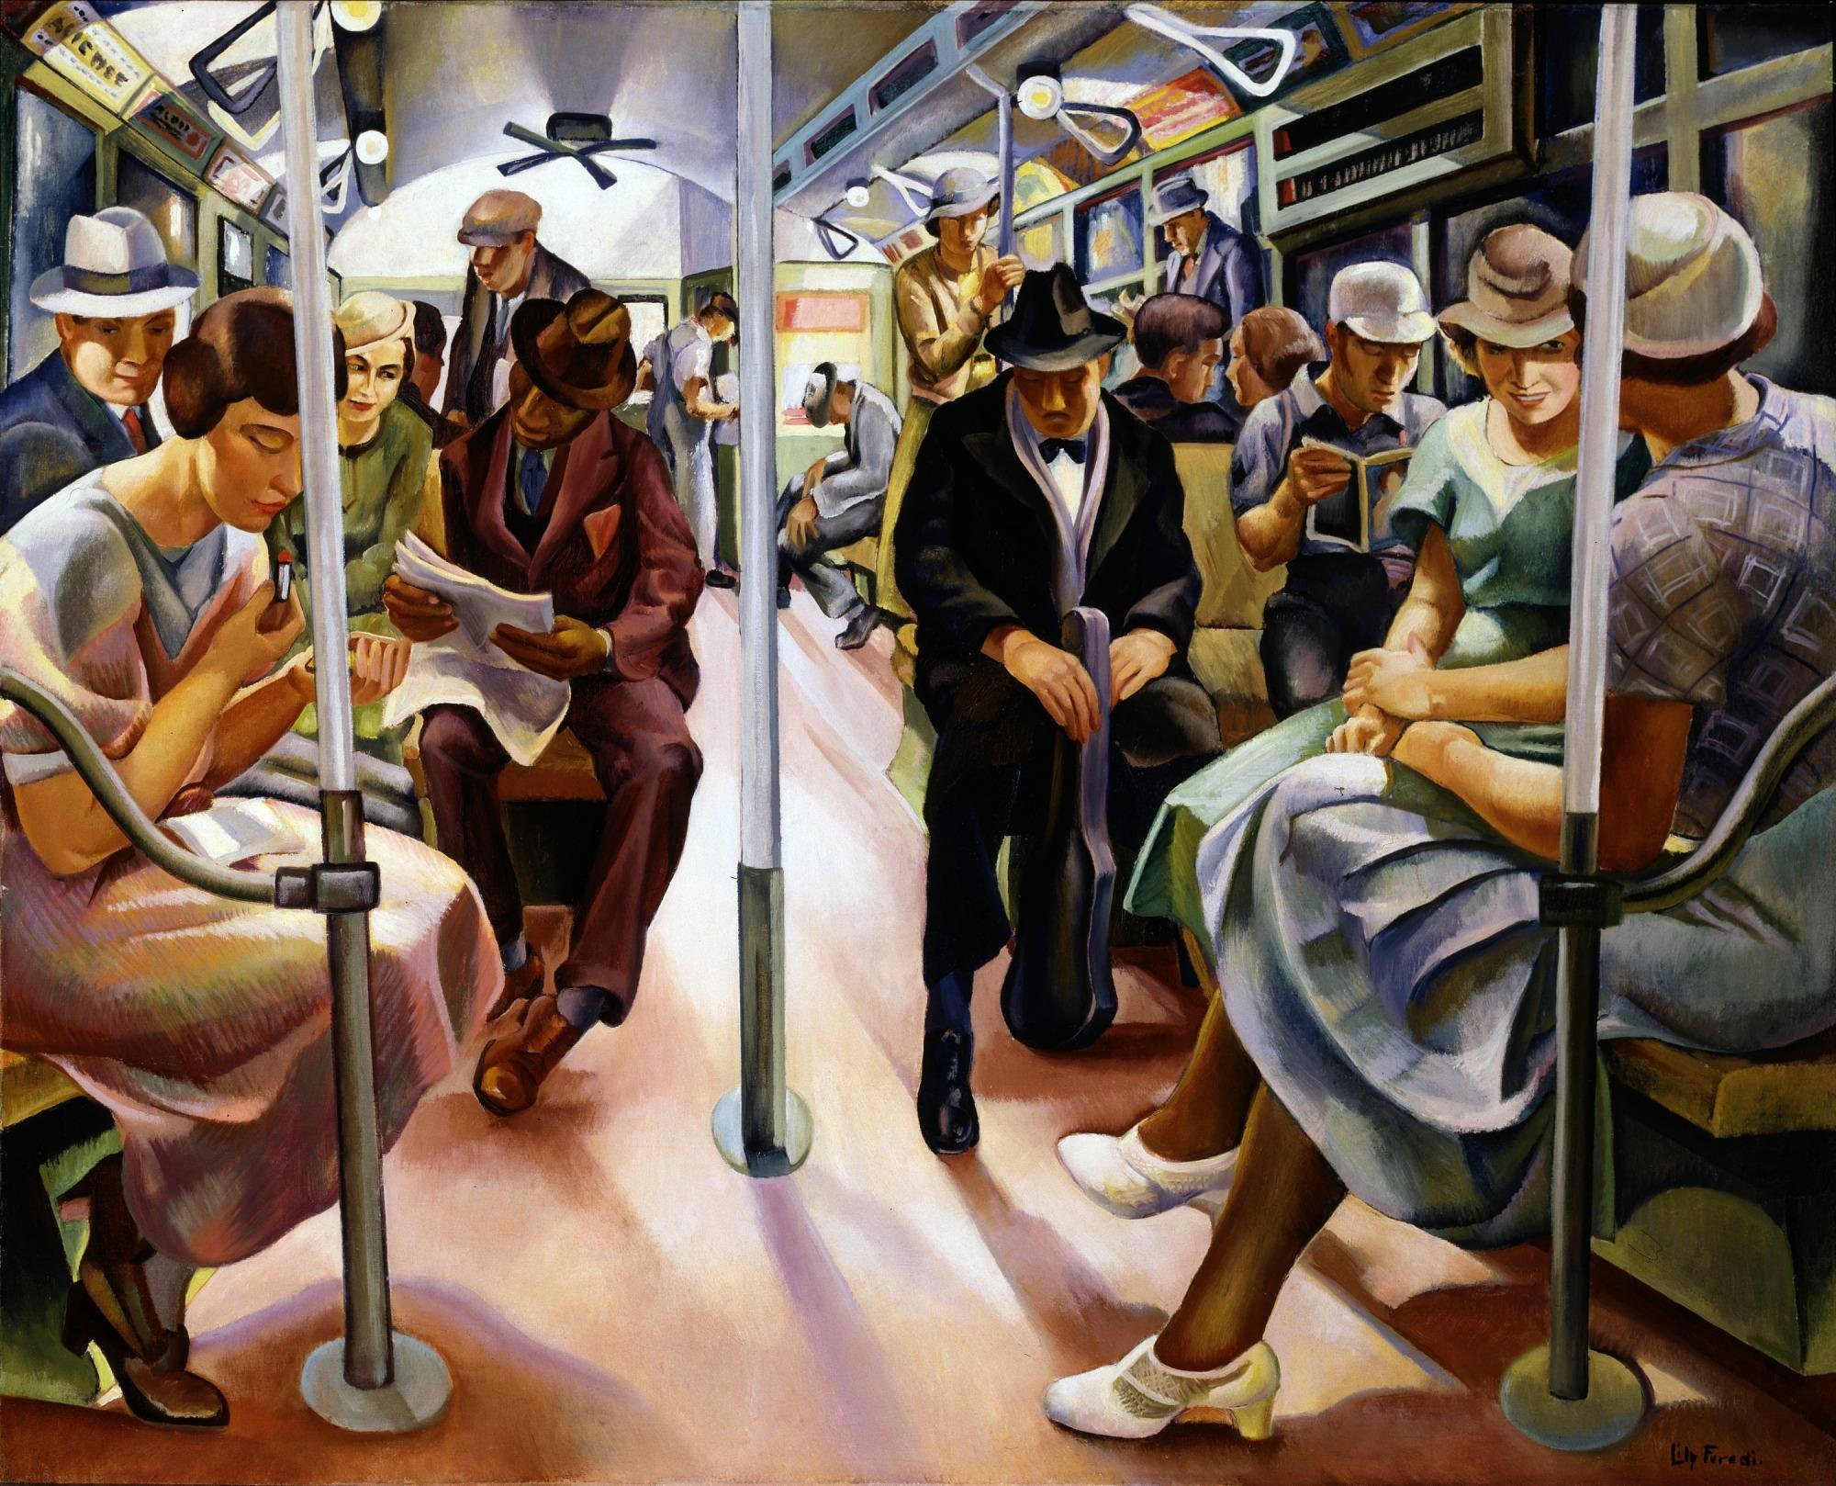
Activity
Individually, look at the picture - take a minute
What do you notice 1st? 2nd? 3rd?
Make up a story about those 3 things
Notes:
1 min
https://americanart.si.edu/artwork/subway-8731
Breakout

Slide 30
Group discussion
In group, share:
What did you notice first?
What stories did you create?
Reflect on what differences exist and why?
As you listen, practice empathetic listening by:
Listening while putting your views, values, and needs aside
Listening to hear
Avoiding comments or questions
Notes:
(5 mins)

Slide 31
Debrief Image Activity
What patterns did you notice in:
What people noticed?
What stories they created?
What differences did you notice in:
What people noticed?
What stories they created?
Why might these differences exist?
How might these differences show up in work relationships?
What might it teach us about how we all navigate the world differently?
What did you do in this practice (specifically) that was different from your usual listening habits?
Notes:
10 mins

Slide 32
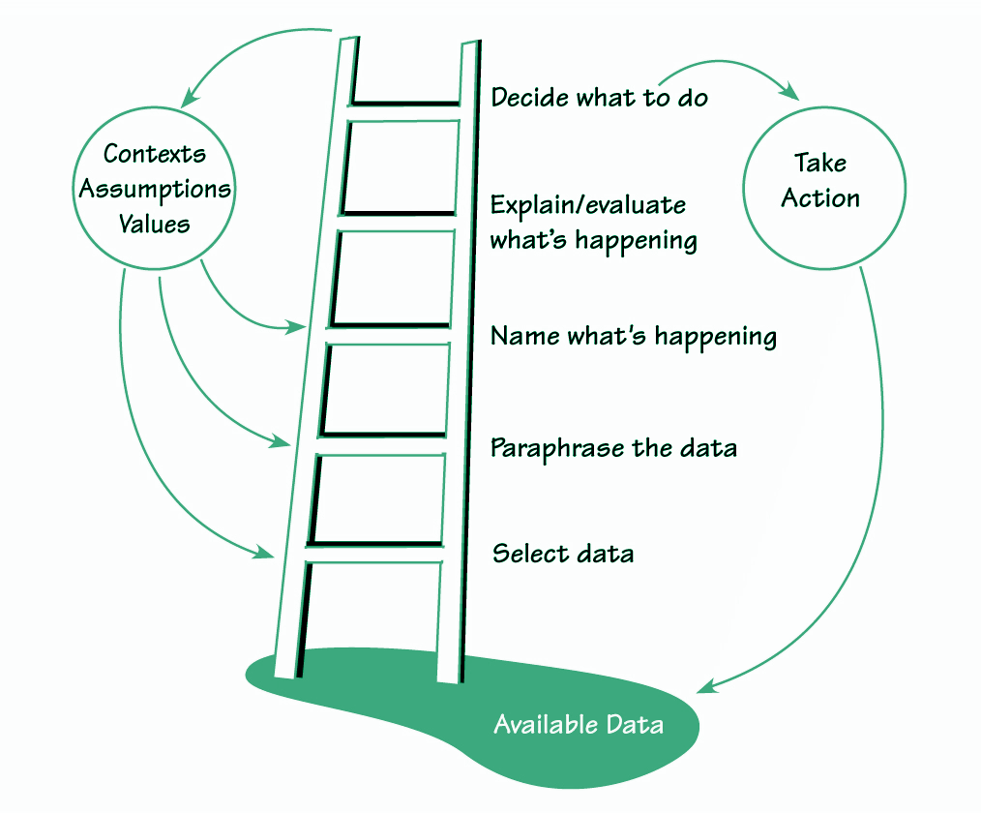
Ladder of Inference
Observe reality
Select data
Add context from experiences & beliefs
Make assumptions
Draw conclusions
Adopt beliefs based on conclusions
Act
Source: Senge, Peter, Et al. The Fifth Discipline Fieldbook: Strategies & Tools for Building a Learning Organization. New York: Doubleday, 1994
Notes:
(1mins)
The ladder of inference is a tool that explains how we come to meaning making. Each step in the process is represented by a rung on the ladder—so you start at the bottom, then climb each rung before coming to a perspective. It was first developed in 1970 by Chris Argyris to explain how people make and sustain their assumptions about the world, also called mental models. Using the ladder of inference can help us to identify cognitive biases that reinforce our beliefs and biases regardless of validity. It can help us understand how others are perceiving an alternative reality.
Available data
This is the reality we are able to observe.
Selected data
We select what we pay attention to based on our prior experiences and existing beliefs. We don't have the mental capacity to take in every piece of data available, so we have to make this selection.
Interpretations
We give facts meaning. We paraphrase what we see or hear to make sense of it.
Assumptions
Based on our interpretation, we make our own personal assumptions.
Conclusions
We draw conclusions from our assumptions.
Beliefs
Our beliefs are then developed from the conclusions we make.
Actions
Finally, we take actions that are rooted in what we believe to be true.
Graphic from: https://thesystemsthinker.com/the-ladder-of-inference/

Slide 33
Walking Down the Ladder of Inference
Actions: Why do I believe this to be the right action? What are some alternative options?
Beliefs: What beliefs do I hold about this? What conclusions are they based on?
Conclusions: Why did I conclude this? What are my assumptions there?
Assumptions:Are my assumptions valid? Why am I assuming this?
Interpretations: Am I looking at this data objectively? What other meanings could they have?
Selected data: What did I ignore or didn't pay attention to? Are there other sources of data I didn't consider?
Notes:
To use the ladder of inference, an individual or groups walk down the ladder by asking a series of questions in order to understand the implicit information and biases at play in misunderstandings or differing conclusions.
Actions:
Why do I believe this to be the right action?
What are some alternative options?
Beliefs:
What beliefs do I hold about this?
What conclusions are they based on?
Conclusions:
Why did I conclude this?
What are my assumptions there?
Assumptions:
Are my assumptions valid?
Why am I assuming this?
Interpretations:
Am I looking at this data objectively?
What other meanings could they have?
Selected data:
What did I ignore or didn't pay attention to?
Are there other sources of data I didn't consider?

Slide 34
Boundaries exercise
Scenario 1 - The Flirty Patron
Sonya has been asked by two separate patrons if I would consider dating them. She sat at the desk as they commented on how much they liked her clothing and eyed her from the computers.
In past, she has not been able to walk away during her desk shift. The library already moved her shift, but the patrons have figured out when she is reachable. Sonya is uncomfortable with this behavior. How might she proceed? How might the Director support Sonya?
Scenario 2 - The Personal Space Invader
You’re standing at the desk or book stacks, and someone’s body is too close for comfort. Maybe it’s intentional, which is creepy. Perhaps they aren’t aware of the space they’re occupying. Regardless, you’re not enjoying their front near your back / the smell of their breath / their odor.
How might you proceed?
Notes:
10 mins

Slide 35
Close Out
Learning Loop
What did you try?
Where did you succeed?
Where did you struggle?
What did you learn?
What will we try next?
1 key takeaway
1 tool or approach you want to try in the next month
In the chat, or raise your hand: answer the bullet of your choice
Notes:
MEGHAN
Hello. Welcome back to the large group. We hope you had some great conversations in your small groups. As a quick, 5-minute close-out exercise, we’re going to ask you to think about 1 key takeaway and/or 1 tool/approach you want to try in the next month. Feel free to share in the chat and we’ll provide an opportunity for folks to unmute and share if you want to.

Slide 36
Questions
Sarah Beaubien - sbeaubie@uoguelph.ca
Annie Bélanger - belange1@gvsu.edu
Meghan Musolff - musolffm@umich.edu
Feel free to email us your questions!
Notes:
MEGHAN

