Slide 1
Informed Learning, Information Literacy, and Scholarly Communication: Library Pedagogy as a Bridge to the Disciplines Kim L. Ranger Grand Valley State University
Notes:
At Grand Valley, we’re fortunate to have a great library building which is always full. Yet that leads to nothing if the students are not learning.

Slide 2
Why and how do librarians invite students into the disciplines?
Overview
Examples
Applications
How do we assess student learning?
Notes:
A preview of what’s to come: an overview and examples, actual applications, then I’ll ask you some questions. First, background information [next slide]:

Slide 3
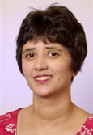
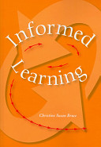
Introduction
Christine Bruce
Informed Learning
2008
Notes:
Bruce’s informed learning definition is “using information, creatively and reflectively, in order to learn,” while learning discipline content and communication practices. This differs from other approaches to information literacy in that the focus is on both the process of learning and entering a field of study while seeking, evaluating, and citing. Reflecting on these relationships and being transformed by what one learns are vital elements of informed learning, and scholarly communication is integrated into the process, not simply an end product.

Slide 4
Literature
Interdisciplinary collaboration: Witt, 2012
Relational: Farrell and Badke, 2015
Gunton et al, 2014
Jaguszewski and Williams, 2013
Informed learning: Webber et al, 2014
Maybee et al, 2013
Lloyd and Bruce, 2011
Radical information literacy: Whitworth, 2014
Notes:
Here are a few categories of relevant literature that informed my work:
Calls for interdisciplinary collaboration in Communication.
Changing the roles of librarians through a relational approach to teaching and learning.
Examining informed learning theory as practiced in information literacy pedagogy.
Applying Bakhtin’s communication philosophy to learning in “radical information literacy” that challenges authority in information practices.

Slide 5
Library Subject Guides Previous tabs:
Current tabs:
Notes:
Here’s an example: Many library guides focus on navigating library tools and accessing information by format. That uses a competency-based approach to finding different types of information. However, guides may be reframed to reflect subject content within a field, as we see in the current tabs for Photography, reorganized based on their program description and professors’ assignments, and modified according to the department’s feedback.
Now the guide may serve as a bridge connecting students, faculty, & librarians, bringing novice scholars into communities while learning about the types of information valued and created (whatever the format), communicating new knowledge, etc. In short, library guides should mirror the organizational practices within a discipline or profession.

Slide 6
Library Subject Guides
Notes:
Another example of a Library guide restructured to reflect professional concepts.

Slide 7
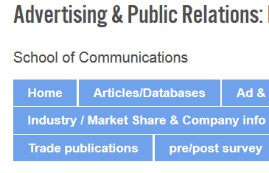
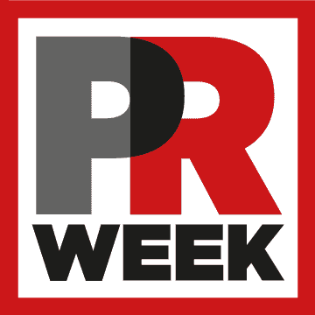
Notes:
Yet some professors still refer to formats like articles, databases, or trade magazines. Students gave me feedback on what they wanted to see in the resource descriptions (info must be relevant to what they need; graphics are essential when available). However, this organization does present challenges for library staff who are unfamiliar with the discipline.

Slide 8
Notes:
So, let me ask you a question: How many of you have done something similar with your library guides or webpages – to more closely reflect the information practices within a discipline or profession?

Slide 9
Upcoming collaboration examples:
Library instruction for assignments
Intellectual / creative property
Assignment design
in:
Advertising & PR
Photography
Communication Studies
Notes:
I liaise primarily with a School of Communications which has 7 undergraduate majors and a Master’s degree. Communication scholars analyze messages, exchange of meaning, and methods of dissemination. In contrast, library scholars investigate various types of information, study the organization and dissemination of it, and consider how best to communicate with various groups in order to increase access to and usage of information.

Slide 10
“Specific Resource Assignment” Directions
Notes:
For example, Advertising faculty teach students how to describe company products, analyze target audiences, and synthesize these in order to create brands or media kits; library faculty teach students how to find and evaluate psychographics, demographics, data, and articles.
Psychographics are particularly difficult in Advertising and Public Relations, so I annotate assignments with directions and resources to use, and share those with library staff and student employees.

Slide 11
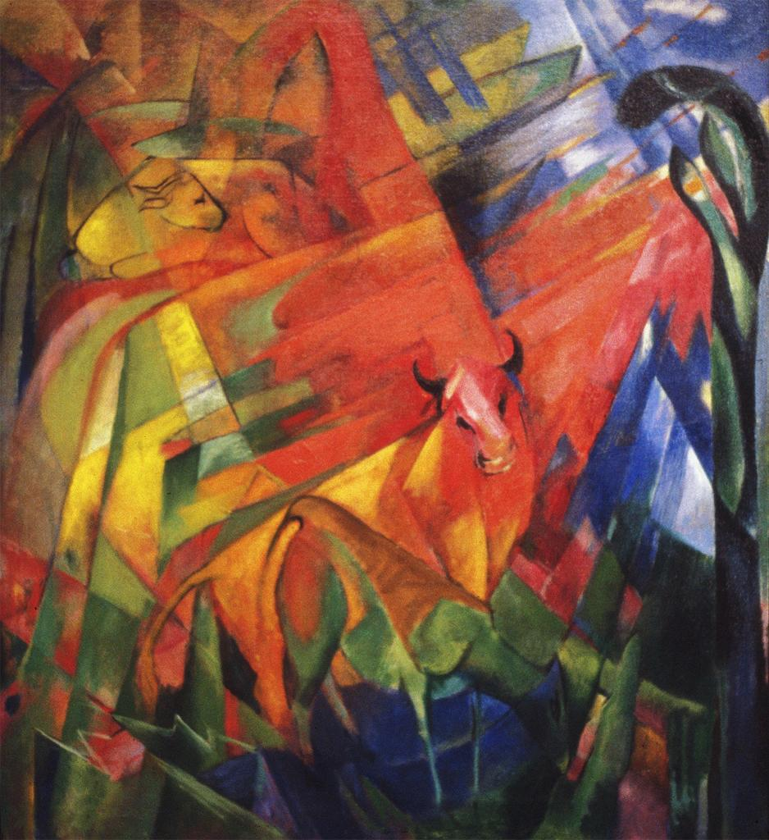
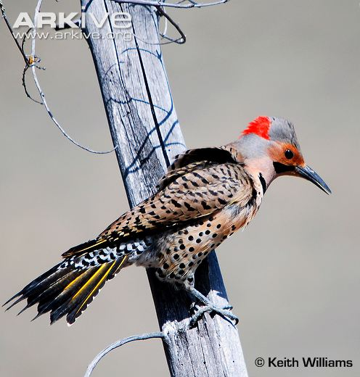
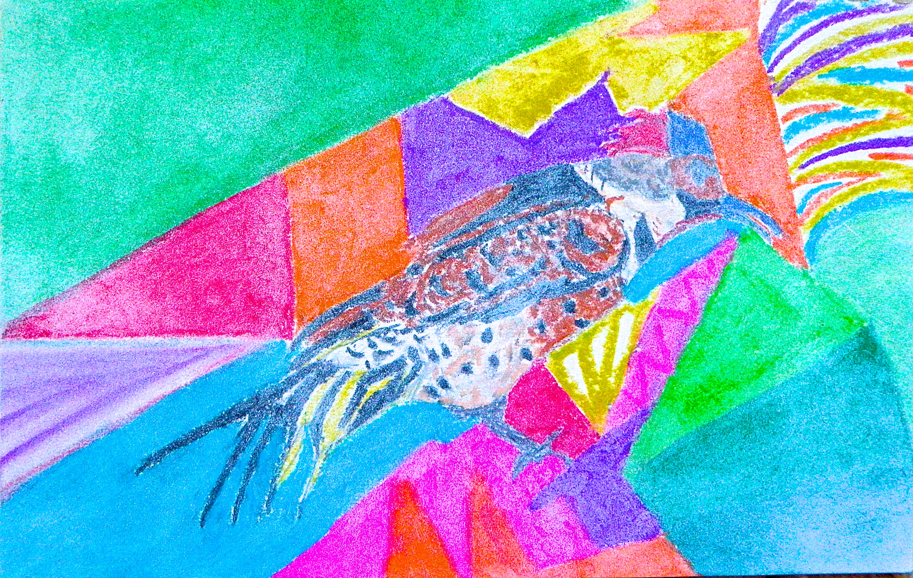
images viewed by students
contexts: art, photography, history, communication
students find meanings in publications/exhibitions
learning = changes in students’ understanding
new image created & disseminated (a.k.a. scholarly communication)
Notes:
Librarians and classroom instructors both teach students about intellectual & creative rights and dissemination options. We need to guide students toward “developing an awareness of both information use and subject content” by emphasizing different perspectives that shape that subject. In other words, activities should lead students to describe different understandings of a topic, delineate how those differences are reflected in published works and how they helped to form the meaning the students have created, while attending to the ways that their knowledge grows as they find materials, evaluate, and choose perspectives to communicate to an audience.
Explain images – And this example is what I’d like our students to come to.

Slide 12
Intersections of Information Literacy & Scholarly Communication
Advertising & Public Relations 105
Course objective:
understand legal & ethical issues in communication technology
Notes:
Now for some applications: Ad&PR profs asked me to work with their Technology course. This gave me the chance to collaborate with our Scholarly Communications Outreach Coordinator to develop discussion prompts such as: major changes in technology history, perspective of retailers vs. consumers, publishing process and costs, “end-runs” like open-access and digital repositories, authors/creators’ rights, creative commons and the workplace, power and privilege in “authority,” private benefit vs. public good…. Some of the professors added questions from the discussion to homework assignments and exams, closing the loop.

Slide 13
Assignment Design
COM 375 pre-library session homework:
Survey
Q about research?
Reading
Watch videos & give e.g.s of how they clarify reading
2 Qs after videos: still unclear or what would you like the librarian to address?
Notes:
A Communication prof asked for help designing her research course. What we came up with was a sequence of assignments.
Before the library session students were assigned homework:
1st, to fill out a Pre-library session survey which asked about their views of knowledge and information practices within their field or profession, providing examples.
Another question asked if they identify with scholars and/or professionals in their field of study.
Next, before they read the course textbook chapter, they wrote 1 question they had about doing library research.
After reading the chapter, they specified how it answered their question or if it didn’t, they described what was still unclear.
They watched a set of 2-minute videos & gave examples of how those clarified the chapter.
Finally, they came up with 2 questions they had related to library research: what would they like me, the librarian, to address?
To focus instruction on directly inviting students into the disciplinary community, I urged them to engage historically-valuable discussions, become familiar with important voices within the field and reply responsibly to them as part of developing a professional identity. Students must dialog with the sources, critique the author’s intentions, and scrutinize the communication technologies themselves (as in the 105 course in the previous slide).

Slide 14
Notes:
Assessment: The COM 375 students showed more nuanced and complex ideas about the characteristics of information, search techniques, and research related to their discipline after the library session. For example, several students asked prior to the library session, “Does search strategy depend on a research question?” and on the final exam, concluded that, “our selected methods impact the whole research process including the writing” and “I would apply the [x] theory to our review of literature to determine the methodology based on already-existing research.”
As for identity, at the beginning of the semester, only 22% of the students identified “highly” with scholars/professionals in their field of study; 56% identified “to some extent” and 22% “not at all.” After completing the series of exercises and participating in the library session described in the previous slide, 26% of the respondents identified “to some extent” and 74% “highly” with scholars/professionals in their field of study. None chose “not at all” at the end of the semester.
COM 375 was the closest I’ve come to feeling “embedded” into a course.

Slide 15
Discussion
Assess effective tool design:
research partner/s needed
Assess student learning:
research partner/s needed
Trust = time; Sustainability?
Planning, scaffolding
Notes:
Arranging Library guides in disciplinary categories should be more functional and result in more effective use by both students and faculty. But assessing this is challenging – numbers of visits or clicks tells nothing about learning or even ease of access. Google Analytics "Event Tracking" and a heat mapping tool such as "Reinvigorate" might give us some data to use in conjunction with assigning typical tasks & observing students’ navigation of the libguides, followed by focus groups to get more qualitative data. This is one of the places I could use a researcher to partner with me, the practitioner librarian!
Co-designing courses or assignments requires big trust between professor and librarian, constant communication, and a lot of time. Faculty come and go, requiring the development of new relationships pretty constantly. Being added to multiple courses and/or sections in a course management system like Blackboard - is any of this sustainable, when one librarian liaises with many disciplines? I hope you have some ideas because I’m about to conclude – I hope your wheels are turning. 1st, let me wrap up & we’ll get to your questions.
It is clear that informed learning takes time, and must be incorporated into the curriculum at early stages to allow for scaffolding the learning objectives and assessment. This is, in itself, a challenge, as universities are experiencing a push to graduate students in 4 years. It means planning the curriculum, and incorporating librarians into that process so that all faculty can clearly see when and how informed learning goals can happen. It also highlights the need to move beyond the “Seeking and then using” model of information that is often taught in introductory courses.

Slide 16
Conclusions: no answers, just questions
Informed learner partners
Why and how we librarians might invite students into the disciplines?
How do we investigate ways of assessing student learning?
Notes:
The librarian is a constant, an “intersection” within the disciplinary differences of programs. These projects highlight various ways collaboration might be used to improve student learning. Both academic and library faculty may become informed learners while working as partners on curriculum redesign.
Applying informed learning theory to practice is messy, difficult to assess, and rewarding. It begins and ends with relationships and dialog, requires constant reflection and documentation, changes with each course instructor and the understanding of the liaison librarian. Yet informed learning implies a practice for the disciplines and should drive our strategies for teaching. In coming to understand the various forms of information in their fields, through selecting and collecting or providing access to disciplinary information, guiding and studying the creation of information and its meaning, in facilitating the process of creating learning outcomes and goals with faculty, and through mapping information literacy across the curricula, the librarian and classroom professors become collaborators in guiding student learning.

Slide 17
References
Farrell, Robert, and William Badke. 2015. “Situating Information Literacy in the Disciplines: A Practical and
Systematic Approach for Academic Librarians.” Reference Services Review 43 (2): 319–340.
Gunton, Lyndelle, Christine Bruce, and Kate Davis. 2014. “Information Literacy Research: The Evolution of the
Relational Approach.” In Library and Information Science Research in Asia-Oceania: Theory and Practice, edited by
Jia Tina Du, Qinghua Zhu, and Andy Koronios, 82–101. Hershey, PA: IGI Global.
Jaguszewski, Janice M. and Karen Williams. 2013. New Roles for New Times: Transforming Liaison Roles in Research
Libraries. Association of Research Libraries. http://www.arl.org/storage/documents/publications/NRNT-Liaison-
Roles-final.pdf
Lloyd, Annemaree, and Christine S. Bruce. 2011. “State of the Art and Future Challenges for Information Literacy
Research.” In Social Media and Information Practices Workshop, 10-11 November 2011, University of Borås,
Sweden. (Unpublished) http://eprints.qut.edu.au/47207/.
Maybee, Clarence, Christine Susan Bruce, Mandy Lupton, and Kristen Rebmann. 2013. “Learning to Use Information:
Informed Learning in the Undergraduate Classroom.” Library & Information Science Research 35 (3): 200–206.
http://eprints.qut.edu.au/60579/.
Webber, Sheila, Ola Pierot, Louise Limberg, and Bill Johnston. 2014. “Relating Research and Practice in Information
Literacy.” Panel presented at the European Conference on Information Literacy, Dubrovnik, October 2014.
http://www.slideshare.net/sheilawebber/ecil-research-practice.
Whitworth, Andrew. 2014. Radical Information Literacy: Reclaiming the Political Heart of the IL Movement. Oxford,
UK: Chandos Publishing.
Witt, Paul L. 2012. The Future of Communication Education. Communication Education 61 (1): 1-3.
Notes:
Here are the full citations for some others doing research in this area.

Slide 18
Image credits
Slide 3:
http://www.christinebruce.com.au/wpcontent/uploads/2011/08/christinebruce.jpg
http://books.google.com/books/about/Informed_learning.html?id=nEYmAQAAIAAJ
Slide 11:
Franz, Marc. 1914. Painting with Bulls II (Animals in Landscape).
ARTstor Slide Gallery ARTSTOR_103_41822000665560.
Williams, Keith. n.d. Courtship display of northern flicker.
http://www.flickr.com/photos/keithmwilliams
Ranger, Kim. 2016.

